Slide 1
JESUS OUR HIGH PRIEST FOREVER 耶稣我们永远的大祭司
HEBREWS 5:1-10
希伯来书五章一到十节

Slide 2
Christ基督（King or Messiah)
Lord上帝神
Master主人
Logos (the Word)道
Son of God神子
Son of man人子
Son of David大卫的子孙
Lamb of God神的羔羊
New Adam / Second Adam / Last Adam 新亚当，第二个亚当，最后的亚当
Light of the World世界的光
King of the Jews犹太人的王
Rabboni and Rabbi拉比
HIGH PRIEST FOR EVER 永远的大祭司
INCOMPLETE TITLES OF JESUS
耶稣的名称（不包括所有的）

Slide 3
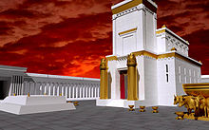
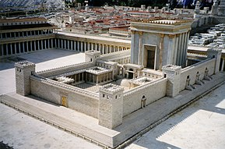
FIRST TEMPLE: SOLOMON
BUILD IN 957BCE DESTROYED
IN 587 BC
Modern reconstruction of SECOND
TEMPLE IN 515BCE DESTROYED BY ROMANS IN 70CE

Slide 4
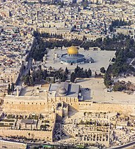
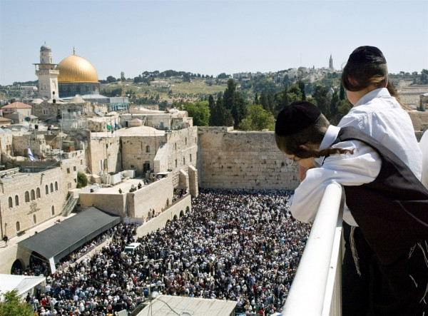
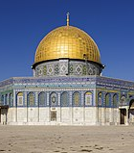
The Visionary Ezekiel Temple plan drawn by the 19th-century French architect and Bible scholar Charles Chipiez. 以西结的异像关于圣殿“Then the nations will know that I the Lord make Israel holy, when my sanctuary is among them forever.” (Ezekiel 37:28)
ARIEL VIEW OF TEMPLE MOUND TODAY今天的圣殿丘
DOME OF THE ROCK
穆斯林岩石圆顶

Slide 5
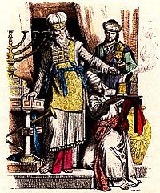
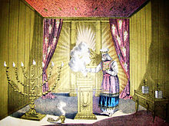
Jewish high priest and Levite in ancient Judah (the depictions of the Menorah, Table of Showbread and trumpets are inspired by the Arch of Titus).
High Priest in the Holy Place.
大祭司在至圣所的工作

Slide 6
WORK OF THE HIGH PRIEST 大祭司的工作
"FOR EVERY HIGH PRIEST CHOSEN FROM AMONG MEN IS APPOINTED TO ACT ON BEHALF OF MEN IN RELATION TO GOD, TO OFFER GIFTS AND SACRIFICES FOR SINS." VS. 1
“凡从人间挑选的大祭司，是奉派替人办理属神的事，为要献上礼物和赎罪祭（或作‘要为罪献上礼物和祭物’）

Slide 7
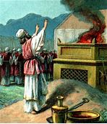
WORK OF THE HIGH PRIEST 大祭司的工作
A sin offering is a sacrificial offering described and commanded in the Torah; it could be fine flour or a proper animal. A sin offering also occurs in 2 Chronicles 29:21 where seven bulls, seven rams, seven lambs and seven he-goats were sacrificed on the command of King Hezekiah for the kingdom, for the sanctuary, and for Judah. Like all types of sacrifices offered on the altar, the flour had to be unscented and the animal had to be completely unblemished. This offered sacrifice accompanied the important required core means of atonement for the committing of an unintentional transgression of a prohibition, that either has brought guilt upon the 'community of Israel' or the individual. This offering is brought during or after atonement for those transgressions that had been committed inadvertently, or in ignorance: intentional transgressions could only be absolved by other forms of atonement, or in severe cases kareth. It was distinct from the biblical guilt offering.

Slide 8
WORK OF THE HIGH PRIEST 大祭司的工作2-3
"He can deal gently with the ignorant and wayward, since he himself is beset with weakness." 2 “他能体谅那愚蒙的和失迷的人，因为他自己也是被软弱所困。”
"Because of this he is obligated to offer sacrifice for his own sins just as he does for those of the people." 3 “故此，他理当为百姓和自己献祭赎罪。”

Slide 9
JESUS IS THE HIGH PRIES FOREVER 耶稣永远的大祭司4-5
"AND NO ONE TAKES THIS HONOR FOR HIMSELF, BUT ONLY WHEN CALLED BY GOD, JUST AS AARON WAS." 4 “这大祭司的尊荣没有人自取，惟要蒙神所召，像亚伦一样。”
"SO ALSO CHRIST DID NOT EXALT HIMSELF TO BE MADE A HIGH PRIEST, BUT WAS APPOINTED BY HIM WHO SAID TO HIM, 'YOU ARE MY SON, TODAY I HAVE BEGOTTEN YOU.'" “如此，基督也不是自取荣耀作大祭司，乃是在乎向他说‘你是我的儿子，我今日生你的那一位。’5

Slide 10
JESUS IS THE HIGH PRIES FOREVER 耶稣永远的大祭司6；10
"AS HE SAYS ALSO IN ANOTHER PLACE, 'YOU ARE A PRIEST FOREVER, AFTER THE ORDER OF MELCHIZEDEK" 6 “就如经上又有一处说：‘你是照着麦基洗德的等次永远为祭司。’”
MELCHIZEDEK麦基洗德：Genesis 创世记14:17-20; Psalms诗篇 110:4; Hebrews希伯来书 7:1; Hebrews 7:2; Hebrews 7:3; Hebrews 7: 4; Hebrews 7: 5; Hebrews 7:6; Hebrews 7:7; Hebrews 7:8; Hebrews 7:9; Hebrews 7:10; Hebrews 7:11; Hebrews 7:15; Hebrews 7:17

Slide 11
JESUS IN THE ORDER OF MELCHIZEDEK 耶稣麦基洗德的等次6
Genesis 创世记14:17-20“After his return from the defeat of Chedorleomer and the kings...Melchizedek King of Salem brought out bread and wine (He was priest of God the Most High) and He blessed Abram..and Abram gave Him a tenth of everything." “亚伯兰杀败同盟的王。。撒冷王麦基洗德带着饼和酒来迎接，他是至高神的祭司。。他为亚伯兰祝福。。亚伯兰就把所得的拿出十分之一来，给麦基洗德。”

Slide 12
JESUS IS THE HIGH PRIES FOREVER 耶稣永远的大祭司7
"IN THE DAYS OF HIS FLESH, JESUS OFFERED UP PRAYERS AND SUPPLICATIONS, WITH LOUD CRIES AND TEARS, TO HIM WHO WAS ABLE TO SAVE HIM FROM DEATH, AND HE WAS HEARD BECAUSE OF HIS REVERENCE." 7 “基督在肉体的时候既大声爱哭，流泪祷告，恳求那能救他免死的主，就因他的虔诚蒙了应许。”7

Slide 13
JESUS IS THE HIGH PRIES FOREVER 耶稣永远的大祭司8-9
"ALTHOUGH HE WAS A SON, HE LEARNED OBEDIENCE THROUGH WHAT HE SUFFERED. AND BEING MADE PERFECT, HE BECAME THE SOURCE OF ETERNAL SALVATION TO ALL WHO OBEY HIM." 8-9 “他虽然为儿子，还是因为所受的苦难学了顺从。他既得以完全，就为凡顺从她的人成了永远得救的根基”8-9

Slide 14
JESUS IS THE HIGH PRIES FOREVER 耶稣永远的大祭司10
"BEING DESIGNATED BY GOD A HIGH PRIEST AFTER THE ORDER OF MELCHIZEDEK." 10 “并蒙神照着麦基洗德的等次称他为大祭司。”
"THE LORD HAS SWORN AND WILL NOT CHANGE HIS MIND, 'YOU ARE A PRIEST FOREVER AFTER THE ORDER OF MELCHIZEDEK." PSALMS 110:4 “耶和华起了誓，决不后悔，说：‘你是照着麦基洗德的等次永远为祭司。’”

Slide 15
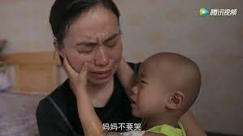
A DYING CHILD
AND HIS MOTHER
儿子得了癌症，
劝妈妈不要哭
HEAVEN IS A WONDERFUL
PLACE BECAUSE OF JESUS
FOREVER OUR HIGH PRIEST
天堂是个美好的地方，因为
耶稣我们的大祭司永远爱着
我们，作永远罪的献祭！
JESUS THE BEST CHRISTMAS
GIFT EVER! 耶稣就是我们圣诞节最美丽的礼物了！

