Slide 1
JESUS, KING OF JUSTICE AND PEACE 耶稣，公义和平之王
HEBREWS 7:1-10
希伯来书七章一-十节

Slide 2
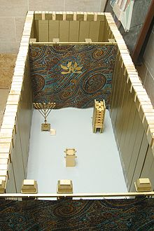
HOLY OF HOLIES
至圣所
The Holy of Holies was entered once a year by the High Priest on the Day of Atonement, to sprinkle the blood of sacrificial animals (a bull offered as atonement for the Priest and his household, and a goat offered as atonement for the people) and offer incense upon the Ark of the Covenant and the mercy seat which sat on top of the ark in the First Temple (the Second Temple had no ark and the blood was sprinkled where the Ark would have been and the incense was put on the Brazen Altar of incense). The animal was sacrificed and the blood was carried into the most holy place. The golden censers were also found in the Most Holy Place
A model of the Tabernacle showing the holy place, and behind it the Holy of Holies

Slide 3
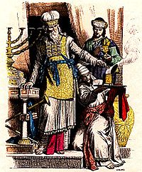
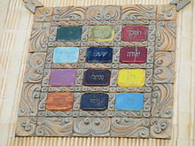
Jewish high priest and Levite in ancient Judah (the depictions of the Menorah, Table of Showbread and trumpets are inspired by the Arch of Titus).
Ceramic replica of the High Priest's breastplate
Notes:
Priests in the OT are decendents of Aaron and of the tribe of Levi.

Slide 4
HIGH PRIEST MELCHIZEDEK 大祭司麦基洗德 1
1. KING OF SALEM 撒冷王
2. PRIEST OF THE MOST HIGH GOD 至高神的祭司
3. MET ABRAHAM AS HE RETURNED FROM SLAUGHTER OF THE KINGS 当年亚伯拉罕杀败众王凯旋归来的时候，他迎上去接亚伯拉罕给他祝福

Slide 5
HIGH PRIEST MELCHIZEDEK 大祭司麦基洗德 2
1. ABRAHAM GAVE A TENTH OF ALL HE CAPTURED IN THE BATTLE AND GAVE IT TO MELCHIZEDEK 亚伯拉罕给麦基洗德十分之一作为感恩的奉献
2. MELCHIZEDEK MEANS KING OF JUSTICE (RIGHTEOUSNESS) AND KING OF SALEM (PEACE)。 麦基洗德是公义的王和撒冷王，就是和平王

Slide 6
HIGH PRIEST MELCHIZEDEK 大祭司麦基洗德 3
1. NO RECORD OF FATHER OR MOTHER OR ANCESTORS 没有父母，没有族谱
2. NO BEGINNING OR END OF HIS LIFE 没有生死的记录
3. PRIEST FOREVER 永远作祭司
4. RESEMBLING THE SON OF GOD 与神的儿子相似

Slide 7
HIGH PRIEST MELCHIZEDEK 大祭司麦基洗德 4
1. HOW GREAT IS MELCHIZEDEK? 麦基洗德是多么尊贵的祭司
2. ABRAHAM THE GREAT PATRIARCH OF ISRAEL, GAVE HIM THE BEST TENTH THAT HE HAD TAKEN IN BATTLE 亚伯拉罕犹太人的父和我们信心之父，都给了他十分之一的战利品

Slide 8
PRIESTS LIVELIHOOD REQUIRED BY LAW 按着律法给祭司的生活 5
1. PRIESTS MUST COLLECT A TITHE FROM THE REST OF THE PEOPLE OF ISRAEL TO LIVE 祭司就是照例向自己的同胞收取十分之一为生活
2. PEOPLE ARE DECENDENTS OF ABRAHAM 同胞就是亚伯拉罕的后裔
Notes:
Today, the church follows this guide that ministers are to live on the tithe given by his/her congregation. The tithe should be the average income of the church.

Slide 9
HIGH PRIEST MELCHIZEDEK 大祭司麦基洗德 6
1. MELCHIZEDEK NOT A DECENDENT OF LEVI, COLLECTED A TENTH FROM ABRAHAM 麦基洗德不是亚伯拉罕的后裔
2. MELCHIZEDEK PLACED A BLESSING UPON ABRAHAM。他还给亚伯拉罕祝福
3. ABRAHAM HAD ALREADY RECEIVED THE PROMISES FROM GOD亚伯拉罕已经收到神的应许

Slide 10
Melchizedek is jesus 麦基洗德就是耶稣 7-8
1. PERSON WHO HAS THE POWER TO GIVE A BLESSING IS GREATER THAN THE ONE WHO IS BLESSED 那为人祝福的比领受祝福的位分大
2. THE PRIESTS WHO COLLECT THE TITHE HAVE DIED 收取十分之一的祭司都是会死的人
3. MELCHIZEDEK LIVES ON FOREVER 麦基洗德是不死的，永远活着

Slide 11
Melchizedek is jesus 麦基洗德就是耶稣 9-10
1. PRIESTS PAID TITHE TO MELCHIZEDEK THROUGH ABRAHAM 接受十分之一奉献的利未（祭司）是透也过亚伯拉罕向麦基洗德纳的十分之一
2. EVEN THOUGH THE LEVI (PRIESTS) WERE NOT BORN WHEN ABRAHAM GAVE THE TITHE TO MELCHIZEDEK。 亚伯拉罕遇见麦基洗德时，利未还没有出生，是已经在他的祖先的身体里面的

Slide 12
Why we give our tithes ? 我们为什么要奉献十分之一？
1. WE RESPECT GOD AND HIS ORDAINED PRIESTS 尊敬神和他的仆人
2. ACCORDING TO OUR FATHER OF FAITH ABRAHAM'S ACTIONS 我们的信心之父亚伯拉罕的榜样，让我们学习
3. RECEIVE A GREAT BLESSINGS FROM JESUS AS OUR HIGH PRIEST 得到我们的大祭司耶稣的祝福
4. WE CAN IN TURN GIVE THE BLESSINGS TO OTHERS 我们就可以给神赐给我们的福份，传给别人

Slide 13
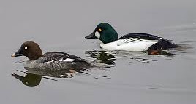
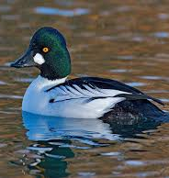
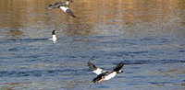
Notes:
Golden eyed ducks from Canada, so beautiful. Wednesday morning while I was thinking on the sermon, these ducks decided to land on my lake. They made a CHOICE to land on my water. I used binoculars to see them, swimming, frolicking, and diving for food. There were five of them male and female. God spoke to me via these special ducks. They made a choice to fly down to my lake, but they actually gave me a blessing watching them and enjoying their beauty. They only come during this time when they are migrating to a warmer place. It reminded me that we all have a choice. God does not force us to give tithe, but once we made the choice to tithe, not only will we get a blessings, but we also will give blessings to others and many time for generations to come!

Slide 14
**COMMUNION 博饼圣餐
1. THANK GOD FOR ALL YOUR BLESSINGS 感谢神给你所有的祝福
2. HAVE YOU GIVEN GOD YOUR TEN PERSENT FOLLOWING ABRAHAM'S LEAD? 你有没有像亚伯拉罕学习给十分之一？因为他是你的信心之父
3. IF YOU LOVE CBC AS YOUR CHURCH AND HOME AWAY FROM HOME, ARE YOU GIVING TO SUPPORT FUTURE MINISTER/MINISTERS TO COME? 你说你爱CBC，那么你有用金钱支持将来的牧师和宣导的伙伴吗？
4. THANK GOD FOR ALL THOSE MISSIONARIES AND MINISTERS WHO DEDICATED THEIR LIVES TO THE LORD 感谢所有奉献的宣道师和牧师的奉献（身，心，钱财，灵）
Notes:
CBC needs to grow in giving to support the church and future God called pastors and ministers to come. If we don't, the church will not be able to survive, especially more hard times to come.

