Slide 1
JESUS THE MOST PRECIOUS GIFT 耶稣最珍贵的礼物
HEBREWS 6:13-20
希伯来书六章十三-二十节

Slide 2
EXCUSES FOR NOT COMING
TO CHURCH 不参加聚会的理由
Jim was leaving church after Christmas services when the pastor greeted him and said, “Jim, it’s time you joined the Army of the Lord. We need to see you every Sunday.”
“I’m already in the Army of the Lord, Pastor,” Jim replied.
“Then why do we only see you on Christmas and Easter?”
Jim looked to the right and to the left, and then leaned over to whisper, “I’m in the Secret Service特务机关部队.”

Slide 3
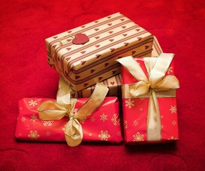
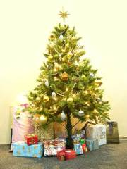
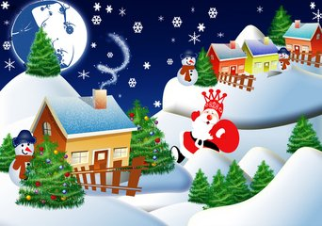
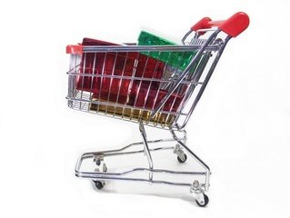
CHRISTMAS IS GOD'S GIFT TO US!
圣诞节是神所赐给我们的礼物
ILLUSTRATION: THE LOST GIFT

Slide 4
GOD'S PROMISE TO ABRAHAM 神对亚伯拉罕的应许13-15
"FOR WHEN GOD MADE A PROMISE TO ABRAHAM, SINCE HE HAD NO ONE GREATER BY WHOM TO SWEAR, HE SWORE BY HIMSELF." 13 当初，神应许亚伯拉罕的时候，因为没有比自己更大可以指着起誓的，就指自己起誓。”13
"SAYING, 'SURELY I WILL BLESS YOU AND MULTIPLY YOU.'" 14 “论福，我必赐大幅给你；论子孙，我必叫你的子孙多起来。”14
"AND THUS ABRAHAM HAVING PATIENTLY WAITED, OBTAINED THE PROMISE." 15 “这样，亚伯拉罕既恒久忍耐，就得了所应许的。”15

Slide 5
PROMISE AND OATH 应许和起誓 16
"FOR PEOPLE SWEAR BY SOMETHING GREATER THAN THEMSELVES, AND IN ALL THEIR DISPUTES AN OATH IS FINAL FOR CONFIRMATION." 16 “人都是指着比自己大的起誓，并且以起誓为实据，了结各样的争论。”16
Illustration: court oath as witness" swear on the Bible"

Slide 6
GOD'S PROMISE AND OATH 神的应许和起誓17
"SO WHEN GOD DESIRED TO SHOW MORE CONVINCINGLY TO THE HEIRS OF THE PROMISE THE UNCHANGEABLE CHARACTER OF HIS PURPOSE, HE GUARANTEED IT WITH AN OATH" 17 “照样，神愿意为那承受应许的人格外显明他的旨意是不更改的，就起誓为证。”17

Slide 7
GOD'S PROMISE AND OATH 神的应许和起誓18
"SO THAT BY TWO UNCHANGEABLE THINGS, IN WHICH IT IS IMPOSSIBLE FOR GOD TO LIE, WE WHO HAVE FLED FOR REFUGE MIGHT HAVE STRONG ENCOURAGEMENT TO HOLD FAST TO THE HOPE SET BEFORE US. "18 “藉着两件不更改的事，神诀不能说谎，好叫我们这逃往避难所，持定摆在我们前头指望的人可以大得勉励。”18

Slide 8
WE HAVE SURE AND STEADFAST HOPE 我们的指望是耶稣基督19-20
"WE HAVE THIS AS A SURE AND STEADFAST ANCHOR OF THE SOUL, A HOPE THAT ENTERS INTO THE INNER PLACE BEHIND THE CURTAIN. WHERE JESUS HAS GONE AS A FORERUNNER ON OUR BEHALF, HAVING BECOME A HIGH PRIEST FOREVER AFTER THE ORDER OF MELCHIZEDEK." 19-20 “我没有指望，如同灵魂的锚，又坚固，又牢靠，且通入慢内。作先锋的耶稣，即照着麦基洗德的等次成了永远的大祭司，就为我们进入慢内。”19-20

Slide 9
The inheritance blessings 继承的福
GALATIANS 3:22 "BUT THE SCRIPTURES (PICTURE ALL MANKING AS SINNERS) SHUT UP AND IMPRISONED BY SIN, SO THAT (THE INHERITANCE, BLESSING) WHICH WAS PROMISED THROUGH FAITH IN JESUS CHRIST (THE MESSIAH) MIGHT BE GIVEN (RELEASED, DELIVERED, AND COMMITTED) TO ALL THOSE WHO BELIEVE (WHO ADHERE TO AND TRUST IN AND RELY ON HIM) AMPC
Notes:
Not only are we saved by Jesus washing our sins away by coming to earth God incarnate, but also He left us a great Promise and Oath through Jesus Christ that All who believed will inherit Eternal Life and Blessings just as Abraham inherited God's blessings!

Slide 10
The inheritance blessings 继承的福
加拉太书 GALATIANS 3:22
“但圣经把众人都围在罪里，使所应许的福因信耶稣基督，归给那信的人。” cunpss “但圣经把所有的人都围在罪中，好把那因信耶稣基督而来的应许，赐给相信的人。”cnvs “但圣经说万物都在罪的权势下，为要使那些相信的人因为相信耶稣基督而得到应许。”ccb
Notes:
Not only are we saved by Jesus washing our sins away by coming to earth God incarnate, but also He left us a great Promise and Oath through Jesus Christ that All who believed will inherit Eternal Life and Blessings just as Abraham inherited God's blessings!

Slide 11
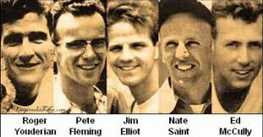
Philip James Elliot was a American Christian missionary, and was one of five killed during Operation Auca, an attempt to evangelize the Huaorani people of Ecuador. Wikipedia
Born: October 8, 1927, Portland, OR
Died: January 8, 1956, Rio Curaray
Spouse: Elisabeth Elliot
Quotes
He is no fool who gives what he cannot keep, to gain that which he cannot lose.
你不是傻瓜因为你给出不能拥有的东西（世界的财宝或者暂时的生命），反而得到不能丢的东西（永生）

Slide 12
My Christmas Gift
我的圣诞节礼物
1. Think about some of the past Christmas Gifts
过去的圣诞节礼物，还记得吗？
2. When I was a child growing up, loved dolls爱娃娃
3. Grew older, loved comic books爱看漫画书
4. College and adult, loved novels小说
5. As I go older, loved painting and want to do pottery画画/陶器
6. All time growing up and even now, loved One particular
Book成长的过程中，最爱一本书
7. Learned to give more to Jesus, not only tithe, offerings, time,
But also my heart学习十一奉献，爱心奉献，时间，心
Notes:
I've changed over the years, but my Lord Jesus Christ never changes. He is the same yesterday, today, and forever! HE IS THE MOST PRECIOUS GIFT FOREVER!
How About You? What is the most precious gift you have? What did you give to Jesus for His Birthday?

