Slide 1
YOU LACK ONE MORE THING 你还缺少一件
LUKE 18:18-30
路加福音十八章十八-三十节

Slide 2
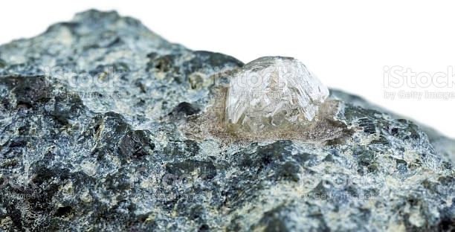

Slide 3
ETERNAL LIFE LINKED WITH TREASURES 永生和财宝的关系
"A certain ruler asked him, saying, Good Master, what shall I do to inherit eternal life?" 18 “有一个官问耶稣说‘良善的夫子，我该作什么事，才可以承受永生。’18

Slide 4
ETERNAL LIFE LINKED WITH TREASURES 永生和财宝的关系
"Jesus said unto him, why call me good? None is good, save one, that is God." 19 “耶稣对他说，你为什么称我是良善的，除了神之外，再没有良善的。”19

Slide 5
ETERNAL LIFE LINKED WITH TREASURES 永生和财宝的关系
"You know the commandments, do not commit adultery, do not kill, do not steal, do not bear false witness, Honor your father and you mother." 20. “诫命你是晓得的，不可奸淫，不可杀人，不可偷盗，不可作假见证，当孝敬父母。”20

Slide 6
ETERNAL LIFE LINKED WITH TREASURES 永生和财宝的关系
"He said, all these have I kept from my youth up." “那人说，这一切我从小都遵守了。”21 "Jesus said, yet lack you one thing; sell all that you have, and distribute to the poor, and you will have treasure in heaven: and come, follow me. 耶稣听见了，就说，你还缺少一件，要变卖你一切所有的，分给穷人，就必有财宝在天上。你还要来跟从我。”22

Slide 7
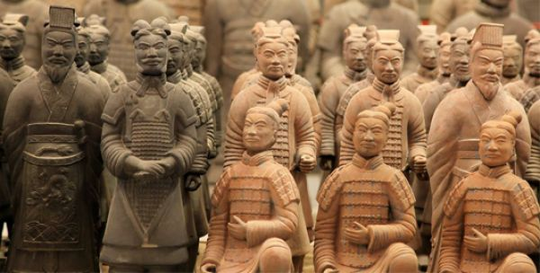

Slide 8
ETERNAL LIFE LINKED WITH TREASURES 永生和财宝的关系
"When he heard this, he was very sorrowful; for he was very rich. When Jesus saw that he was very sorrowful, He said, how hard will they that have riches enter into the Kingdom of God! 他听见这话，就甚忧愁，因为他很富足。耶稣看见他，就说：‘有钱财的人进神的国是何等的难哪！”24

Slide 9
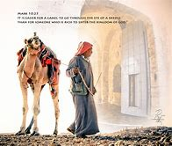
Illustration Meaning of Eye of the Needle
"for it is easier for a camel to go through the eye of a needle than for a rich person to enter the Kingdom of God. 骆驼穿过针眼比财主进天国还容易呢！”25
Notes:
The "eye of the needle" mentioned in the Bible, was one of the many gates providing passage through Jerusalem's massive walls. The "Needle Gate" was used when the city's main gates were closed at night. It was designed for security so that enemies could not simply ride into the city.

Slide 10
ETERNAL LIFE LINKED WITH TREASURES 永生和财宝的关系
"Those who heard it said, 'then who can be saved? But He said, 'what is impossible with man is possible with God." 26-27 听见的人说：“这样，谁能得救呢？耶稣说：‘在人所不能的事，在神却能。”26-27

Slide 11
ETERNAL LIFE LINKED WITH TREASURES 永生和财宝的关系
Peter said "see, we have left our homes and followed you. He said to them, "truly, I say to you, there is no one who has left house or wife or brothers or parents or children, for the sake of the Kingdom of God, who will not receive many times more in this time, and in the age of come eternal life." 28-30

Slide 12
ETERNAL LIFE LINKED WITH TREASURES 永生和财宝的关系
彼得说：“看哪，我们已经撇下自己所有的跟从你了。耶稣说：”我实在告诉你们：人为神的国撇下房屋，或者妻子，弟兄，父母，儿女，没有在今世不得百倍，在来世不得永生的。”29-30

Slide 13
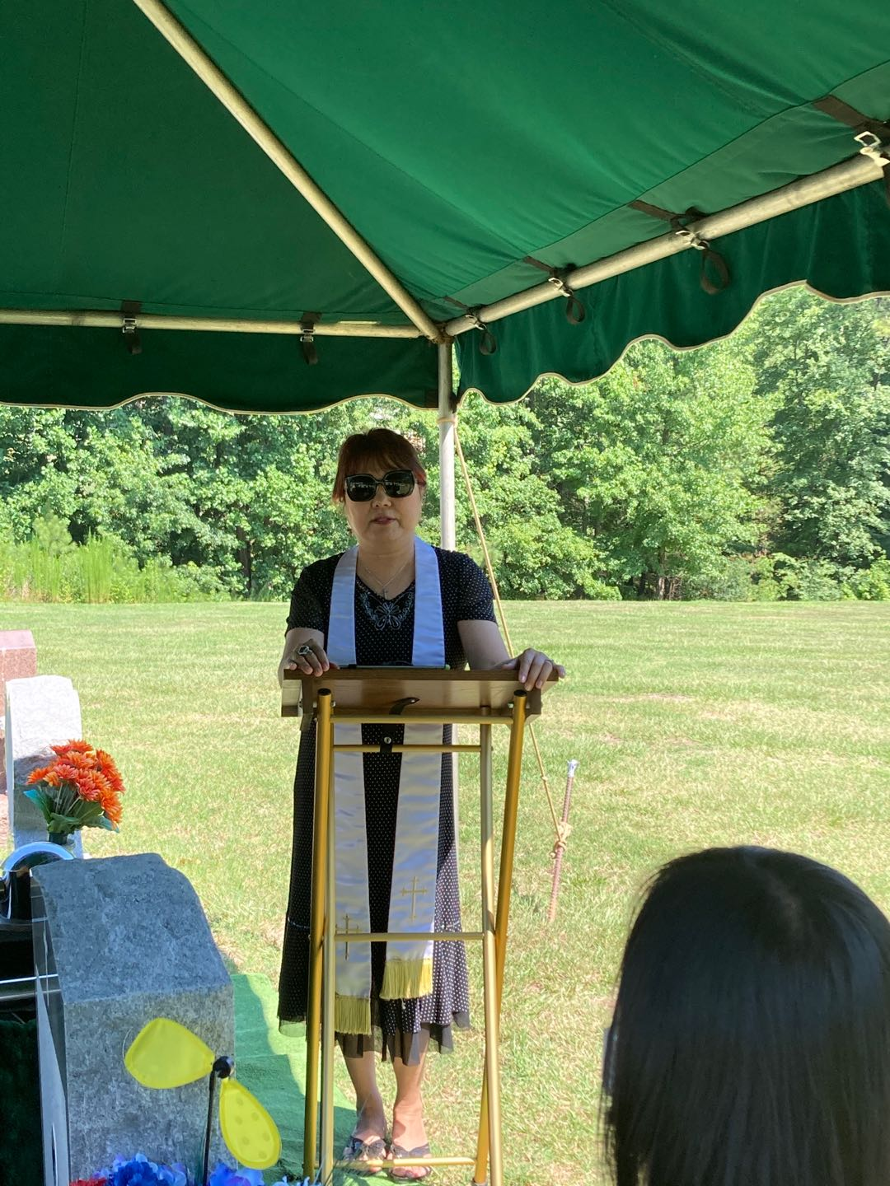
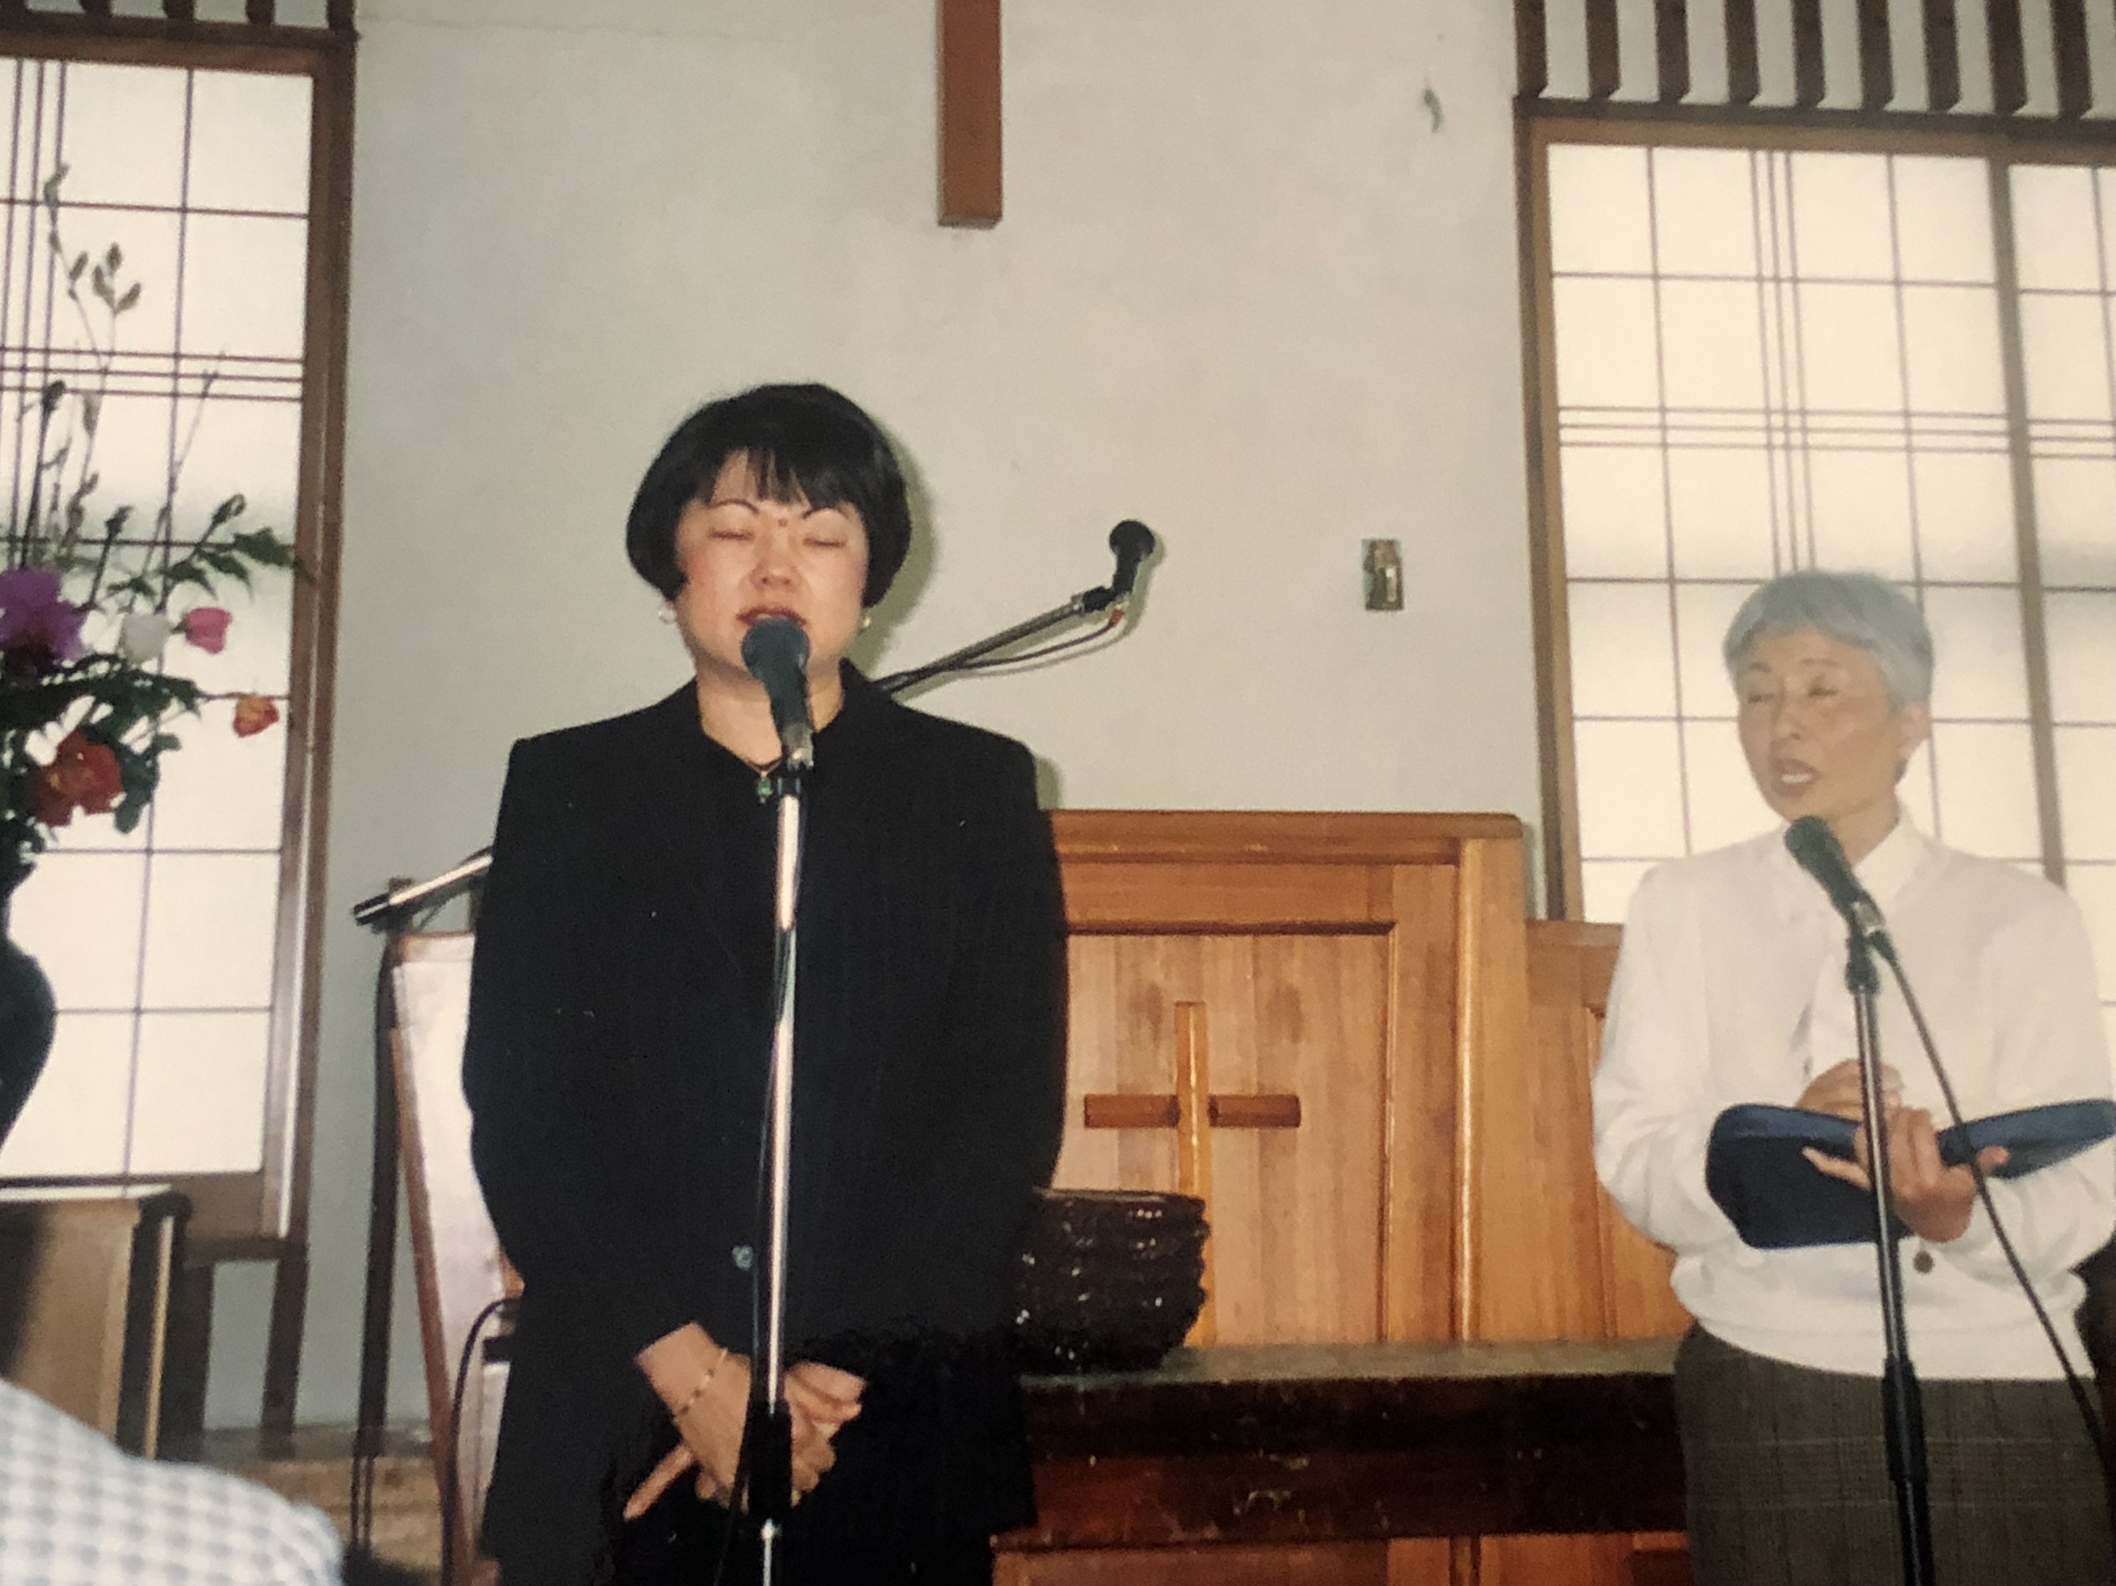
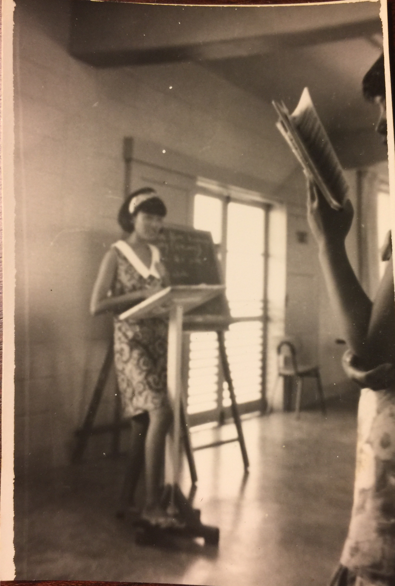
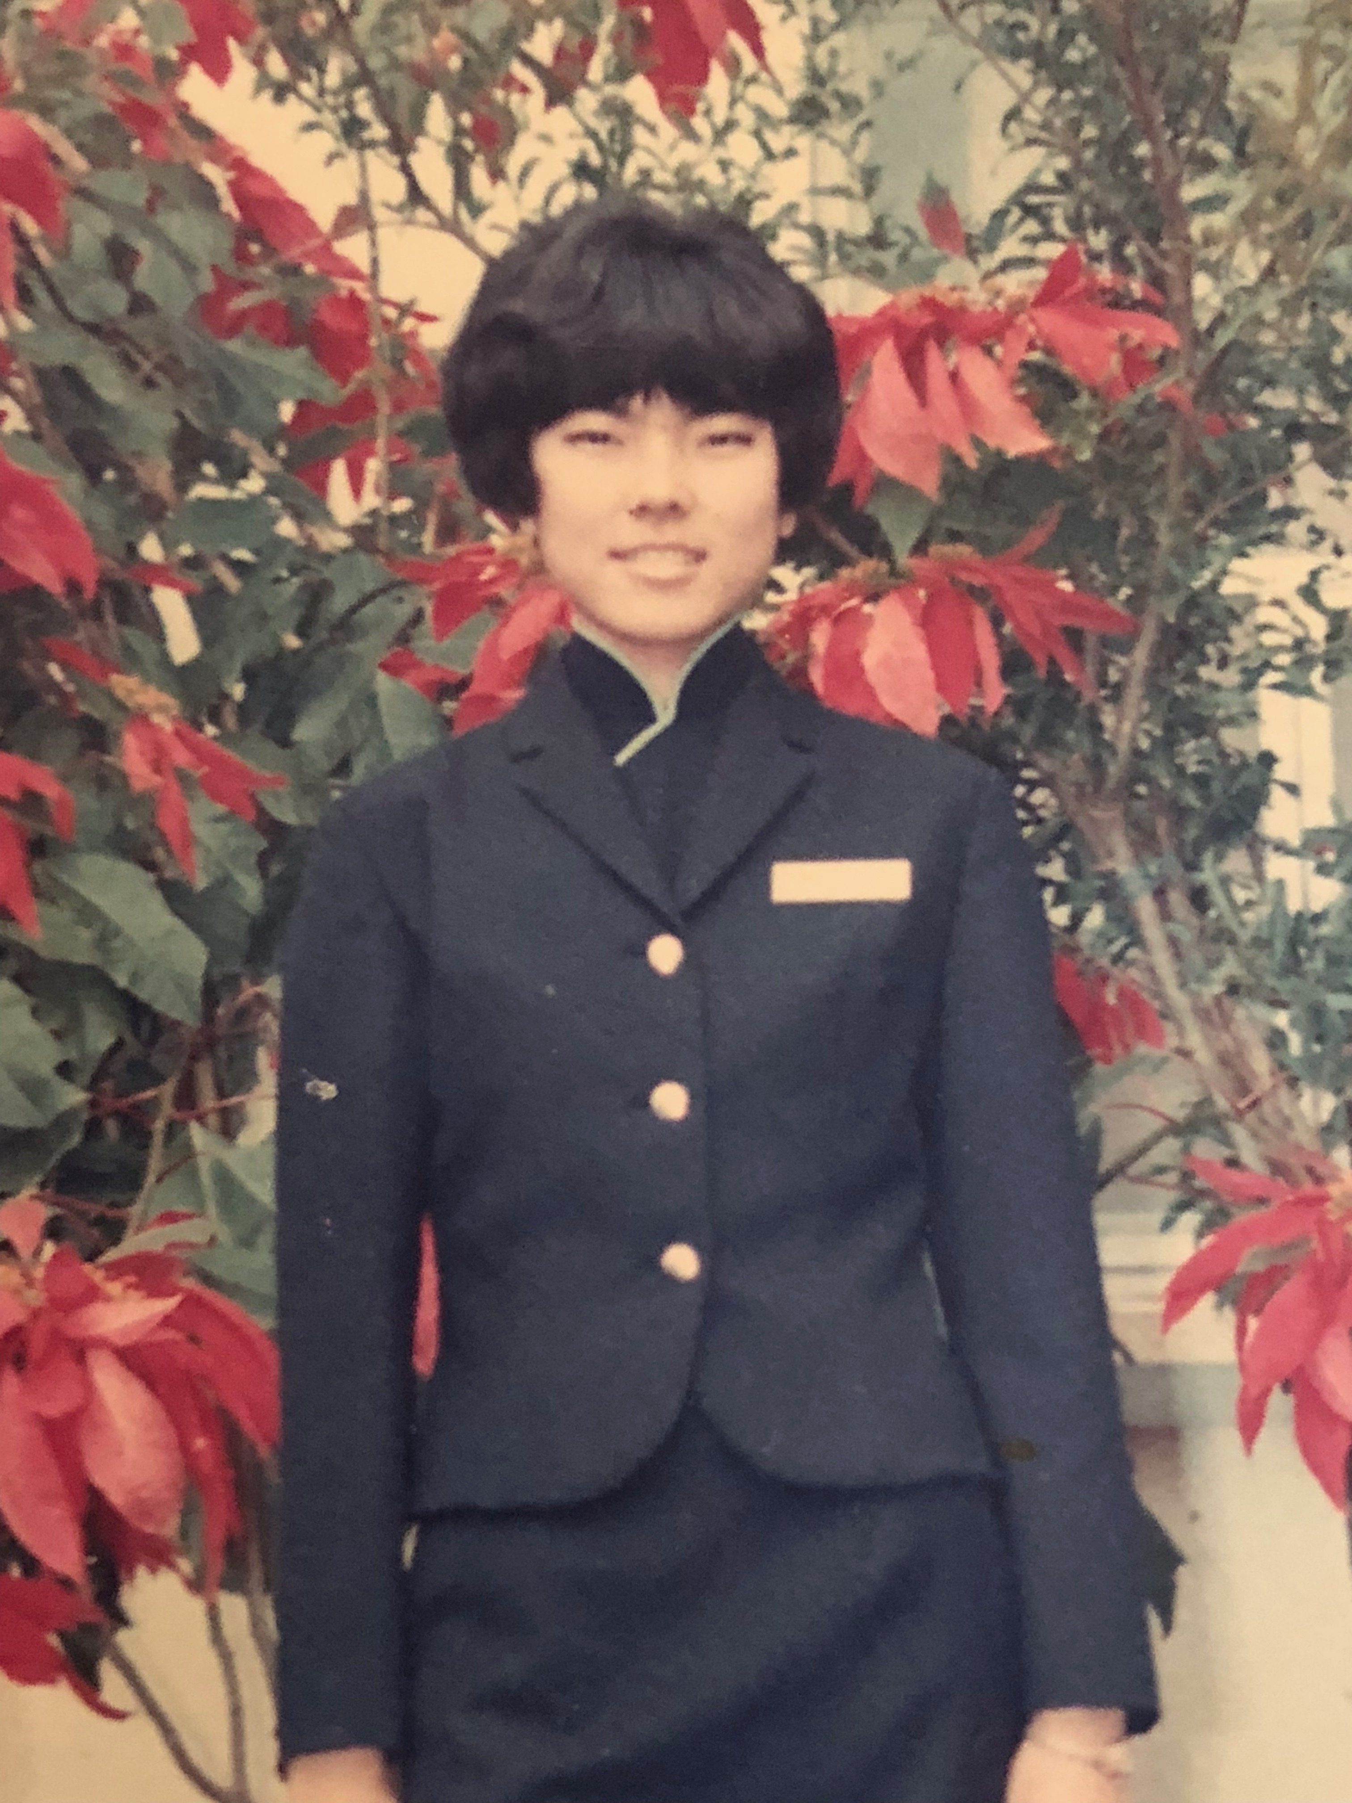
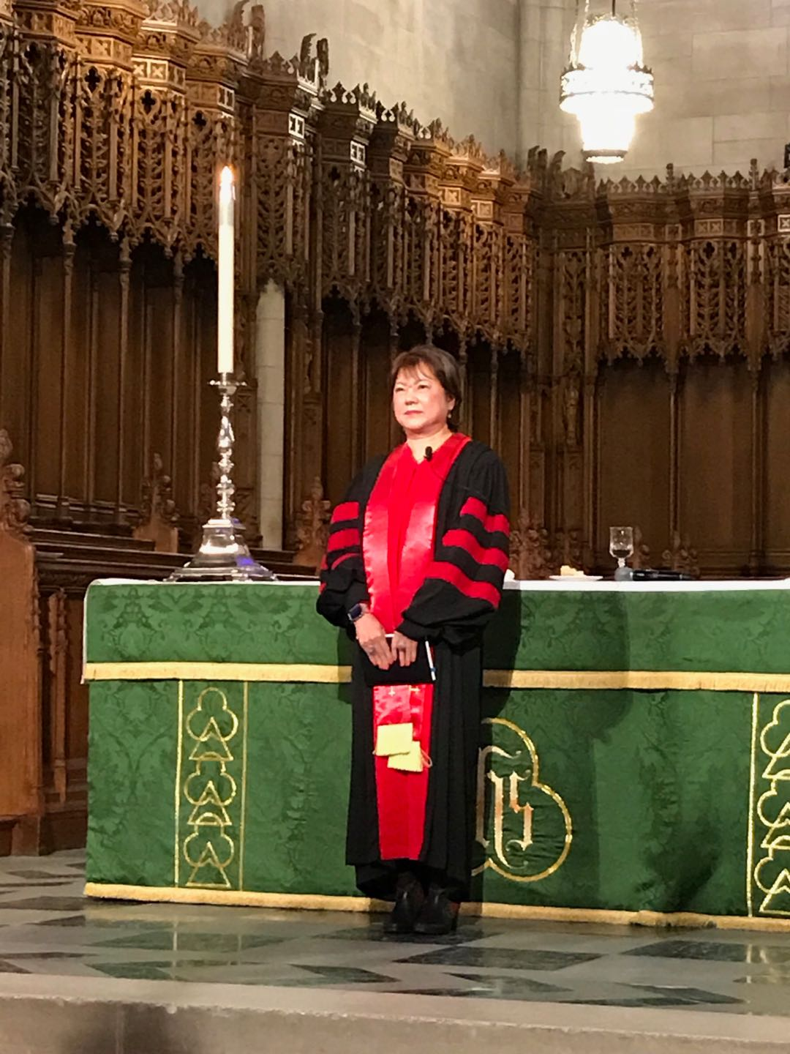
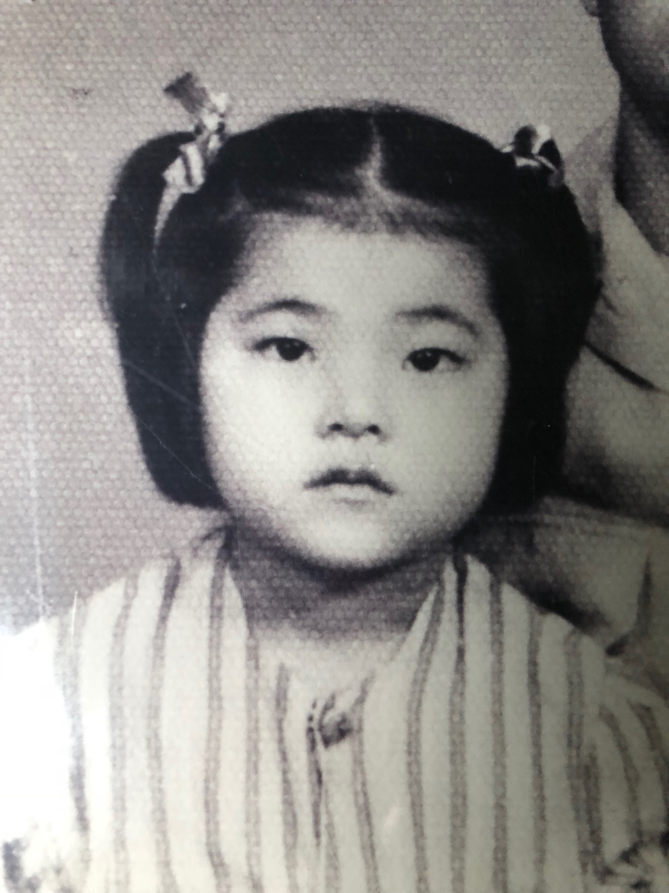
Notes:
My Dedication to the Lord, since I was 16, I served in the Youth Group on Okinawa. I had careers as a supervisor for China Airline, went to become a Physician Assistant, then dedicated my whole life at 37 as a PA then to become what I am today. I've never regreted my dedication to the Lord, I am happiest when I serve Him!

Slide 14
**ETERNAL LIFE LINKED WITH TREASURES 永生和财宝的关系
The Young man asked for Eternal Life。 少年问如何得永生
Jesus answered with not only eternal life but also Treasures in Heaven耶稣的回答
What Do You Have? Eternal Life or both你得到的是哪一个?
Notes:
We are done with the series of Managing your Money 理财有道。What have you gained? Do you want both eternal life and treasures stored in heaven?

Slide 15
**ETERNAL LIFE LINKED WITH TREASURES 永生和财宝的关系
"But store up for yourselves treasures in heaven, where neither moth nor rust destroys and where thieves do not break in or steal." Matthew 6:20
“要在天上积蓄财宝；天上没有虫子咬，不会锈坏，也没有贼挖洞来偷。”马太福音6:20
Notes:
We are done with the series of Managing your Money 理财有道。What have you gained? Do you want both eternal life and treasures stored in heaven? 马太福音6:21 “你的心是随着你的财宝走的。”"Your heart will always be where your treasure is." Contemporary English Translation

