Slide 1
SERVE GOD IN A GOOD WAY 好好的服事主 6
"Then you should learn to rule yourselves properly. That is not all. You should also learn to be patient and brave. And you should serve God in a good way." 6
在知识上加自制；在自制上加忍耐；在忍耐上加敬神；6

Slide 2
BE KIND TO EVERYONE 要爱所有的人 7
"You should not only serve God, but you should be kind to other believers like your own brothers and sister. And you should not only love other Christians, but you must also love all people." 7
“在敬神上加弟兄之情；在弟兄之情上加爱；”7

Slide 3
GROW AND BEAR FRUITS 成长和结果子 8
"You should grow as believers in all these ways, more and more. When you live in that way, it will show that you really know our Lord Jesus Christ. People will see that your life has good results." 8
“因为你们如果有了这些，并且不断增多这些，它们就会使你们在真正认识我们主耶稣基督的事上，不会成为懒惰的或不结果子的人”8

Slide 4
GLORY TO GOD GOOD TO MEN 荣神益人
"Then the way you live will always honor and please the Lord, and your lives will produce every kind of good fruit. All the while, you will grow as you learn to know God better and better." Colossians 1:10
“好让你们行事为人配得上主，凡事蒙他喜悦，在一切美善的工作中结出果子，在神的真正知识上不断长进。”歌罗西书1:10

Slide 5
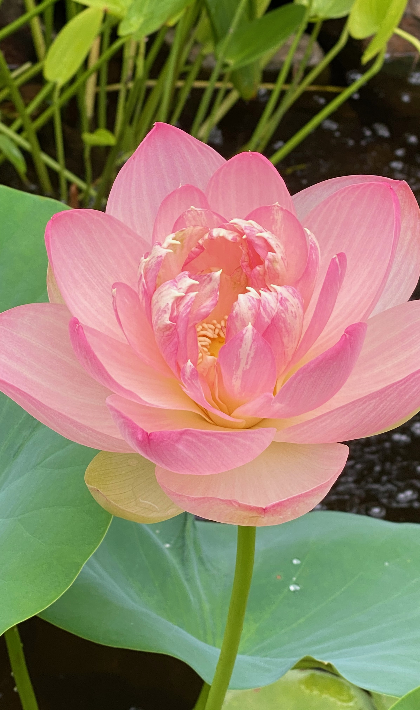
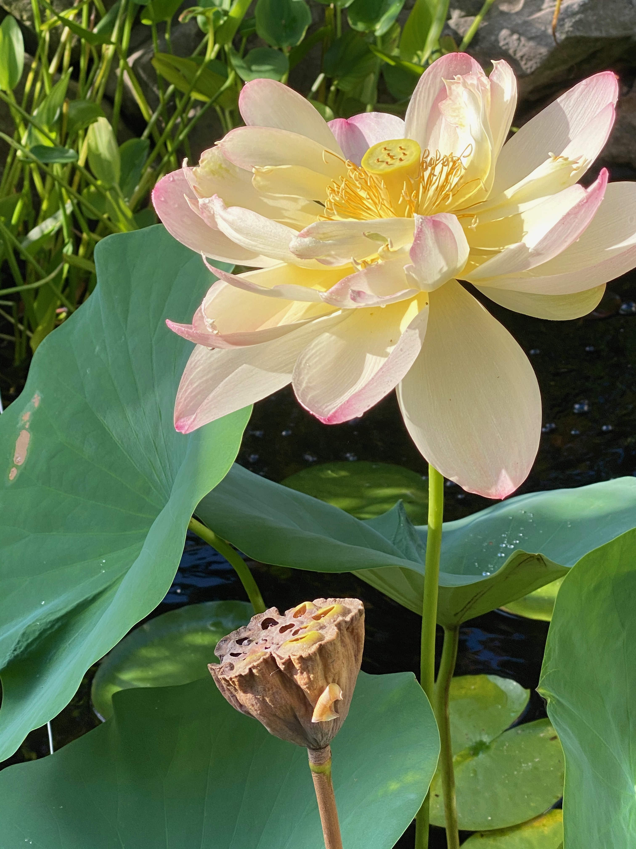
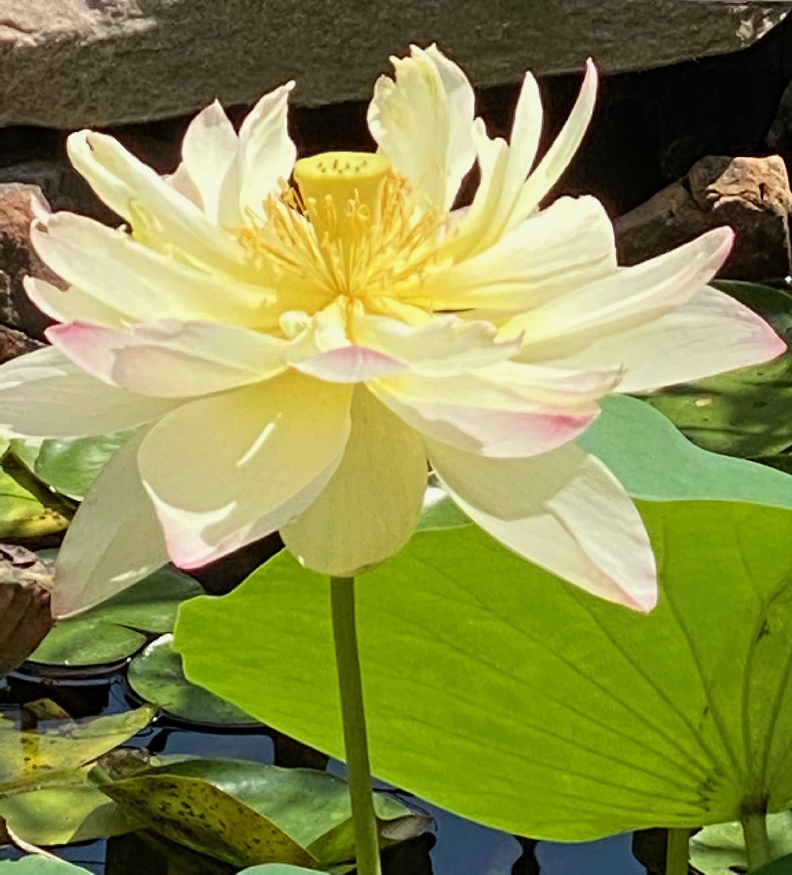
Notes:
This lotus is one of a king that changes color as it ages for 4 days. It started as pink with stripes, then turns pink at the border, then yellow to white. Are we changing like this flower, from beginning Christian to a faithful and loyal Christian? Yes, we need to change from self-realization to God-realization Christian. Don't stay in a stagnant place, or else we will not be the most useful and beautiful for our Lord! Be patient, let God grow you via His Spirit!

Slide 6
**COMMUNION 圣餐摆饼
1. Are You Changing for Good你有改变吗?
2. Are You Giving God Glory and Love to Others你的生活是不是荣耀神，爱人？
3. Are You Spiritually Growing 属灵上有长进吗?
4. Are You Bearing Fruit for Our Lord 你有为神结果子吗?
Notes:
我们必须常常的衡量自己属灵的生命。过去的老我有没有死去，我有没有望着好的改变？什么地方还需要神工作？有没有结圣灵的果子？有没有荣神益人？

