Slide 1
LIFE CHANGE 生命的变化
2 PETER 1:2-8
彼得后书一章二-八节

Slide 2
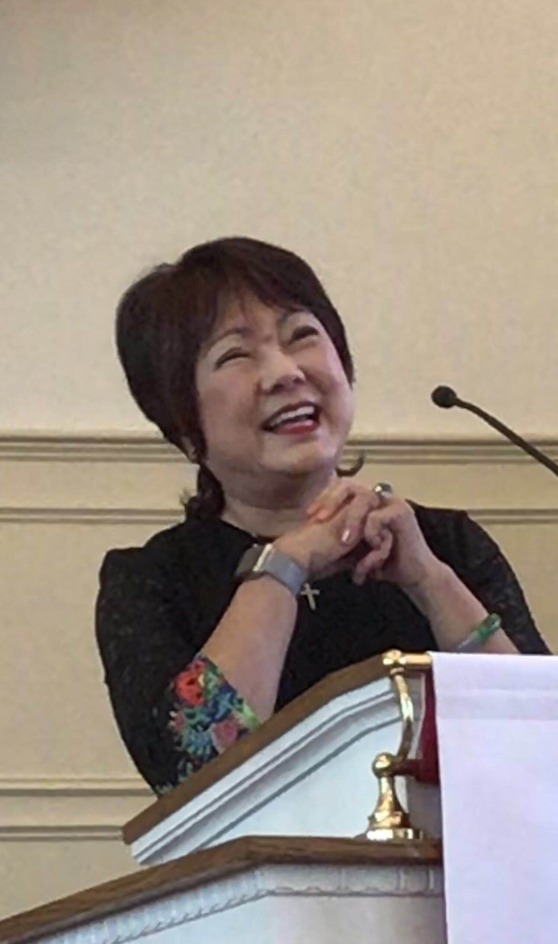
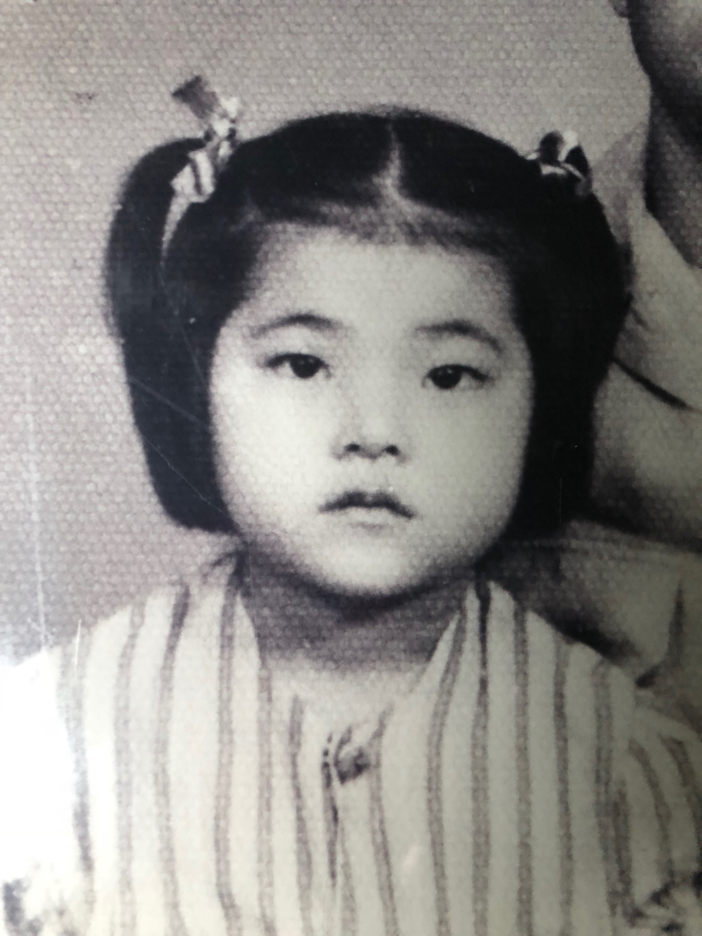
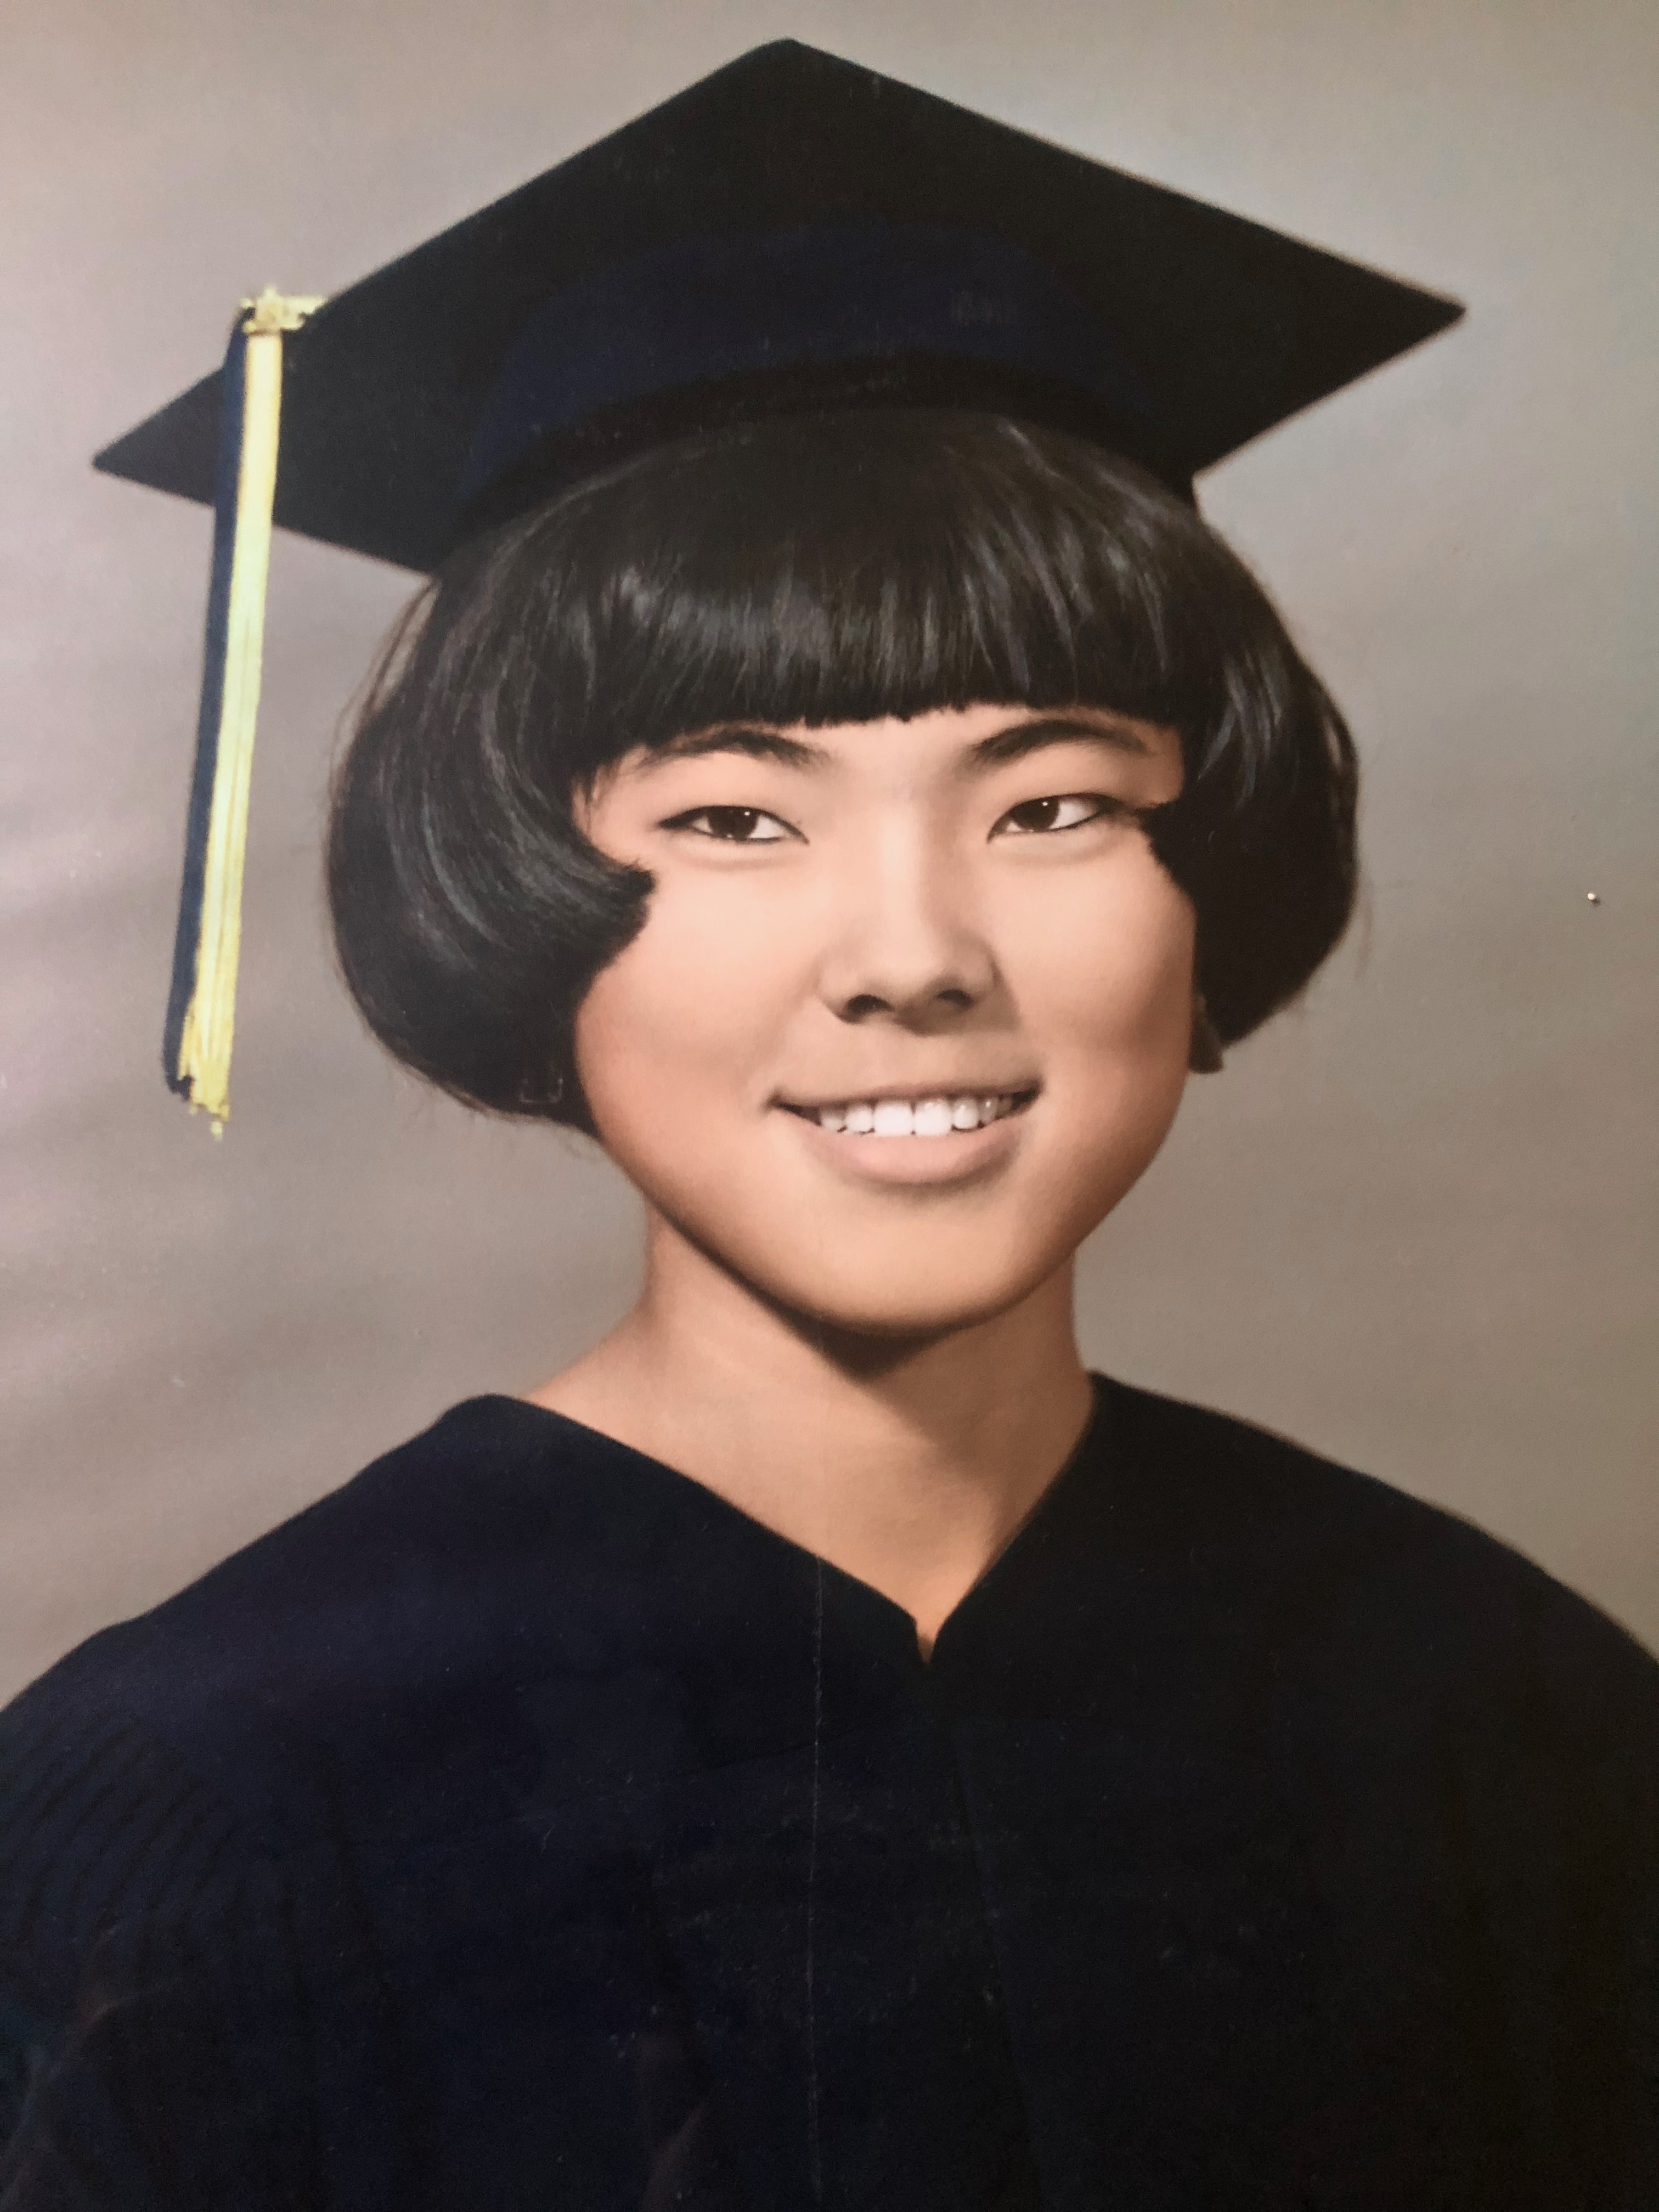
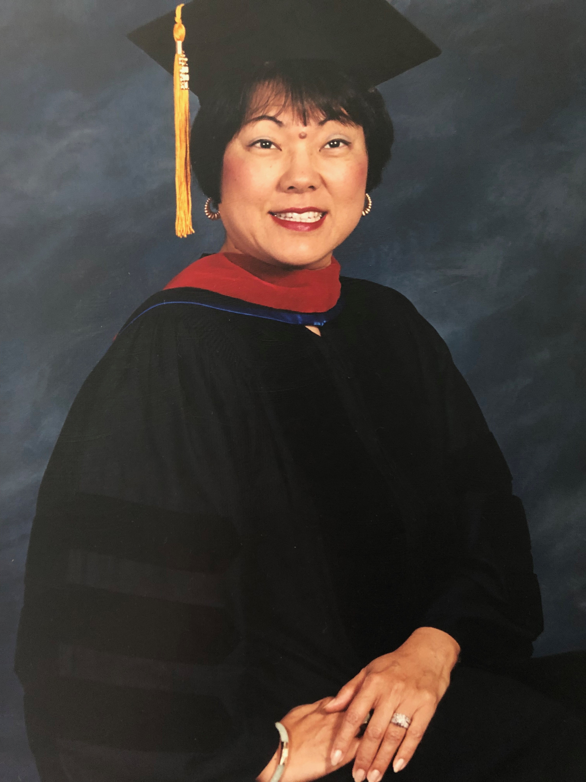
Notes:
Life change for me. From a little girl born in Beijing, to high school graduate on Okinawa, to graduate seminary doctorate to today's pastoral ministry. Now I am a senior, what changes had I in the Spiritual realm? Time pass fast, and our bodies change, how about our spirits? Are we growing in the Spirit?

Slide 3
GROW AS BELIEVERS 基督徒的成长 2
"I pray that God will help you and give you peace in your minds more and more. You will grow as believers because you know Jesus, our Lord." 2
“愿恩典与平安，藉着你们真正认识神，我们的主耶稣，多多地加给你们。”2

Slide 4
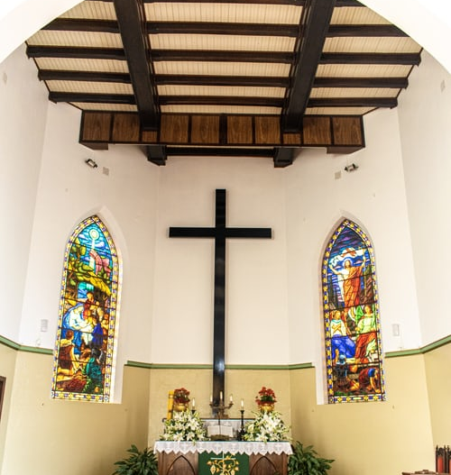
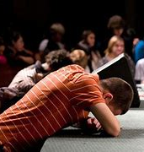
Notes:
GIVE YOURSELF TO GOD
A young man was eager to grow in His Christian life. He got a piece of paper and made a list of all the things he would do for God. He wrote down the things he would give up, the places he would go to minister and the areas of ministry he would enter. He was excited. He took that list to the church and put it on the altar.
He thought he would feel joy, but instead he felt empty. So he went home and started adding to his list. He wrote down more things he would do and wouldn’t do. He took the longer list and put it on the altar, but still he felt nothing.
He went to a wise, old pastor, told him the situation and asked for help. The pastor said, “Take a blank sheet of paper. Sign your name at the bottom. Put that on the altar.” The young man did, and then peace came to his heart.

Slide 5
GOD HAS GIVEN US EVERYTHING 神已经给我们所需要的 3
"God is very powerful because He is God. He has used that power to help us. He has given us everything that we need to live in a good way. We can do things that make God happy. This is possible because now we know Him. God has chosen us to be His people because He is very great and very good “主耶稣性的大能，因我们真正认识以自己的荣耀和美德召唤我们的那一位，就把一切有关生命和敬畏神的事都赐给了我们。”3

Slide 6
DO WHAT IS RIGHT 作对的事 4
"Because of this, God has promised that He will do very great and valuable things for us. As a result, you can do what is right, like God does. The people who belong to this world want to do bad things. Those bad things make them become worse and worse. But God gives you the power to be free from all that." 4

Slide 7
DO WHAT IS RIGHT 作对的事 4
“藉着这荣耀和美德，他把那些又宝贵又极大的应许赐给了我们，好使你们能藉着这些应许，逃脱世上因欲望而来的衰朽，成为在神的本性上有份的人。”4

Slide 8
GROW AS BELIEVERS 信主的人要成长 5
"God has done all this to help you. Do, now that you believe in Christ, you must grow as believers. Try very much to do always what is good. Then you should grow to know God more and more." 5
“是的，也正是为此，你们应当经量的殷勤，在信仰上加美德；在美德上加知识；5

