Slide 1
CONTRACT OR COVENANT 合同还是盟约
EPHESIANS 5:21-33
以弗所书五章二十一到三十三

Slide 2
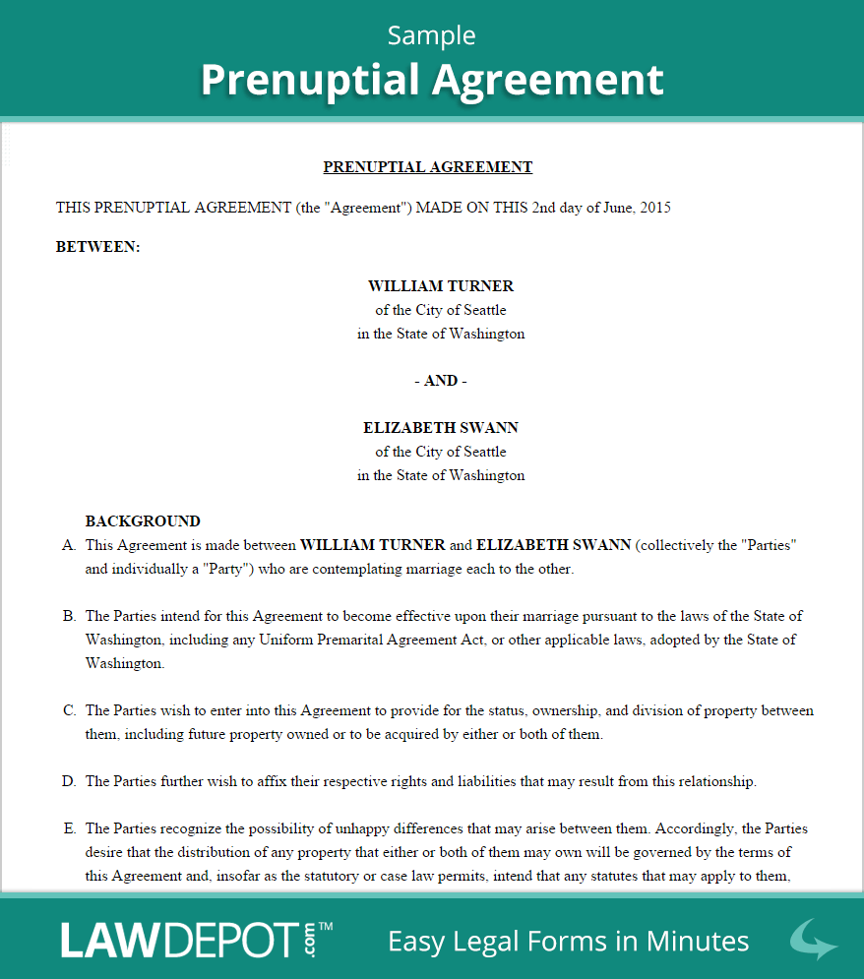
婚姻前的
合同书

Slide 3
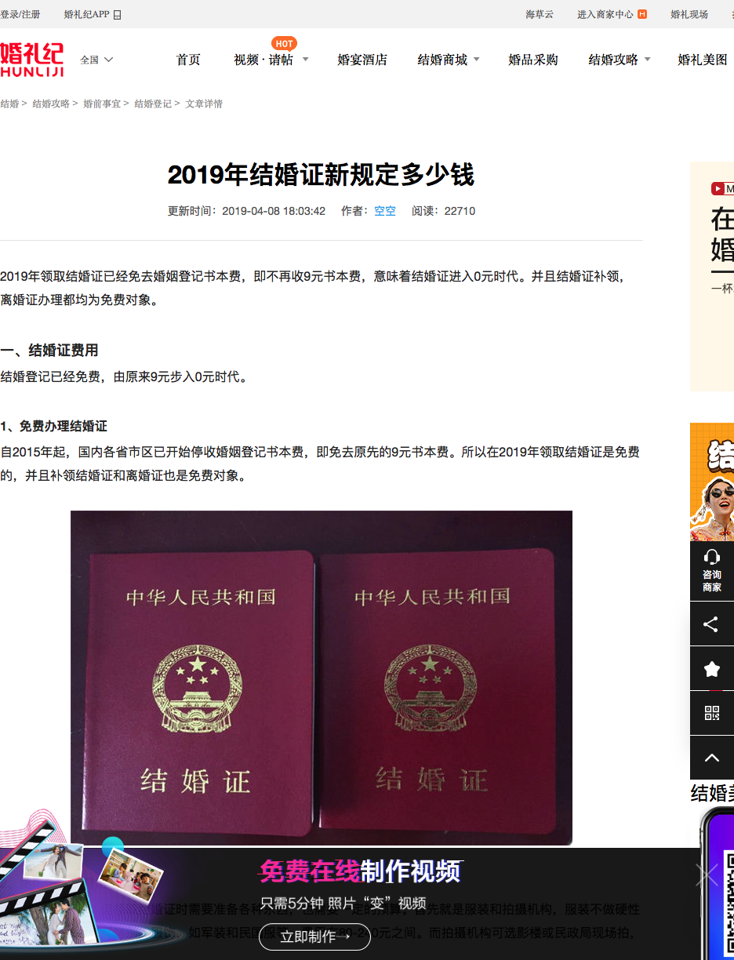
中国
结婚的
合同
证书

Slide 4
COVENANT IN MARRIAGE 婚姻是神指示我们的盟约
Marriage is a Covenant: "your wife by covenant... Malachi 2:14-16 因为耶和华在你和你的发妻中间作证，她是你的配偶，是你盟约的妻子，你却对她不忠。神不是把你们结合为一体，叫你们肉体和心灵都归他吗？他为何这样做？是为了得敬虔的后裔。所以你们要小心谨慎，不可对自己的发妻不忠。。以色列的神说‘我憎恶休妻和以暴虐待妻子的人。所以你们要小心谨慎，不可有不忠的行为。”玛拉基书2:14-16

Slide 5
CONTRACT OR COVENANT 合同和联盟的区别
CONTRACT合同
1. Social社会责任
2. Legal Agreement法律同意
3. Can be Broken by Law可以毁掉，离婚
4. No Grace没有恩典
COVENANT联盟
1. Sacred神圣的责任
2. Agreement -God与神立约
3. Broken with Consequences离婚有后果玛拉基书2:16
4. By Grace靠着恩典
Notes:
Examples in the Bible: 1. Israel relationship with God is by Covenant. Today our relationship with God is by Covenant. It is because of Jesus's death on the cross that we are set free. 2. Therefore our relationship now including the marriage is a covenant before God. 3. A contract is on paper, a legal document and can be broken. But a covenant with God, even though we may break it, God never never breaks with us! 4. The legal binding document has no grace involved. In China you can get married like you can get divorced. All on papers, and legally confirmed. However, our marriage vows before the Lord is by Grace. We are forgiven of our sins, and if one partner sinned, God does forgive, therefore the other person also need to forgive. In the Bible, we see David sinned. God forgave him, however, the consequences are great, that his family was punished through his children. Violence and death never left his family.

Slide 6
COVENANT RELATIONSHIP 盟约的关系
WIFE妻子
1. SUBMISSION顺服
2. POWER IN GOD神的力量带领作好的妻子
3. HELPER TO HUSBAND丈夫的助理
4. RESPECT HUSBAND敬重
HUSBAND丈夫
1. SUBMISSION顺服
2. POWER IN GOD神的力量作好的丈夫
3. HEAD OF THE FAMILY家的头
4. PROTECT THE WIFE保护
Notes:
Submission does not void your value as a partner in the marriage. It simply puts a title on who is the CEO. I like to say I'm the COO. 🙂 He's the head of our home&I'm the heart. I regulate the pulse.

Slide 7
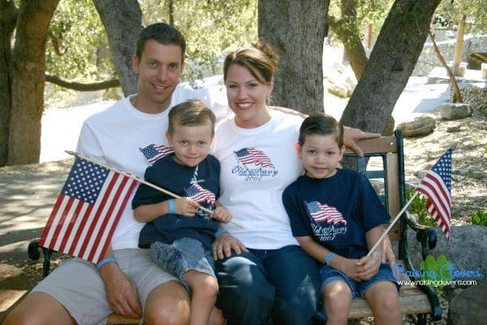
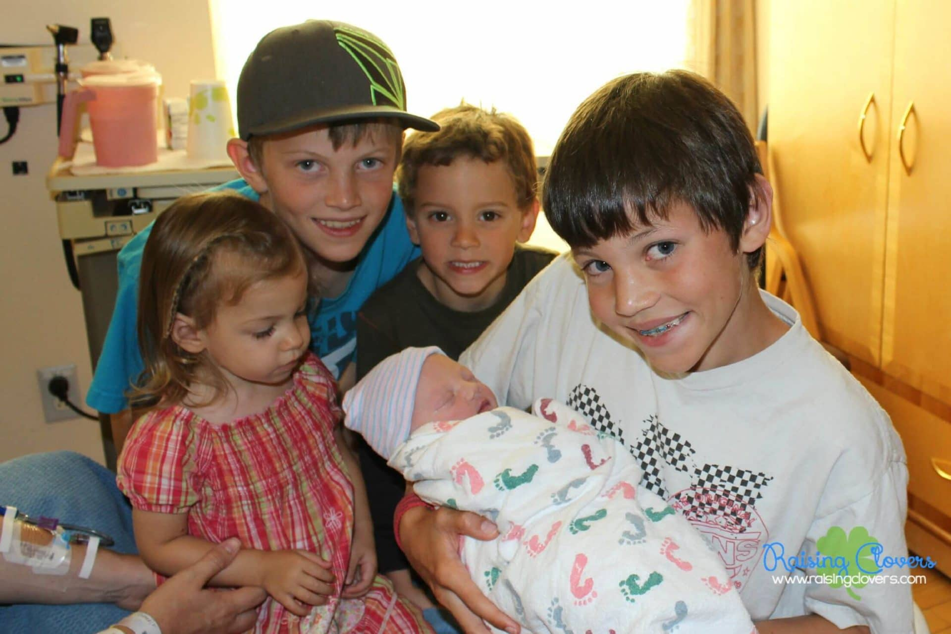
Christy Clover's Story
Notes:
Submission does not void your value as a partner in the marriage. It simply puts a title on who is the CEO. I like to say I'm the COO. 🙂 He's the head of our home&I'm the heart. I regulate the pulse.

Slide 8
BROKEN COVENANT 失败盟约的关系
WIFE妻子
1. SHE WILL TAKE OVER THE REIN AND BE A LEADER OF THE HOUSEHOLD霸道妻子
2. HER HUSBAND WILL HAVE INSECURITY AND BECOME WEAK使丈夫胆小，没有能力
HUSBAND丈夫
1. HE WILL HAVE FEAR OF FAILURE, NOT ABLE TO PROTECT THE FAMILY怕失败，不能保护家和家人
2. WEAKLING AND SUBMIT TO HIS WIFE没有用的丈夫，怕妻子
社会上的弱者

Slide 9
WIFE'S RESPONSIBILITIES 妻子的责任
1. SUBMIT TO THE HUSBAND AS TO THE LORD VS. 21顺服丈夫就是顺服主
2. PARALLEL TO CHURCH SUBMIT TO CHRIST
像教会顺服基督22
3. PARALLEL TO CHRIST AS THE HEAD OF THE CHURCH 像主是教会的头23

Slide 10
HUSBAND'S RESPONSIBILITIES 丈夫的责任
1. SUBMIT AS TO THE LORD顺服主21
2. LOVE YOUR WIFE 爱妻子25
3. SANCTIFY YOUR WIFE使她洁净 (IN THE WORD)26
4. MAKE HIS WIFE HOLY使她圣洁 27
5. LOVE AS YOUR OWN BODY 爱自己的身子28-29
6. TWO BECOME ONE 二人成为一体30-32

Slide 11
MOST IMPORTANT TEACHING 最重要的教导
WIFE妻子
1. SUBMIT TO LORD顺服神21
2. SUBMIT TO HUSBAND顺服丈夫22-24
3. RESPECT THE HUSBAND敬重丈夫33
HUSBAND丈夫
1. SUBMIT TO THE LORD顺服神21
2. LEAD THE WIFE 带头作25F
3. SACRIFICE AS CHRIST SACRIFICED牺牲26-32
4. LOVE YOUR WIFE爱 33

Slide 12
患难生强壮的婚姻
1. DON'T DWELL ON THE NEGATIVE
不要消极要积极
2. ACT AND NOT REACT不要快反应
要用行动解决问题
3. COMMUNICATE IS THE KEY沟通
是个婚姻的钥匙
4. WILLING TO ADAPT随时柔软，要
适应，要看看对方的需要
5. ALWAYS LOVE, NOT BLAME用爱
不是用批评或者责怪

Slide 13
OBEY THE LORD 顺服神
LEARN TO TRUST AND OBEY GOD ISAIAH 55:8-9 "FOR MY THOUGHTS ARE NOT YOUR THOUGHTS, NEITHER ARE YOUR WAYS MY WAYS, DECLARES THE LORD. FOR AS THE HEAVENS ARE HIGHER THAN THE EARTH, SO ARE MY WAYS HIGHER THAN YOUR WAYS AND MY THOUGHTS THAN YOUR THOUGHTS."
“耶和华说：我的意念非同你们的意念，我的道路非同你们的道路。天怎样搞过地，照样，我的道路高过你们的道路，我的意念高过你们的意念。”

