Slide 1
Love our family 爱我们的家
LUKE 15:11-32
路加福音十五章十一-三十二

Slide 2
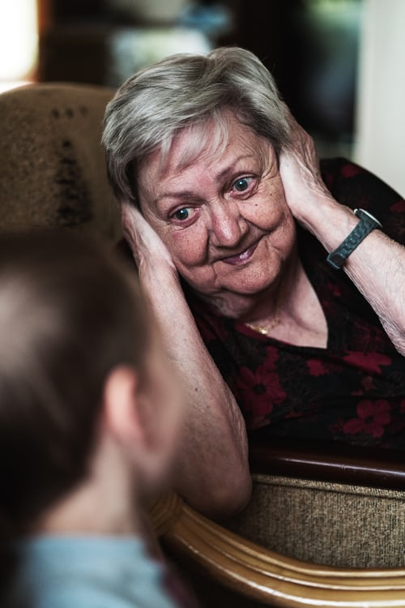
REASON
FOR WHITE
HAIR
妈妈你的头发
为什么会白？
Notes:
A child asked his Mom "why are your hair getting white?" Mom answered, "because you caused it, every white hair represents your disobedience and I had to spend a lot of time help you to be good."
The child said, "Oh, that is the reason why grandma's hair is all white!"

Slide 3
Value of parenting 父母的价值
Your value as a parent never changes
Illustration of the value of $20.00
Parenting takes effort, patience, and time
Rewards are seen in your grandchildren

Slide 4
The father 父亲
“HE DIVIDED HIS PROPERTY BETWEEN THEM. 他父亲就把产业分给他们”11
他为什么还没有死，却给了他们产业
“HIS FATHER SAW HIM AND FELT COMPASSION
相离好远，他父亲看见，就动了慈心。。”20
WHAT KIND OF A FATHER ARE YOU 你是什么样的父亲?

Slide 5
The bad son 不好的儿子
NO LOVE AT ALL 12-13
自己没有爱，也在找爱
BOTTEM PIT 掉在坑里，堕落最下层14-16 神使他无路可走，只有回家认罪悔改先，因为他得罪了神（饥荒，天灾是神许可的，神是掌管一切万物的）
ARE THERE ANY BAD THING ABOUT YOU? 作为儿子，你有走投无路的时候吗？

Slide 6
The good son 好儿子
WORKING HARD, IN THE FIELD努力做事 25
GOT MAD, BECAUSE HE WAS A GOOD SON 生气是自然的26
NOT PERFECT BECAUSE NO LOVE EITHER他也是不完全，对弟弟没有爱 29-30
ARE THERE ANY GOOD THING ABOUT YOU你觉得你是个好人吗?

Slide 7
Save the sinner 拯救罪人
"FOR EVERYONE HAS SINNED; WE ALL FALL SHORT OF GOD'S GLORIOUS STANDARD." ROMANS 3:23
“因为人人都犯了罪，亏缺了神的荣耀。” 罗马书三章二十三节

Slide 8
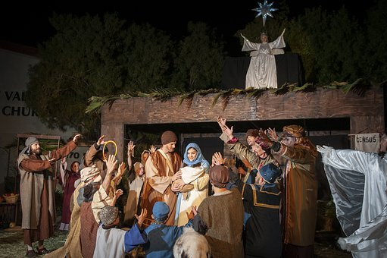

Slide 9
God loves us 神爱我们
Christmas This Week to the World
GOD'S LOVE IS TIMELESS。
无时间的限制（永恒的）
GOD'S LOVE IS ENDLESS
无边无标的（到处都有）无所不在
GOD'S LOVE IS PRICELESS
无价之宝，无法估价的
LOVE OUR
FAMILY
爱我们的家

Slide 10
COMMUNION 圣餐博饼
1. 请圣灵在你的心中说话
2. 认罪悔改，做个有爱的基督徒
3. 原耶稣的爱充满你
4. 做个好的儿子，女儿，妈妈，爸爸
5. 了解为什么耶稣爱我？往上看看！

