Slide 1
BUILD OUR CHURCH: 2 GIVE THE BEST TO GOD 将你最好的献给主
PROVERBS 3:5-10
箴言三章五到十节

Slide 2
HOW TO GIVE YOUR BEST? 如何把最好的献给主？
"TRUST IN THE LORD WITH ALL YOUR HEART, AND DO NOT LEAN ON YOUR OWN UNDERSTANDING"5
“你要专心仰赖耶和华，不可依靠自己的聪明。”
1. Trust信靠神
2. Not on Your Own Understanding不靠自己
Illustration: Boy trusted his father

Slide 3
HOW TO GIVE YOUR BEST? 如何把最好的献给主？
"IN ALL YOUR WAYS ACKNOWLEDGE HIM, AND HE WILL MAKE STRAIGHT YOUR PATHS." 6
“在你一切所行的事上，都要认定他，他必指引你的路。”六节
Illustration: What Barna Found about Christians

Slide 4
HOW TO GIVE YOUR BEST? 如何把最好的献给主？
"BE NOT WISE IN YOUR OWN EYES; FEAR THE LORD, AND TURN AWAY FROM EVIL." 7
“不要自己以为有智慧，要敬畏耶和华，远离恶事。”七节
Illustration: We all need a bullet proof vest

Slide 5
HOW TO GIVE YOUR BEST? 如何把最好的献给主？
"IT WILL BE HEALING TO YOUR FLESH AND REFRESHMENT TO YOUR BONES." VS. 8
“这便医治你的肚脐，滋润你的白骨。”八节
Illustration: The King and the Prince

Slide 6
HOW TO GIVE YOUR BEST? 如何把最好的献给主？
"HONOR THE LORD WITH YOUR WEALTH AND WITH THE FIRSTFRUITS OF ALL YOUR PRODUCE." 9
“你要以财物和一切初熟的土产尊荣耶和华。”
Illustration: Can you afford to give? Can you afford not to give? GIVING IS AN ACT OF WORSHIP

Slide 7
HOW TO GIVE YOUR BEST? 如何把最好的献给主？
"THEN YOUR BARNS WILL BE FILLED WITH PLENTY, AND YOUR VATS WILL BE BURSTING WITH WINE."10
“这样，你的仓房必充满有余，你的酒榨有新酒盈溢。”十节

Slide 8
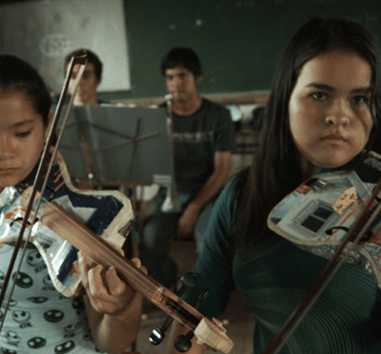
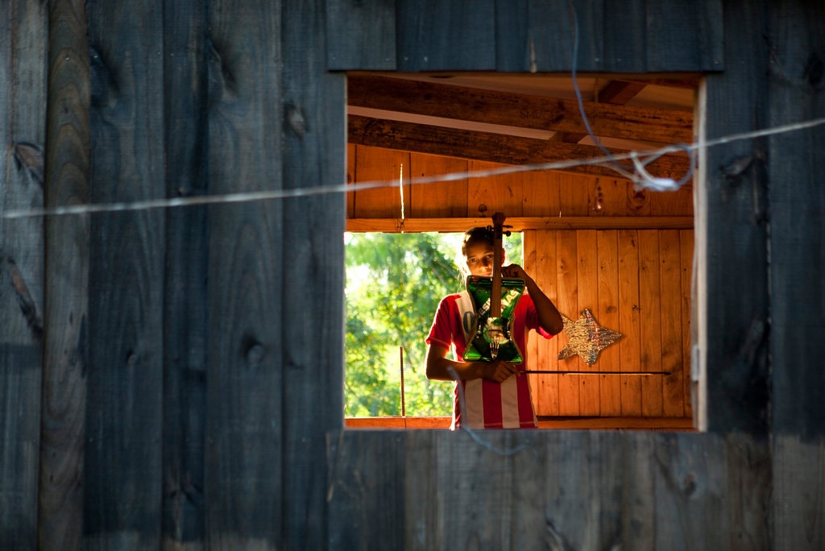
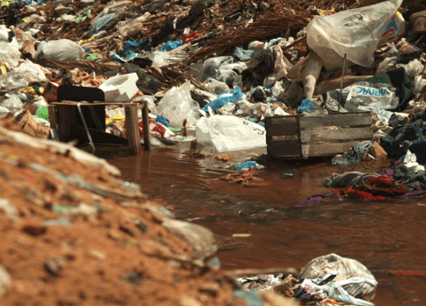
Notes:
The Landfill Orchestra formed because of a couple's love to give their best to their country. Over 40,000 lived in the landfill in Paraguay. These children would have been poor and lost for the rest of their lives, but because of the hardworking couple, they gave their best, now give hope and future to these children!

Slide 9
COMMUNION 圣餐
CANNOT AFFORD TO GIVE, NOT GIVING WHATEVER YOU CAN 不能给，有的时候给一点点
CAN AFFORD TO GIVE, BUT NOT GIVING 有钱可以给，不愿意给神，给自己买，存起来，投资
CAN YOU AFFORD MISS BLESSINGS AS WELL AS GOD'S JUDGMENT IN NOT GIVING?你不要神的祝福吗？你能够逃神的审判吗？
GIVING IS WORSHIP 奉献是崇拜的一个项目

