Slide 1
BUILD OUR CHURCH 1
WE MUST PRAY
建立我们的教会1
必须祷告
MATTHEW 18:18-20
马太福音十八章十八-二十节

Slide 2
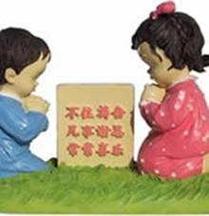
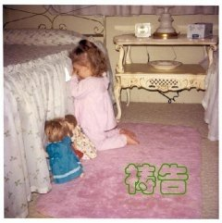
帖撒罗尼迦前书5:16 “不住祷告，凡事谢恩，常常喜乐”
一位可爱的小女孩都知道祷告！

Slide 3
WE MUST PRAY
必须祷告
TRULY, I SAY TO YOU, WHATEVER YOU BIND ON EARTH SHALL BE BOUND IN HEAVEN, AND WHATEVER YOU LOOSE ON EARTH SHALL BE LOSSED IN HEAVEN." 18
“我实在告诉你们；凡你们在地上所捆绑的，在天上也要捆绑；凡你们在地上所释放的，在天上也要释放。”18

Slide 4
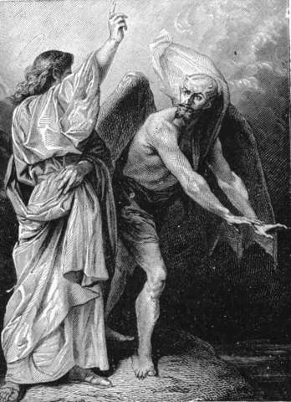
1. PRAY FOR FORGIVENESS OF SINS求神赦免
2. PRAY TO THE FATHER IN THE NAME OF
JESUS CHRIST AND COVER BY HIS BLOOD
祷告向阿爸父，借着耶稣的宝血，圣灵的引导
3. PRAY THE HOLY SPIRIT TO INTERCEDE
ROMANS 8:26
“况且，我们的软弱有圣灵帮助，我们本不晓得
当怎样祷告，只是圣灵亲自用说不出来
的叹息替我们祷告。”罗马8:26
4. He that is in us is greater！ “那在你们里面的
比那在世界上的更大。”约翰一书4:4

Slide 5
WE MUST PRAY
必须祷告
"AGAIN I SAY TO YOU, IF TWO OF YOU AGREE ON EARTH ABOUT ANYTHING THEY ASK, IT WILL BE DONE FOR THEM BY MY FATHER IN HEAVEN." VS. 19
“我又告诉你们；若是你们中间有两个人在地上同心合意地求什么事，我在天上的父也必为他们成全。”19

Slide 6
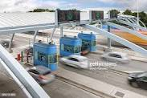
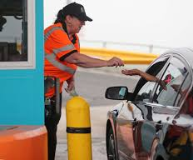
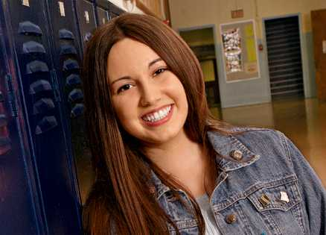
Notes:
The tollbooth lady who prayed for miracle for this girl's mother who was dying in the hospital.

Slide 7
WE MUST PRAY
必须祷告
"FOR WHERE TWO OR THREE ARE GATHERED IN MY NAME, THERE AM I AMONG THEM." 20
“因为无论在哪里，有两三个人奉我的名聚会，那里就有我在他们中间。”20

Slide 8
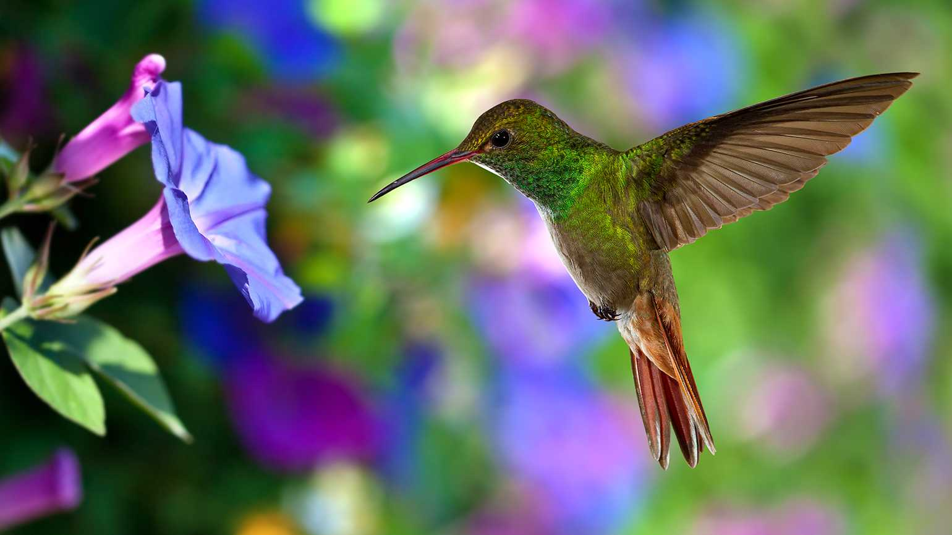

Slide 9
WE MUST PRAY
必须祷告
ROMANS 罗马书8:26 "LIKEWISE THE SPIRIT HELPS US IN OUR WEAKNESS. FOR WE DO NOT KNOW WHAT TO PRAY FOR AS WE OUGHT, BUT THE SPIRIT HIMSELF INTERCEDES FOR US WITH GROANINGS TOO DEEP FOR WORDS."
“况且，我们的软弱有圣灵帮助，我们本不晓得当怎样祷告，只是圣灵亲自用说不出的叹息替我们祷告。”

Slide 10
FIVE KEYS TO PRAYER
祷告的五个钥匙
1. TRAIN OUR MINDS, BODIES, AND SPIRIT TO FOCUS ON GOD我们必须要训练我们的思想，身体，和灵专心在神里
2. TIME MANAGEMENT SUCH AS CBC PRAYER SCHEDULE: SUNDAY AT 9AM; SMALL GROUP PRAYERS; PARTNER PRAYER 2020年，CBC教会要每一个人都参与祷告：礼拜日9点，小组祷告，两个人同心祷告组.
3. TRUST GOD ONLY: DON'T ONLY DEPEND ON OTHERS TO PRAY 信靠神，不要靠人，祷告不能只有靠人为你祷告，自己也要祷告

Slide 11
FIVE KEYS TO PRAYER
祷告的五个钥匙
4. BETTER UNDERSTANDING OF THE BIBLE学习圣经，多了解神的本性，和他的话（你认识神吗？不认识神怎能与他亲近？）
5. LISTEN TO GOD SPEAK EVERYDAY要听神说话啊！:
A. 神是活的 B. 他说话,我们能听见的 C. 他的话经常是微小的声音 D. 他会用自然界说话（风，雨，花草） E. 他会用人说话 F. 他会用动物说话 （巴兰的骡子说话，看到天使）
Illustration： "DON'T BE AFRAID, I WILL TAKE CARE OF EVERYTHING" 神说“我会照顾你的一切，不要怕”

