Slide 1
MAKE TIME FOR GOD
给神最好的时间
Matthew 6:31-33
马太福音六章三十一到三十三节

Slide 2

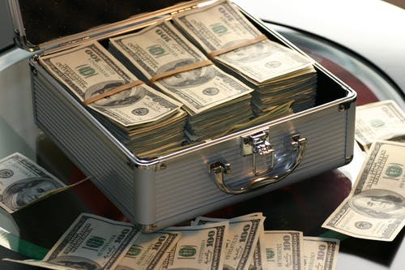
TIME
时间
Illustration: time is not deposit： In a bank deposit, say you have $86,000. Once the day is finished you have $0 balance of the unused money. That is what we do with time.

Slide 3
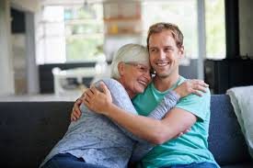
Spend time with your family
花宝贵的时间在家人身上
Illustration:
A man talks about his date with his
mom after 21 years of marriage
Cannot Retrieve lost time
时光不能倒流

Slide 4
We have needs and worries
我们有需要和解决困难
"Therefore do not be anxious, saying 'what shall we eat? Or what shall we drink? Or what shall we wear?" vs. 31
“所以，不要忧虑说：吃什么？喝什么？穿什么？”三十一节

Slide 5
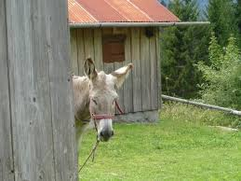
Illustration of a Donkey:
How a Donkey Got Out of the Well
BY SHAKING OFF THE DIRT!
1. FORGIVE 饶恕 （Shake Off）
2. FREE YOUR MIND 忧虑还没有
发生的事
3. APPRECIATE What You Have
By Living Simply谢谢神你现在
有的，过个简单的生活
4. GIVE MORE 多多的给，大方的
给出去

Slide 6
GOD KNOWS OUR NEEDS
神知道你的需要
"FOR THE GENTILES SEEK AFTER ALL THESE THINGS, AND YOUR HEAVENLY FATHER KNOWS THAT YOU NEED THEM ALL." 32
“这都是外邦人所求的，你们需用的这一切东西，你们的天父是知道的。”32

Slide 7
Love My Garbage Man
我爱我捡拉稀工作的男人

Slide 8
"I DON'T THINK THE JOB MAKES THE MAN, I BELIEVE THE MAN MAKES THE JOB! 不是工作影响成了男人，是男人影响成了工作"
"IF A MAN IS CALLED TO BE A STREET SWEEPER, HE SHOULD SWEEP THE STREETS EVEN AS MICHELANGELO米开朗琪罗 PAINTED OR BEETHOVEN贝多芬 COMPOSED MUSIC OR SHAKESPEARE 莎士比亚 WROTE POETRY. HE SHOULD SWEAP THE STREETS SO WELL THAT ALL THE HOSTS OF HEAVEN AND EARTH WILL PAUSE TO SAY, 'HERE LIVED A GREAT STREET SWEEPER WHO DID HIS JOB WELL.'”
MARTIN LUTHER KING马丁路德

Slide 9
GIVE GOD YOUR TIME FIRST
⌚️⌚️先把时间给神
"SEEK FIRST THE KINGDOM OF GOD AND HIS RIGHTEOUSNESS, AND ALL THESE THINGS WILL BE ADDED TO YOU." VS. 33
“你们要先求他的国和他的义，这些东西都要加给你们了。”33

Slide 10




Slide 11
A TIME FOR EVERYTHING
ECCLESIASTES 3:2-8
A TIME TO EMBRACE AND A TIME TO TURN AWAY
A TIME TO KEEP AND A TIME TO THROW AWAY
A TIME TO TEAR AND A TIME TO MEND
A TIME TO BE QUIET AND A TIME TO SPEAK
A TIME TO LOVE AND A TIME TO HATE
A TIME FOR WAR AND A TIME FOR PEACE
A TIME FOR GOD IN EVERYTHING!
A TIME TO BE BORN AND A TIME TO DIE
A TIME TO PLANT AND A TIME TO HARVEST
A TIME TO KILL AND A TIME TO HEAL
A TIME TO TEAR DOWN AND A TIME TO BUILD UP
A TIME TO CRY AND A TIME TO LAUGH
A TIME TO GRIEVE AND A TIME TO DANCE
A TIME TO SCATTER STONES AND A TIME TO GATHER STONES

Slide 12
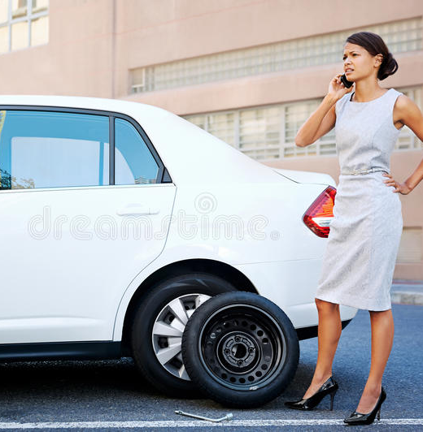
PAY FORWARD
让爱传出去
"WHAT GOES AROUND COMES AROUND"

