Slide 1
COMPETION OR COMPROMISE 竞争还是互让解决
EPHESIANS 5:20-21
以弗所书五章二十-二十一节

Slide 2
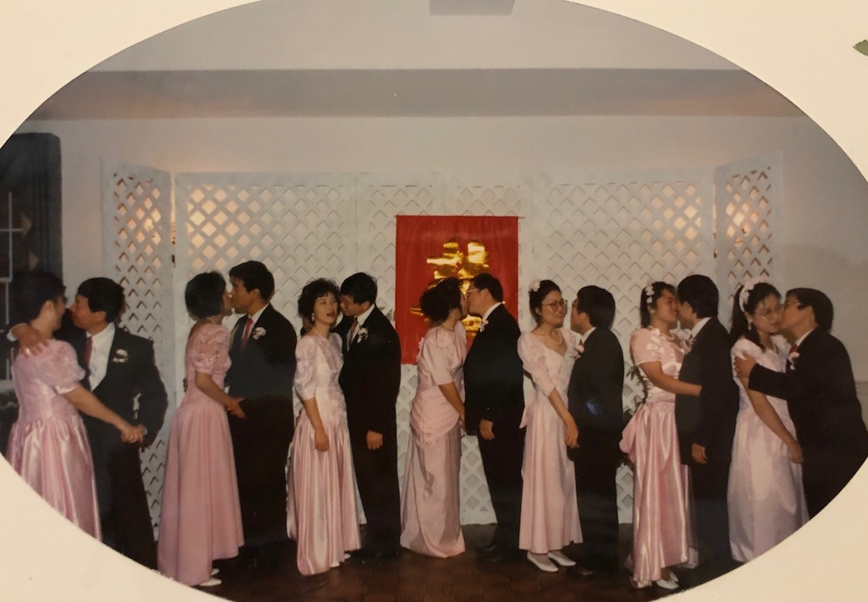
Notes:
孟慧红/史亮；郭全林/郝兰峰；武玉平/张春山；杨志平/漆红；赵炎芳/周伟庆；郑远新/王代；魏秋明/龚俊辉 队夫妻在 11/26/1995年般的更新婚礼进入殿堂！

Slide 3
Subjects
PERSONALITY TEST个性
COMMUNICATION沟通
CONFLICT RESOLUTION解决冲突
PARENTING家养儿女
RENEWAL WEDDINGS AND VOWS
更新婚礼

Slide 4
MARRIAGE RENEWAL WORKSHOPS
Date: September 2, 9, 16, 23, 30
October 7, 21, 28
November 11, 18
Time: Workshops 9:30am-10:45am
Lectures 11am-12:30pm
Lunch Provided
Place: Forest Hills Baptist Church Chapel
Topics: Communication, Personality Conflict,
Rearing Children, In-laws, Budgeting
Renewal Wedding Ceremony
Children welcome to our regular Sunday schools and nurseries

Slide 5
COMPETITION OR COMPROMISE 竞争还是互让解决
Why competition? It is human nature 人的本性就是要竞争。有了竞争才会上进。
Illustration: Sensei and the judo boy "Biggest weakness can be the biggest strength"

Slide 6
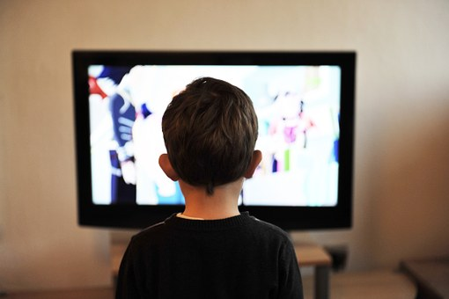
COMPETITION OR COMPROMISE 竞争还是互让解决
Compromise the best way to go 要互让解决是要努力的，不是人的本性。
Illustration: be a tv
Notes:
﻿God Make Me A TV Students at an elementary school were asked to write an essay about what they would like God to do for them. At the end of the day, while grading the essays, a teacher read one that made her very emotional. Her husband, who had just walked in, saw her crying and asked her "What happened?" She answered "Read this. It is one of my school's students' essays.": "Oh God, tonight I ask you something very special. Make me into a television set. I want to take its place and live like the TV in my house. Have my own special place, and have my family around me. To be taken seriously when I talk. I want to be the center of attention and be heard without interruptions or questions. I want to receive the same special care as the TV set Liraz, Meir. Top 100 Motivational Stories: The Best Inspirational Short Stories And Anecdotes Of All Time (pp. 8-9). BizMove.com. Kindle Edition.

Slide 7
COMPETITION OR COMPROMISE 竞争还是互让解决
Ephesians 5:20 " Giving Thanks always and for everything to god the father in the name of our lord jesus Christ."
“凡事要奉我们主耶稣基督的名常常感谢父神。”

Slide 8
COMPETITION OR COMPROMISE 竞争还是互让解决
Ehpesians 5:21 "Submitting to One another out of reverence for Christ."
“又当存敬畏基督的心，彼此顺服。”

Slide 9
COMPETITION OR COMPROMISE 竞争还是互让解决
Illustration: old couple's problem-look at self before blaming your spouse
Have you done your best and give your all to your marriage and family?
Do you truly believe god is love, therefore we love?

