Slide 1
COMPARISON OR CONTENTMENT 相比论还是知足论
PHILIPPIANS 4:10-13
腓立比书四章十到十三节

Slide 2
WHAT IS COMPARISON? 相比的定义
1. NOT SATISFIED WITH WHAT YOU HAVE对自己现有的不满足
2. PARALLEL THE POSITION想要和别人一样

Slide 3
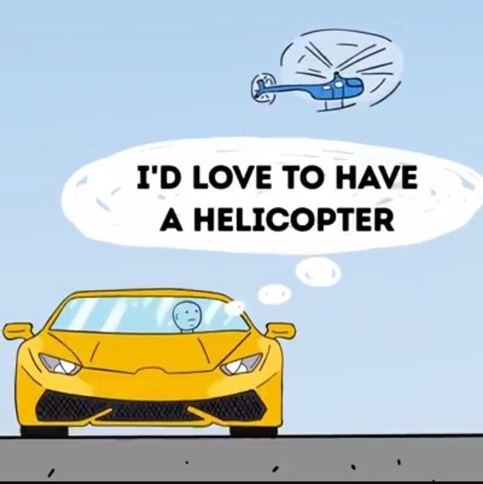
Driver A
开车A是个
跑车：“我
希望也有个
直升飞机”

Slide 4
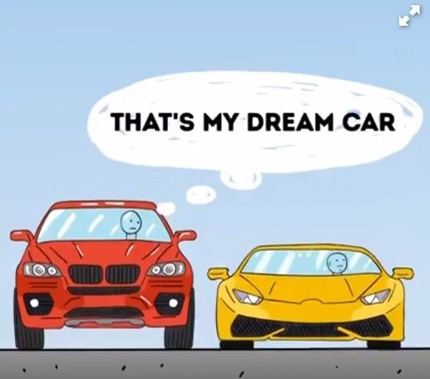
Driver B
开车B是个
四轮SUV：
“那是我的
梦想车”

Slide 5
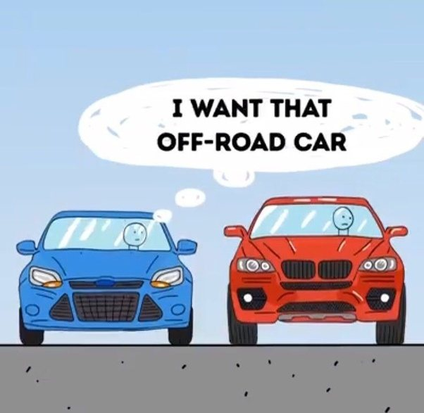
Driver C
开车C是个
新车：
“我要那个四轮
车可以跑土路”

Slide 6
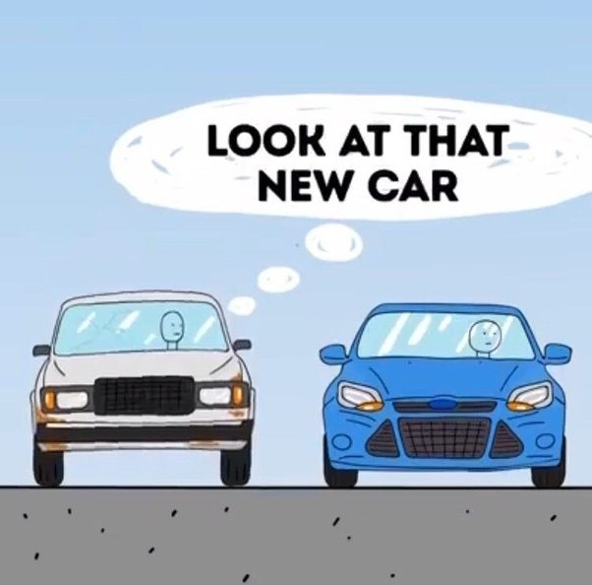
Driver D
开车D旧车：
“好美的新车！”

Slide 7
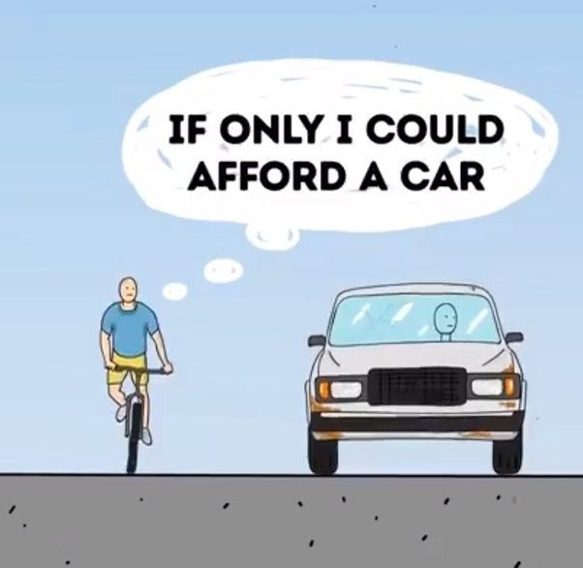
Bicyclist
骑自行车的:
“真希望我可以
买一部车”

Slide 8
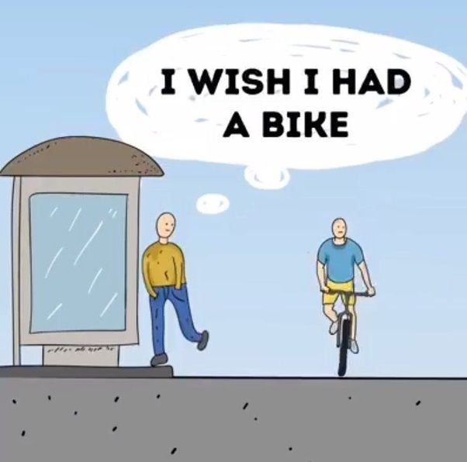
Pedestrian
走路的人:
“我希望我有
一个自行车”

Slide 9
Handicapped
Person 残废的人:
“他真好，可以自
由的想去那里
就去那里”

Slide 10
Philippians 4:11 腓立比书四章十一节
"NOT THAT I AM SPEAKING OF BEING IN NEED, FOR I HAVE LEARNED IN WHATEVER SITUATION I AM TO BE CONTENT."
“我并不是因缺乏说这话，我无论在什么景况都可以知足，这是我已经学会了。”

Slide 11
Philippians 4:12 腓立比书四章十二节
"I KNOW HOW TO BE BROUGHT LOW, AND I KNOW HOW TO ABOUND. IN ANY AND EVERY CIRCUMSTANCE, I HAVE LEARNED THE SECRET OF FACING PLENTY AND HUNGER, ABUNDANCE AND NEED."

Slide 12
Philippians 4:12 腓立比书四章十二节
“我知道怎样处卑贱，也知道怎样处丰富，或饱足，或饥饿，或有余，或缺乏，随事随在，我都得了秘诀。”

Slide 13
Philippians 4:13 腓立比书四章十三节
“i can do all things through him who strengthens me."
“我靠着那加给我力量的，凡事都能作。”

Slide 14
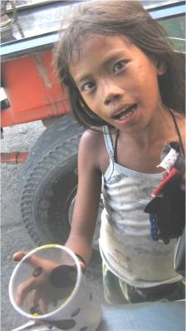
The happiest of people don't
necessarily have the best
of everything; they just make
the most of everything that
comes along their way.
The brightest future
will always be based on a
forgotten past, you can't go on
well in life until you let go of
your past failures and heartaches.
Notes:
He explained that it was through one incident that he saw in India that happened a few years ago when he was really feeling low and touring India after a major setback. He said that right in front of his very eyes he saw an Indian mother chop off her child's right hand with a chopper. The helplessness in the mother's eyes, the scream of pain from the innocent 4-year-old child haunted him until today. Why？ To have sympathy from others while this child beg. So, he with all the money he had bought those begging kids food and clothing. He realized he had so much and not look at the past, but the future with hope.

Slide 15
SECRET TO CONTENTMENT 知足的秘诀
"Contentment is not the fulfillment of what you want, it is the realization of how much you already have."
知足不是满足你想要的，而是真知道你已经有的是什么

Slide 16
SECRET TO CONTENTMENT 知足的秘诀
Illustration: A Farmer's Comparison or contentment to 99 Club “The 99 Club is a name given to those people who have enough to be happy but are never content, because they’re always yearning and striving for that extra
Notes:
He continued, “The 99 Club is a name given to those people who have enough to be happy but are never content, because they’re always yearning and striving for that extra

Slide 17
SECRET TO CONTENTMENT 知足的秘诀
“whatever is honorable, just, pure, lovely, commendable, excellence, worthy of praise."8
“凡是真实的，可敬的，公义的，清洁的，可爱的，美名的，什么德行，什么称赞，都要思念。”腓立比书4章8节

Slide 18
Notes:
Illustration of a unhappy farmer. Too big a land, lots of trees to trim, pond full of fish but worried about too much, had a house but wanted some change because it is an older house, therefore he asked an agent to sell his house and land. Agent asked what kind of house you want? "a ranch and with a nice lake where if I want to go fishing I can. A land with freedom and if I wanted to have some animals, my neighbor will not complain." So the realtor put in an ad as he described. The farmer saw it and said hey that is exactly what I want, looked at the agent and found out it was his home and land. He immediately called the agent to stop the ad and sale.

Slide 21
COMMUNION 摆饼纪念
GIVE THANKS TO WHAT YOU HAVE- JESUS!
“凡是真实的，可敬的，公义的，清洁的，可爱的，美名的，什么德行，什么称赞，都要思念。”
不要和人相比，要知足！
COUNT YOUR BLESSINGS数算神给你的恩典!

