Slide 1
BE DILIGENT 要殷勤
II PETER 1:3-11
彼得后书一章三到十一节

Slide 2
LOVE众人
BROTHERLY爱弟兄
GODLINESS虔敬
STEADFAST忍耐
SELF- CONTROL节制
KNOWLEDGE知识
VIRTUE德行
FAITH信心

Slide 3
FAITH ADDS ON VIRTUE 信心加上德行
WHAT IS VIRTUE德行?
Seven Virtues in the Bible are: 1. Chastity贞洁（古来用贞洁带） 2. Temperance戒酒 3. Charity善行 4 Diligence勤劳 5. Patience忍耐 6. Kindness仁慈 7. Humility/Humble谦卑， 谦柔

Slide 4
FAITH ADDS ON KNOWLEDGE 信心加上知识
WHAT IS KNOWLEDGE知识?
Illustration: We need the knowledge to discern分别 if it is from God or the Evil One? To not be so naive Christian. (Lots of deceivers in today's age such as the One for Business)

Slide 5
FAITH ADDS ON SELF-CONTROL 信心加上节制
WHAT IS SELF-CONTROL节制? Defined as: the ability to control self or the expression of them in ones' behavior in difficult situations.
Self-control plays a major role in your emotional happiness. It can solve Trust issue in a relationship.

Slide 6
FAITH ADDS ON STEADFASTNESS 信心加上忍耐
WHAT IS STEADFASTNESS忍耐?
Loyal, faithful, committed, dependable, reliable, uncompromising
In the Bible: immovable, not subject to change
God's steadfast love (We can depend on God)

Slide 7
FAITH ADDS ON GODLINESS 信心加上虔敬
WHAT IS GODLINESS虔敬?
Godliness is comforming to the laws and wishes of God; pious
Holiness is sacred, set apart "Make every effort to live in peace with everyone and to be holy, without holiness no one will see the Lord." Hebrews 12:14

Slide 8
FAITH ADDS ON BROTHERLY LOVE 信心加上爱弟兄的心
WHAT IS BROTHERLY LOVE爱弟兄?
Greek: Philia the same as John 13:34-35 "Love your Neighbor" which is the second greatest commandment
Affection (a connection)

Slide 9
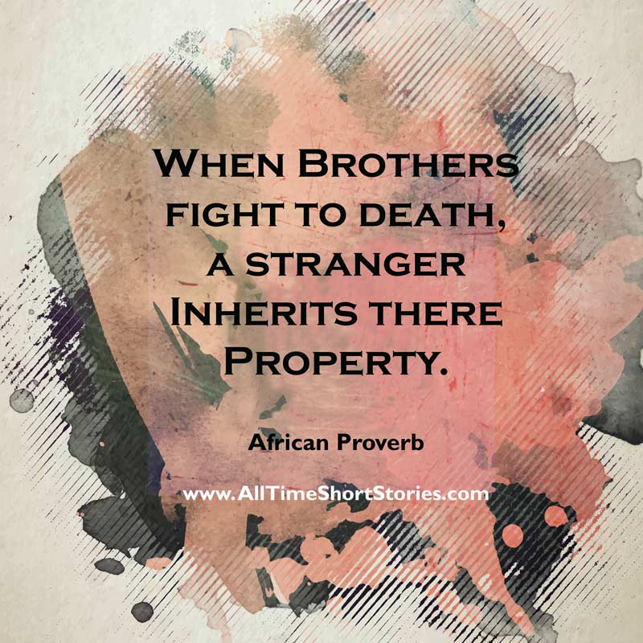
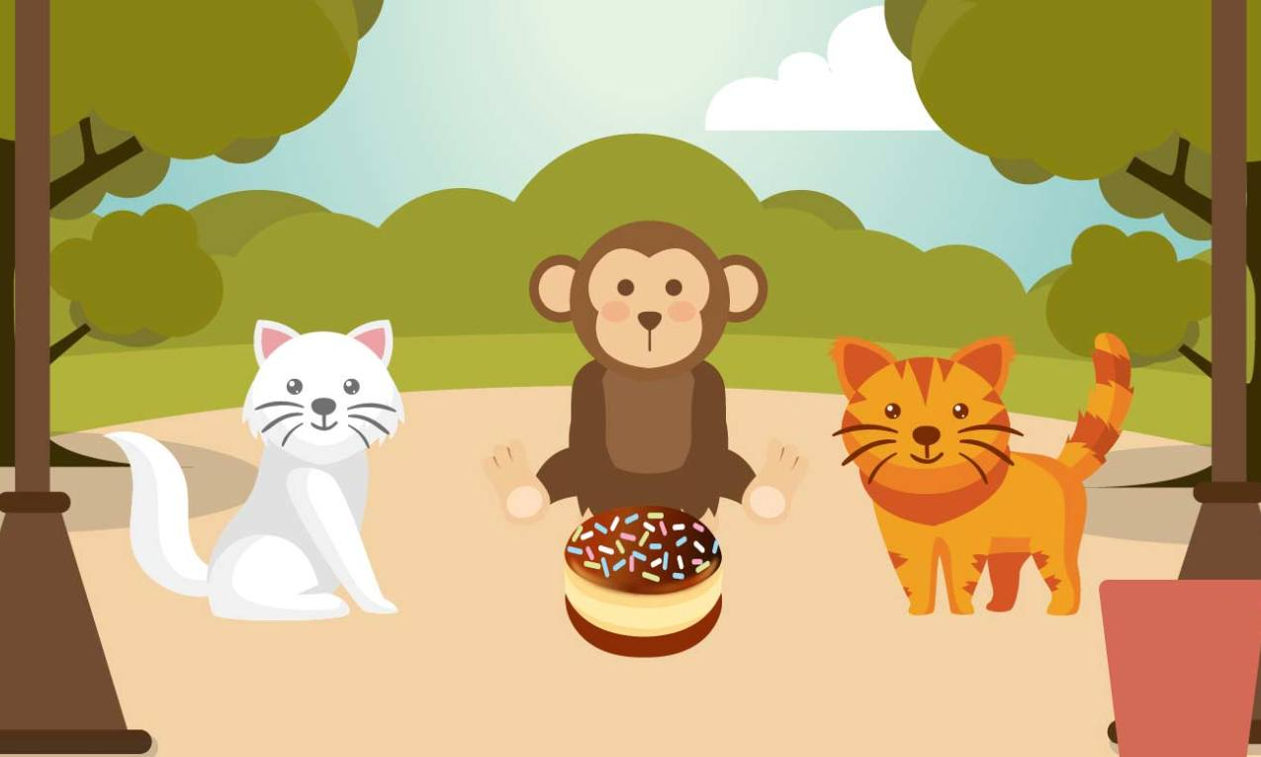
Illustration
Two cats
And a Monkey
Notes:
Two cats fight to eat a nice and beautiful cake. Along came a monkey who saw their fights and said, it is easy, let me help. He divided the cake into two parts, the cats were not happy because one piece was bigger than the other. So the monkey ate another bite and so on until the cake is gone! Always settle your arguments before sun down, so that there is no regret. If let others settle for you, it will end up bad. Only God can intercede and he is fair!

Slide 10
FAITH ADDS ON LOVE FOR ALL 信心加上爱众人的心
WHAT IS LOVE FOR EVERYONE爱众人?
God is Love: Agape love-the kind of sacrificial love that Christ had for us!

Slide 11
Notes:
Young man's heart compared to an Old man's heart scarred and ugly. Why, because he took part of his heart and gave one who needed. As Christ gave us His life, according to Isaiah 53, he was not good to look at, yet He died for us because of Love.

Slide 12
Isaiah 53:2 以赛亚书五十三章二节
"For He grew up before Him like a young plant, and like a root out of dry ground; He had no form or majesty that we should look at Him, and No beauty that we should desire him."
“他在耶和华面前生长如嫩芽，像根出于干地。他无佳形美容，我们看见他的时候，也无美貌使我们羡慕他。”

Slide 13
James 4:12 雅各书四章十二节
"Therefore, to One who knows the right thing知道对的事 to do and does not do it, to him it is SIN." NASB
"THEREFORE, TO HIM WHO KNOWS TO DO GOOD 作好事的AND DOES NOT DO IT, TO HIM IT IS SIN." NKJV
"Remember, it is SIN to know what you ought 因该做的to do and then not do it." NLT
可以分别什么是好坏； 知道要作好事；每一天因该作的

Slide 14
LOVE众人
BROTHERLY爱弟兄
GODLINESS虔敬
STEADFAST忍耐
SELF- CONTROL节制
KNOWLEDGE知识
VIRTUE德行
要加上信心
要殷勤！
你愿意吗？
FAITH信心

