Slide 1
TIME MANAGEMENT
时间管理
EPHESIANS 5:15-17
以弗所书五章十五-十七节

Slide 2
KAIROS AND CHRONOS
古希腊文的时间
KAIROS (used 86 times in the New Testament) means " the time when God acts (e.g. Mark 1:15:日期满了 the kairos is fulfilled and 神的国近了). "Kairos" ^{[17]} a "moment" or a "season" "harvest time."
CHRONOS (used 54 times in the NT)^{[19]} refers to a specific amount of time, such as a day or an hour 一个钟头，一天， 40年 (e.g. Acts 13:18 and 27:9).

Slide 3
WALK CAREFULLY
谨慎行事
15 NOT AS UNWISE, BUT AS WISE "So be careful how you live. Don't live like fools, but like those who are wise." “你们要谨慎行事，不要像愚昧人，当像智慧人。”

Slide 4
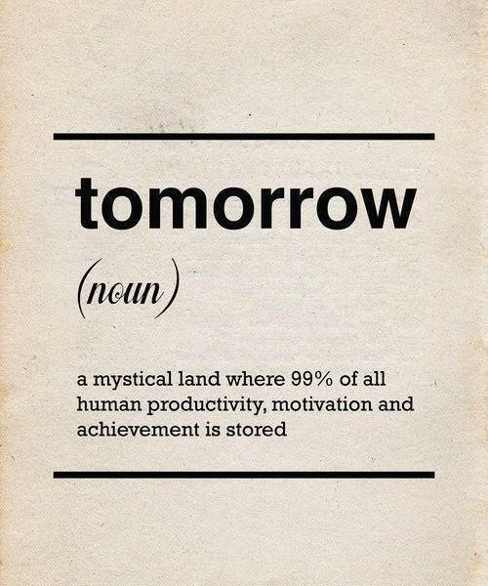


Slide 5
TIME IN GOD'S HANDS
时间在神的手里
James 4:13-15
"Come now, you who say, 'Today or tomorrow we will go into such and such a town and spend a year there and trade and make a profit,' yet you do not know what tomorrow will bring. What is your life? For you are a mist that appears for a little time and then vanishes. Instead you ought to say, 'if the Lord wills, we will live and do this or that.'"

Slide 6
TIME IN GOD'S HANDS
时间在神的手里
雅各书4:13-15
“瞎！你们有话说：“今天，明天，我们要往某城里去，在那里住一年，作买卖得利。”其实明天如何，你们还不知道。你们的生命是什么呢？你们原来是一片云雾，出现少时就不见了。你们只当说：“主若愿意，我们就可以活着，也可以作这事，或作那事。”

Slide 7
DO NOT BE LAZY
不要懒惰
16 "Making the best use of the time, because the Days are Evil" “要爱惜光明，因为现今的世代邪恶。”

Slide 8
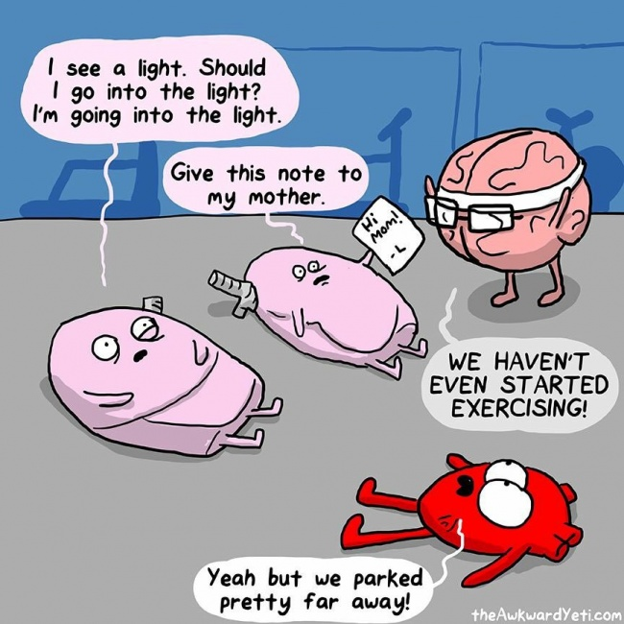
Laziness
Can be
Catching
与偷懒的人
在一起会
感染懒惰

Slide 9
TAKE ADVANTAGE OF TIME
好好用时间
John 9:4 “We must work the works of Him who sent me while it is day, night is coming, when no one can work."
约翰福音9:4“趁着白日，我们必须作那差我来者的工；黑夜将到，就没有人能作工了。”

Slide 10
DON'T ACT THOUGHTLESS
不要糊涂
17 "Therefore do not be foolish, but understand what the will of the Lord is." “不要作糊涂人，要明白主的旨意如何。”

Slide 11
DILIGENT WITH YOUR TIME
神许可的筹划时间
Proverbs 21:5 "The plans of the diligent lead surely to abundance, but everyone who is hasty comes only to poverty.”
箴言21:5“殷勤筹划的，足致丰裕；行事急躁的，都必缺乏。”
早起；不要懒惰；作聪明人；改坏习惯！

Slide 12
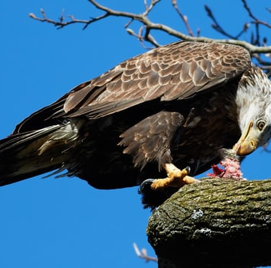
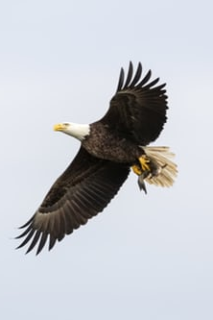
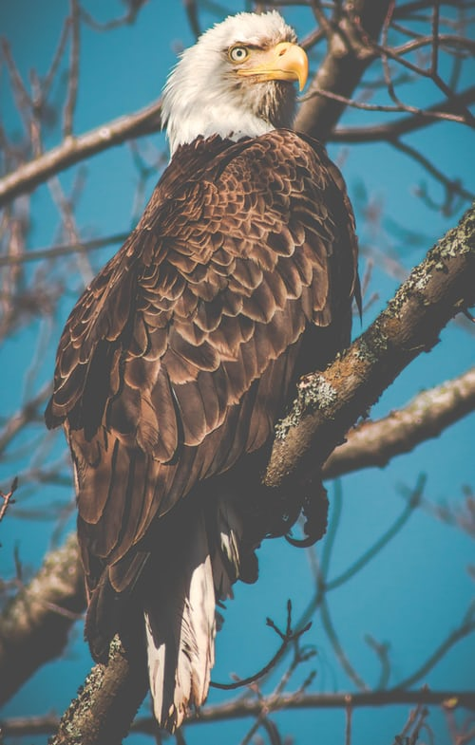
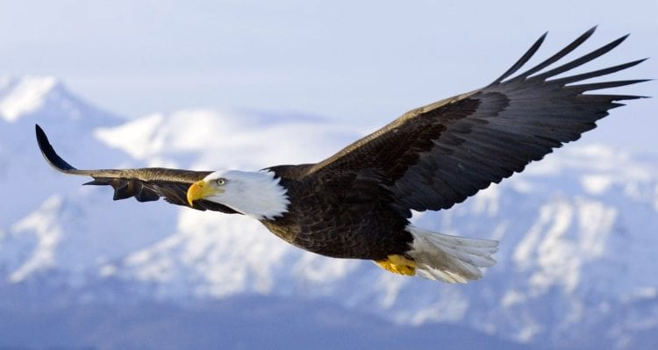

Notes:
Change is Hard! Illustration of the baldhead eagle, the American symbol bird. Eagles can have a lifespan of 70 years. The first 40 depends on the food, environment, and genes of the eagle. Bald Eagle, US National Emblem. The bald eagle was chosen June 20, 1782 as the emblem of the United States of America, because of its long life, great strength and majestic looks, and also because it was then believed to exist only on this continent. Forty years ago, our national symbol was in danger of extinction throughout most of its range. Habitat destruction and degradation, illegal shooting, and the contamination of its food source, largely as a consequence of DDT, decimated the eaglepopulation.

