Slide 1
JEHOVAH'S BLESSINGS 耶和华的祝福
NUMBERS 6:24-26
民数记六章二十四-二十六

Slide 2
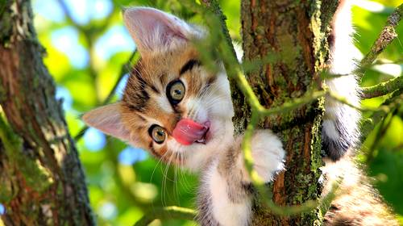
Notes:
Kitten from Heaven. A pastor tried to get his kitten down from the tree. The Kitten just refused, so the pastor tied a rope at the branch and tied the other end to the car. He thought if he could just bend the branch a little, he can get to the kitten. But as he tried sever times to get the branch lower, it snapped and out flew the kitten. He searched everywhere, but couldn't find it. Few days later, he was at the grocery and saw one of his members shopping for cat food. He asked, "didn't you say you hate kittens and never would get one?" "Yes, the lady said, my young daughter wanted a kitten so badly and pestered me everyday. Finally I said, if a kitten falls from heaven, God send, then we can get one. Well, what do you know, Three days ago, that is exactly what happened. One came from heaven and landed right in front of my daughter." Well, what can the pastor say? God blesses in a strange way!

Slide 3
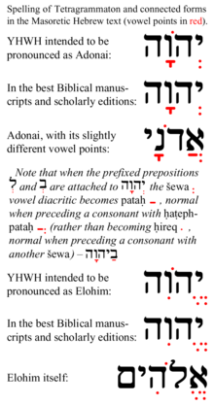
JEHOVAH 耶和华
Latin 拉丁文for
Hebrew希伯来文
YHWH (子音）子音
不能发音，所以加上
母音就变成YAWEH

Slide 4
WHO IS JEHOVAH? 耶和华是谁？
Hebrew (Strong's #3068) YEHOVAH יְהֹוָה |  |  | Hebrew (Strong's #136) ADONAY אֲדֹנָי
י | Yod | Y | א | Aleph | glottal stop
ְ | Simple sheva | E | ֲ | Hataf patah | A
ה | He | H | ד | Dalet | D
ֹ | Holam | O | ֹ | Holam | O
ו | Vav | V | נ | Nun | N
ָ | Qamats | A | ָ | Qamats | A
ה | He | H | י | Yod | Y

Slide 5
BLESSINGS 祝福
Blessings OT 400 times (87 is God to the people)旧约里头400多次
Priestly Blessing: Aaron and his descendants today used by Pastors. 亚伦和他的后代给以色列百姓的祝福。 现在牧师们给会众的祝福

Slide 6
HOW DOES JEHOVAH BLESS US? 耶和华如何祝福我们？
I. PROTECTION VS 24
神的机会就是保护他的儿女，越亲近神越了解神的保护
Illustration: Things are not always what they seem!
Notes:
GOD’S PROTECTION IN DIFFERENT WAYS
Two traveling angels stopped to spend the night in the home of a wealthy family. The family was rude and refused to let the angels stay in the mansion's guest room. Instead, the angels were given a small space in the cold basement. As they made their bed on the hard floor, the older angel saw a hole in the wall and repaired it. When the younger angel asked why, the older angel replied, "Things aren't always what they seem."
The next night, the pair came to rest at the house of a very poor, but very hospitable farmer and his wife. After sharing what little food they had, the couple let the angels sleep in their bed where they could have a good night's rest. When the sun came up the next morning, the angels found the farmer and his wife in tears. Their only cow, whose milk had been their sole income, lay dead in the field. The younger angel was infuriated and asked the older angel, How could you have let this happen? The first man had everything, yet you helped him," she accused. "The second family had little but was willing to share everything, and you let the cow die
"Things aren't always what they seem," the older angel replied. "When we stayed in the basement of the mansion, I noticed there was gold stored in that hole in the wall. Since the owner was so obsessed with greed and unwilling to share his good fortune, I sealed the wall so he wouldn't find it." "Then last night as we slept in the farmer's bed, the angel of death came for his wife. I gave him the cow instead. Things aren't always what they seem." Sometimes, that is exactly what happens when things don't

Slide 7
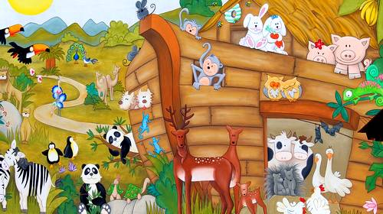

Slide 8
HOW DOES JEHOVAH BLESS US? 耶和华如何祝福我们？
II. SMILE ON YOU “愿耶和华使他的脸光照你”25
笑脸就是神很幽默，耶和华使他的光照耀着
脸代表神的能力，恩典，他与我们同在
Illustration: Creation Humor
On the Sixth Day, God created living creatures and Man
Notes:
First the Dog: 20 years, but dog cut into 10. Second Monkey: 20 years, but cut into 10 years like the dog. Third, Cow: Gave him 60 years, cut to 20 years. Then fourthly, God created Man and gave him 20 years to eat, sleep, play, marry and enjoy life. Man thought too short and wanted his 20 years +dogs 20 years+ Monkey's 20 years+ cow's 40 years equals 80 years. God said OK (Humorous God) Then, what we did for the 80 years? First 20 we eat, sleep, play and enjoy ourselves. Next 40 years that the cow gave us we slave in the sun to support our family. For the next 10 years, we do monkey tricks to entertain the grandchildren. And for the last 10 years, we sit on the front porch and bark at everyone. (Become grouchy and negative) That's how life is explained through God's creation!

Slide 9
HOW DOES JEHOVAH BLESS US? 耶和华如何祝福我们？
III. BE GRACIOUS TO YOU赐恩给你 VS 25
1. Material Things (clothes)/How many you helped?
2. Salary and job title/Compromised your character?
3. Friends/How many to whom you were a friend?
4. Neighborhood and House/How you treated them?
5. Color of your Skin/Content of your Character?
6. Salvation/Will you witness to heaven instead of hell?

Slide 10
HOW DOES JEHOVAH BLESS US? 耶和华如何祝福我们？
IV. SHOW YOU HIS FAVOR VS 26
“愿耶和华向你仰脸”愿神喜欢你 (Make His face to shine upon you."
Illustration: The Little Girl who knows God loves her, He is shining on her as the rain with the lightening

Slide 11
HOW DOES JEHOVAH BLESS US? 耶和华如何祝福我们？
V. GIVE YOU PEACE VS 26
Illustration: Perfect Peace of the King's Selection of two paintings, which is the perfect peace?
Notes:
The King's Selection: Peace

Slide 12
HOW DOES JEHOVAH BLESS US? 耶和华如何祝福我们？
"I have told you all this so that you may have 'peace' in me. Here on earth you will have many trials and sorrows. But take heart, because I have overcome the world." John 约翰福音16:33 我将这些事告诉你们，是要叫你们在我里面有平安。在世上，你们有苦难；但你们可以放心，我已经胜了世界,"约翰福音 十六章三十三节
Notes:
The King's Selection: Peace

Slide 13
HOW DOES JEHOVAH BLESS US? 耶和华如何祝福我们？
"I am leaving you with a gift-PEACE OF MIND AND HEART. And the PEACE I give is a gift the world cannot give. So don't be troubled or afraid." John 14:27
“我留下平安给你们；我将我的平安赐给你们。我所赐的，不像世人所赐的。你们心里不要忧愁，也不要胆怯。”约翰福音14:27

