Slide 1
LOOK UP, BE WHOLE!
往上看，作完全人
PSALM 19
诗篇十九篇

Slide 2
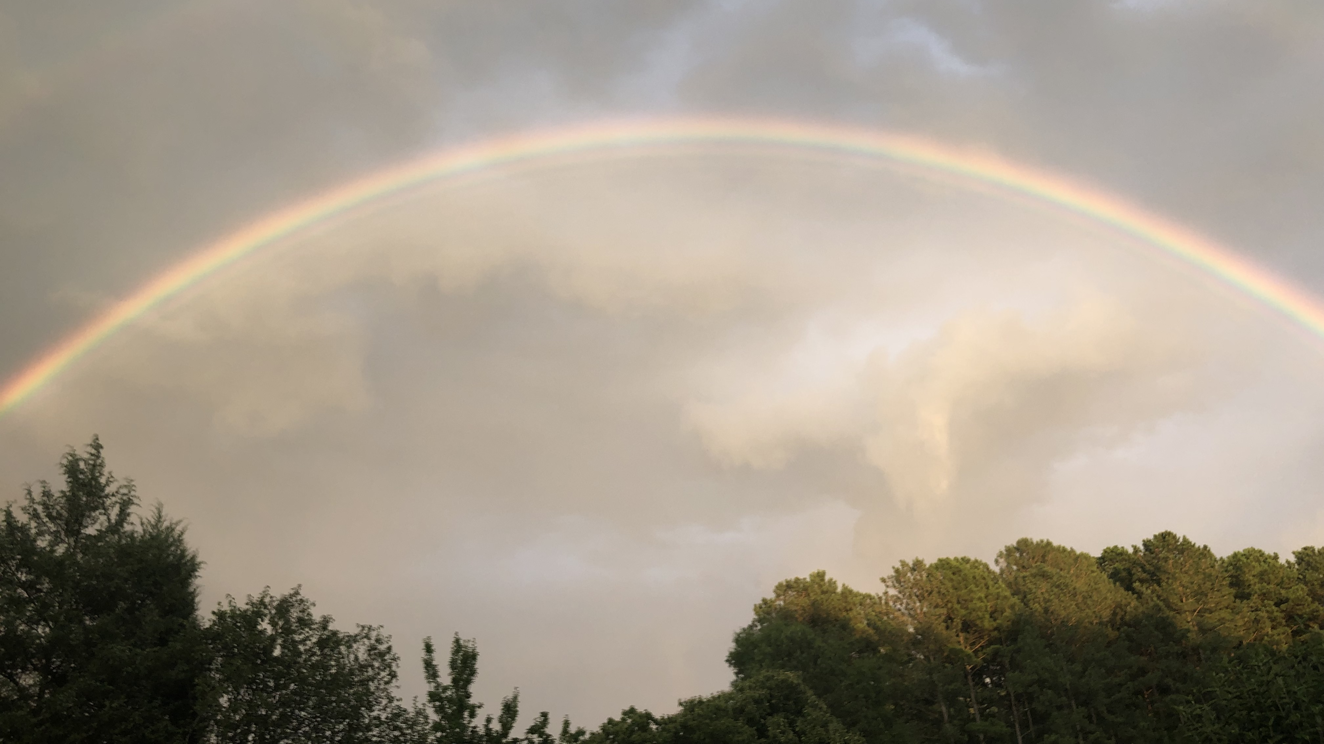
Notes:
Rainbow reflected by the rain and the sun opposite of each other.

Slide 3
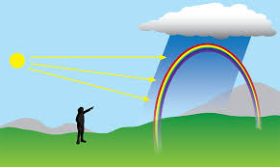

Slide 4
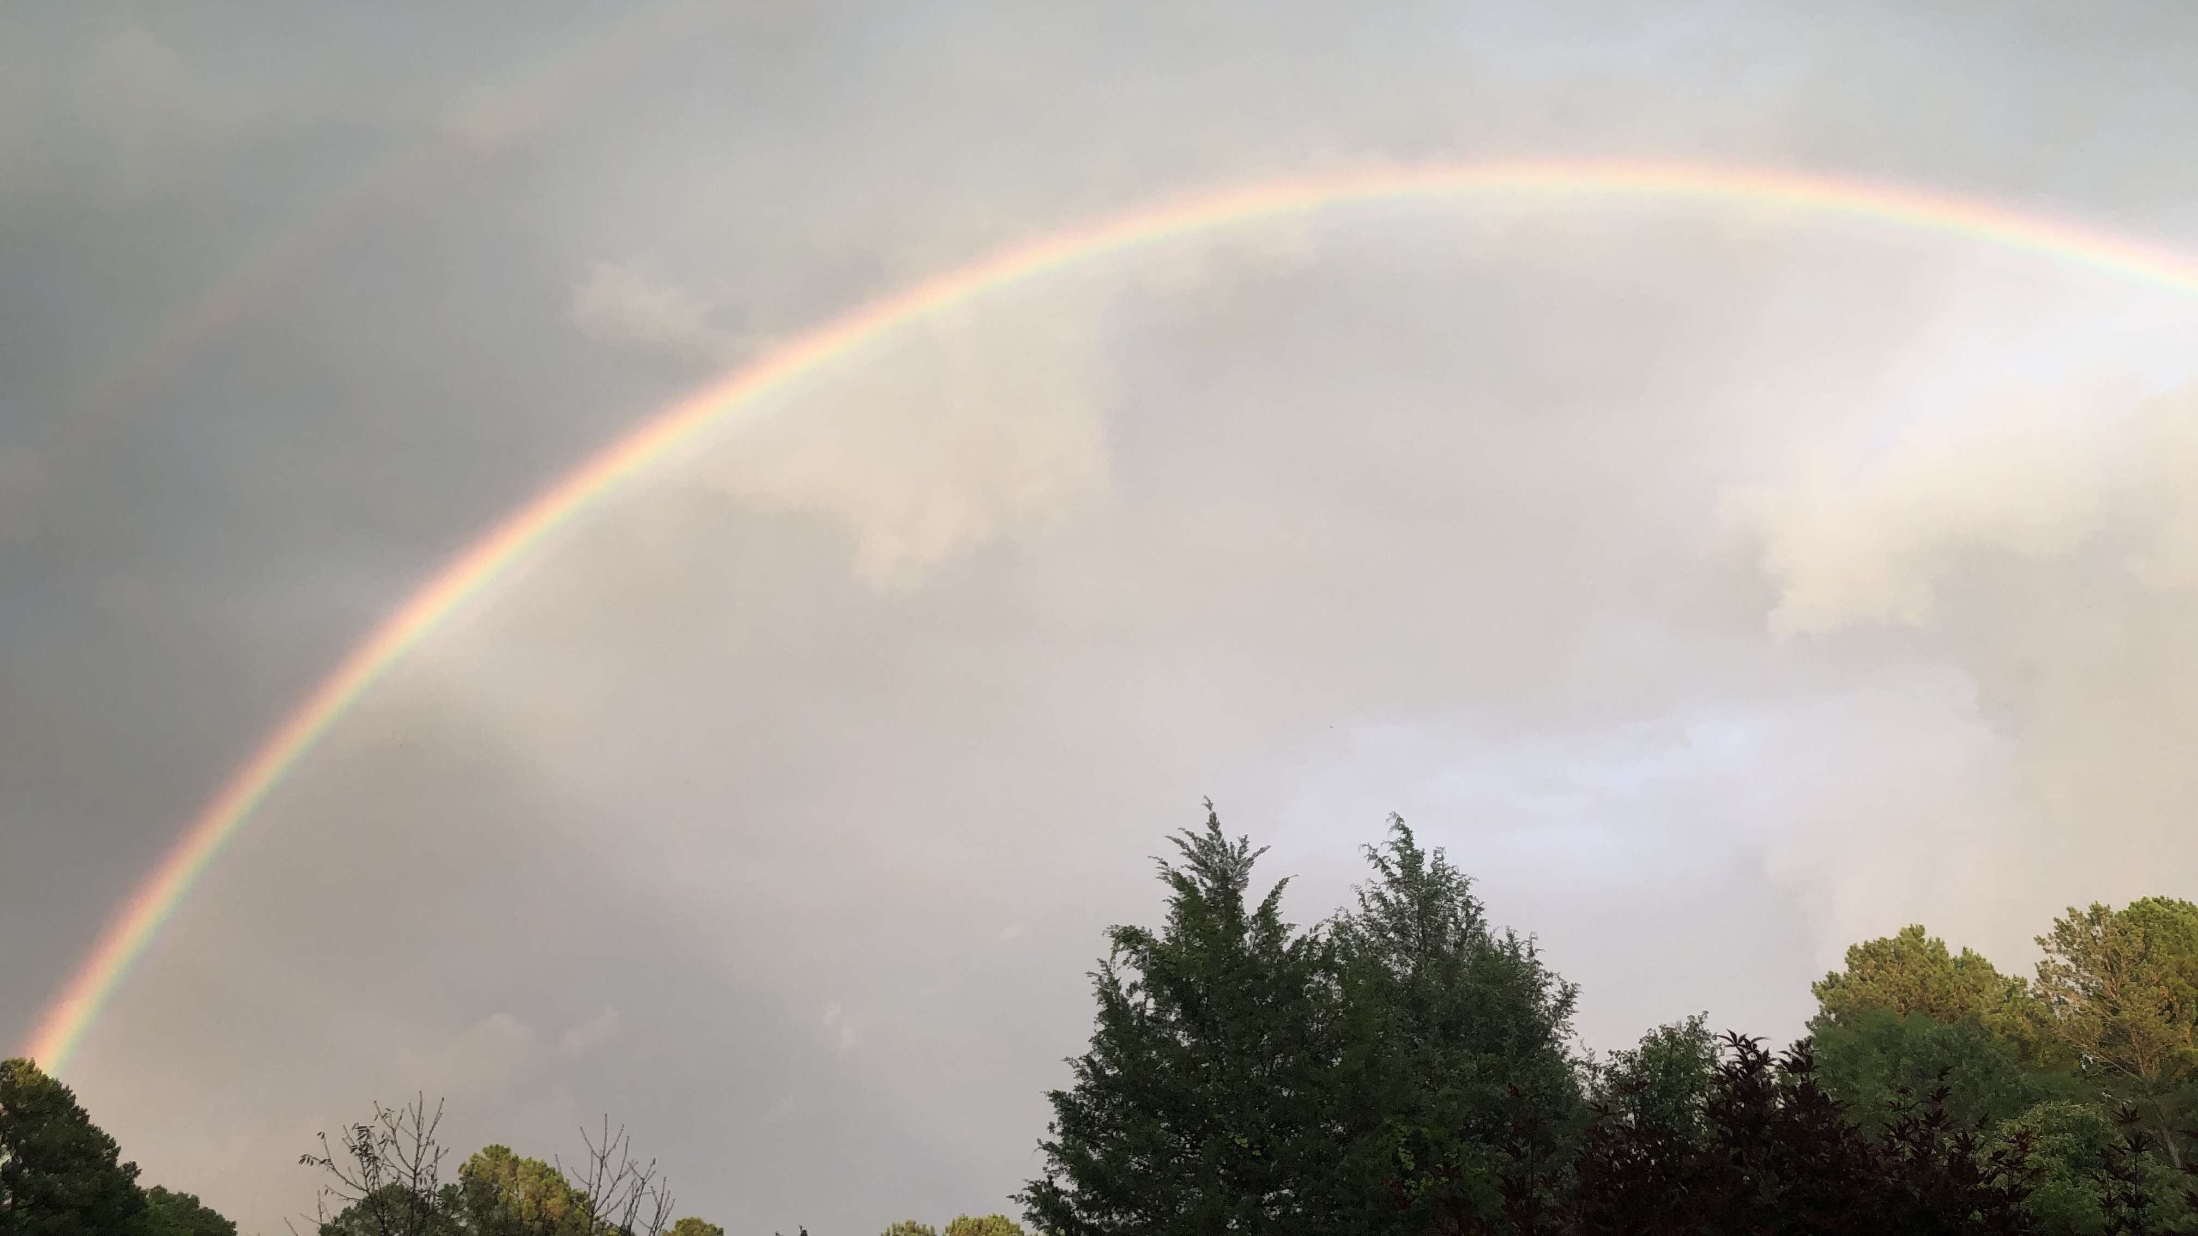
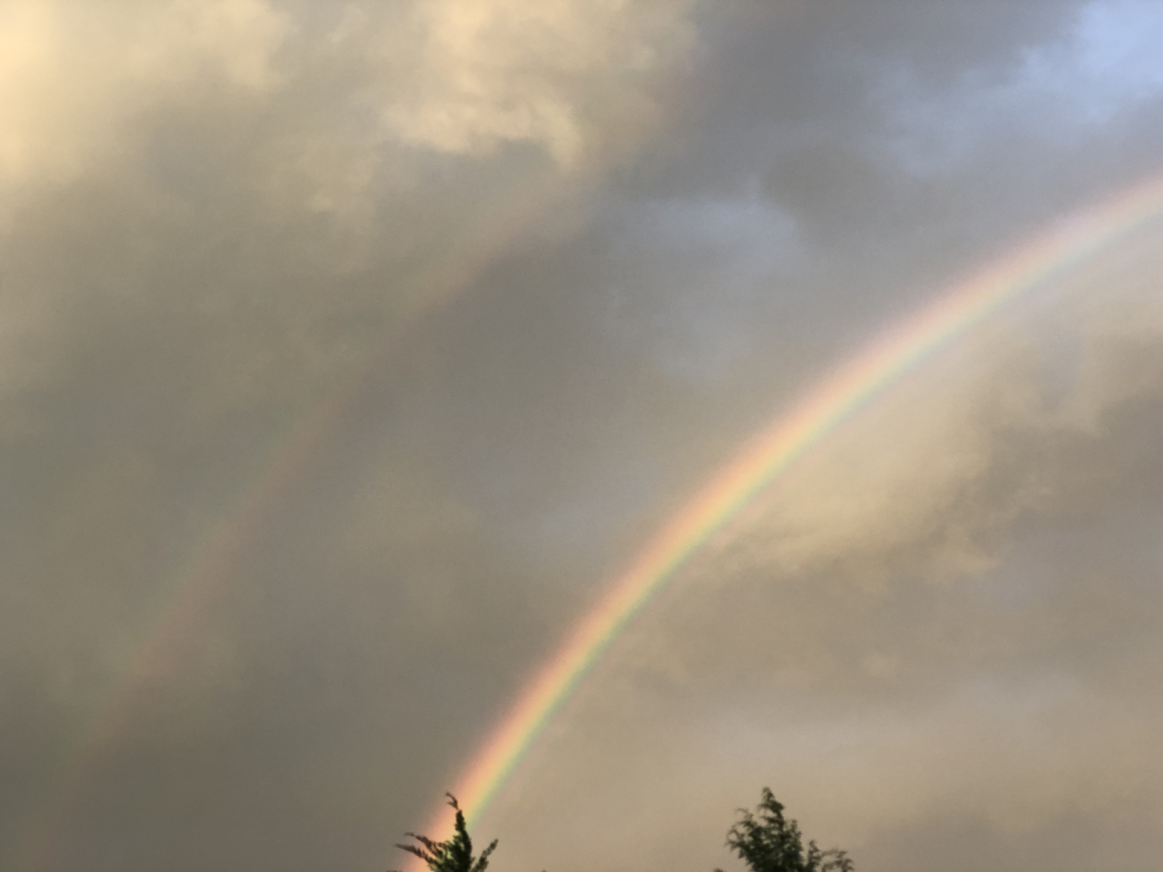
Notes:
Double Rainbow is caused by two different droplets of rain. The round ones and the fat, flat drops called burgeroids names after the shape of a humburger. The burgeroids shift light in one director and the small round ones in another, therefore produces a separate rainbow!

Slide 5
GOD'S GLORY 1-6
神的荣耀
HEAVENS AND SKY 诸天述说神的荣耀（造万物的主）
DAY AND NIGHT （这日到那日发出言语，这夜到那夜传出知识）
TENT FOR THE SUN（神的荣耀，话语，像个帐幕）
SUN LIKE A BRIDEGROOM （太阳如同新郎出洞房，又如勇士焕然奔路）
NOTHING HIDDEN FROM THE HEAT（没有一物被隐藏不得它的热气。）

Slide 6
GOD'S WORD 7-11
神的话语
LAW OF THE LORD IS PERFECT神的律法全备，能苏醒人心
PRECEPTS OF THE LORD ARE RIGHT神的训词正直
WORD IS HOLY神的命令清洁，能明亮人的眼目
RULES ARE TRUE AND RIGHTEOUS神的道真实公义
BETTER THAN GOLD, SWEETER THAN HONEY比金子可羡慕，比蜜甘甜
KEEP THE WORD HAS REWARD爱警戒就可有大赏

Slide 7
GOD'S HONOR 12-14
神的道义
FORGIVE OUR HIDDEN FAULTS 赦免隐而未现的过错
NO PRESUMPTUOUS SINS 不犯任意妄为的罪
LORD IS MY ROCK AND MY REDEEMER 耶和华是我的磐石，我的救赎主
HONOR THE LORD BY THE HEART AND THE MOUTH 愿我口中的言语，心里的意念，在你面前蒙喜悦

Slide 8
JAMES 1:19
雅各书一章十九节
"KNOW THIS, MY BELOVED BROTHERS: LET EVERY PERSON BE QUICK TO HEAR, SLOW TO SPEAK, SLOW TO ANGER."
“我亲爱的弟兄们，这是你们所知道的。但你们各人要快快地听，慢慢地说，慢慢地动怒。”

Slide 9
ECCLESIASTES 3:7B
传道书三章七节后
"A TIME TO KEEP SILENCE, AND A TIME TO SPEAK."
“静默有时，言语有时。”

Slide 10

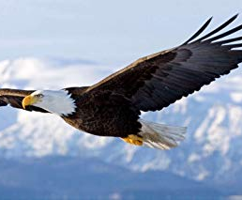
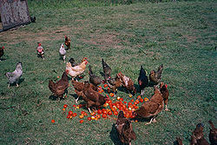
Notes:
My favorite story on how we need to act like eagles and not chicken!

Slide 11
Isaiah 40:31
以赛亚书四十章三十一节
"They who wait for the Lord shall renew their strength; they shall mount up with wings like eagles; they shall run and not be weary; they shall walk and not faint."
“但那等候耶和华的，必从新得力，他们必如鹰展翅上腾，他们奔跑却不困倦，行走却不疲乏。”

