Slide 1
WEAR NEW CLOTHES 穿上新衣
COLOSSIANS 3:12-17
歌罗西书三章12-17节

Slide 2
Illustration:
Girls Love
New Clothes

Slide 3
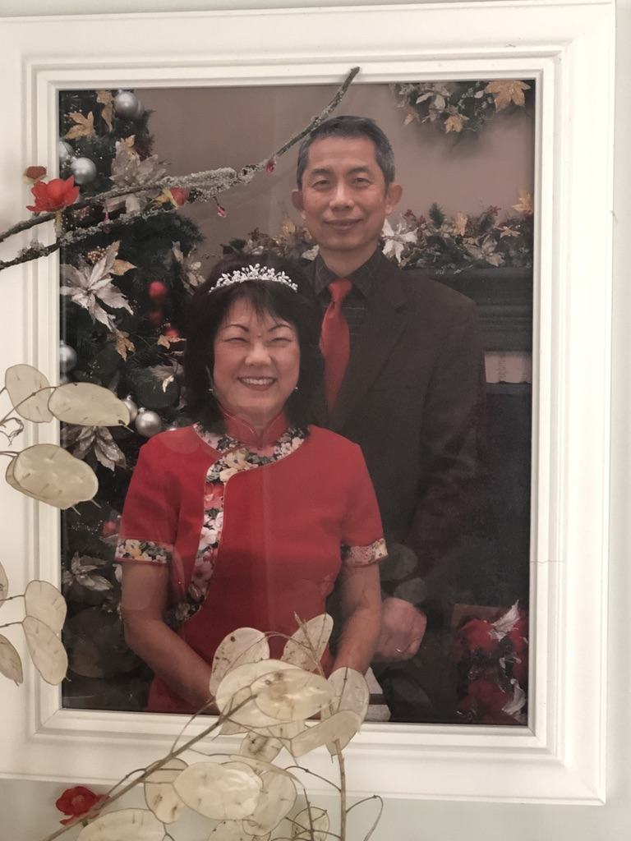
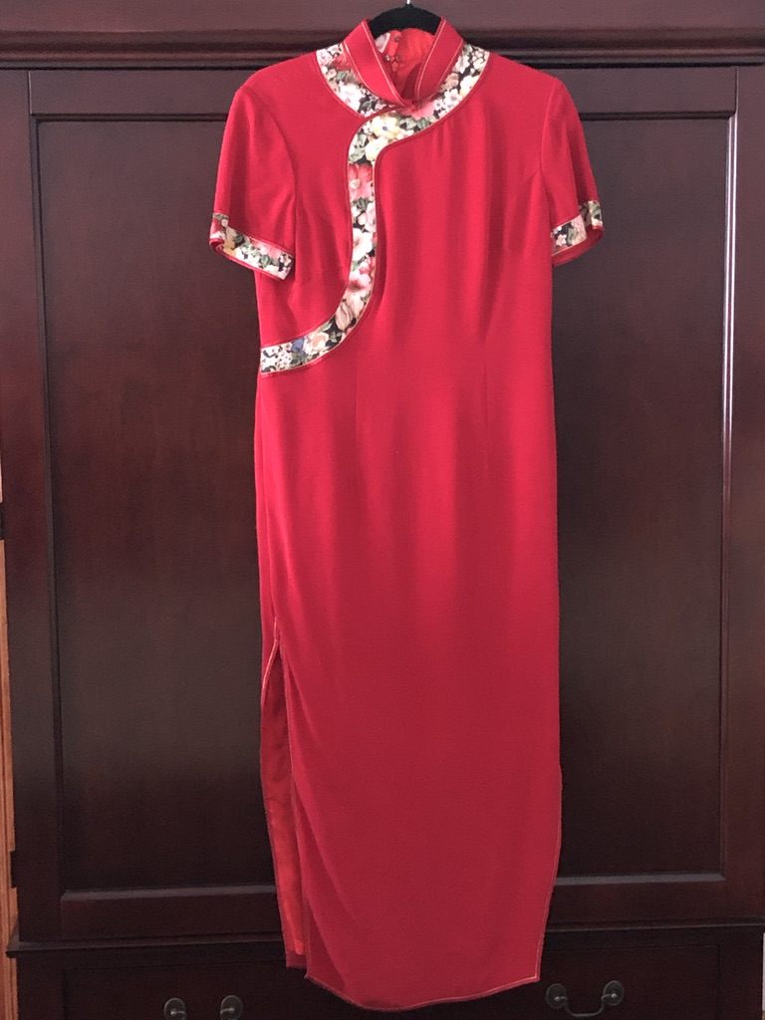

Slide 4
COMPASSIONATE HEARTS 怜悯的心
Other Translation:
Tender Mercy 柔和的怜悯(NKJV)
Bowels of Mercies 肚皮里的怜悯(KJV)
Gentle 温柔的怜悯(CEV Contempory English Version)

Slide 5
Kindness 恩慈
he quality of being friendly, generous, and considerate.
synonyms: | Warm-heartedness, tender-heartedness, goodwill, affectionateness, affection, warmth, gentleness, tenderness, concern, care

Slide 6
Humility 谦虚
I CORINTHIANS 哥林多前书6:2 "AND IF ANYONE THINKS THAT HE KNOWS ANYTHING, HE KNOWS NOTHING YET AS HE OUGHT TO KNOW. 若有人以为自己知道什么，按他所当知道的，他仍是不知道。”

Slide 7
Meekness 温柔
synonyms: | patience, gentleness, mildness, softness, peacefulness, docility, modesty, humility, humbleness, unpretentiousness, lowliness; submissiveness, Illustration: “温柔的人有福了，因为他们必承受地土。”马太5:5

Slide 8
Patience 忍耐
as the bearing of provocation, annoyance, misfortune, or pain,without complaint, loss of temper, irritation, or the like.
an ability or willingness to suppress restlessness or
annoyance when confronted with delay:
Illustration: to have patience with a slow learner (child)
quiet, steady perseverance; even tempered care;
diligence: Illustration: Older and slower husband

Slide 9
Forgiveness 彼此饶恕
“你们饶恕人的过犯，你们天父也必饶恕你们的过犯。”马太6:14
"For if you forgive others their trespasses, your heavenly Father will also forgive you." Matthew 6:14

Slide 10
Love 爱
Not the Worldly love: More physical肉体的爱
I Corinthians 哥林多前书13: 4-8 (Used in Wedding Blessing)
Agape Love of our Lord Jesus Christ 耶稣给了我们无条件的爱）

Slide 11
Everything in Jesus' name 奉主耶稣的名
The Powerful Name of Jesus 魔鬼最怕耶稣的名：使徒16:16-18 “有一个使女，她被巫鬼所咐，用法术叫她主人们大得财利。。。她一连多日这样喊叫，保罗心中厌烦，转身对那鬼说：我奉耶稣基督的名，吩咐你从她身上出来！那鬼当时就出来了。”
Everything we do or say the Father knows: However, He only hears us in Jesus' Name 天上的父听我们的祷告是因为耶稣的名，不是因为我们是基督徒多年

Slide 12
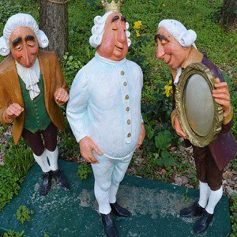

Slide 13
1. Are You a Naked Christian裸体基督徒?
2. Do You Have Foolish Pride你有骄傲?
3. Wear the Clothes God Provided穿上: Compassionate怜悯的心
Kindness 恩慈；Humility谦虚;
Meekness温柔；Patience忍耐, Forgiveness饶恕; Love 爱
Do Everything in Jesus' Name奉耶稣的名

