Slide 1
FAITH up-FEAR DOWN
信心增加-惧怕减少
I KINGS 17:8-16
列王纪上十七章八-十六节

Slide 2
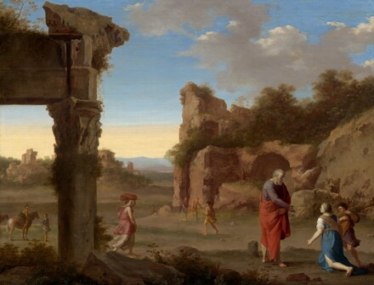
Notes:
Cornelis van Poelenburch was an important representative of the first generation of Dutch artists who drew inspiration from the landscape and culture of Italy. Painted in 1630. He is celebrated for his small-scale paintings of arcadian, biblical, or mythological subjects that featured figures in an Italianate landscape, often with Roman ruins. This work was painted in Utrecht, after the artist had spent nearly a decade in Italy, and although the landscape setting here is imaginary, the ruin on the left is based on the Temple of Castor and Pollux in the Roman Forum, built in 495 BC.

Slide 3


Slide 4
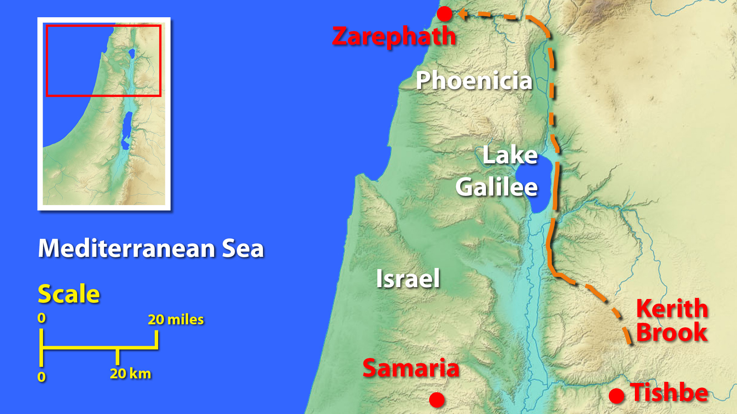
撒勒法
撒玛利亚

Slide 5
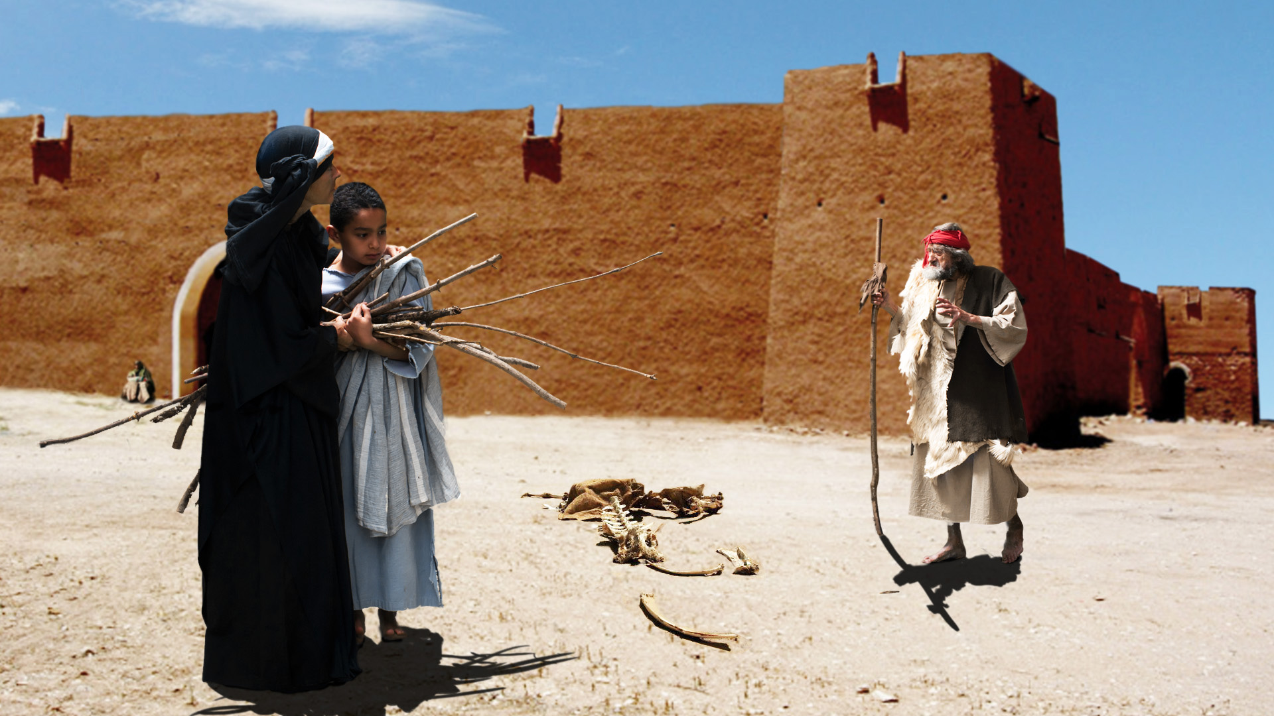

Slide 6
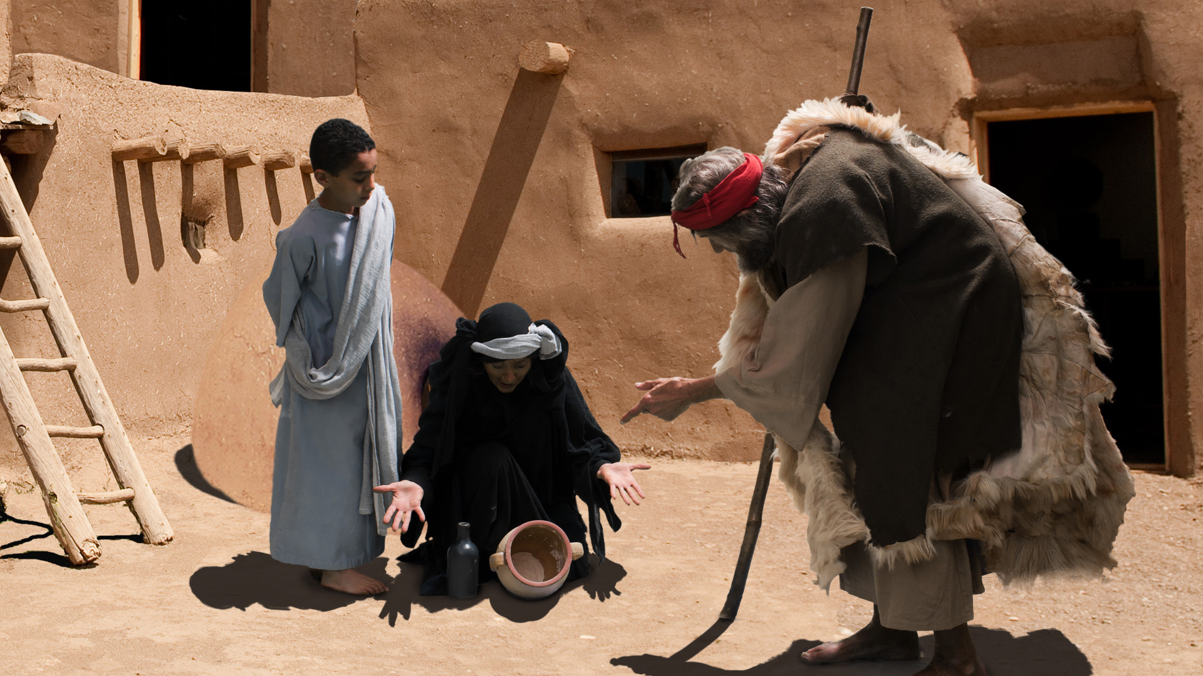

Slide 7
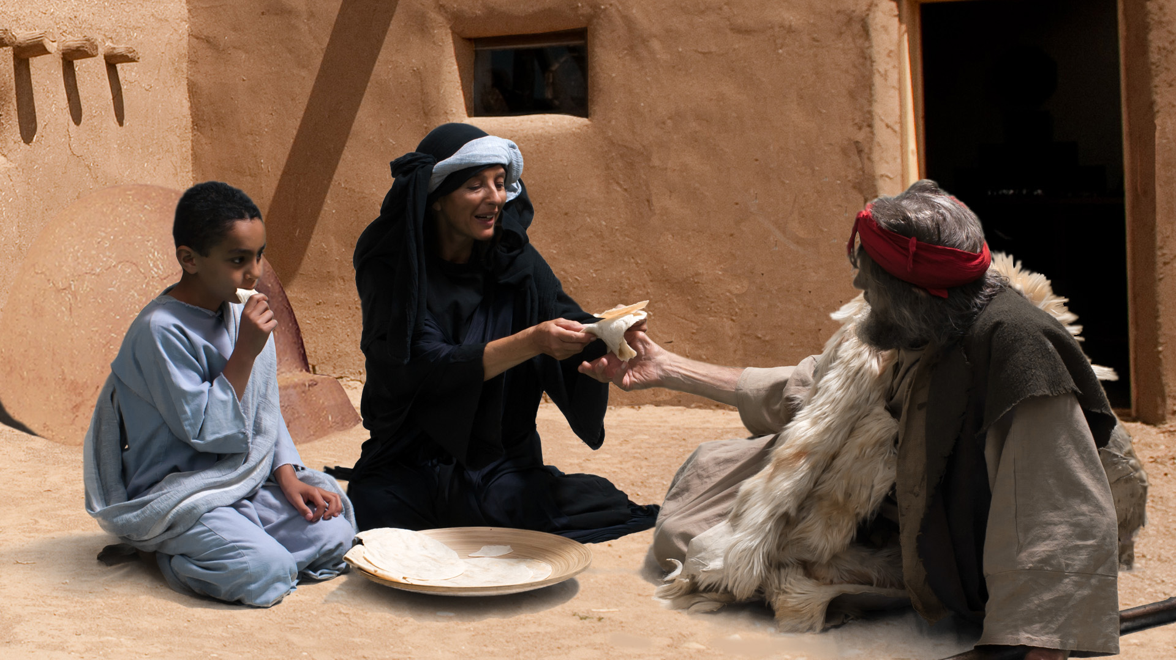

Slide 8
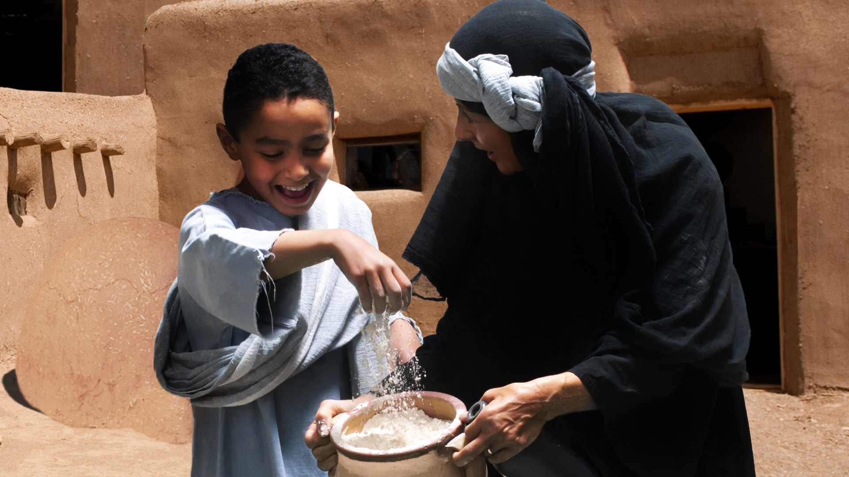

Slide 9
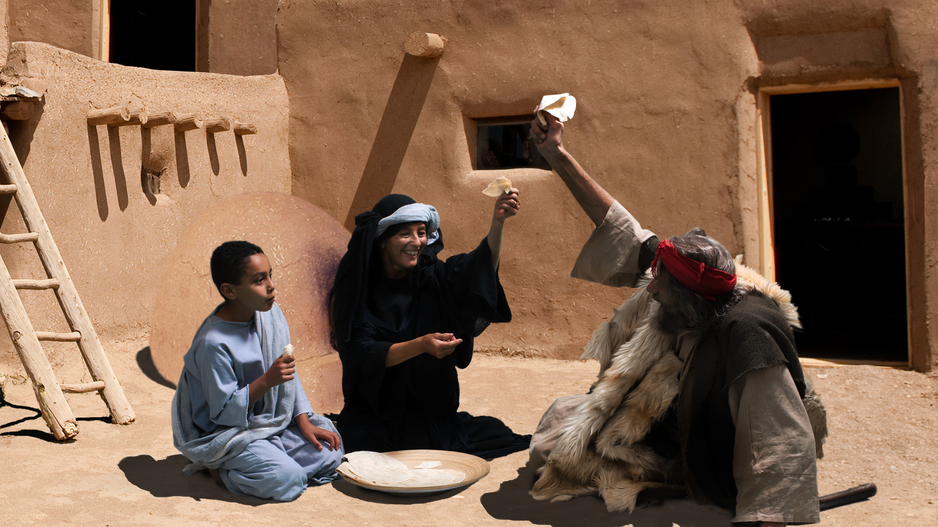

Slide 10
TEN MOST COMMON FEARS
世界上最惧怕是什么？
10: FEAR OF GETTING OLD怕老
9: FEAR OF BEING POISONED (5% OF WORLD POPULATION怕被中毒

Slide 11
TEN MOST COMMON FEARS
世界上最惧怕是什么？
8: FEAR OF BEING A COWARD怕胆子小
7: FEAR OF GERMS怕菌
6: FEAR OF GOING CRAZY (HEALTH)怕神经病（怕精神问题）

Slide 12
TEN MOST COMMON FEARS
世界上最惧怕是什么？
5: FEAR OF INTIMACY怕太亲密（性）
4: FEAR OF IMAGINATIVE THINGS怕虫，黑暗，灵界，想象丰富
3: FEAR OF SOCIALIZATION怕站在人前

Slide 13
TEN MOST COMMON FEARS
世界上最惧怕是什么？
2: FEAR OF DEATH怕死
1: FEAR OF LONELINESS怕孤独，孤单
FEAR OF HUNGER NOT LISTED怕饿死?
FEAR OF GOD IS NOT LISTED怕神?

Slide 14
Fear of god-number one
因该最惧怕的是神
"If you fear god, you will fear nothing else怕神就什么都不怕了."
If you have faith, fear will decrease信心使惧怕减少到没有"

Slide 15
Fear of god-number one
因该最惧怕的是神
Illustration of a little girls who has the faith 一位小女孩子的故事

Slide 16
Fear of god-number one
因该最惧怕的是神
Mark 马可福音4:40 "He said to them, why are you so afraid? Have you still no faith 耶稣对他们说：为什么胆怯？你们还没有信心吗?"

Slide 17
Count your blessings
数算恩典
Communion: 摆饼纪念神为你作了什么think about what god has done for you：Count your blessings Hymn 救主恩典270

