Slide 1
ALL FOR ONE, ONE FOR ALL
合而为一
JOHN 17:20-26
约翰福音十七章二十-二十六节

Slide 2


Slide 3
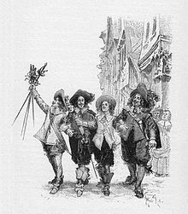
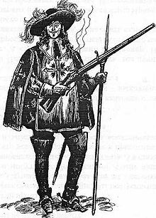

ONE FOR
ALL, ALL
FOR ONE
合而为一
Notes:
Written by Alexandre Dumas in 1844, a French novel made into movies
The theme of the Three Muskateers are during the upheaval of King Louis XIII of France as a fairly weak monarch often manipulated by his chief ministers. Therefore the Muskateers are involved in fighting corruptions, fairness, and justice. However, they are also involved personally with their own affairs and needs. As the young D'Artagnan (a poor young nobleman) trying to join the three famous musketeers, the story deals with this quest and many others involved.

Slide 4
JESUS' HIGH PRIESTLY PRAYER
大祭司的祷告
One with the Father (Prays for Himself) 1-5 耶稣为自己祷告（与阿爸父合而为一）
One with the Disciples 6-19 为门徒祷告（与门徒合而为一）
One with All Believers 20-26 为所有世界的基督徒祷告（与基督徒合而为一）

Slide 5
JESUS' HIGH PRIESTLY PRAYER
大祭司的为基督徒的祷告 20-26
"That they may be One, as You, Father, are in Me, and I in You; that they also may be One in Us, that the world may believe that You sent Me使他们都合而为一。正如你父在我里面，我在你里面，使他们也在我们里面，叫世人可以信你差了我来." 21

Slide 6
JESUS' HIGH PRIESTLY PRAYER
大祭司的祷告 20-26
"And the glory which You gave Me I have given them, that they may be One just as We are one你所赐给我的荣耀，我已赐给他们，使他们合而为一，像我们合而为一." 22

Slide 7
JESUS' HIGH PRIESTLY PRAYER
大祭司的祷告 20-26
"I in them, and You in Me; that they may be made perfect in One, and that the world may know that You have sent Me, and have loved them as You have loved Me我在他们里面，你在我里面，使他们完完全全地合而为一，叫世人知道你差了我来，也知道你爱他们如同爱我一样." 23

Slide 8
JESUS' HIGH PRIESTLY PRAYER
大祭司的祷告 20-26
"Father, I desire that they also whom You gave Me may be with Me where I am, that they may behold My glory which You have given Me; for You loved Me before the foundation of the world父啊，我在哪里，愿你所赐给我的人也同我在那里，叫他们看见你所赐给我的荣耀；因为创立世界以前，你已经爱我了." 24

Slide 9
JESUS' HIGH PRIESTLY PRAYER
大祭司的祷告 20-26
"O righteous Father! The world has not known You, but I have known You; and these have known that You sent Me 公义的父啊，世人未曾认识你，我却认识你；这些人也知道你差了我来." 25

Slide 10
JESUS' HIGH PRIESTLY PRAYER
大祭司的祷告 20-26
"And I have declared to them Your name, and will declare it, that the love with which You loved Me may be in them, and I in them我已将你的名指示他们，还要指示他们，是你所爱我的爱在他们里面，我也在他们里面." 26

Slide 11
Ephesians 3:18-19
以弗所书三章十八-十九节
"May have strength to comprehend with all the saints what is the breadth and length and height and depth. And to know the love of Christ that surpasses knowledge, that you may be filled with all the fullness of God能以和众圣徒一同明白基督的爱是何等长阔高深；并知道这爱是过于人所能测度的，便叫神一切所充满的，充满了你们.”

Slide 12
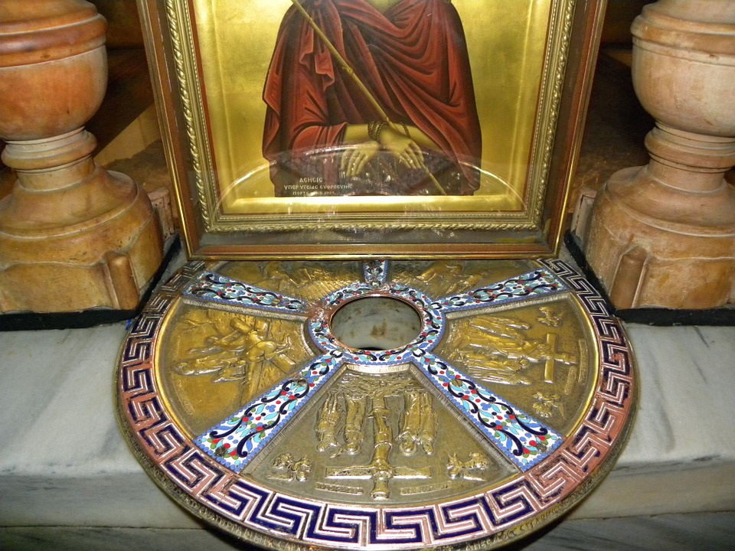
Holy Sepulchure
Burial Rock
Notes:
What Disunity looks like. The Holy Sepulchure church where it is said Christ was buried. July 2002 the church became a scene of ugly fighting between Mons who run it. Coptic mond was sitting on the rooftop decided to move his chair into the shade. This took him into the part of the rooftop courtyard looked aster by the Ethiopia monks. In. 1752 Ottoman Sultan issued an edict declaring which parts of the Church belong to which Christian groups: The Latins, Greek Orthodox, Armenian Orthodox, Syrian Orthodox, Copts, and Ethiopians. The Coptic Monks then controlled the rooftop and even has one monk live there. In 2002 when the Coptic Monk moved his chair to the shade, there was a fight among all the Monks, and ended with 11 of the monks injured, including one monk unconscious in hospital and another with broken arm. Is this what a church should be? This is opposite of what Christ said that "We are One and One with Him, and One with the Father."

Slide 13
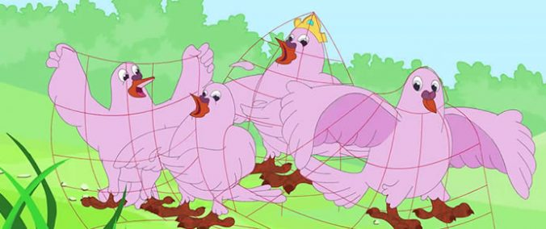
Notes:
Doves were caught in a hunter's net. They would all have been killed. But the leader King dove said we need to unite and fly up. So they escaped the hunter's grasp. However, still entangled by the net, the King said I have a friend who can help. So they flew to the Mouse to get help and were freed from the entangledment. Unity is Power and Strength

Slide 14
COMMUNION
圣餐
ASK THE LORD FOR FORGIVENSS。请神饶恕我们的无知
ASK THE LORD FOR ONE WITH GOD THE FATHER, SON, AND HOLY SPIRIT请三位一体的神和我们合而为一
Ask the Lord for Unity in Christ for All求神让我们所有的CBC家庭合而为一；世界的基督徒合而为一

