Slide 1
THE WISE AND THE FOOL
聪明人和愚顽人
JEREMIAH 17:5-11
耶利米书十七章
五到十一节

Slide 2
LORD SEARCH THE HEART
耶和华鉴察人心
9 "The heart is deceitful above all things, and desperately sick; who can understand it?" “人心比万物都诡诈，坏到极处，谁能识透呢？”

Slide 3
LORD SEARCH THE HEART
耶和华鉴察人心
10 "THE LORD SEARCH THE HEART AND TEST THE MIND, TO GIVE EVERY MAN ACCORDING TO HIS WAYS, ACCORDING TO THE FRUIT OF HIS DEEDS" “我耶和华是鉴察人心，试验人肺腑的，要照各人所行的和他作事的结果报应他。”

Slide 4
WHAT THE LORD SAYS耶和华说
THE WISE聪明人
THE FOOL愚顽人
7 "blessed is the man who trusts in the Lord.. “依靠耶和华，以耶和华为可靠的，那人有福了！”
5 Cursed is the man who trusts in man "依靠人血肉的膀臂，心中离弃耶和华的，那人有祸了！"

Slide 5
WHAT THE LORD SAYS耶和华说
THE WISE聪明人
THE FOOL愚顽人
"Like a tree planted by the water; that sends out its roots by the stream, and does not fear.."“他必象树栽于水旁，在河边扎根；炎热来到，并不惧怕，叶子仍必青翠；在干旱之年毫无忧虑，而且结果不止。”
6 Like a shrub in the desert...dwell in the parched places of the wilderness, in an uninhabited salt land. “因他必象沙漠的杜松，不见福乐来到，却要住旷野干旱之处，无人居住的咸地”

Slide 6
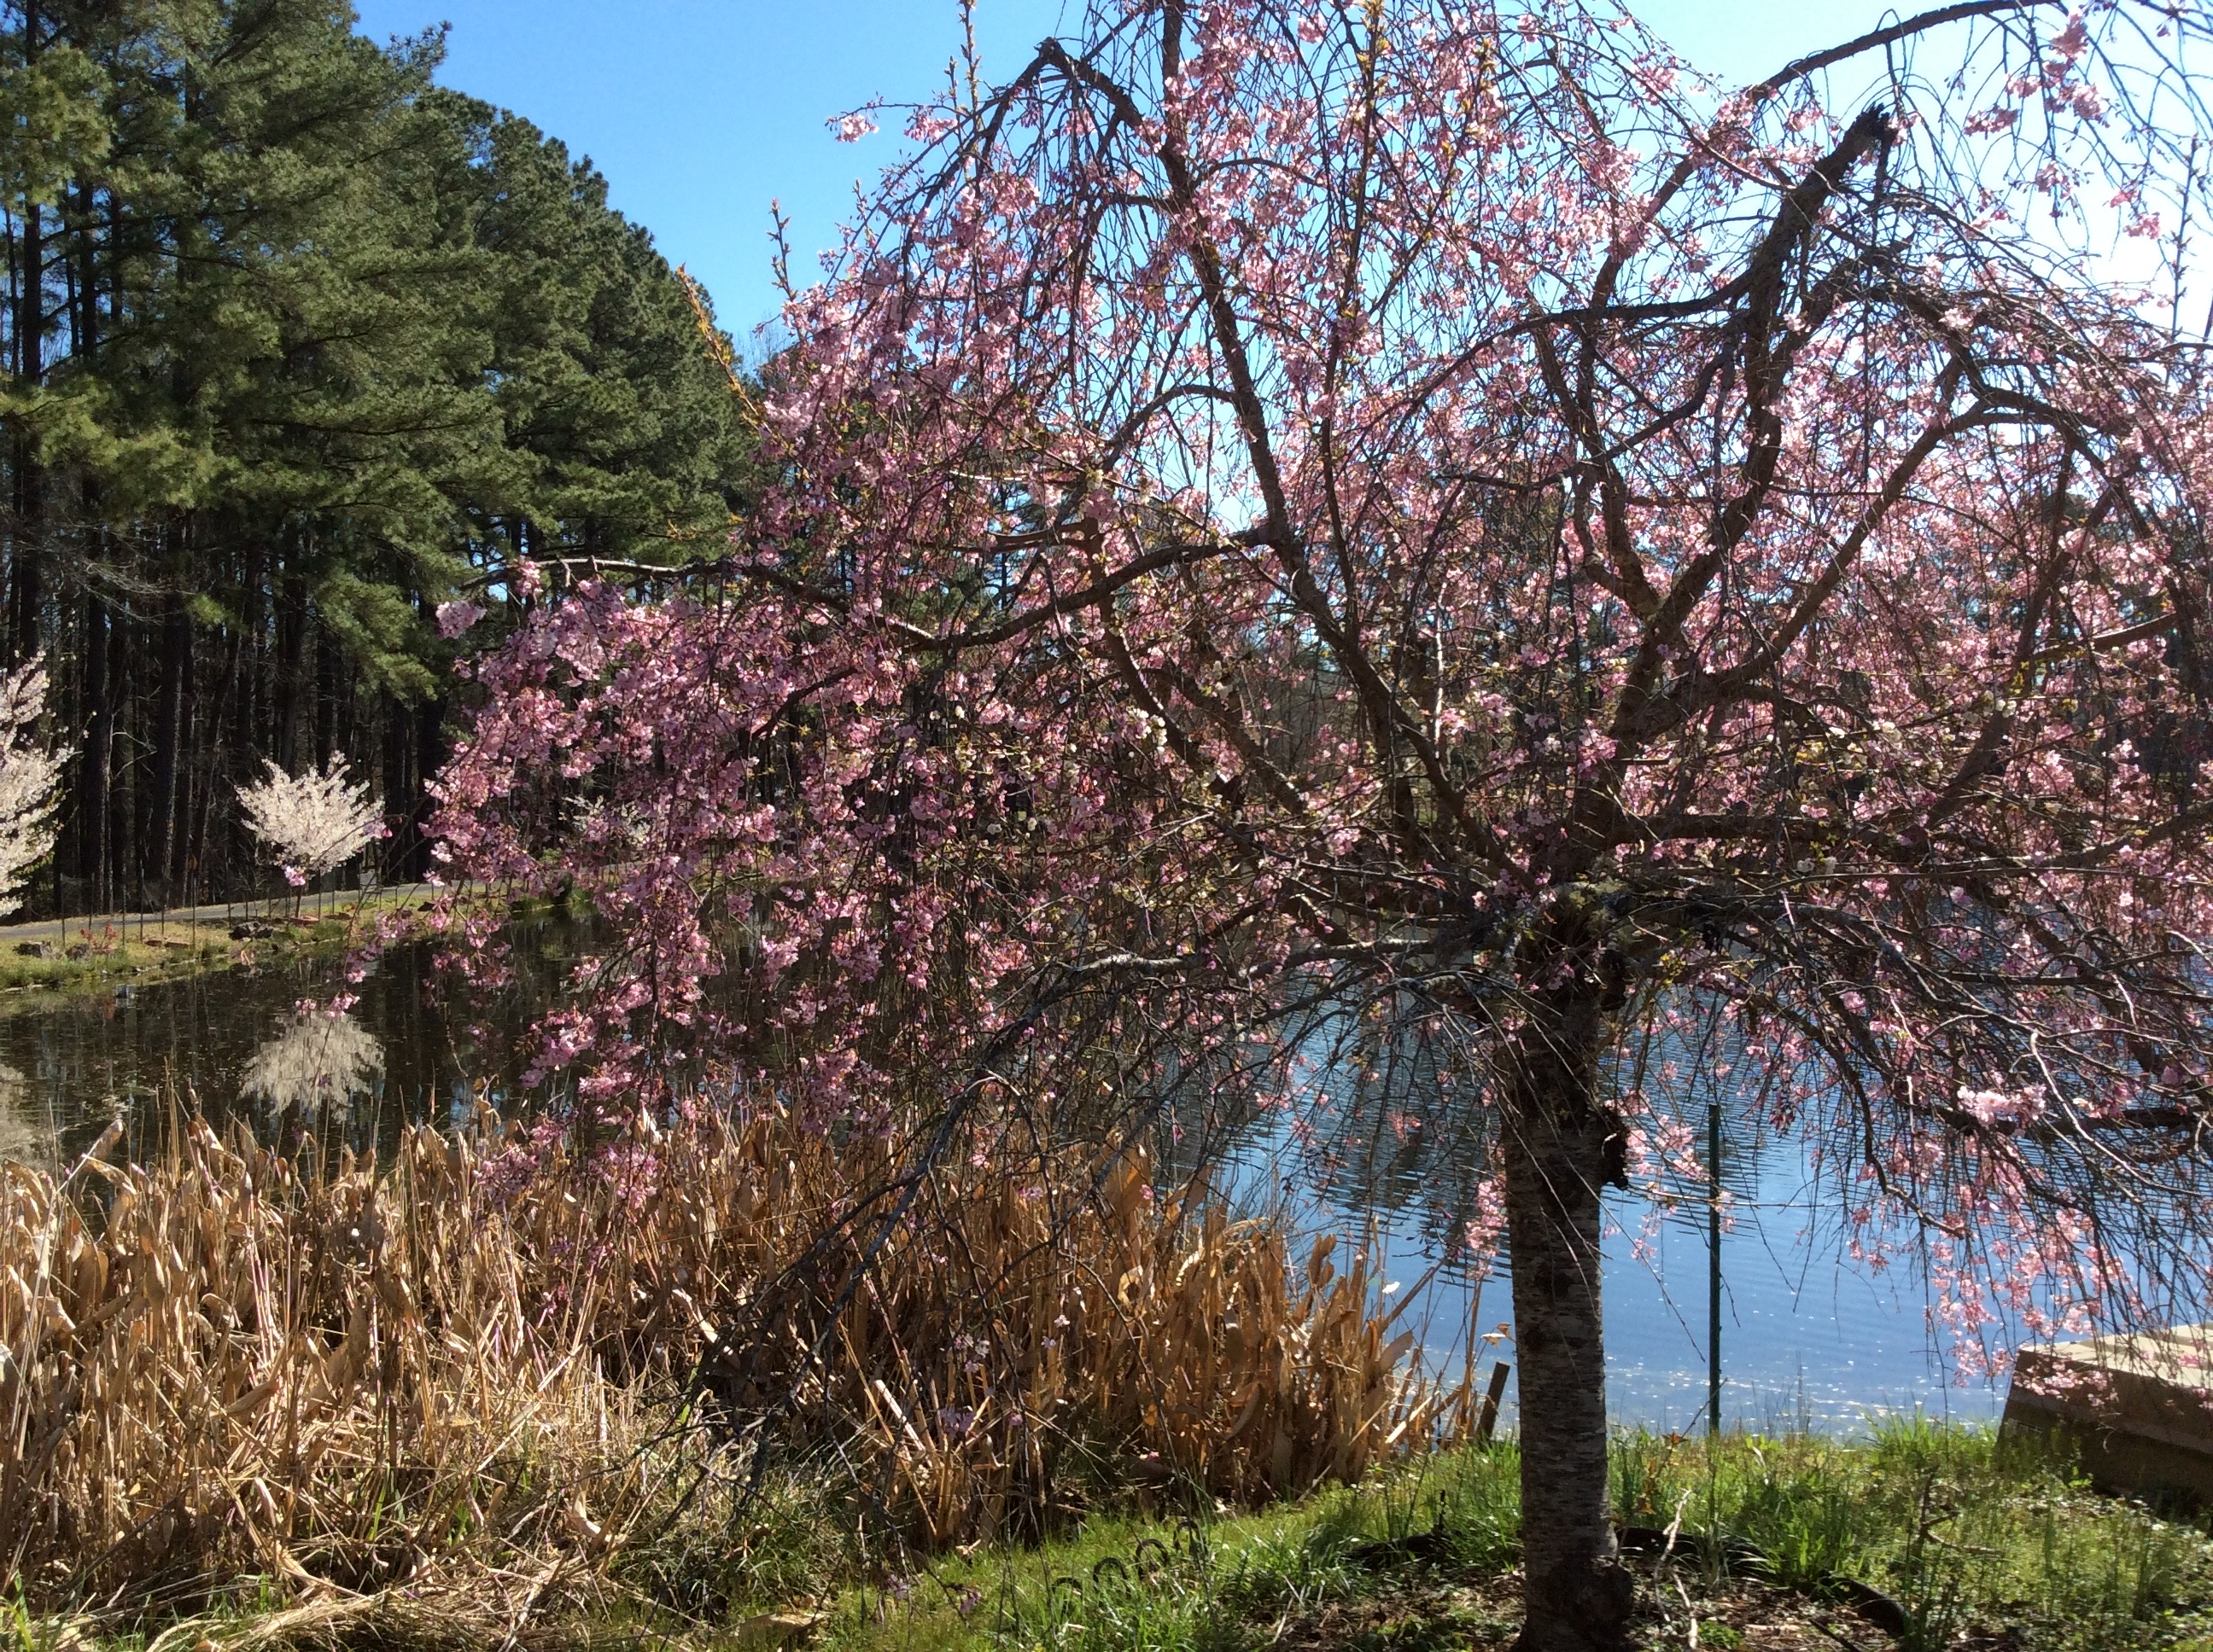
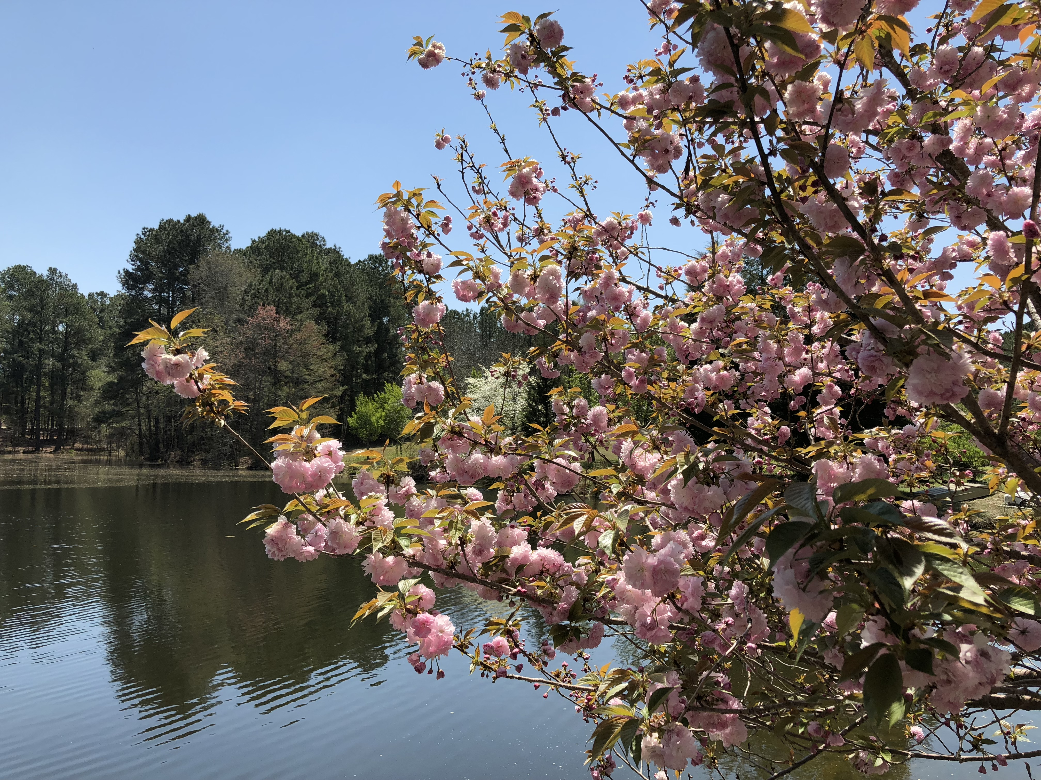
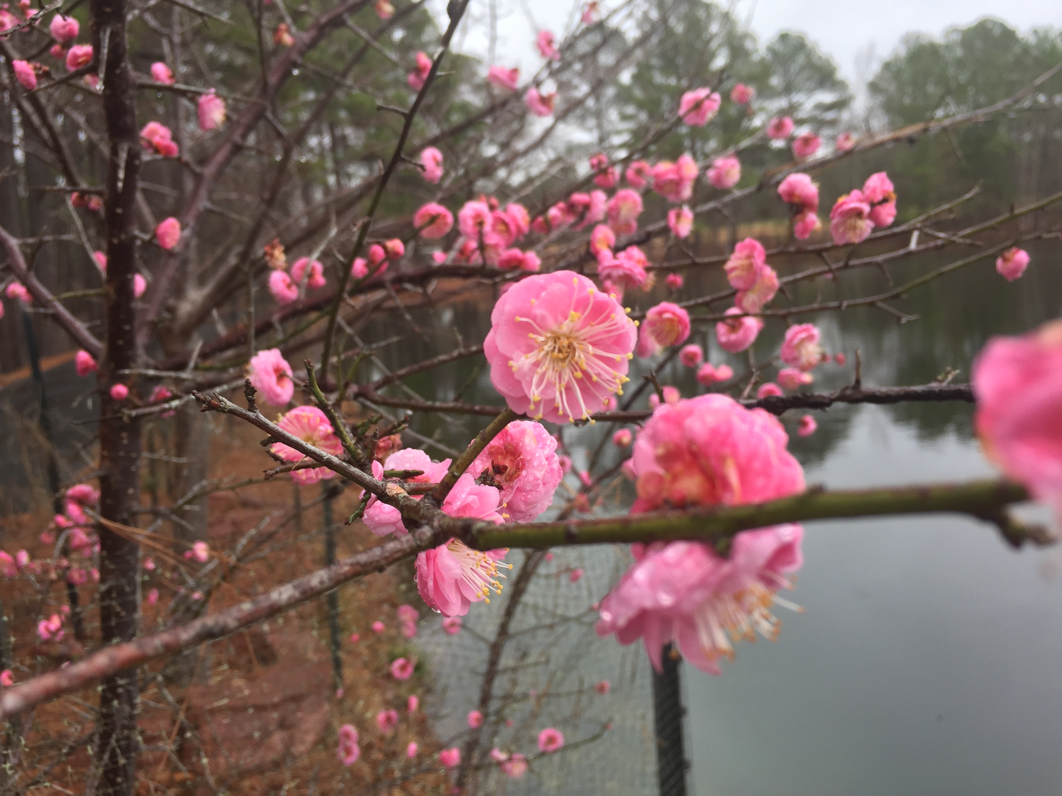

Slide 7
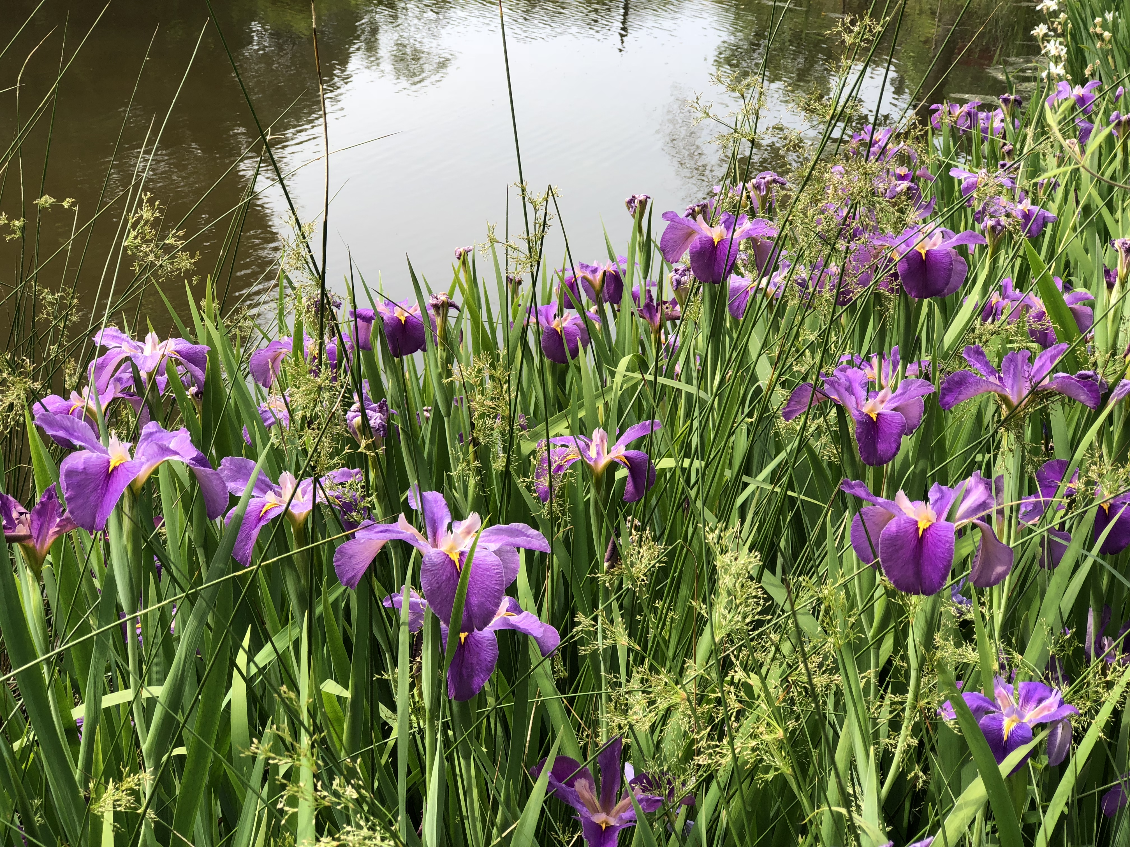

Slide 8
BEARING FRUIT FOR OUR LORD
为主结果子
"THEY STILL BEAR FRUIT IN OLD AGE, THEY ARE EVER FULL OF SAP AND GREEN." Ps 92:14
“他们年老的时候，仍要结果子；要满了汁桨而常发青。”诗篇九十二篇十四节

Slide 9
COMMUNION
摆饼圣餐
"He is like a tree planted by streams of water that yields its fruit in its season, and its leaf does not wither. In all that he does, he prospers." Psalm 1:3。 “他象一棵树，栽在溪水旁，按时侯结果子，叶子也不枯干。凡他所作的，尽都顺利。”。诗篇一篇三节

