Slide 1
REGRET, REMORSE, REPENTANCE 悔恨，悔痛，悔罪
MATTHEW 26:14-16; 27:3-5
马太福音26:14-16；27:3-5

Slide 2
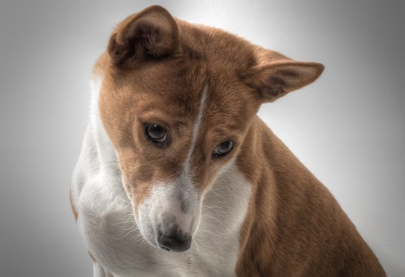
1. REGRET
悔恨
2. REMORSE
悔痛
3. REPENTANCE
悔罪（悔改）

Slide 3
REGRET 悔恨
1. Hate Own Decision不喜欢（恨）自己的决定
2. Avoid Future Self Punishment保护自己，怕管教
3. Try Not to Do It Again用自己的办法不再被错抓到把柄
Notes:
Illustration：Got caught for speeding. Try to avoid punishment by looking around and see if the police are nearby. Still speed and try not get caught is regret. Many women today are promiscuous. Have affairs in marriage, the thing they regret is that they got caught!

Slide 4
REMORSE 悔痛
1. Want to Change想改变
2. Avoid Future Hurt to Self
And Others (Know Self)不想
伤害自己和别人
3. Future is Bleak (Don't
Know God)痛苦因为没有
解脱出来，不认识神

Slide 5
Maud Muller: poem 1856
By John Greenleaf Whittier
About a beautiful maid when
She was smitten by A Judge.
She thought she would like
To be a wealthy judge's wife
While he was thinking that
He would like to be a local
Farmer married to Maud.
Notes:
Both didn't share their feelings until time passed. Maud married a local farmer while the judge married a woman who only loves his money. The remorse they both felt, only if at that time they had shared their feelings. Too Late!

Slide 6
REPENT 悔罪
1. Ask for Forgiveness 求饶恕
2. Looking forward to Future
将来的盼望
3. Know Self and God 认识
自己也认识神

Slide 7
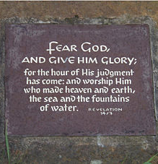
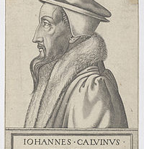
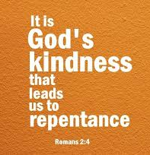
使徒3:19 “所以你们当悔改归正使你们的罪得以涂抹，那安舒的日子就必从主面前来到。”

Slide 8
Judas' Case犹大如何?
Matthew 马太福音26:14-16:
1. Thirty Pieces of Silver 15
(According to today's silver
Price about $3,000)
2. Sought Opportunity to
Betray Jesus 他找机会把
耶稣交给他们16

Slide 9
Judas' Case犹大如何?
Matthew 马太福音27:3-5:
1. Remorse是有悔痛的心
2. Want to Change想要改
3. Self-centered and not
God-centered改不了，还是
自私的，没有想到神
4. Solution was Hanged Self
后悔，自杀了

Slide 10
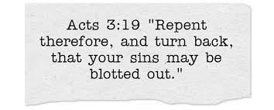
God Wants Us to Repent
Repentance Requires悔罪:
1. Acknowledge Our Sins认识
自己的罪
2. We cannot change靠着自己
不能改变
3. Ask God to Change求神饶恕
4. Look forward to the Future
盼望着将来

Slide 11
How Do You Deal with Sin你对罪的看法?
1. Regret悔恨自己?
2. Remorse悔痛决定?
3. Repentance悔改
认罪?
Notes:
We will deal with Repentance (N) next time and see the Bible teaching on Repentance!

