Slide 1
GIVING IS A PRIVILEGE 奉献是基督徒的特权
I Corinthians 16:2
哥林多前书十六章二节

Slide 2
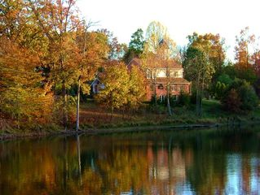
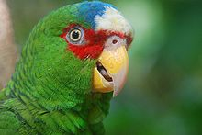
Notes:
There was a older woman who has four sons. She worked hard all her life raising her sons by herself. Her husband died when the children were still little. Finally the sons graduated from colleges and each had great job and made lots of money. They decided to give back to their mother for all the hard work she had done. The oldest son gave her a nice big house by the lake, so that she can enjoy the nature. The second son gave her a movie theater that can seat 50 people. The third son gave her a nice luxury car, and the fourth son spent $100,000 bought a talking parrot that was trained by 10 pastors. The bird can recite Scriptures which the mother loves, and can answer Biblical questions that she may have. After all, he was taught by 10 pastors. So, they sent all the gifts to the mother. They were very happy and excited to hear what their mother would say to the splendid gifts. She wrote them a letter, they being in different states, and said, "Thank you for the big and beautiful house. However, I am aging, and I can only sleep in one bed. Beside it takes too much energy for me to clean the house. Thank you for the indoor theater that you built in the house. I am aging, and my eightsight and hearing is not as good as it used to be. Besides all my friends have died and it is too lonely sitting in that large room all by myself! Thank you for the car, which I am too old to drive. Nowadays, I get my groceries and goods delivered home, so that car is sitting in the garage rusting. Thank you for the colorful chicken. That was the most delicious chicken I have ever eaten! All she needed was their love and companionship and not big and facny gifts that she doesn't know how to use. We are needed by the Father to love Him and not always receiving gifts and wants from Him.

Slide 3
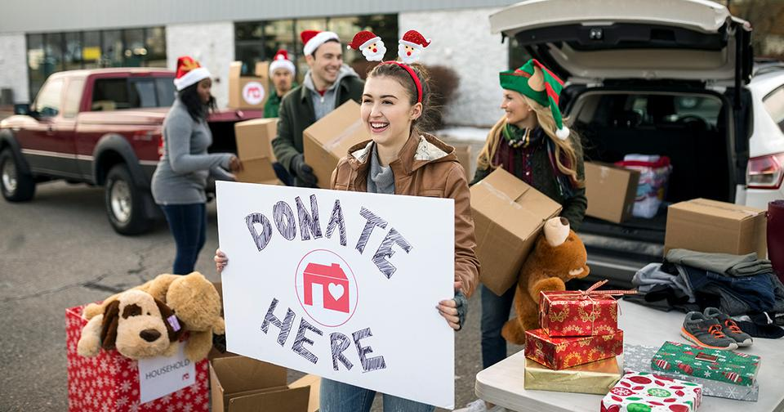
Notes:
When give, you are genuinely happy. That is human nature. So, as God's children, it is a privilege to give back to God. Who wants to owe debt? I still have mortgage, and it will be great to pay that off. As we live for Christ, as good Christians, we need to pay our debt to God. After all, He sent His son and paid the debt of sin. However, God only asks that we take care of His church. Money comes by His children giving and using the money for the Kingdom sake. That is all God requires of us, therefore, let us not owe God any debt and take care of the church together. As Malachi 3 taught us, we should never rob God of His money. All we have are His. He only requires 10% and let us have the 90%. Why can't we live to please Him? The more we give, the more happier we are. Gifting by tithing is certainly a privilege!

Slide 4
Why Tithe? 为什么十分之一要还给神？
10% of your Income return to the Lord 你的收入的十分之一是还给神的: Leviticus利未记 27:30 "Every tithe of the land, whether of the seed of the land or of the fruit of the trees, is the Lord's; it is holy to the Lord." “地上所有的，无论是地上的种子，是树上的果子，十分之一是耶和华的，是归给耶和华为圣的。”

Slide 5
Why Tithe? 为什么十分之一要还给神？
God's Money, not only 10%, but ALL we have
Malachi 3:10 "Bring the full tithe into the storehouse, that there may be food in my house. And thereby put me to the test, says the Lord of Hosts, if I will not open the windows of heaven for you and pour down for you a blessing until there is no more need."

Slide 6
Why Tithe? 为什么十分之一要还给神？
God's Money, not only 10%, but ALL we have 神的钱不只有十分之一，我们所有的财产都是神的
玛拉基书3:10
“万军之耶和华说：你们要将当纳的十分之一，全然送入仓库，使我家有粮，以此试试我，是否为你们敞开天上的窗户，倾福与你们，甚至无处可容。”

Slide 7
Why Tithe? 为什么十分之一要还给神？
不能停止奉献，因为停止是欠神的钱： “人 岂可夺取神之物呢？你们竟夺取我的供物。你们却说：我们在和事上夺取你的供物呢？就是你们在当纳的十分之一和当献的供物上。”玛拉基书3:8
Such as Absent from Church due to vacation, traveling, or loss of job. Pay back because that is what you owe God不在教会的时候，要补回

Slide 8
Why Tithe? 为什么十分之一要还给神？
Tax Deductible: We are a non-profit organization, therefore recognized by IRS
Tax Return: Already paid God the 10%, can use the money for needs
Tithe is from the Heart, not by Duty
Illustration of Bad Dream of a Christian

Slide 9
I Corinthians 16:2 哥林多前书十六章二节
"That is, each Sunday each of you must put aside part of what you have earned. If you do this, you won't have to take up a collection when I come."
“每逢周日，各人应按照自己的收入抽出一部分留起来，免得我到的时候才先凑。”

Slide 10
I Corinthians 16:2 哥林多前书十六章二节
1. Give Individually各人按照自己: "Each of you"
2. Give Regularly每逢周日: "Each Sunday"
3. Give Methodically抽出一部分留起来: "Put Aside"
4. Give Proportionally按照自己的收入: "Keeping with Income"

Slide 11
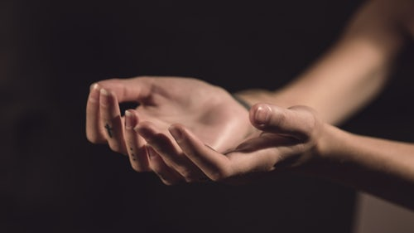
GRATEFUL HEARTS
感恩的心
GRATEFUL HEARTS: ARE YOU GRATEFUL FOR WHAT GOD HAS DONE FOR YOU?
GOD PAID FOR YOU神付了代价
GOD PROSPERED YOU神使你富足
GOD PROTECTED YOU神保护你
GOD PLANNED FOR YOU神计划和看顾你前面道路

