Slide 1
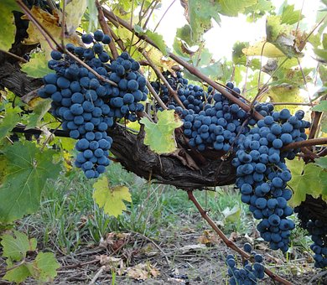
TRINITY AND THE CHURCH (US) 神和我们的关系
JOHN 15
约翰福音十五章

Slide 2
CHURCH DEFINED 教会的意义
BUILDING OR PEOPLE 是房子还是人?
FAMILY OF GOD ON EARTH 地上的家
KNOW YOUR BIBLE 来教会是深查神的话。 Illustration: HEBREWS

Slide 3
TRINITY DEFINED 三位一体的神
ABBA FATHER 阿爸父
LORD JESUS CHRIST 主耶稣基督
HOLY SPIRIT 圣灵，神的灵

Slide 4
IN THE GARDEN

Slide 5
Story of the VINEYARD
1. TRINITY AND OUR
RELATIONSHIP
2. NECESSITY OF BEARING
FRUIT
3. GOD INITIATES AND
WE OBEY

Slide 6
ROLES OF THE FATHER 阿爸父的名称
HUSBANDMAN 农夫(KJV)
VINEDRESSER 栽培的人(NASB)
GARDNER 园丁，花匠(NLT, GOOD NEWS)
VINEYARD KEEPER 葡萄园饲养员(HOLMAN STANDARD)
FARMER 农夫(WORLD ENGLISH BIBLE)

Slide 7
OUR ABBA FATHER 阿爸父
"ABBA Father is the Gardner父是栽培人" vs. 1
"He cuts off every branch that doesn't produce fruit 父剪去不结果子的枝子" vs. 2
"He prunes the branches that do bear fruit so they will produce even more结果子的，父就修理干净." vs. 2
ILLUSTRATION: MANAGEMENT AND NOT SALES

Slide 8
RELATIONSHIP WITH THE SON 儿子的关系
True Vine 真葡萄树vs. 1
We as branches are 我们是枝子 vs. 5
Abide in Him, we will bear fruit 在他里面vs. 5
If we don't, we will wither 枯干vs. 6
If we don't, we will wither and die 会死vs. 6

Slide 9
RELATIONSHIP WITH THE SON 儿子的关系
Ask whatever we wish will be done可以求 7
Father is glorified when we bear fruit vs. 8
We are loved as the Father loves the Son vs.10
Joy of the Son in us and our joy be full vs. 11
Illustration: Soggy Cereal (爱神的原则）

Slide 10
ROLE OF THE HOLY SPIRIT 圣灵的名称
Helper 帮者(NASB, NKJV))
Advocate 站在我们这边的(NLT, NIV)
Comforter 安慰者(KJV)
Counselor 辅导者(RSV)
保惠师/Comforter（新标的和合本）
FEED US
喂养我们

Slide 11
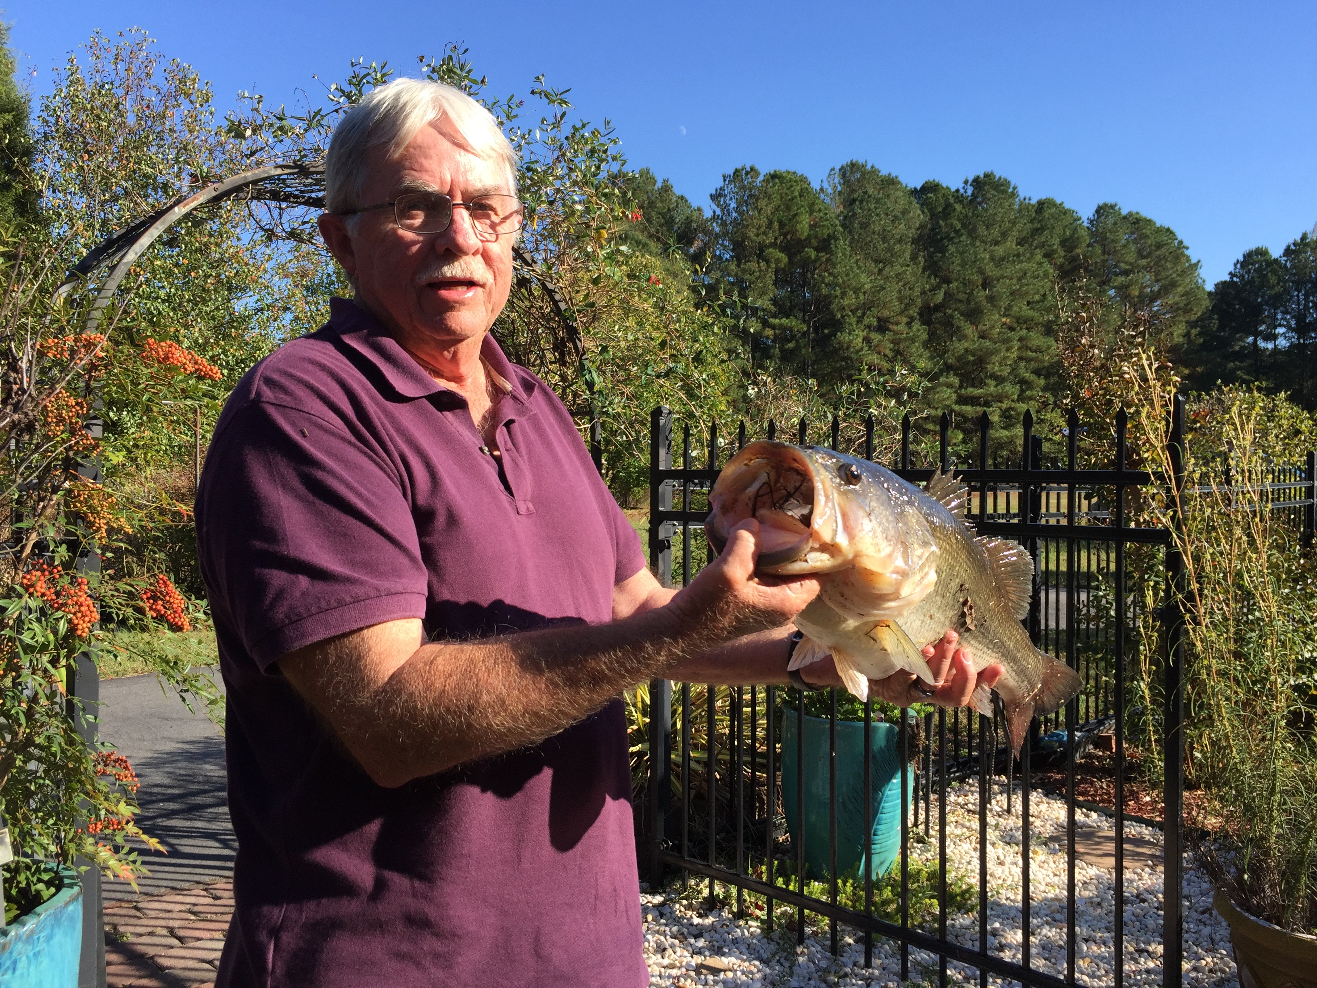
Friend
Tom,
Almost
Professional
Fisherman
圣灵的工作：
得人如鱼

Slide 12
阿爸父是栽培人
圣灵是帮助我们
仁爱，喜乐，和平，忍耐，
恩慈，良善，信实，温柔，
节制
结圣灵的果子
我们是枝子
耶稣基督是葡萄树

Slide 13
COMMUNION 摆饼圣餐
1. ALLOW FATHER TO TRIM US 愿阿爸父修剪我们
2. ALLOW THE HOLY SPIRIT TO FEED US 让圣灵帮助我们，喂养我们
3. ATTACHED TO JESUS TO BEAR FRUIT 永不离开耶稣，接丰盛的果子

