Slide 1
WHY DO WE COME TO CHURCH? 我们为什么来教会？
HEBREWS 10:22-25
希伯来书十章二十二-二十五节

Slide 2
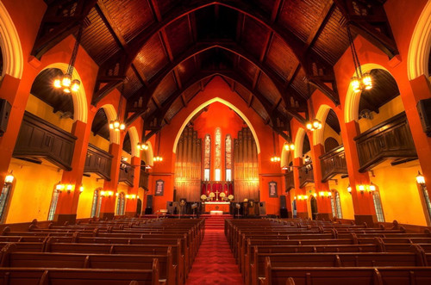
Why do we come to church? 我们为什么来教会？
COMMUNITY CHURCH in Shanghai 上海的国际礼拜堂
A multinational congregation attends this large Christian church with Mandarin&English sermons.
Address: 53 Hengshan Rd, Xuhui Qu, Shanghai Shi, China

Slide 3
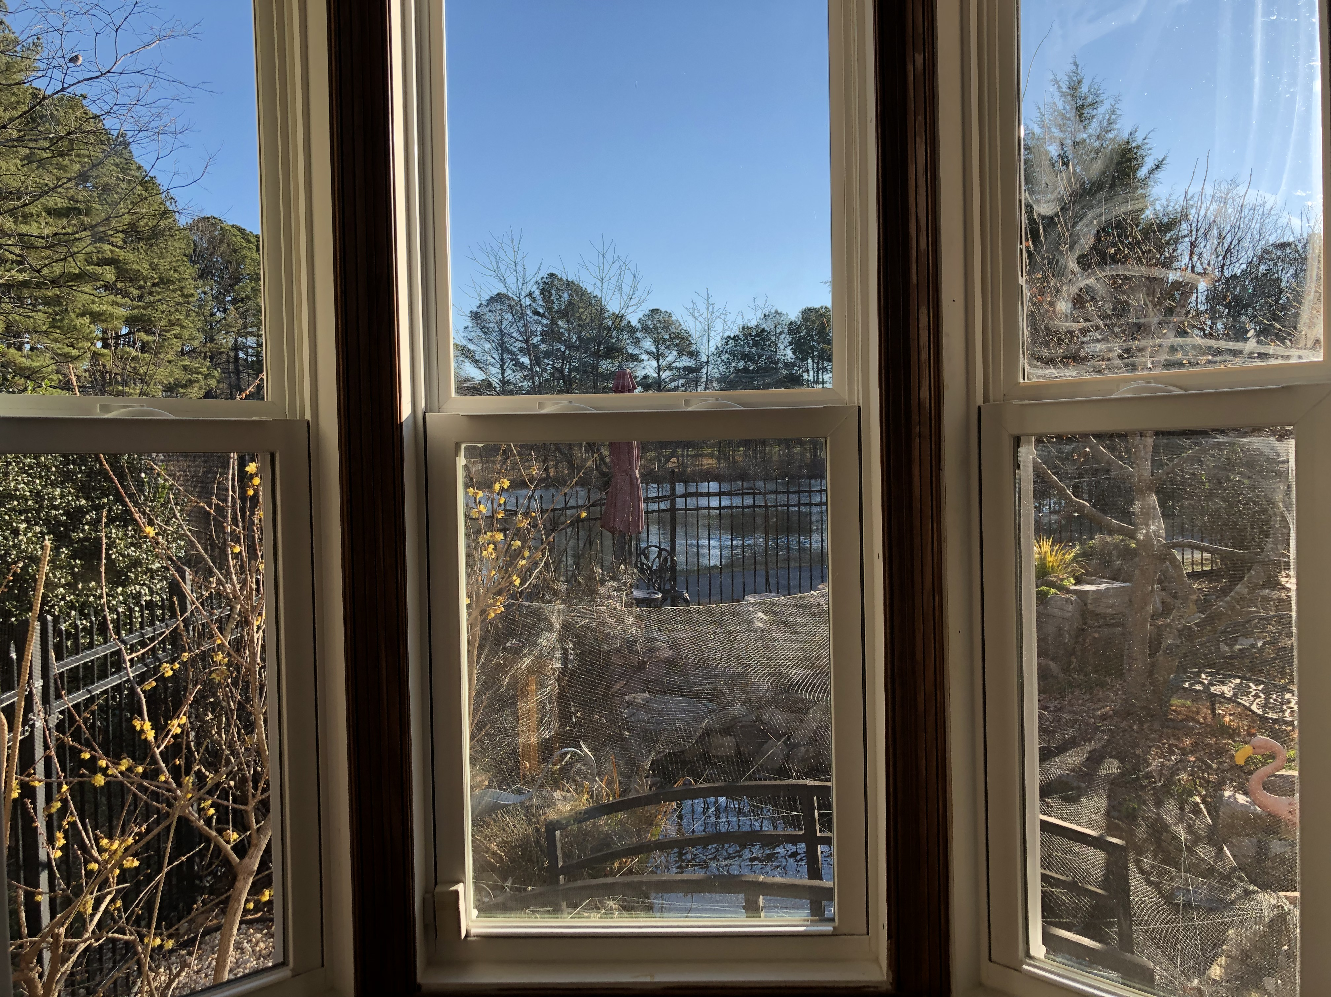
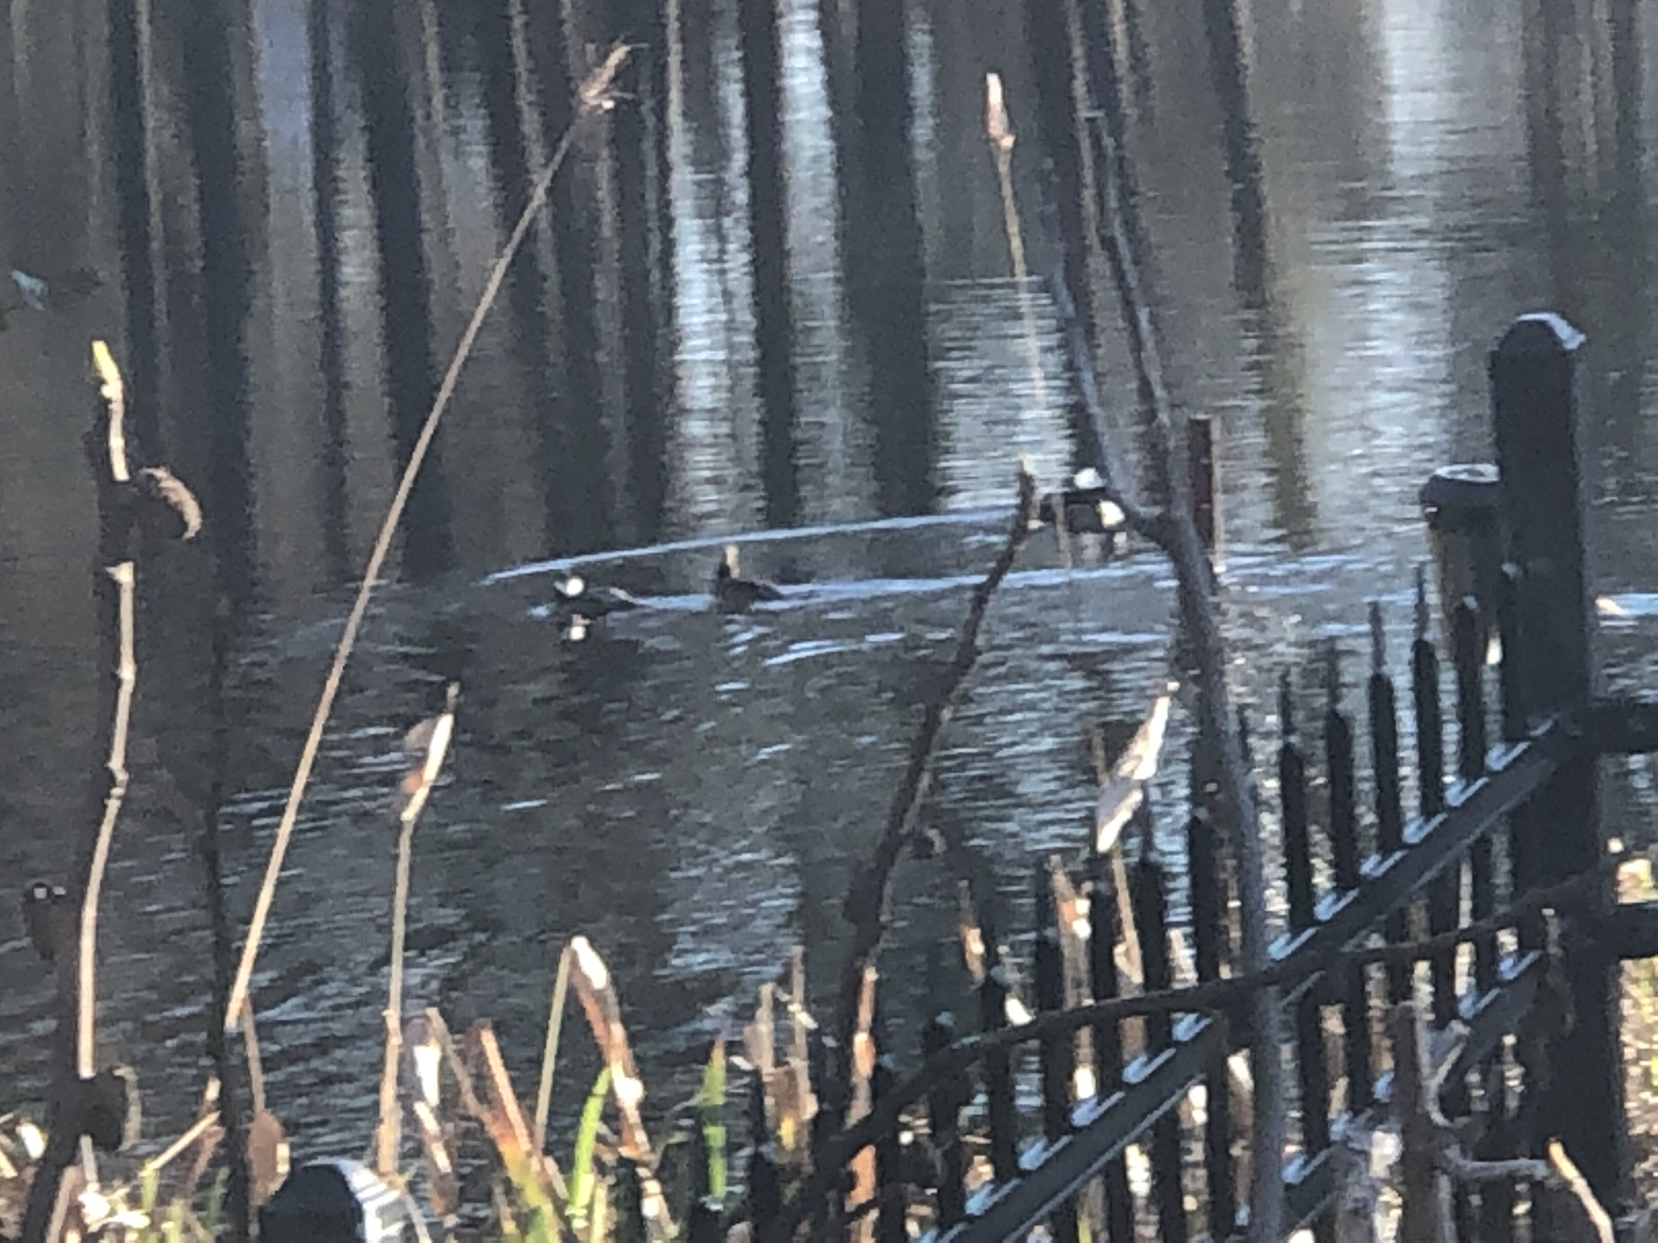

Slide 4
Why do we come to church? 我们为什么来教会？
I。Church is a Home Away from Home 中浸信会是大家的家 -主日学，崇拜，婚礼，丧礼，受洗，诗班，训练班，祷告地方，团契， 讲座，辅导，教导，儿童教育，朋友，学习给，身体，心，灵得医治，饶恕，等等
Illustration of A Church in Brooklyn，NY

Slide 5
Draw near to god- vs 22 来到神面前
II。 "Let us draw near with a true heart in full assurance of faith, with our hearts sprinkled clean from an evil conscience and our bodies washed with pure water." “。。。。身体用清水洗净了，就当存着诚心和充足的信心来到神面前。”
CBC started as a Mainland Chinese Fellowship-early90's

Slide 6
Confession of our hope 坚守我们的指望-23
III。 "Let us hold fast the confession of our hope without wavering, for he who promised is faithful." 23 “也要坚守我们所承认的指望，不至动摇，因为那应许我们的是信实的。”
What do these dates have in common (1248, 1306, 1689, 1792, 1836, 1844, 1914, 1936, 1960, 1974, 1981, 1988, 1989, 1992, 1994, 2011)? They all represent the times in which people predicted that the second coming of Christ would occur. No one, not even Jesus knows the exact time of Christ’s coming. Matthew 24:36 What we do know is this: Christ’s coming will be unexpected and dramatic. "But the day of the Lord will come as a thief in the night, in which the heavens will pass away with a great noise, and the elements will melt with fervent heat; both the earth and the works that are in it will be burned up. 但主的日子要像贼来到一样；那日，天必大有响声废去，有性质的都要被烈火融化，地和其上的物都要烧尽了。" 2 Peter 彼得后书 3:10

Slide 7
Care for love and good works 激发爱心，勉励行善-24
IV。 "And let us consider how to stir up one another to love and good works." “又要彼此相顾，激发爱心，勉励行善。”
June 6, 1944; the day when allied forces invaded the beaches of Normandy. Four days after D-Day a German soldier, Franz Gockel wrote to his family describing it. “We shot at everything that moved. The beach was soon covered with the bodies of American soldiers.” Maybe some of you have seen the opening scene of the movie Saving Private Ryan, Hollywood’s vivid depiction of what it was like on that day to be an American soldier who arrived on an armored passenger transport by sea, but when the big armored door was lowered to instantly have hundreds of shots fired at you, and to see the men in front of you fall to their death. 425,000 Allied and German troops were killed, wounded, or went missing in action. Over 53,000 Allied troops were reported as killed, all on one fateful day.

Slide 8
CONTINUOUS WORSHIP 不可停止聚会-25
V。 "Not neglecting to meet together, as is the habit of some, but encouraging one another, and all the more as you see the Day drawing near." “你们不可停止聚会，好象那些停止惯了的人，倒要彼此劝勉。即知道那日子临近，就更当如此。”
There's a story about a man who, leaving church one Sunday, complained about the music. "I didn't like the hymns you chose today," he said. The pastor simply replied, "That's OK; we weren't singing them for you."

Slide 9
Don't neglect worship 不可停止聚会-25
A Christian man was stranded on a deserted island for many, many years. When he was finally spotted by accident and the rescue crew arrived. They were impressed with all the things he built by himself. The most prominent was 3 buildings. They asked him about the first building and he answered, “That is where I live.” Then they asked about the second. “That is where I go to church.” In amazement they then asked about the third building, to which he immediately switched to a very angry demeanor and replied gruffly. “That is where I USED to go to church!”

Slide 10
WHY DO WE COME TO CHURCH? 我们为什么来教会？
I。HOME AWAY FROM HOME 是个家
II。 DRAW NEAR TO GOD- vs 22 来到神面前，亲近神
III。ALWAYS HAVE HOPE OF OUR LORD'S COMING AGAIN 坚守我们的指望（等候耶稣在来）-23
IV。 LOVE AND DO GOOD 激发爱心，勉励行善-24
V。 CONTINOUS WORSHIP 不可停止聚会-25

