Slide 1
WHO IS THE HEAD OF THE CHURCH? 谁是教会的头？
COLOSSIANS 1:15-20
歌罗西书一章十五到二十节

Slide 2
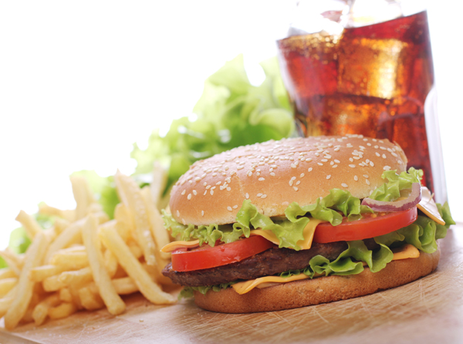
FAULTY ASUMPTION
所见的是真的吗？
LOOK DEEP IN THE WORD
圣经也要更深一层的
看里面的含义

Slide 3
THROUGH HIM AND FOR HIM 靠耶稣，为耶稣
I. "He is the image of the invisible God, the firstborn of all creation. 爱子神那不能看见之神的像，是首生的，在一切被造的以先。”15节
Illustration: idols偶像（anything you treasure more than God)道教:关公,岳飞

Slide 4
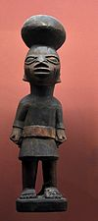
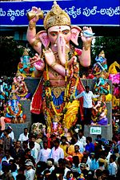
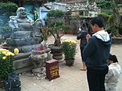
PRIDE骄傲
LUST私欲
SELF 自我
ENTERTAINMENT
娱乐（电影，电视，视频）
RULES 规则
RELIGION 信仰
HATRED 恨
FEAR 恐惧
WORRY 忧虑
WORLD 世界

Slide 5
THROUGH HIM AND FOR HIM 靠耶稣，为耶稣
II. "For by Him all things were created, in heaven and on earth, visible and invisible, whether thrones or dominions or rulers or authorities—all things were created through Him and for Him." 16

Slide 6
THROUGH HIM AND FOR HIM 靠耶稣，为耶稣
II. “因为万有都是靠他造的，无论是天上的，地上的，能看见的，不能看见的，或是有位的，主治的，执政的，掌权的，一概都是藉着他造的，又是为他造的。”十六节
Illustration: Omnipotent God无所不能的神 (power of evil in an idol)

Slide 7
THROUGH HIM AND FOR HIM 靠耶稣，为耶稣
III. "And He is before all things, and in Him all things hold together." 17 “他在万有之先；万有也靠他而立。”十七节
Illustration: Without Jesus, the world will be in chaos
"Jesus makes the universe "a cosmos instead of a chaos."

Slide 8
THROUGH HIM AND FOR HIM 靠耶稣，为耶稣
IV. "And He is the Head of the Body, the Church. He is the beginning, the firstborn from the dead, that in everything He might be preeminent." 18

Slide 9
THROUGH HIM AND FOR HIM 靠耶稣，为耶稣
IV. “他也是教会全体之首，他是原始，是从死里首先复生的，使他可以在凡事上居首位。”十八节
Illustration: "Focus on the little girl instead of an apple tree in bloom"

Slide 10
THROUGH HIM AND FOR HIM 靠耶稣，为耶稣
V. "For in Him all the fullness of God was pleased to dwell." 19 “因为父喜欢叫一切的丰盛，在他里面居住。”十九节
Illustration: No God, No Potatoes

Slide 11
THROUGH HIM AND FOR HIM 靠耶稣，为耶稣
IV. "And through Him to reconcile to Himself all things, whether on earth or in heaven, making peace by the blood of His Cross." 20

Slide 12
THROUGH HIM AND FOR HIM 靠耶稣，为耶稣
IV. “既然藉着他在十字架上所流的血成就了和平，便藉着他叫万有，无论是地上的，天上的，都与自己和好了。”二十节
Illustration: Total Package (Jesus bought us in total, therefore, everything we have belong to Him)

