Slide 2
ad

Slide 24
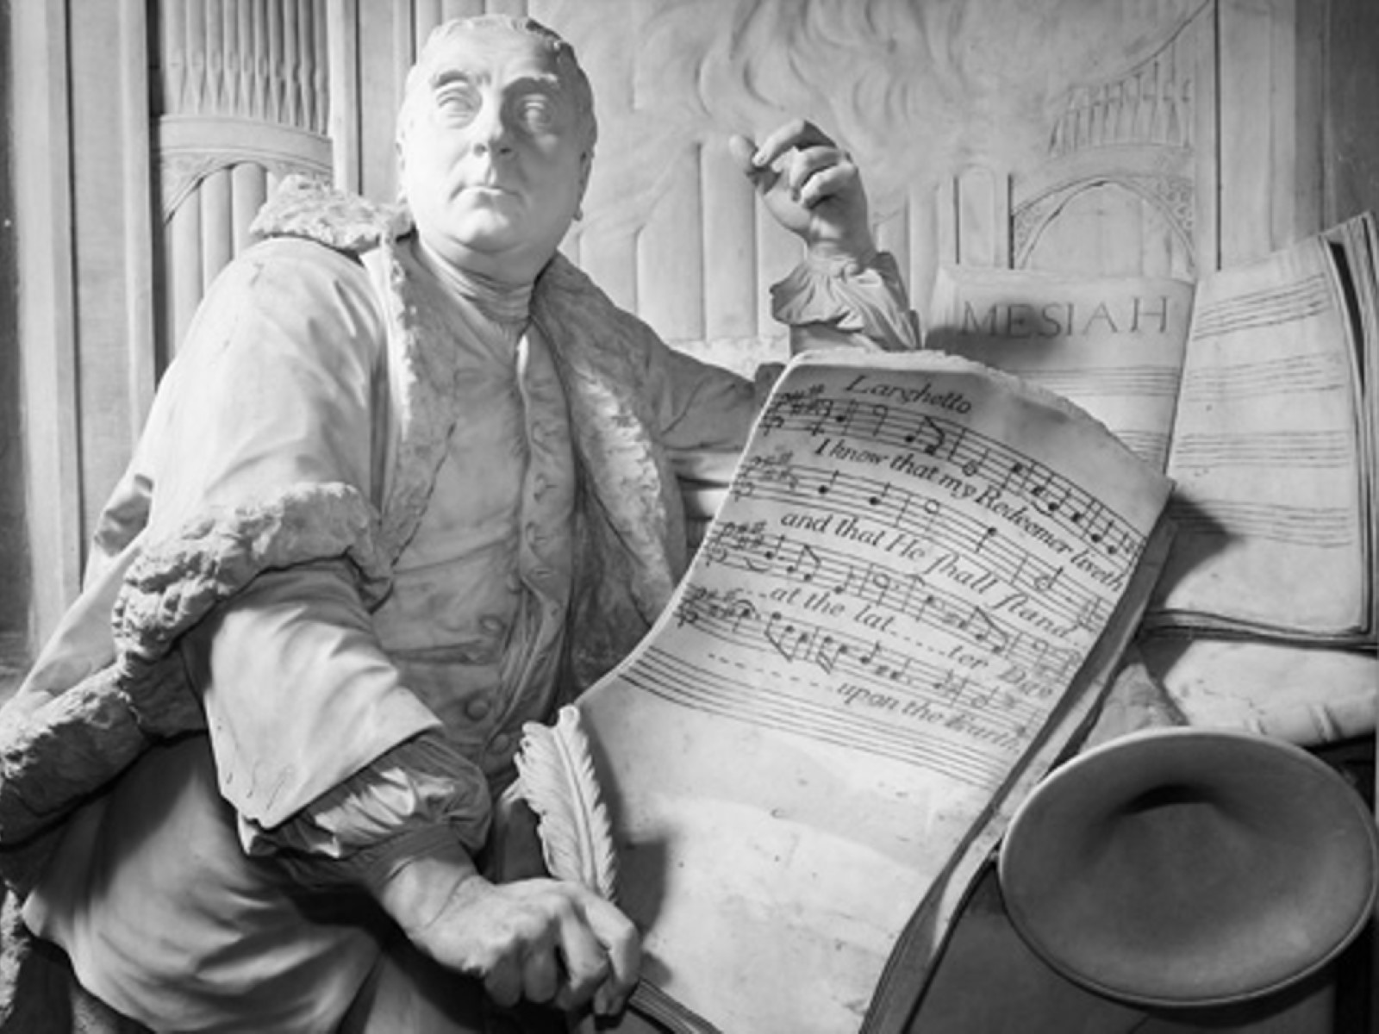

Slide 33
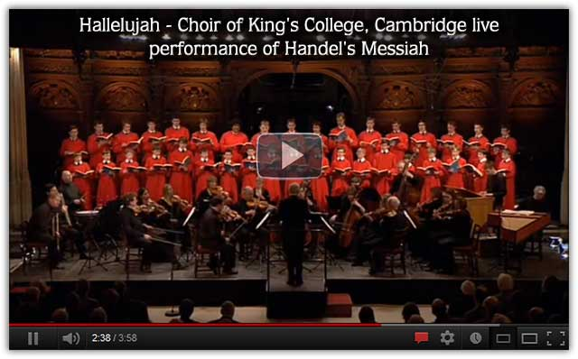
点击: https://www.youtube.com/watch?v=C3TUWU_yg4s
https://www.sosoclip.com/video/45WWA1QQ0809F6AACCMMII.html

