Slide 1
JESUS IS MY FRIEND 耶稣是我的朋友
JOHN 15:12-17
约翰福音十五章十二-十七节

Slide 2
ENEMIES OR FRIENDS 敌人或者朋友
Pastor asked his congregation: "How many of you have friends?"
"How many of you have enemies?"
A 98 year old lady said she has no enemy at all"

Slide 3
God desires a mutually giving relationship with us—a friendship (John 15:15). “What then is the difference between a servant of God and an intimate friend of God? Jesus proved to His disciples that they were His ‘friends’ as well as His servants, but He pointed out that a master shares his plans with his friends but not with his slaves. He had told them what was coming, and thereby was treating them as His friends. Abraham and Moses, the only Old Testament characters whom God called His friends, also received revelations of God’s plans from Him.” – Dr. Thomas Constable
How do we view God? Do we expect Him to share with us or to just demand things from us—our tithe, our time of worship, our obedience? As Christians, are we seeking the relationship with God or only seeking what he can do for us?

Slide 4
We can live only in relationships. We need each other. A rather crude and cruel experiment was carried out by Emperor Frederick, who ruled the Roman Empire in the thirteenth century. He wanted to know what man's original language was: Hebrew, Greek, or Latin?
He decided to isolate a few infants from the sound of the human voice. He reasoned that they would eventually speak the natural tongue of man. Wet nurses who were sworn to absolute silence were obtained, and though it was difficult for them, they abided by the rule. The infants never heard a word not a sound from a human voice. Within several months they were all dead.

Slide 5
JESUS IS MY FRIEND 耶稣是我的朋友
I. LOVE ONE ANOTHER 彼此相爱
Vs. 12 AND 17 "This is my commandment, that you love one another as I have loved you你们要彼此相爱，象我爱你们一样；这就是我的命令（12）我这样吩咐你们，是要叫你们彼此相爱（17）."

Slide 6
JESUS IS MY FRIEND 耶稣是我的朋友
Vs. 13 "Greater love has no one than this, that someone lay down his life for his friends 人为朋友舍命，人的爱心没有比这个大的."

Slide 7
JESUS IS MY FRIEND 耶稣是我的朋友
II. OBEY GOD 顺服神
Vs. 14 "You are my friends if you do what I command you." “你们若遵行我所吩咐的，就是我的朋友了。”

Slide 8
JESUS IS MY FRIEND 耶稣是我的朋友
III. NO LONGER SERVANTS 不在作仆人
Vs. 15 "No longer do I call you servants....but I have called you friends, for all that I have heard from my Father I have made known to you以后我不再称你们为仆人，因仆人不知道主人所作的事；我乃称你们为朋友，因我从我父所听见的，已经都告诉你们了."

Slide 9
JESUS IS MY FRIEND 耶稣是我的朋友
IV. CHOSEN BY GOD TO BE HIS FRIEND
Vs. 16 "You did not choose me, but I chose you and appointed you that you should go and bear fruit and that your fruit should abide, so that whatever you ask the Father in my name, he may give it to you 不是你们拣选了我，是我拣选了你们，并且分派你们去接果子，叫你们的果子常存；使你们奉我的名，无论向父求什么，他就赐给你们。."

Slide 10
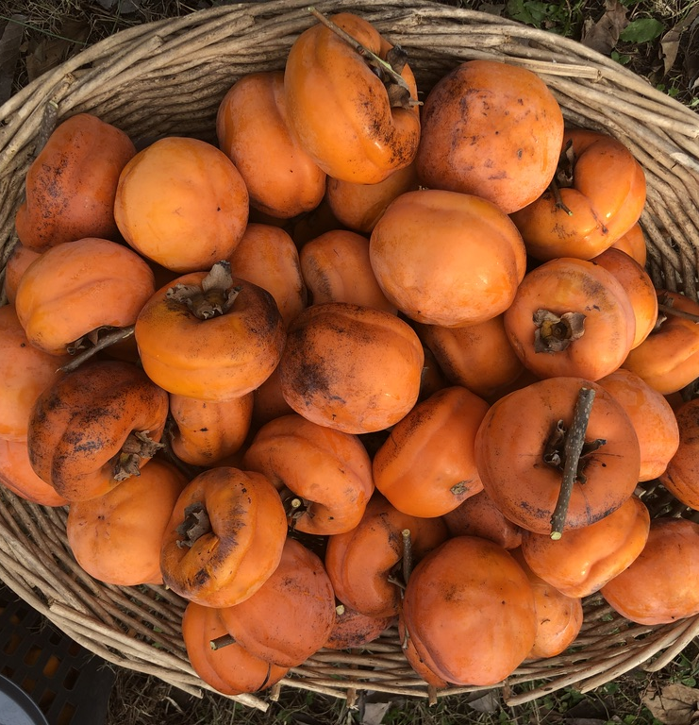
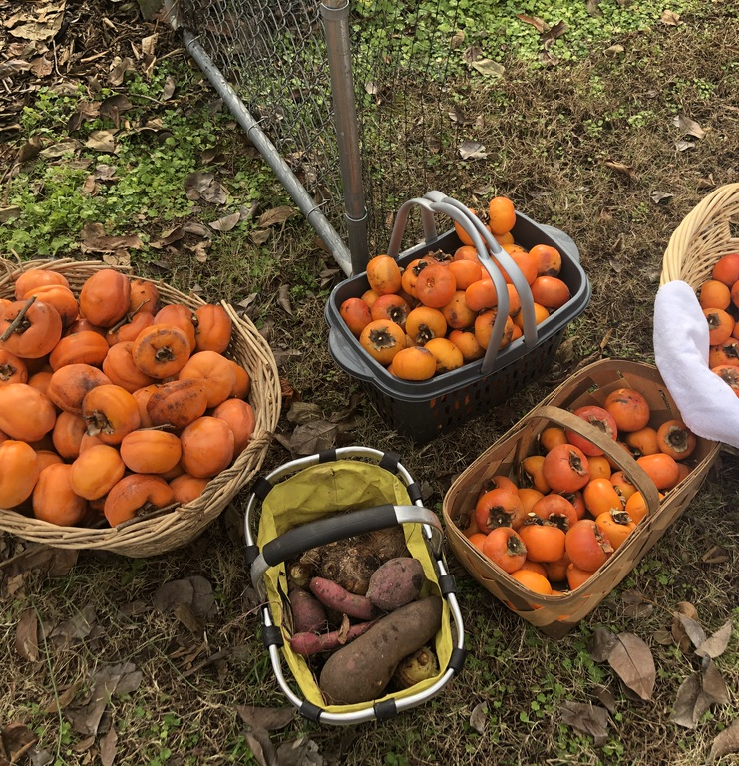

Slide 11
JESUS IS MY FRIEND 耶稣是我的朋友
THE PRINCE OF PEACE ILLUSTRATION A man was swimming in the morning and was having fun. (My Dad also loves to swim in the Okinawa Ocean) but I always tell him not to swim alone. This man did, and suddenly a dense fog came and he didn't know which direction is the shore. Start to panic, increased his heart beat and cramp. He could've drowned.

Slide 12
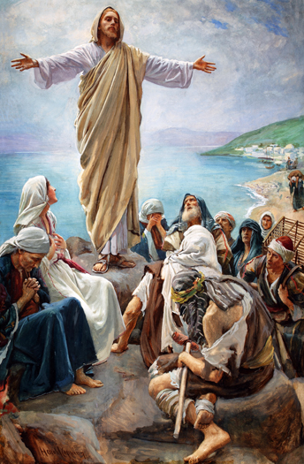
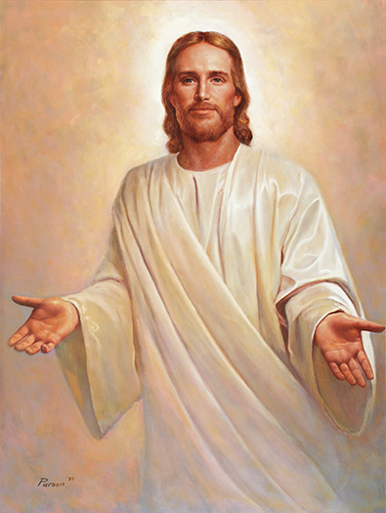
Prince
Of Peace
和平之君
Advent:
Hope盼望
Peace平安
Love爱
Joy喜乐
Christ基督

