Slide 1
CHRISTIAN MATURITY (4) SUFFERING IS INEVITABLE 成熟的基督徒 （4） 苦难是不可避免的事
I PETER 4:12-19
彼得前书四章十二-十九节

Slide 2
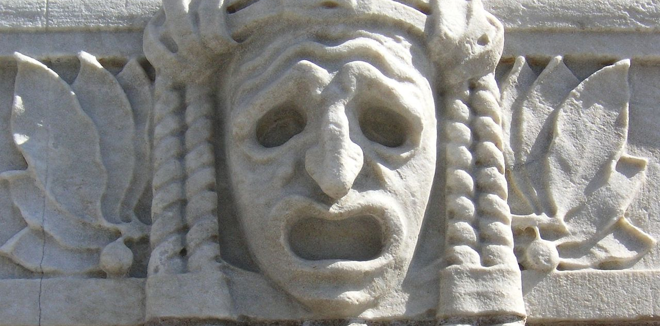

Slide 3
苦难的解释：
The word suffering is sometimes used in the narrow sense of physical pain, but more often it refers to mental pain, or more often yet it refers to pain in the broad sense, i.e. to any unpleasant feeling, emotion or sensation. The word pain usually refers to physical pain, but it is also a common synonym of suffering.
什么是苦难？
疼痛的意思是包括我们的三个体： 1. 肉体（身体） 2. 魂体 3. 灵体

Slide 4
SUFFERING IS INEVITABLE 受苦是不可避免的事
Suffering is for everyone Vs. 12 "fiery trial to test you. 有火炼的试炼。。”
Deserved Suffering 因得的报应; Innocent suffering 自然界的受苦 ; and Righteous suffering 为义受苦

Slide 5
SUFFERING IS INEVITABLE 受苦是不可避免的事
Suffering is differentiated 受苦有别
Physical 肉身的痛苦
Psychological (mental)心里/精神的痛苦
Spiritual 灵里的痛苦

Slide 6
SUFFERING IS INEVITABLE 受苦是不可避免的事
Suffering is differentiated 受苦有别
Physical 肉身的痛苦
We are all Aging the minute we are born, inevitable we will have poor health
Pray for Me

Slide 7
SUFFERING IS INEVITABLE 受苦是不可避免的事
Suffering is differentiated 受苦有别
Psychology or mental 心里/精神的痛苦
Today's Age, Many are into this suffering

Slide 8
SUFFERING IS INEVITABLE 受苦是不可避免的事
Suffering is differentiated 受苦有别
Spiritual （ Because you believe in jesus）。 灵里的痛苦 （为义受苦）因为相信耶稣为主。
Illustration of Carl's garden

Slide 9
SUFFERING IS INEVITABLE 受苦是不可避免的事
Suffering is the will of god Vs. 14, 16, 19
Illustration of the story of the man born blind in John 9:3 "It was neither that this man sinned, nor his parents...也不是这人犯了罪，也不是他父母犯了罪，是在他身上显出神的作为来。"

Slide 10
SUFFERING IS INEVITABLE 受苦是不可避免的事
What to do amidst suffering? Vs. 13
1. the origin of your suffering为什么受苦？
2. pray and seek God's guidance 祷告寻求神
4. learn to rejoice and trust god 信心学习

Slide 11
SUFFERING IS INEVITABLE 受苦是不可避免的事
Perfect love drives out fear。 完全的爱会把惧怕除去 I john 约翰一书4:18 "There is no fear in love, but perfect love casts out fear. For fear has to do with punishment, and whoever fears has not been perfected in love. 爱里没有惧怕；爱即完全，就把惧怕除去，因为惧怕里含着刑罚；惧怕的人在爱里未得完全。"

