Slide 1
CHRISTIAN MATURITY (3) LOVE IN OUR HOME 成熟的基督徒（3） 爱在我们的家
I PETER 3:1-10
彼得前书三章一到十节

Slide 3
LOVE FROM THE WIFE 妻子的爱 Vs. 1-6
Subject to the husband。 顺服丈夫
Won over without a Word and Pure Conduct 被感化
Be Respectful 贞洁的品行和敬畏的心

Slide 4
LOVE FROM THE WIFE 妻子的爱 Vs. 1-6
Love does not show from exterior adornment。 爱不是看外表，所以辫头发，戴金饰，穿美衣不是最重要的
Gentile and Quiet Spirit be the chief adornment 要温柔，心里安静的心为妆饰

Slide 5
LOVE FROM THE WIFE 妻子的爱 Vs. 1-6
Holy Women of the Past Submit to their husbands 过去的妇女也是顺服丈夫
Do Good like Sarah 就如撒拉一样的顺服亚伯拉罕
Not in Fear but of Love 顺服不是恐惧而是爱的关系

Slide 6
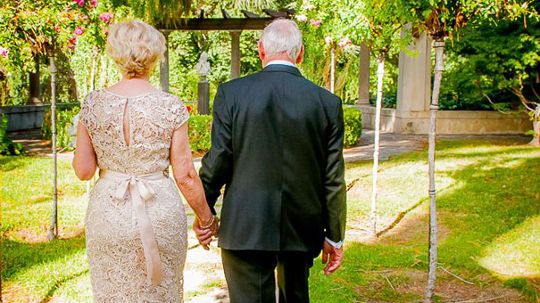
Notes:
A Wife who supported her husband all through her life. When he had Alzeheimer and couldn't remember proposed to her and she said yes. He died but was well cared by her and never missed a day to not hear her say "I Love You" until death do us apart.

Slide 7
LOVE FROM THE HUSBAND 丈夫的爱 Vs. 7
Live in an Understandable way。 按着知识和妻子合作
Showing Honor to the Wives as Weaker Vessel 妻子是器皿上的软弱 （今天还是女人比较力量软弱）

Slide 8
LOVE FROM THE HUSBAND 丈夫的爱 Vs. 7
Heirs Together 一同承受生命之恩
Show Respect 要敬重妻子
Prayers May Not be Hindered 祷告就没有阻碍

Slide 9
A HUSBAND'S TRUE LOVE
一位有爱的丈夫
Notes:
A heart warming farewell gift.

Slide 10
LOVE FROM EVERYONE 弟兄姐妹们的爱 Vs. 8-10
Unity of Mind 同心
Sympathy in Brotherly Love 彼此体恤
Brotherly Love and Tender Heart彼此相爱存慈悲的心
Humble Mind 要有谦卑的心

Slide 11
LOVE FROM EVERYONE 弟兄姐妹们的爱 Vs. 8-10
Do Not Repay Evil for Evil 不要以恶报恶
Bless and Be Blessed 祝福人也会被祝福
Keep the Tongue from Evil 禁止舌头不说恶言
No Deceit from the Lips 禁止舌头不说诡诈的话

Slide 12
LOVE CENTERED ON GOD
爱在你的家吗？耶稣就是爱！

Slide 13
COMMUNION
摆饼圣餐
I John 4:7-8
约翰一书4:7-8 “亲爱的弟兄啊，我们因当彼此相爱，
因为爱是从神来的。凡有爱心的，
都是由神而生。并且认识神。没有爱心的，
就不认识神，因为神就是爱。”

