Slide 1
CHRISTIAN MATURITY (1) HOLY LIVING 基督徒成长的身量 （1） 圣洁的生活 I PETER 1:15-25 彼得前书一章十五-二十五节

Slide 2
SEVEN SIGNS OF CHRISTIAN IMMATURITY 七个基督徒不成熟的标志
1. PITY PARTY 可怜自己
2. BLAME GAME错怪别人
3. HASTY DECISION 太快的决定

Slide 3
SEVEN SIGNS OF CHRISTIAN IMMATURITY 七个基督徒不成熟的标志
4. FEAR FACTOR 惧怕事情
5. ANGRY ISSUE 动怒，失去控制
6. LACK OF TRUST 不信任
7. TEMPTING GOD, DISOBEY 试探神，不服从神

Slide 4
We are holy 15-16 我们是圣洁的
"He who called you is holy, you also be
holy in all your conduct. Since it is
written, You shall be holy, for I am Holy.
那召你们的即是圣洁，你们在一切所行的事上
也要圣洁；因为经上记着说：你们要圣洁，
因为我是圣洁的。”

Slide 5
The great scientist Isaac Newton once tried an experiment by looking directly at the Sun. It was recorded: "The brightness burned into his retina, and he suffered temporary blindness. Even after he hid for three days behind closed shutters, still the bright spot would not fade from his vision. If he had stared a few minutes longer, Newton might have permanently lost all vision. The chemical receptors that govern eyesight cannot withstand the full force of unfiltered sunlight. " This a great lesson for all of us. We can live with God of the Universe, by living a Holy Life, but can never be greater than God. As illustrated by the children of Israel. God is holy and they must be holy. However, out of thousands of Israelites, only Joshua and Caleb went into the Promise Land!

Slide 6
We fear god (17) 我们惧怕（敬畏）神
"conduct yourselves with FEAR throughout the time of your exile.
你们既称那不偏待人，按各人行为审判人的主为父，
就当存敬畏的心，度你们在世寄居的日子."

Slide 7
Illustration:
1. The Fear of the King一位国王的惧怕
2. "We fear men much because we
Fear God little我们惧怕人是因为我们
不惧怕神！"
3. If you don't fear God, you will fear
Everything. Vice Versa Truth要是你
惧怕神，那你什么都不会惧怕了！

Slide 8
We WERE ransomed (18-19) 我们得赎
“Knowing that you were ransomed from the futile ways inherited from your forefathers, not with perishable things such as silver or gold, but with the precious blood of Christ, like that of a lamb without blemish or spot.
知道你们得赎，脱去你们祖宗所传流虚妄的行为，不是凭着能坏的金银等物，乃是凭着基督的宝血，如同无瑕疵，无沾污的羔羊之血."

Slide 9
We are at the end time (20-21) 我们在末世中
"He was foreknown before the foundation of the world but was made manifest in the LAST TIMES for the sake of you....so that your faith and hope are in God.
基督在创世以前是预先被神知道的，却在这末世才为你们显现。你们也因着他，信那叫他从死里复活，又给他荣耀的神，叫你们的信心和盼望都在于神."

Slide 10
WE OBEY the truth (22) 我们顺从真理
"Having purified your souls by your obedience to the truth for a sincere brotherly love, love one another earnestly from a pure heart.
你们既因顺从真理，洁净自己的心，以致爱弟兄没有虚假，就当从心里彼此切实相爱."
Illustration: The Love of God

Slide 11
We HAVE BEEN born again (23) 我们蒙了重生
"Since you have been born again, not of perishable seed but of imperishable, through the living and abiding word of God.
你们蒙了重生，不是由于能坏的种子，乃是由于不能坏的种子，是藉着神活泼常存的道."

Slide 12
We are temporary ON EARTH (24) 我们在世是暂时的居民
"For all flesh is like grass and all its glory like the flower of grass. The grass withers and the flower falls.
因为凡有血气的，尽都如草，他的美荣都象草上的花。草必枯干，花必凋谢."

Slide 13
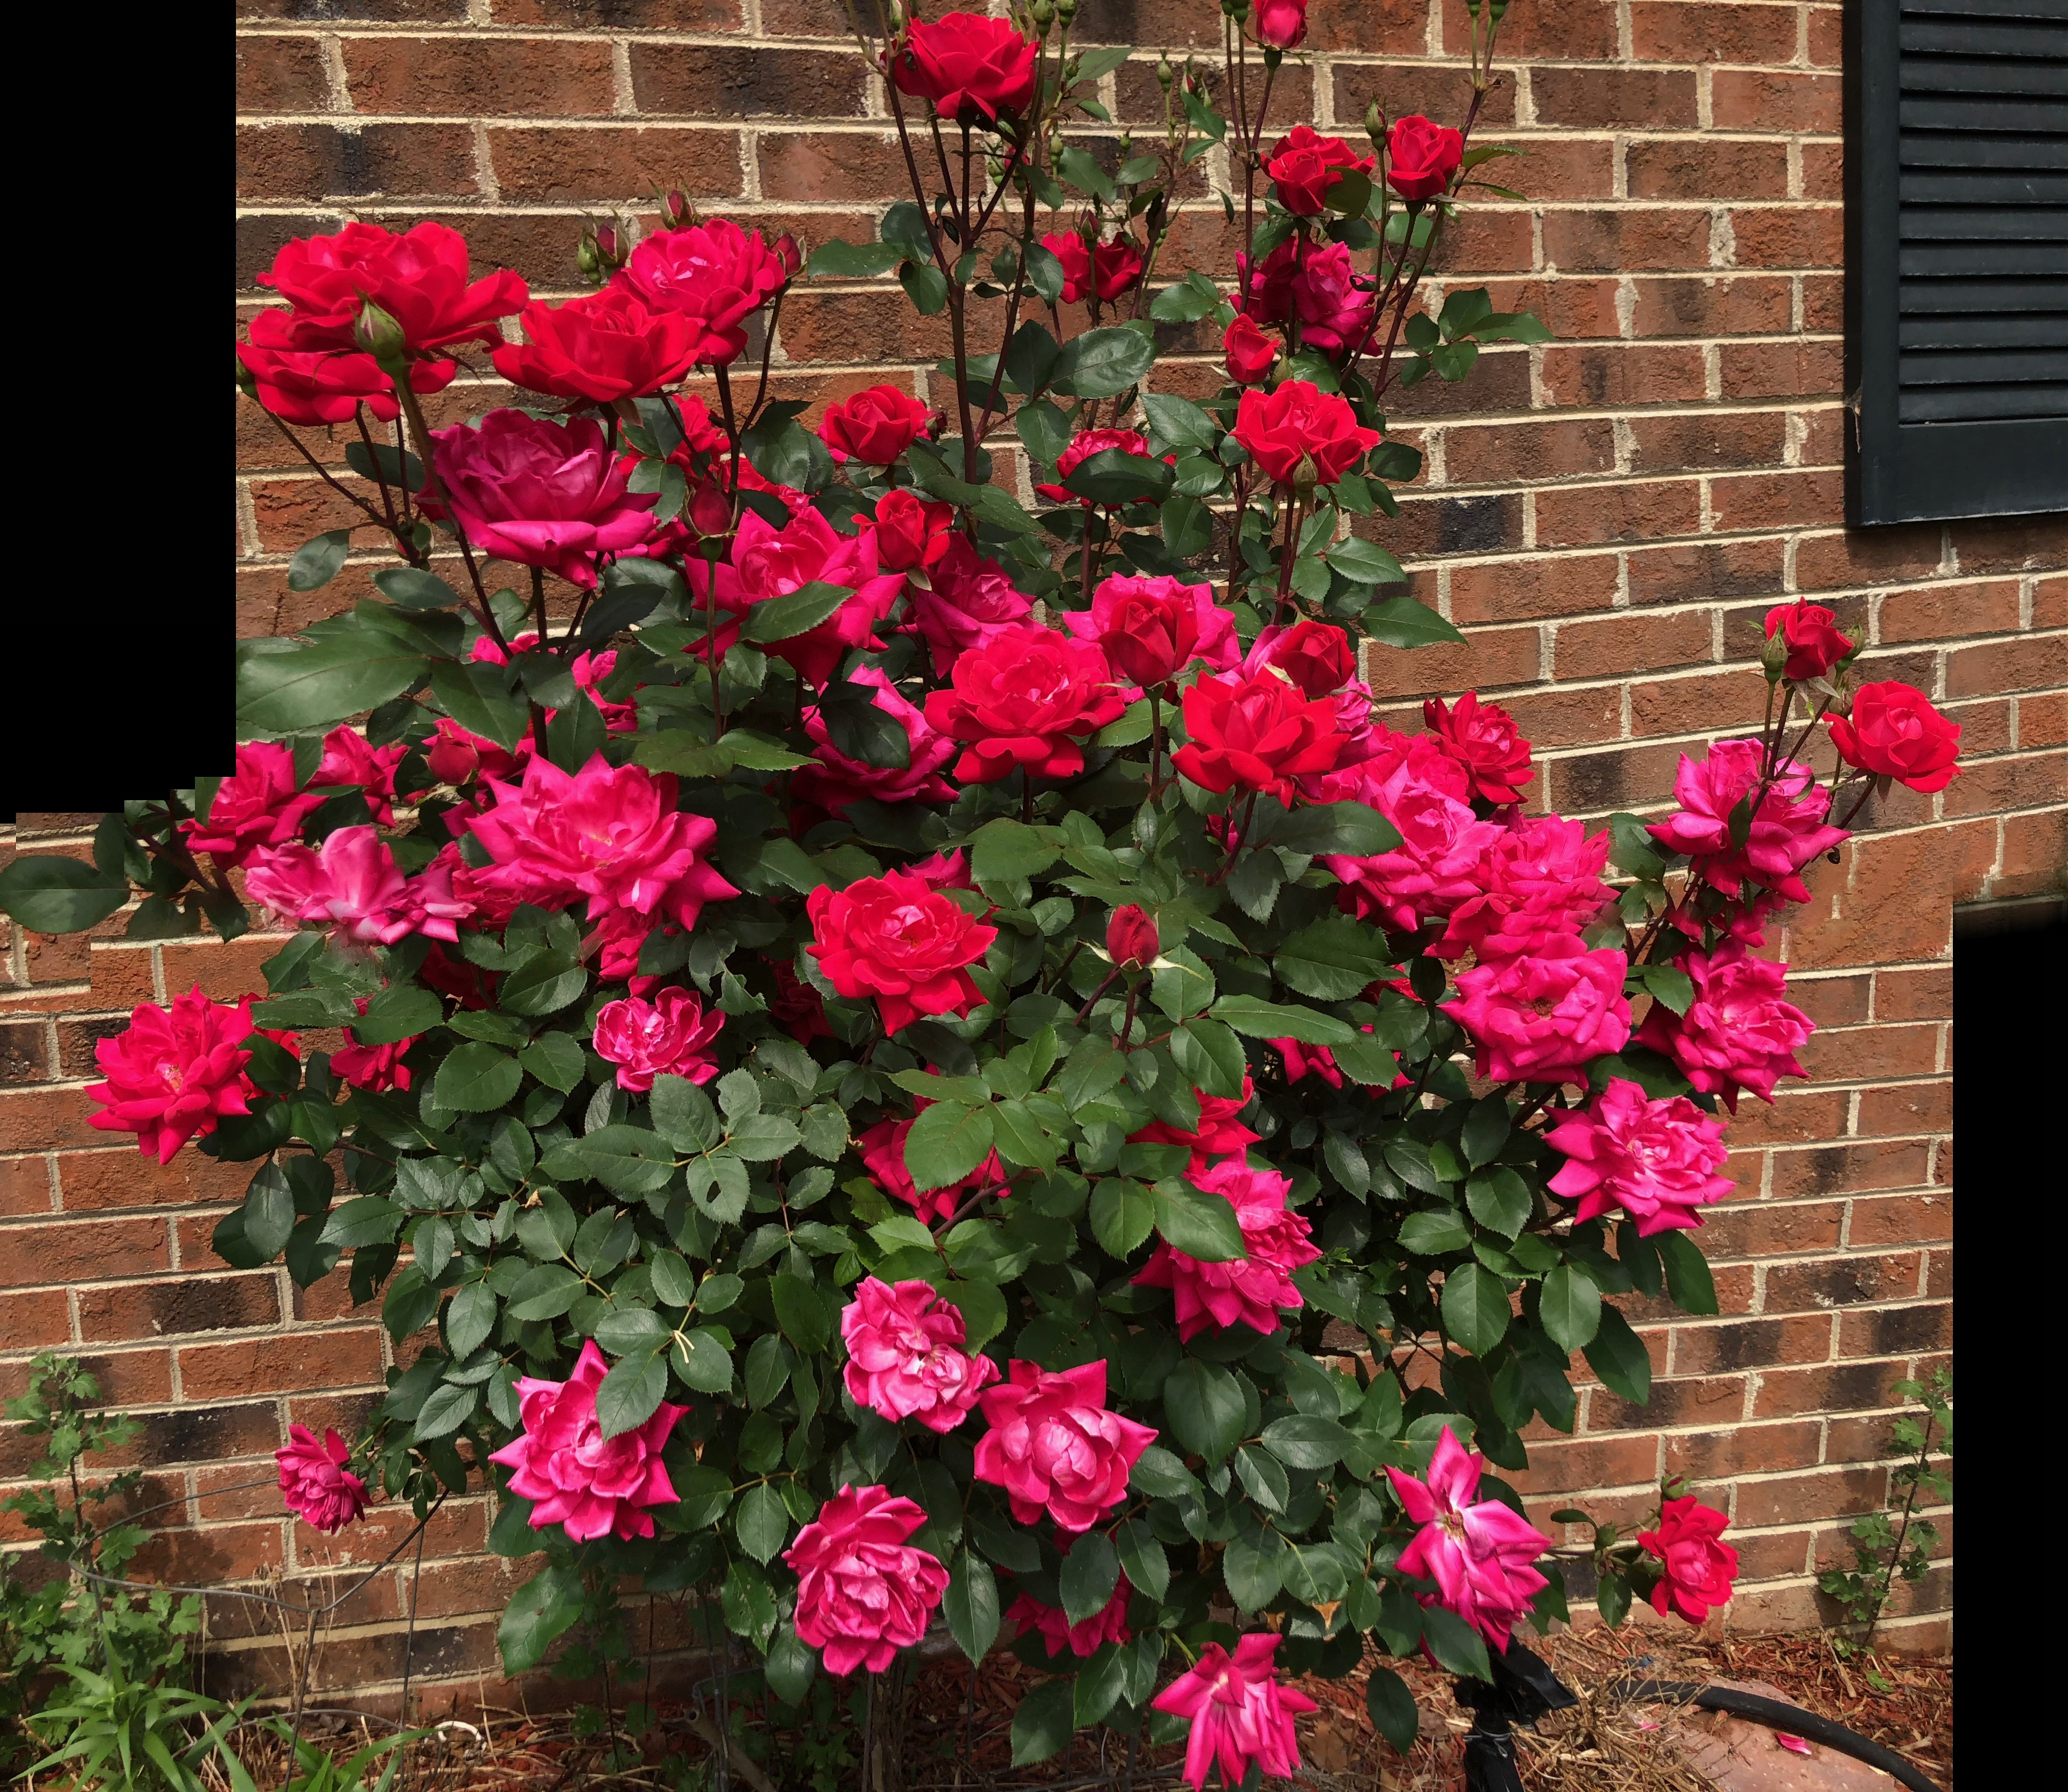
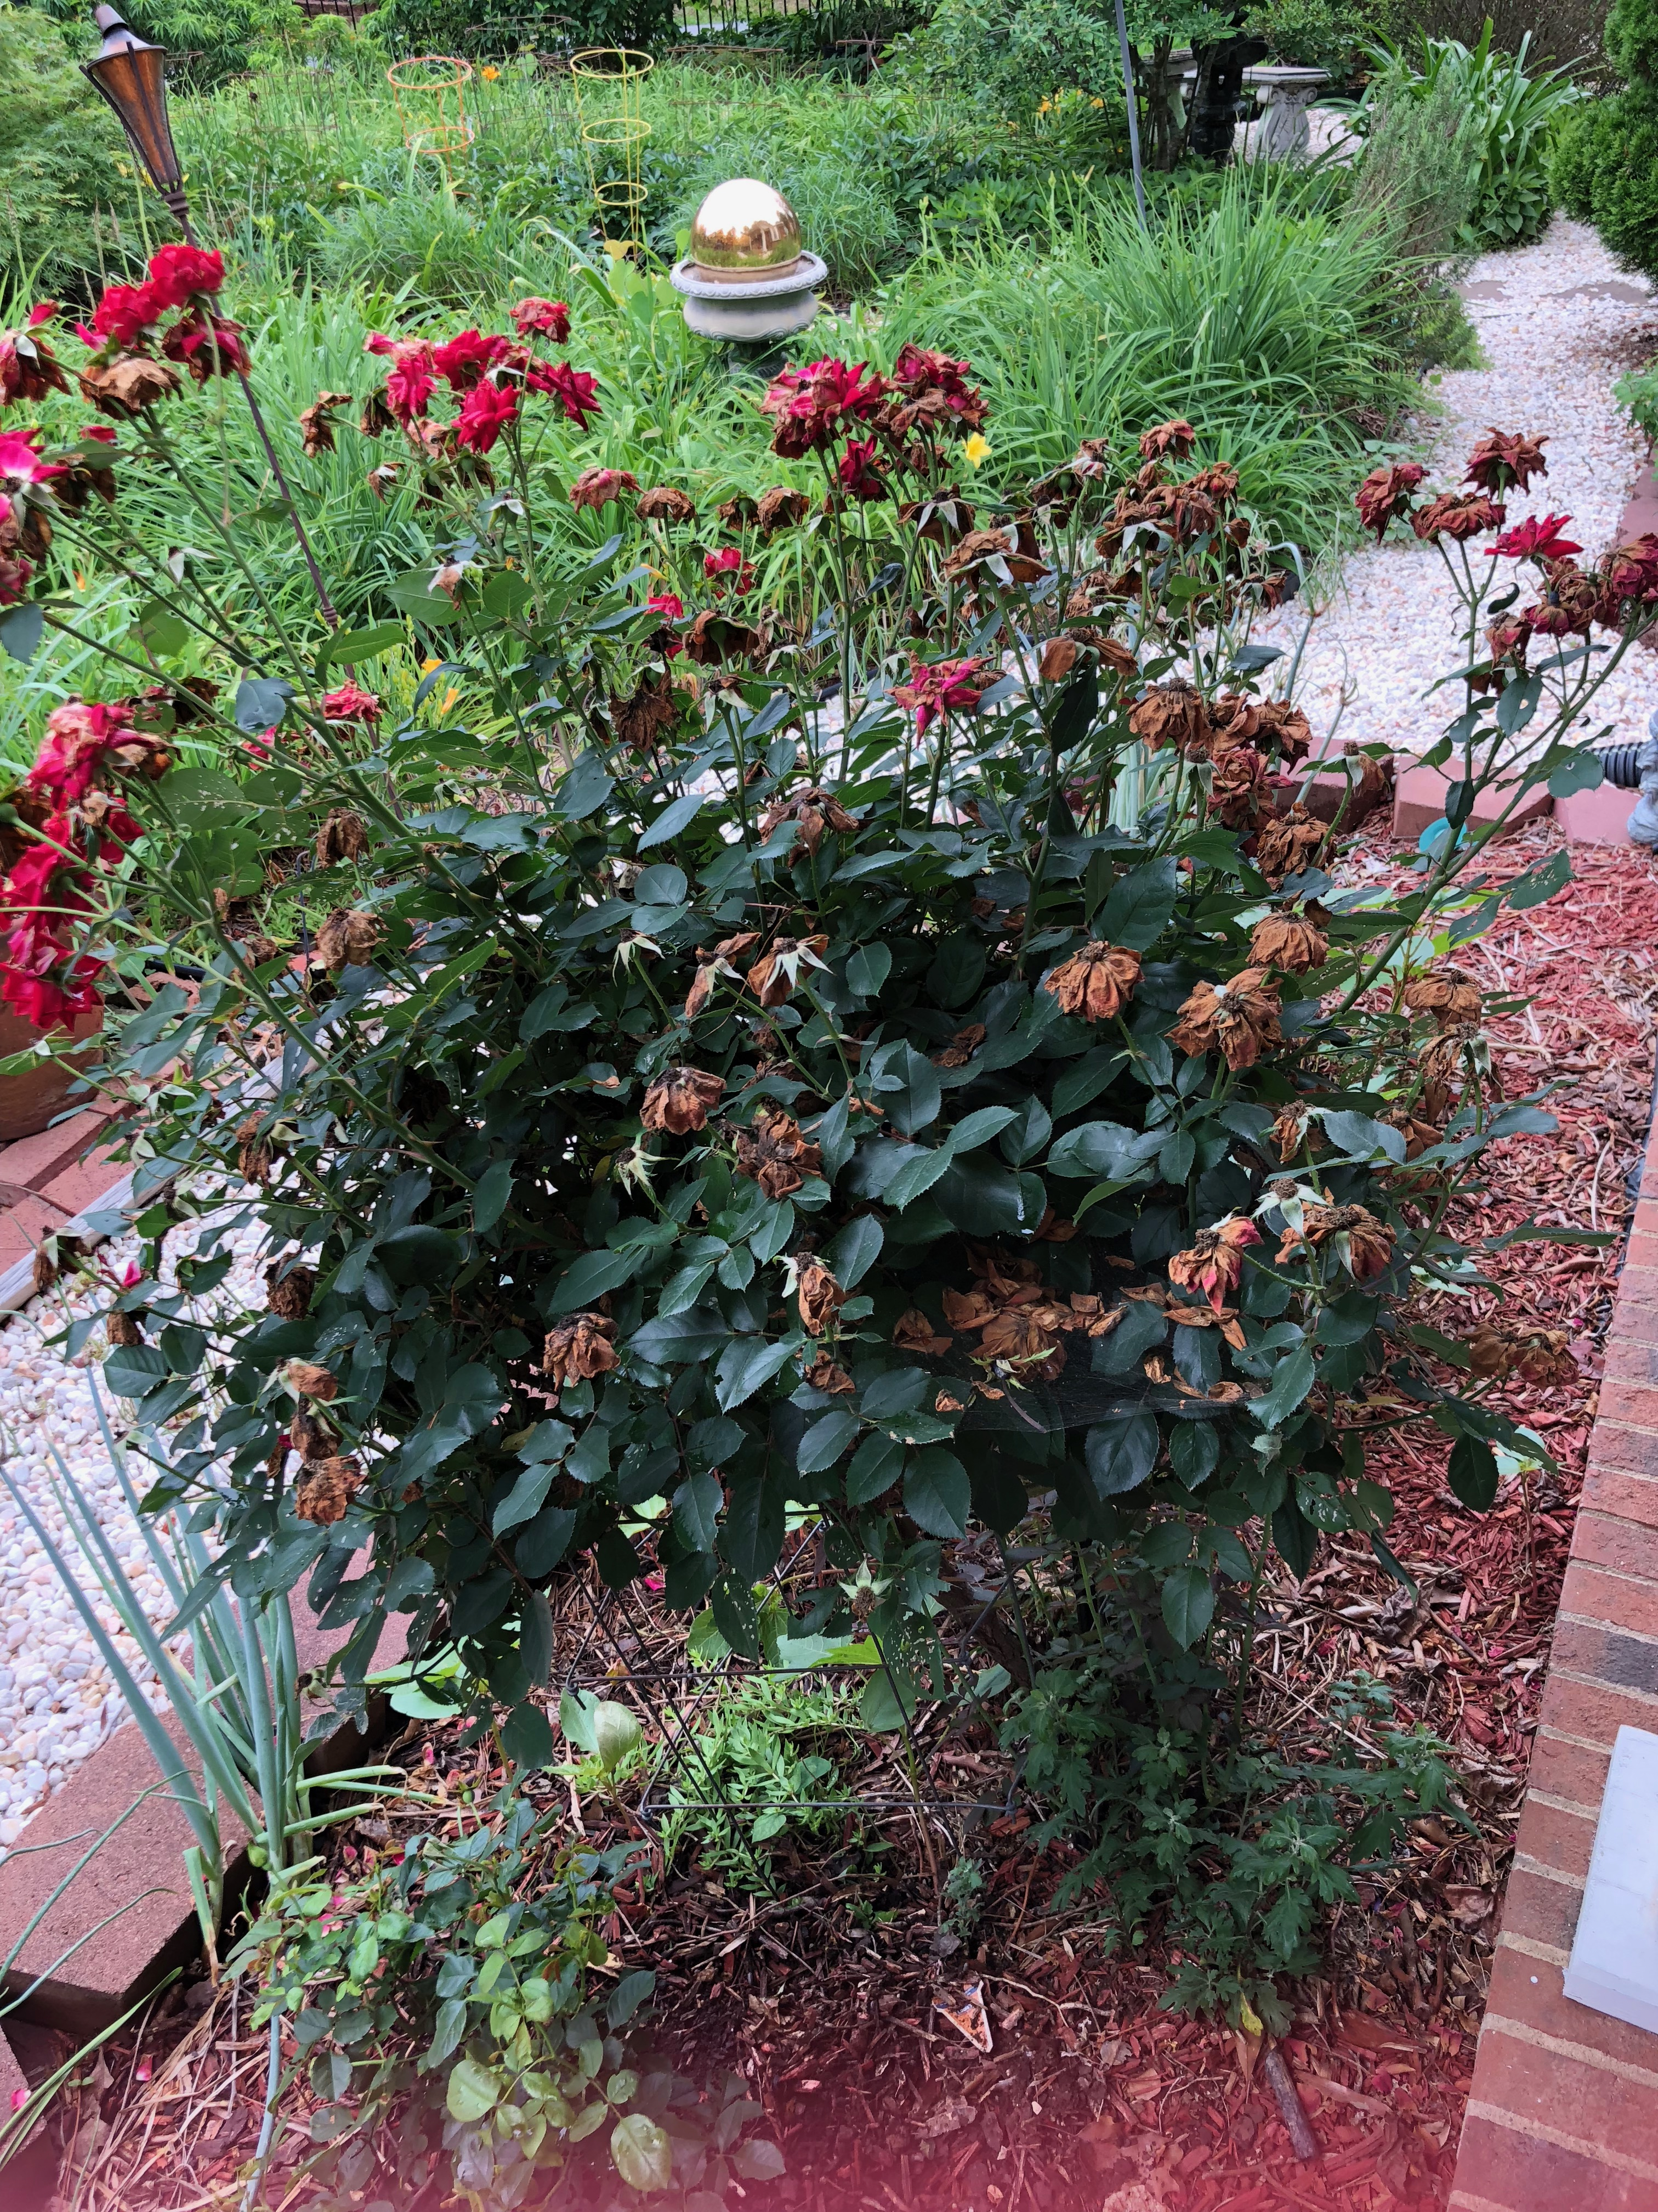

Slide 14
WE HAVE GOD'S WORD FOREVER (25) 我们永远有神的话 （道）
"but the WORD of the Lord remains forever. And this WORD is the GOOD NEWS that was preached to you.
惟有主的道是永存的。所传给你们的福音就是这道."
Illustration: "Are You Jesus?"

