Slide 1
MATURE CHRISTIANS (2) HOLY ROYAL PRIESTHOOD 成熟的基督徒 （2） 圣洁君尊的祭司
I PETER 2:1-10
彼得前书二章一到十节

Slide 2
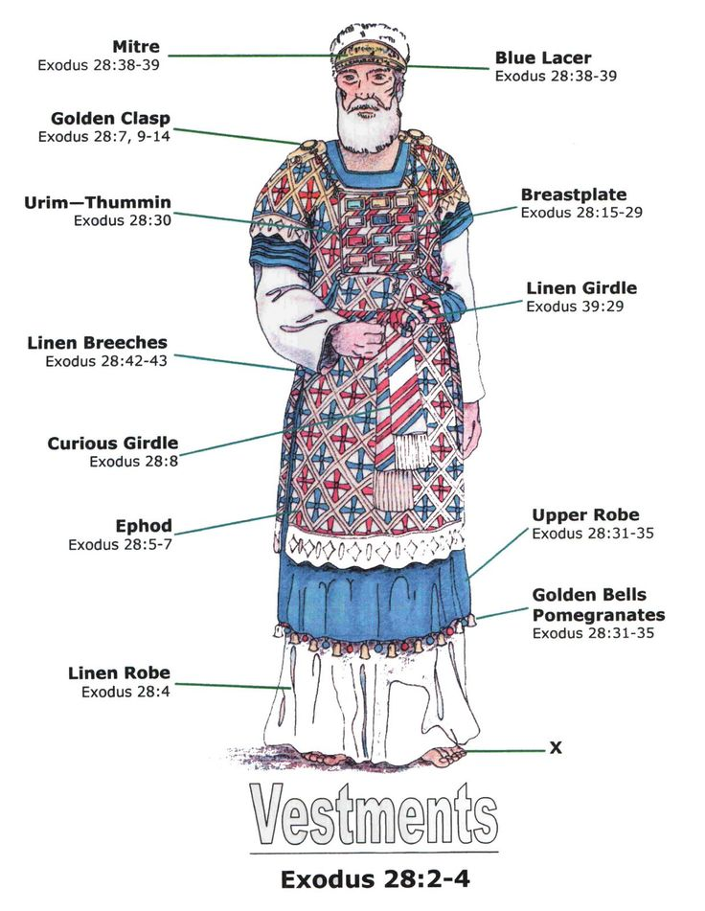
WHAT IS A PRIEST?
1. A Mediator 调解者
between God and Men
2. Offers Sacrifice to God on
Behalf of men献祭
3. Administers worship obligation
That people felt unworthy to
Offer personally 主持聚会，代替
百姓（不配因为自己的罪）

Slide 3
Why priesthood? 为什么要作祭司？
"For every high priest, being taken from among men, is appointed for men in things pertaining to God, that he may offer both gifts and sacrifices for sins." Hebrews 5:1

Slide 4
Why priesthood? 为什么要作祭司？
“凡从人间挑选的大祭司，是奉派替人办理属神的事，为要献上礼物和赎罪祭 （或作‘要为罪献上礼物和祭物’）” 希伯来书5:1

Slide 5
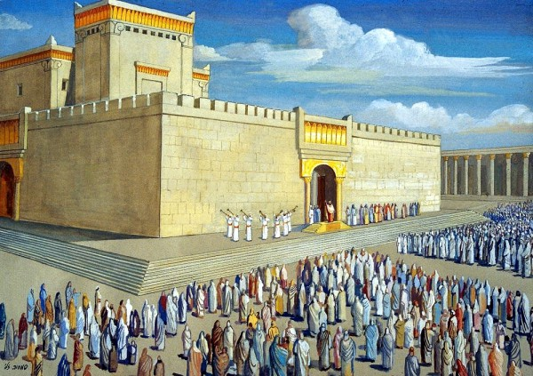
TEMPLE
THE ROLE
OF PRIEST
所罗门的
圣殿，祭司
作为神的代表
作神的事工

Slide 6
WHAT DO PRIESTS DO? 祭司的责任是什么？
Divine Choice神亲自拣选
Representation代表神人关系
Offering Sacrifice主持献祭
Intercession代人求情（祷告，辅导，礼节）

Slide 7
WhO ARE THE priestS? (POSITION) 谁作祭司？(牧师的职位）
CHOSEN BY GOD神呼召
ORDAINED BY MEN人前任命，被按立
SPECIAL EDUCATION AND TRAINING特别教育和训练
TAKEN CARE BY THE CHURCH教会照顾

Slide 8
Priest's Position and function 所有祭司的运作（运用）
ALL BORN AGAIN CHRISTIANS重生的
PRIESTHOOD OF ALL BELIEVERS重生的基督徒都要做祭司的运作
JESUS CHRIST LED AS EXAMPLE耶稣的榜样

Slide 9
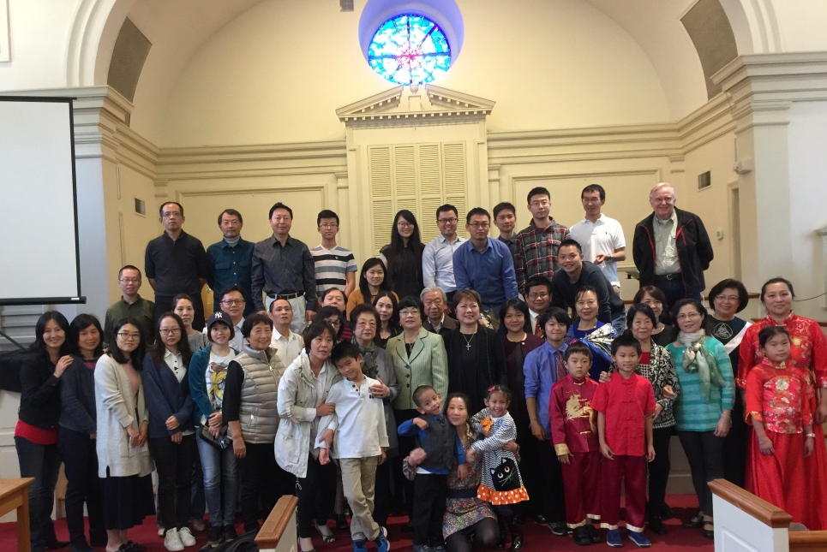
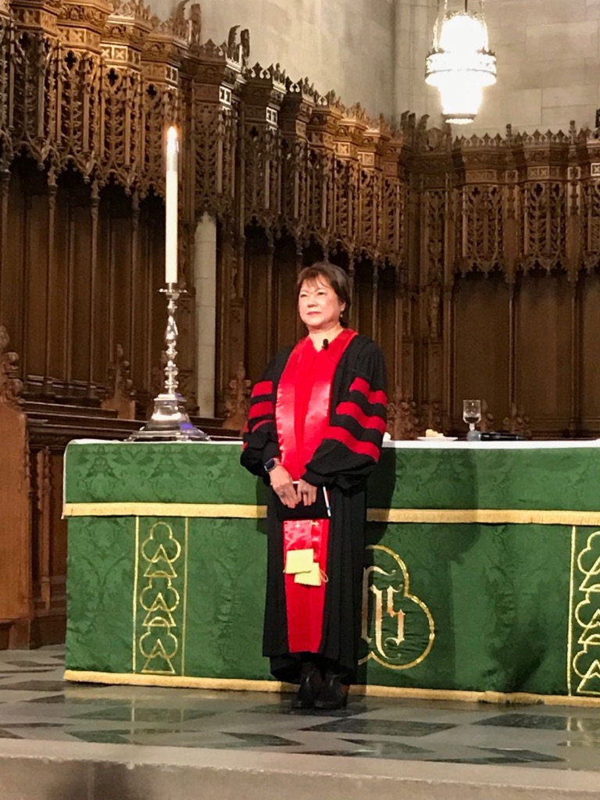
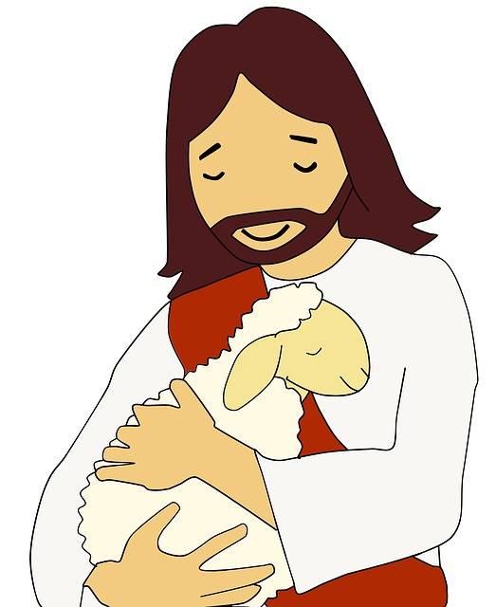

Slide 10
QUALIFICATIONS OF THE PRIESTS 祭司运用的资格1-3
Put away all malice, start like newborn infants, tasted the Lord is good “要除去一切恶毒，诡诈，假善，嫉妒和一切毁谤的话。爱慕纯洁的灵奶，因此渐长，以致得救”

Slide 11
QUALIFICATIONS OF THE PRIESTS 祭司运用的资格4-5
God is a living stone 主乃是活石，固然是被人所弃的，却是被神所拣选所宝贵的。你们来到主面前，也就象活石，被建造成为灵宫，作圣洁的祭司，藉着耶稣基督奉献神所喜悦的灵祭。”

Slide 12
QUALIFICATIONS OF THE PRIESTS 祭司运用的资格6-7
A Cornerstone chosen and precious ..The stone that the builders rejected has become the cornerstone “看哪！为把所拣选，所宝贵的房角石安放在锡安；信靠他的人必不至于羞愧。他在你们信的人有话说：匠人所弃的石头，已作了房角的头快石头。”

Slide 13
QUALIFICATIONS OF THE PRIESTS 祭司运用的资格8
A stone of stumbling, a rock of offense. “作了绊脚石头，跌人的磐石。他们既不顺从，就在道理上绊跌。。惟有你们是被拣选的族类，是君尊的祭司，是圣洁的国度，是属神的子民，要叫你们宣扬那召你们出黑暗奇妙光明者的美德。”

Slide 14
QUALIFICATIONS OF THE PRIESTS 祭司运用的资格9
"But you are a chosen race, a royal priesthood, a holy nation, a people for his own possession, that you may proclaim the excellencies of Him who called you out of darkness into His marvelous light."

Slide 15
QUALIFICATIONS OF THE PRIESTS 祭司运用的资格9
惟有你们是被拣选的族类，是有君尊的祭司，是圣洁的国度，是属神的子民，要叫你们宣扬那召你们出黑暗入奇妙光明者的美德。”

Slide 16
QUALIFICATIONS OF THE PRIESTS 祭司运用的资格10
“Once you were not a people, but now you are God's people; once you had not received mercy, but now you have received mercy. 你们从前算不得子民，现在却作了神的子民；从前未曾怜恤，现在却蒙了怜恤。”

Slide 17
Josh
McDowell's
Story:
Evidence
Demands a
Verdict
铁证待判

Slide 18
