Slide 1
GROW UP 长大成人
NUMBERS 14:1-24
民数记十四章一到二十四节

Slide 2
“Infantile love 不成熟的爱follows the principle: "I love because I am loved我爱因为我被爱." Mature love 成熟的爱follows the principle: "I am loved because I love我被爱是因为我爱." Immature love 不成熟says: "I love you because I need you我爱因为我需要你." Mature love 成熟says: "I need you because I love you我需要你因为我爱你.” ― Erich Fromm, The Art of Loving

Slide 3
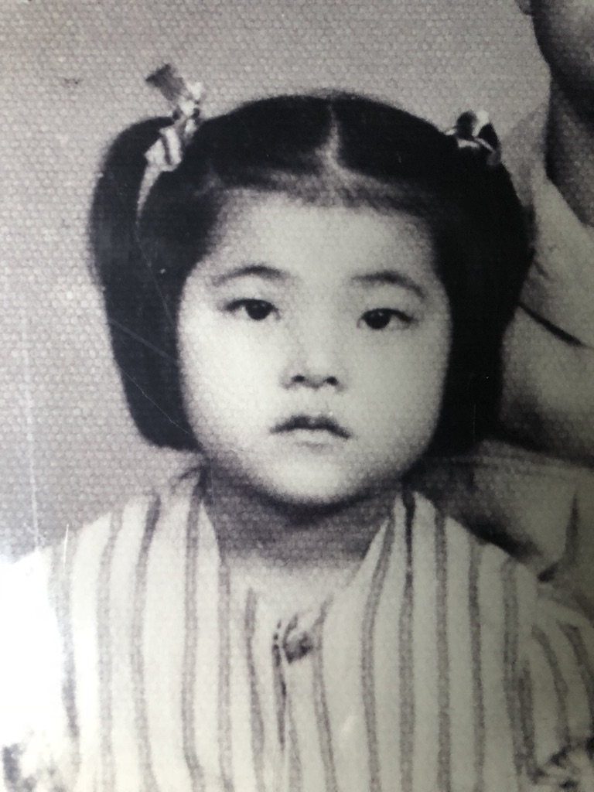
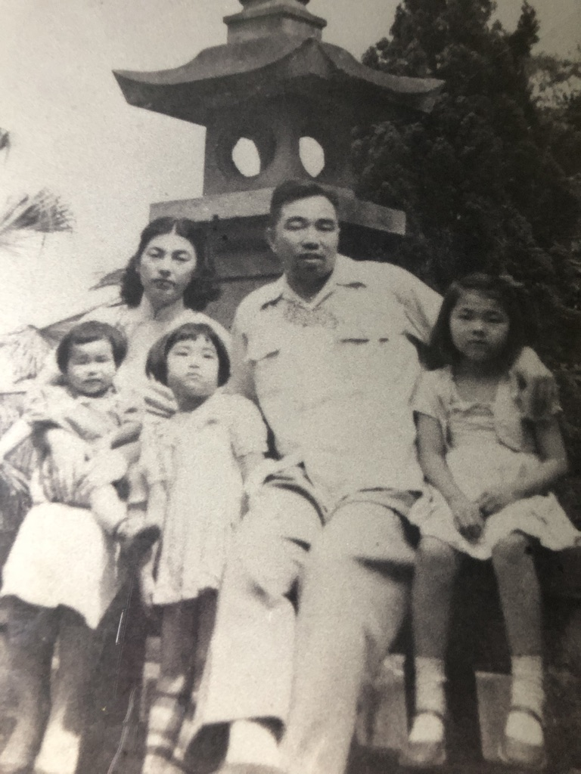

Slide 4
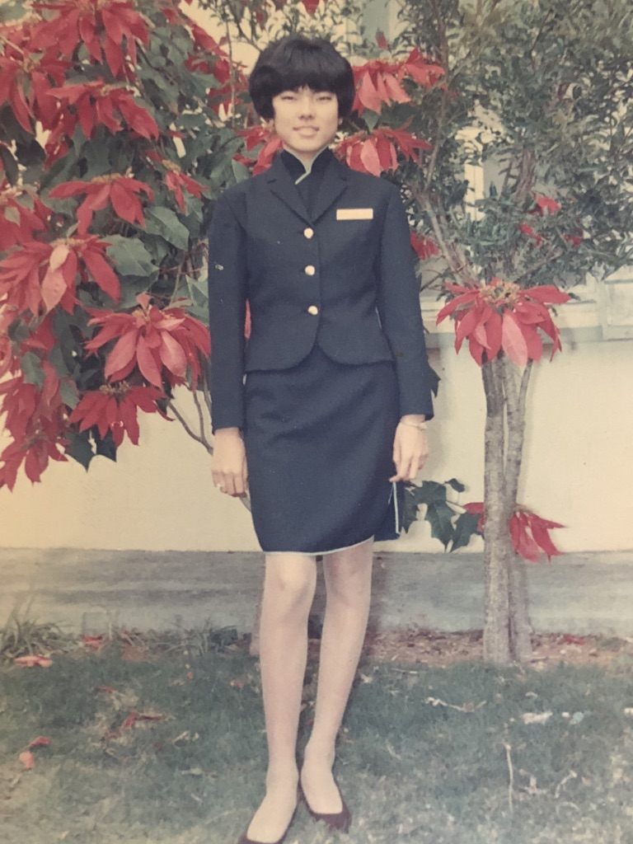

Slide 5
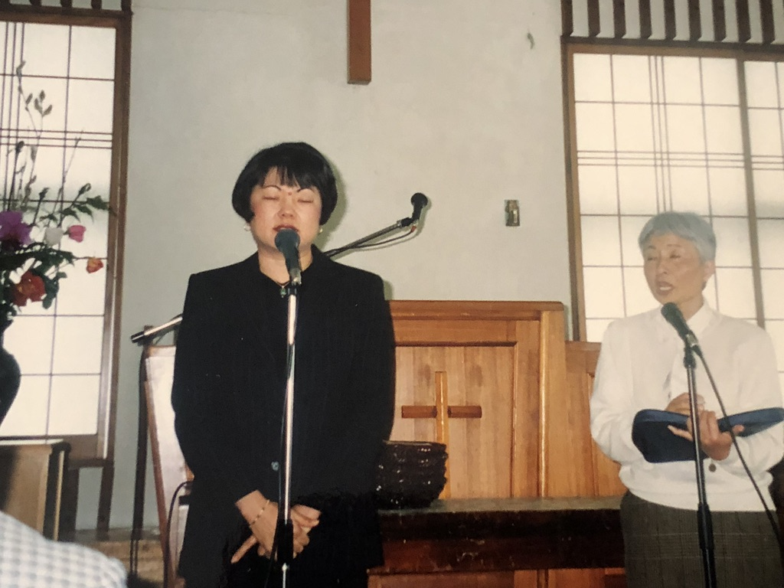
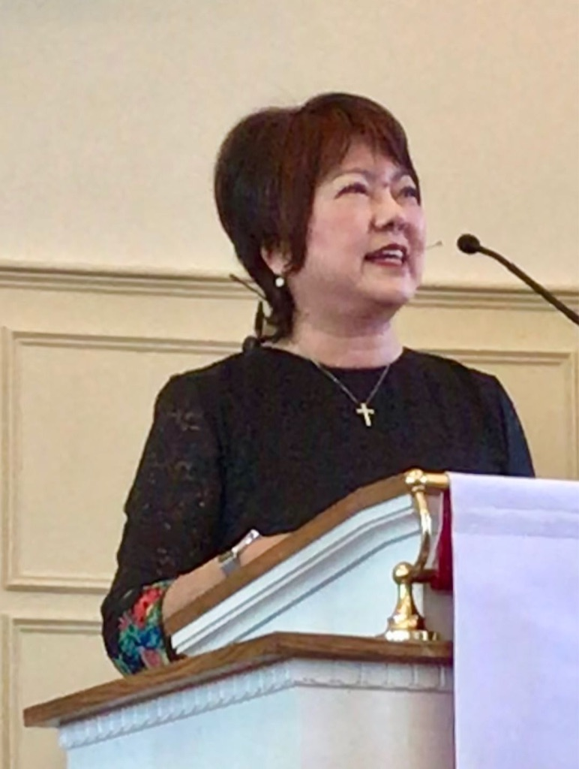

Slide 6
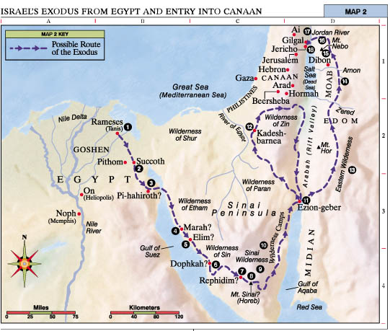

Slide 7
ISRAEL'S IMMATURITY 以色列百姓的不成熟
14:1-2 PITY PARTY可怜自己 " Then all the congregation raised a loud cry, and the people wept that night. 当下，全会众大声喧嚷，那夜百姓都哭号。以色列众人向摩西，亚伦发怨言，全会众对他们说：巴不得我们早死在埃及地，或是死在这旷野。”

Slide 8
ISRAEL'S IMMATURITY 以色列百姓的不成熟
14:3 BLAME GAME怪比人 "Why is the Lord bringin us into this land? 耶和华为什么把我们领到那地，使我们倒在刀下呢？我们的妻子和孩子必被掳惊，我们回埃及去岂不好吗？”

Slide 9
ISRAEL'S IMMATURITY 以色列百姓的不成熟
14:4 HASTY DECISION不考虑作急的决定 "And they said to one another, Let us choose a leader and go back to Egypt. 众人彼此说： 我们不如立一个首领，回埃及去吧！“

Slide 10
ISRAEL'S IMMATURITY 以色列百姓的不成熟
14:9 FEAR FACTOR惧怕失去理智 "Do not rebel against the Lord. And do not FEAR the people of the land, for they are bread for us. Their protection is removed from them, and the Lord is with us; DO NOT FEAR THEM."

Slide 11
ISRAEL'S IMMATURITY 以色列百姓的不成熟
14:9 FEAR FACTOR惧怕失去理智 "但你们不可背叛耶和华，也不要怕那地的居民，因为他们是我们的食物，并且荫庇他们的已经离开他们，有耶和华与我们同在，不要怕他们！”

Slide 12
ISRAEL'S IMMATURITY 以色列百姓的不成熟
14:10 ANGRY ISSUE 怒气管制 "Then all the congregation said to stone them with stones.. 但全会众说：拿石头打死他们二人！忽然，耶和华的荣光，在会幕中向以色列众人显现。”

Slide 13
ISRAEL'S IMMATURITY 以色列百姓的不成熟
14:11 LACK OF TRUST不相信神 "And the Lord said to Moses, How long will this people despise me? 耶和华对摩西说：这百姓藐视我要到几时呢？我在他们中间行了这一切神迹，他们还不信我要到几时呢？”

Slide 14
ISRAEL'S IMMATURITY 以色列百姓的不成熟
14:22-24 REPEATEDLY TESTING GOD WITH DIESOBEDIENCE试探神（10次）"none of the men who have seen my glory and my signs that I did in Eqype and in the wilderness...shall see the land ...except Caleb and Joshua.

Slide 15
ISRAEL'S IMMATURITY 以色列百姓的不成熟
14:22-24 REPEATEDLY TESTING GOD WITH DIESOBEDIENCE试探神（10次）“这些人虽看见我的荣耀，和我在埃及与狂野所行的神迹，仍然试探我这十次，不听我的话。一个也看不见所应许之地。。唯独我的仆人迦勒。。”

Slide 16
Notes:
Not growing up has nothing to do with age, but factors below that Israel also showed. Do you know yourself, are you grown up? Let us examine that closely.

Slide 17
GAUGE YOURSELF 测验自己有没有不成熟
SIGNS OF IMMATURITY不成熟的标志:
1. PITY PARTY 可怜自己
2. BLAME GAME错怪别人
3. HASTY DECISION 太快的决定

Slide 18
GAUGE YOURSELF 测验自己有没有不成熟
SIGNS OF IMMATURITY不成熟的标志: :
4. FEAR FACTOR 惧怕，恐惧的控制
5. ANGRY ISSUE 容易发脾气，失去控制
6. LACK OF TRUST不信任神

Slide 19
GAUGE YOURSELF 测验自己有没有不成熟
SIGNS OF IMMATURITY不成熟的标志: :
7. TESTING GOD WITH DISOBEDIENCE 经常试探神，不只是一次两次（以色列在旷野试探神十次）

Slide 20
COMMUNION 摆饼圣餐
EPHESIANS 4:13 "THIS WILL CONTINUE UNTIL WE ALL COME TO SUCH UNITY IN OUR FAITH AND KNOWLEDGE OF GOD'S SON THAT WE WILL BE MATURE IN THE LORD, MEASURING UP TO THE FULL AND COMPLETE STANDARD OF CHRIST. THEN WE WILL NO LONGER BE IMMATURE LIKE CHILDREN..."

Slide 21
COMMUNION 摆饼圣餐
以弗所书4:13 “直等到我们众人在真道上同归于一，认识神的儿子，满有基督长成的身量，使我们不再作小孩子。。”

