Slide 1
A MOTHER'S PRAYER 一位母亲的祷告
I SAMUEL 2:1-10
撒母耳记上二章一到十节

Slide 2
Mother Praying for a Homeless Son
一位母亲为她的流浪儿子祷告

Slide 3
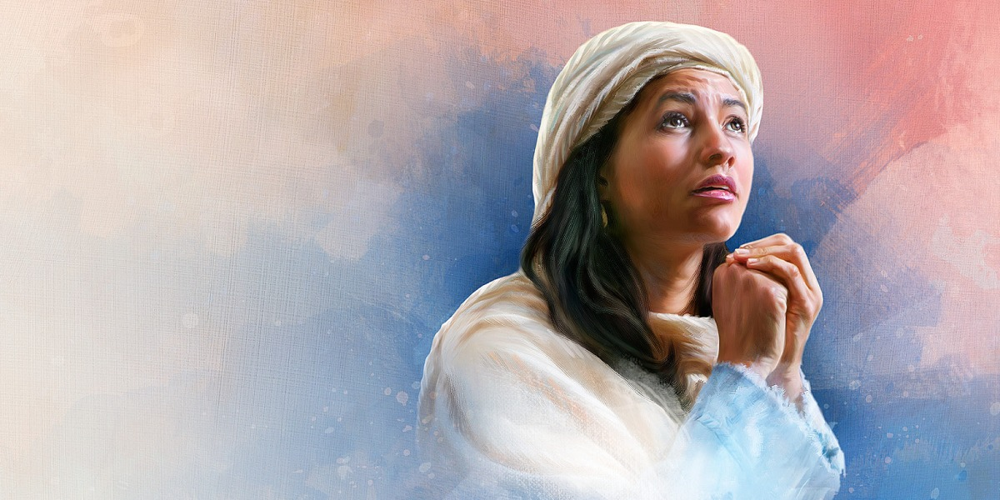
STORY OF HANNAH
I SAMUEL 1
哈拿的故事
撒母耳记上第一章

Slide 4
A WOMAN OF PRAYER 祷告的母亲
2:1-2 “My heart exults in the Lord...there is none holy like the Lord; for there is none besides you; there is no rock like our God." 哈拿祷告说：“我的心因耶和华快乐。我的角因耶和华高举。我的口向仇敌张开，我因耶和华的救恩欢欣！只有耶和华为圣，除他以外没有可比的，也没有磐石象我们的神。”

Slide 5
A WOMAN OF PRAYER 祷告的母亲
2:3-4 "Talk no more so very proudly, let not arrogance come from your mouth; for the Lord is a God of knowledge, and by Him actions are weighed....不要夸口说骄傲的话，也不要出狂妄的言语；因耶和华是大有知识的神，人的行为被他衡量。勇士的弓都已折断。跌倒的人以力量束腰。”

Slide 6
A WOMAN OF PRAYER 祷告的母亲
2:5-6 “The barren has born 7...The Lord kills and brings to life... The Lord kills and brings to life; he brings down to Sheol and raises up. 不生育的，生了七个儿子。耶和华使人死，也使人活，使人下阴间，也使人往上升。”

Slide 7
A WOMAN OF PRAYER 祷告的母亲
2:7-8 "The Lord makes poor and makes rich; he brings low and he exalts. He lifts the needy from the ash heap and make them sit with princes and inherit a seat of honor. 他使人贫穷，也使人富足；使人卑微，也使人高贵。他从灰尘里抬举贫寒人，从粪堆中提拔穷乏人，使他们与王子同坐。”

Slide 8
A WOMAN OF PRAYER 祷告的母亲
2:9-10 "He will guard the feet of his faithful ones...The adversaries of the Lord shall be broken to pieces;.. The Lord will judge the ends of the earth.他必保护圣民的脚步。。。与耶和华竞争的，。。。耶和华必审判地级的人。。”

Slide 9
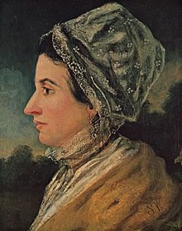
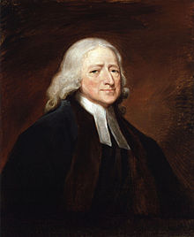
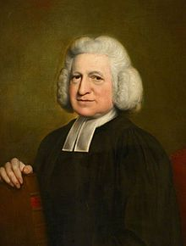
John Wesley
Charles
Wesley

Slide 10
A WOMAN OF PRAYER 祷告的母亲
Tips for Successful Mothers送给母亲P- 开头话:
1. Pray 祷告: God loves Mothers to pray, dedicate your children to the Lord
2. Praise赞美: God is Holy and None like Him
3. Peace平安: Quiet Your Heart first before you do anything with your children

Slide 11
A WOMAN OF PRAYER 祷告的母亲
Tips for Successful Mothers:
4. Plan计划: Look Ahead
5. Patience忍耐: As Hannah waited upon God
6. Play娱乐: Have Fun with Your Children
7. Practice 不要忘记总是练习: Only discipline and not punishment 练习教导孩子们，不是罚他们:

Slide 12
Calling Mothers to Pray
Rededicate to the Lord
摆饼献给主

