Slide 1
CHURCH (11) RELATIONSHIPS IN THE WORKPLACE 教会（11） 关系：工作的场所
EPHESIANS 6:5-10
以弗所书六章五到十节

Slide 2
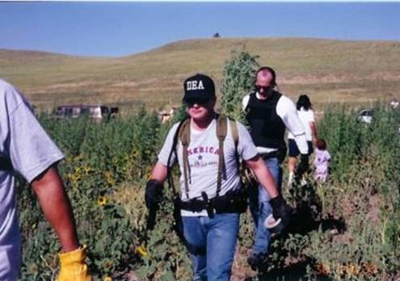
DEA AGENT
美国缉毒jidu局
And HIS USE OF AUTHORITY

Slide 3
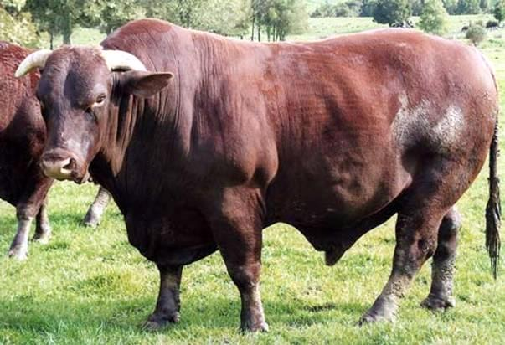

Slide 4
CRAZY BOSS
STORIES
关于老板关系的故事

Slide 5
SLAVERY IN THE BIBLE TIMES 圣经时代的奴仆
ROMAN RULE 罗马时代： 1. 60,000,000 slaves in Paul's days 2. Romans very lazy, everything done by slaves (doctors and other important ones as well as house servants) 3. Gaius (Roman Official) "we may note that it is universally accepted that the master possesses the power of Life and Death over the slaves"
4. "Everything the master does is justified by law"

Slide 6
SLAVERY IN THE BIBLE TIMES 圣经时代的奴仆
ISRAEL HARDSHIP 以色列百姓的苦难
1. Can own slaves and could sell himself or family into slavery because of poverty
2. However, masters can be punished for cruelty or injury to his slave (Exodus 21)
3. Example of slavery in the New Testament: Onesimus to Philemon the master 新约腓利门书的阿尼西母的故事

Slide 7
BIBLICAL TEACHINGS ON SUBMISSION 圣经的教导关于顺服
The whole chapter 5 and 6 are on Relationships, the key is 5:21 "Submitting to one another out of reverence for Christ."
“又当存敬畏基督的心，彼此顺服。”5:21
Illustration of the Ship Captain said, "Signal that ship, we are on a collision course. You change course to 20 degrees?"

Slide 8
BIBLICAL TEACHINGS ON SUBMISSION 圣经的教导关于顺服
Submission to Authority Important: Youths today think of nothing but themselves. They have no reverence for parents or persons of authority."
"Youths today love luxury. They have bad manners, contempt for authority, no respect for older people, and talk nonsense when they should work. Young people do not stand up any longer when adults enter a room. They contradict their parents, talk too much in company, guzzle their food, lay their legs on the table, and tyrannize their elders."
(Socrates)

Slide 9
BIBLICAL TEACHINGS ON SUBMISSION 圣经的教导给仆人关于顺服
6:5 "Bondservants, obey your earthly masters with fear and trembling, with a sincere heart, as you would Christ. 你们作仆人的，要惧怕战兢，用诚实的心听从你们肉身的主人，好象听从基督一般。”
6:6 "not by the way of eye-service, as people-pleasers, but as bondservants of Christ, doing the will of God from the heart. 不要只在眼前事奉，象是讨人喜欢的，要象基督的仆人，从心里遵行神的旨意。"

Slide 10
BIBLICAL TEACHINGS ON SUBMISSION 圣经的教导给仆人关于顺服
6:7 "rendering service with a good will as to the Lord and not to men. 甘心事奉，好象服事主，不象服事人。”
6:8 "knowing that whatever good anyone does, this he will receive back from the Lord, whether he is a bondservant or is free.因为晓得各人所行的善事，不论是为奴的，是自主的，都必按所行的，得主的赏赐。”

Slide 11
BIBLICAL TEACHINGS ON SUBMISSION 圣经的教导关于顺服
6:9 "Masters, do the same to them, and stop your threatening, knowing that he who is both their Master and yours is in heaven, and that there is no partiality with him. 你们作主人的待仆人，也是一理，不要威吓他们；因为知道他们和你们，同有一位主在天上，他并不偏待人。”
6:10 "Finally, be strong in the Lord and in the strength of his might. 我还有末了的话，你们要靠主，依赖他的大能大力，作刚强的人。”

Slide 12
Paul Harvey.
And now you know — the rest of the story.
Paul Harvey Aurandt (4 September 1918 – 28 February 2009)
was an American radio broadcaster, famous for his idiosyncratic
delivery of news stories with dramatic pauses, quirky intonations,
and many of his standard lead-ins and sign offs.
"Retiring is just
practicing up to
be dead.
That doesn't take any practice."
Author: Harvey Quotes

