Slide 1
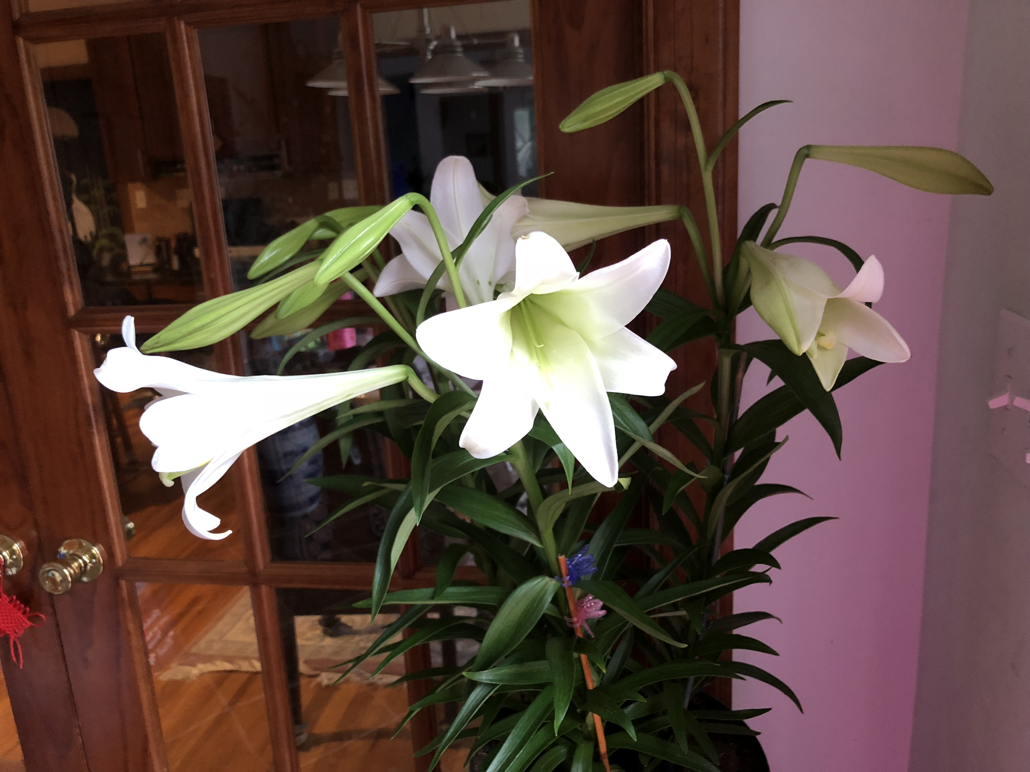
SURRENDERED BY LOVE
被爱环绕
ROMANS 罗马书8:32-39

Slide 2
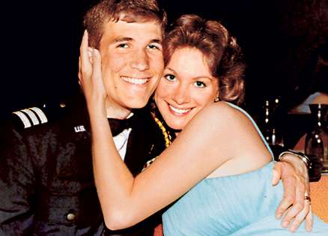
Story:
Evelyn
And
Rick

Slide 3
GREATEST LOVE EVER!
最大的爱
Vs 32 “He who did not spare his own Son but gave Him up for us all, how will he not also with Him graciously give us all things? 神既不爱惜自己的儿子为我们众人舍了，既岂不也把万物和他一同白白的赐给我们吗？”

Slide 4
GREATEST LOVE EVER!
最大的爱
Vs. 33 “Who shall bring any charge against God's elect? It is God who justifies. 谁能控告神所拣选的人呢？有神称他们为义了”

Slide 5
GREATEST LOVE EVER!
最大的爱
Vs. 34 “Who is to condemn? Christ Jesus is the one who died—more than that, who was raised—who is at the right hand of God, who indeed is interceding for us. 谁能定他们的罪呢？有耶稣基督已经死了，而且从死里复活，现今在神的右边，也替我们祈求。

Slide 6
GREATEST LOVE EVER!
最大的爱
Vs. 35 “Who shall separate us from the love of Christ? Shall tribulation, or distress, or persecution, or famine, or nakedness, or danger, or sword? 谁能使我们与基督的爱隔绝呢？难道是患难吗？是困苦吗？是逼迫吗？是饥饿吗？是赤身露体吗？是危险吗？是刀剑吗？”

Slide 7
GREATEST LOVE EVER!
最大的爱
Vs 36 “As it is written, 'for your sake we are being killed all the day long; we are regarded as sheep to be slaughtered.' 如经上所记：我们为你的缘故终日被杀；人看我们如将宰的羊。”

Slide 8
GREATEST LOVE EVER!
最大的爱
Vs 37 “No, in all these things we are more than conquerors through him who loved us. 然而，靠着我们的主，在这一切的事上已经得胜有余了。”

Slide 9
GREATEST LOVE EVER!
最大的爱
Vs 38 “For I am sure that neither death nor life, nor angels nor rulers, nor things present nor things to come, nor powers, 因为我深信无论是死，是生，是天使，是掌权的，是有能的，是现在的事，是将来的事，

Slide 10
GREATEST LOVE EVER!
最大的爱
Vs 39 “nor height nor depth, nor anything else in all creation, will be able to separate us from the love of God in Christ Jesus our Lord. 是高处的，是低处的，是别的受造之物，都不能叫我们与神的爱隔绝；这爱是在我们的主基督耶稣里的。”

Slide 11
STORY OF THE
WHITE LILY百合花的故事
By Jane Tyson Clement

Slide 12

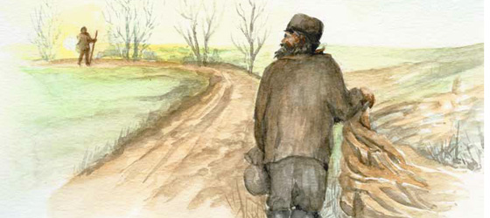
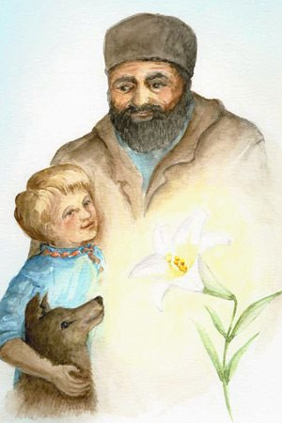
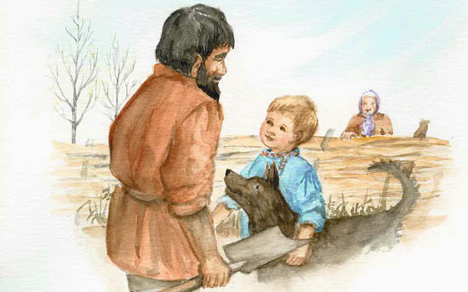

Slide 13
COMMUNION
掰饼圣餐
1. Surrounded by Love被爱环绕
2. Living God复活的神
3. Nothing Can Separate Us
在耶稣基督里的爱不能隔绝

