Slide 1
CHURCH (6) FORGIVENESS AND THANKFUL HEART 教会 （6） 饶恕和感恩的心
LUKE 18:9-14
路加福音十八章九-十四节

Slide 2
LESSONS ON FORGIVENESS 饶恕的功课
UNDERSTAND GOD'S GRACE 了解神的恩典
CHOICE OF LETTING GO OF SELF 我们可以选择放弃自我
ALWAYS BE THANKFUL 一定要处处感恩

Slide 3
THANKFULNESS LIKE THE DOG?
In his book FOLK PSALMS OF FAITH, Ray Stedman tells of an experience H.A. Ironside had in a crowded restaurant. Just as Ironside was about to begin his meal, a man approached and asked if he could join him. Ironside invited his to have a seat. Then, as was his custom, Ironside bowed his head in prayer. When he opened his eyes, the other man asked, "Do you have a headache?" Ironside replied, "No, I don't." The other man asked, "Well, is there something wrong with your food?" Ironside replied, "No, I was simply thanking God as I always do before I eat."
The man said, "Oh, you're one of those, are you? Well, I want you to know I never give thanks. I earn my money by the sweat of my brow and I don't have to give thanks to anybody when I eat. I just start right in!"
Ironside said, "Yes, you're just like my dog. That's what he does too!"

Slide 4
PARABLE OF JESUS 耶稣的比喻
TO EASILY UNDERSTAND 让我们了解: 1. THOSE WHO ARE CONFIDENT OF OWN RIGHTEOUSNESS 杖着自己是义人
2. THOSE WHO LOOKED DOWN ON EVERYBODY ELSE EXCEPT THEMSELVES 藐视别人，只看重自己的人

Slide 5
PARABLE OF JESUS 耶稣的比喻
VS11-12 Pharisee's Prayers法利赛人的祷告: 1. Prayed about himself 自言自语，外表的 2. "I thank you that I am not like other men.. robbers, evildoers, adulterers.. even like this tax collector 我不像哪个税利."
3. "I fast twice a week and give a tenth of all I get."十分之一不是作好事，是每一位基督徒因该作

Slide 6
PARABLE OF JESUS 耶稣的比喻
VS13 The Tax Collector's Prayer税利的祷告:
1. He stood at a Distance觉得自己不配
2. He would not look up to heaven 不敢举目望天，认识自己是什么样的人
3. Beat his breast "God, have mercy on me, a sinner 神阿，开恩可怜可怜我这个罪人."

Slide 7
PARABLE OF JESUS 耶稣的比喻
VS14 Why Jesus said that the Tax Collector is more righteous than the Pharisee?税利的公义
1. God looks into the heart (Inside and Outside should be the same) 神看我们的心
2. The humility of the Tax Collector is knowing yourself and knowing Who God is! 认识自己
3. BE THANKFUL, GOD FORGAVE OUR SINS!感恩

Slide 8
WHY BE THANKFUL？ 为什么要感恩？
Thankfulness acknowledges that God is our provider.感恩是承认神是我们的供应者
Thankfulness prevents a complaining spirit.感恩阻挡埋冤的灵
Thankfulness creates a positive outlook on life感恩创造生命积极的看法，不是消极
Thankfulness invites joy to dwell in our hearts.感恩让喜乐住在我们的心里！
(Kent Crockett, Making Today Count for Eternity, Sisters, OR: Multnomah Publishers, 2001, pp. 161)

Slide 9
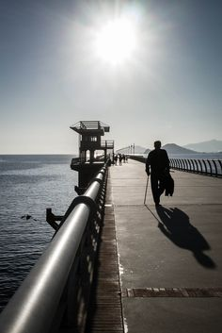
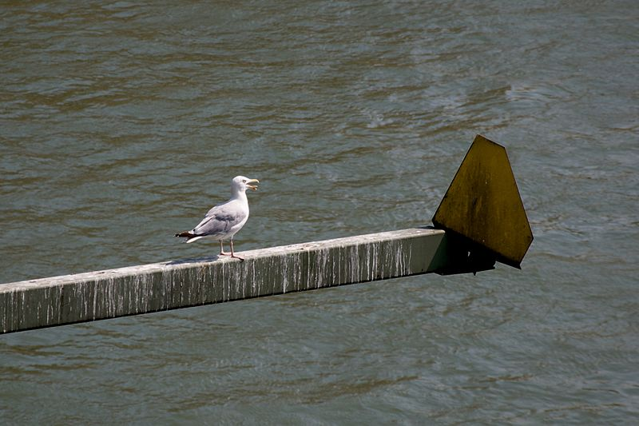
OLD MAN AND THE
SEAGULL STORY

Slide 10
COMMUNION
掰饼圣餐
1. EXAMINE OURSELVES检查自己
2. REPENT OF OUR SINS求神饶恕
3. HUMBLE BEFORE THE LORD谦卑
4. GIVE THANKS ALWAYS存感恩的心!

