Slide 1
CHURCH (9) RELATIONSHIPS: HUSBAND AND WIFE 教会（9） 关系：丈夫和妻子
EPHESIANS 5:21-33
以弗所书五章二十一到三十三节

Slide 3
HEALTHY CHRISTIAN MARRIAGE 健康基督徒的婚姻
Wife Wanted
Son: Dad, I've heard that in some part of the world a man doesn't know his wife until he marries her. Father: Son, that's true everywhere
Bigamy is against the law

Slide 4
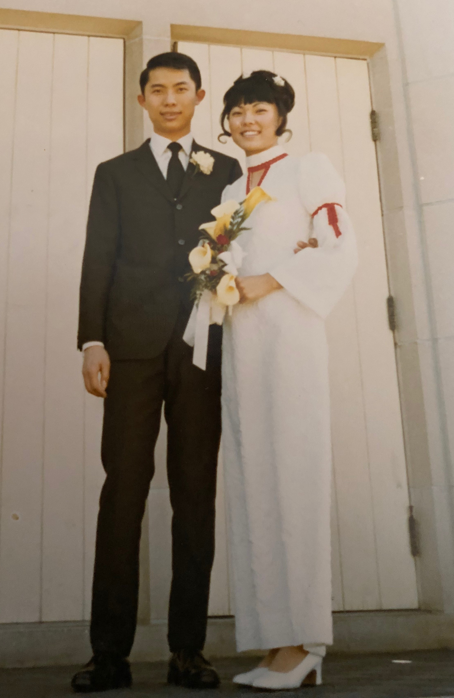
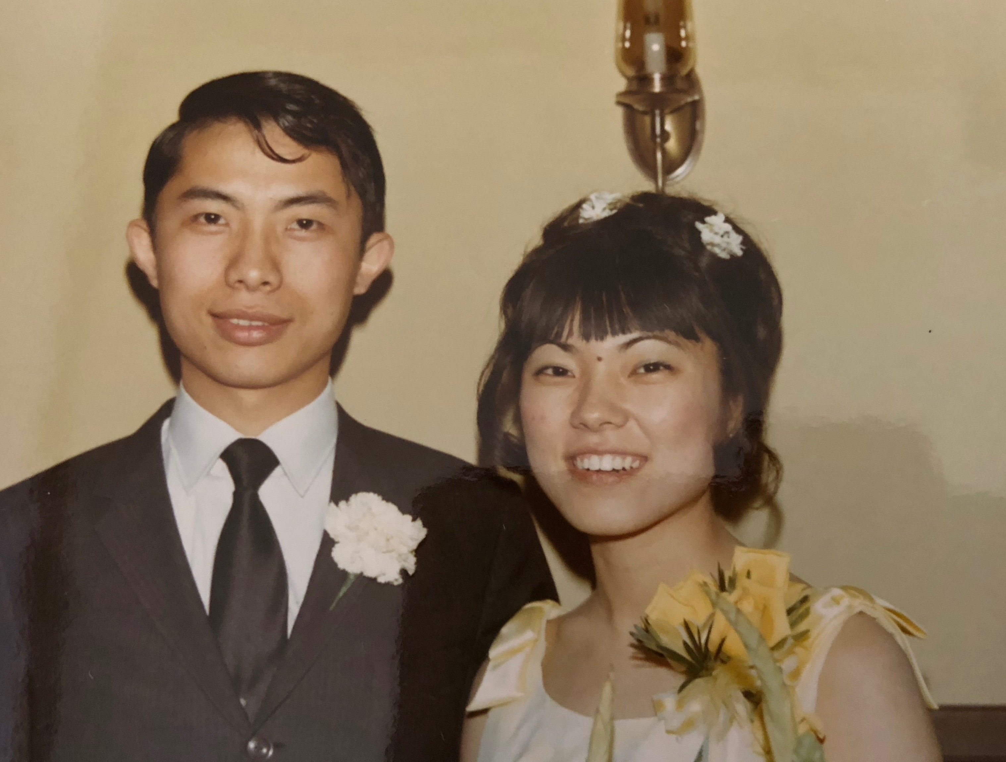

Slide 5
HEALTHY CHRISTIAN MARRIAGE 健康基督徒的婚姻
Vs 21"submitting to one another out of reverence for Christ. 又当存敬畏的心，彼此顺服。”
Not that one is greater than the other 顺服是顺服主，不是比较谁好

Slide 6
HEALTHY CHRISTIAN MARRIAGE 健康基督徒的婚姻
Vs 22-24 Wife's Responsibility “wives, submit to your own husband, as to the Lord. 妻子，当顺服自己的丈夫，如同顺服主。”
Misunderstood verse. Husband is not the Lord, but when wife submit, she is submitting to Jesus Christ, what is pleasing to Jesus!丈夫不是君王，是与妻子同等的！

Slide 7
HEALTHY CHRISTIAN MARRIAGE 健康基督徒的婚姻
Vs. 25-27 As Christ Loves the Church "husbands, love your wives, as Christ loved the church and gave himself up for her. 你们作丈夫的，要爱你们的妻子，正如基督爱教会，为教会舍己。”
Husbands are to lead, sacrifice, and make the marriage holy丈夫作带领的头，榜样

Slide 8
HEALTHY CHRISTIAN MARRIAGE 健康基督徒的婚姻
Vs. 28-31 Two Become One "Because we are members of His body. 因我们是他身上的肢体 （他的骨他的肉）
Husband first need to love self enough to make the marriage holy to the Lord "人要离开父母，与妻子连合，二人成为一体”

Slide 9
HEALTHY CHRISTIAN MARRIAGE 健康基督徒的婚姻
Vs. 32-33 The Great Mystery奥秘 of the Relationship "The marriage refers to Christ and the church" It is a most holy institution!
Satan‘s evil plan to harm God’s children is to destroy marriage. Today, many (men especially) are fooled!魔鬼只要破坏了婚姻，他就成功在这个世界作王。

Slide 10
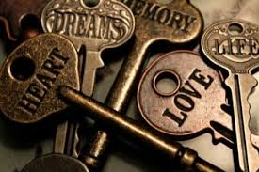
Notes:
Seven Keys to a Happy Marriage!

Slide 11
HEALTHY CHRISTIAN MARRIAGE 健康基督徒的婚姻
GOD
神
1. Common Ground共同点（沟通） a. Love God爱神
b. Prayer，Devotions
and Worship 祷告，灵修，聚会
Husband
丈夫
Wife
妻子

Slide 12
HEALTHY CHRISTIAN MARRIAGE 健康基督徒的婚姻
2. Submit to Each Other vs. 21
Not 50% each, but 100% each 要百分之百的彼此顺服
3. Biblical Mandate Responsibilities 圣经教导男女都有责任
4. Remember Nobody is Perfect。 记得，世界上没有完全人！

Slide 13
HEALTHY CHRISTIAN MARRIAGE 健康基督徒的婚姻
5. Listen 听（Love Language) “I Love You" 要学习用爱的言语，投资在爱的银行里
6. Fight Fair 吵架要公平
7. Take a Break, go to Prayer, asking God to be the judge and Intercessor 吵架也要暂停休息，祷告，让神作法官来调 解，让圣灵感动，不能冲动说话伤害人

Slide 14
HEALTHY CHRISTIAN MARRIAGE 健康基督徒的婚姻
Illustration:
Sad Marriage
悲哀的婚姻
Notes:
It is too late when the husband changed his mind, not to go to his mistress but stay with the wife.

Slide 15
HEALTHY CHRISTIAN MARRIAGE 健康基督徒的婚姻
LOVE, Love, Love爱神，爱人，爱自己
SUBMIT顺服
RESPECT敬重
SACRIFICE舍己
SELFLESS没有自我（不在乎自己的想法）

