Slide 1
CHURCH 教会 (10) RELATIONSHIPS: PARENT AND CHILD 关系：父母与孩子
EPHESIANS 6:1-4
以弗所书六章一到四节

Slide 2
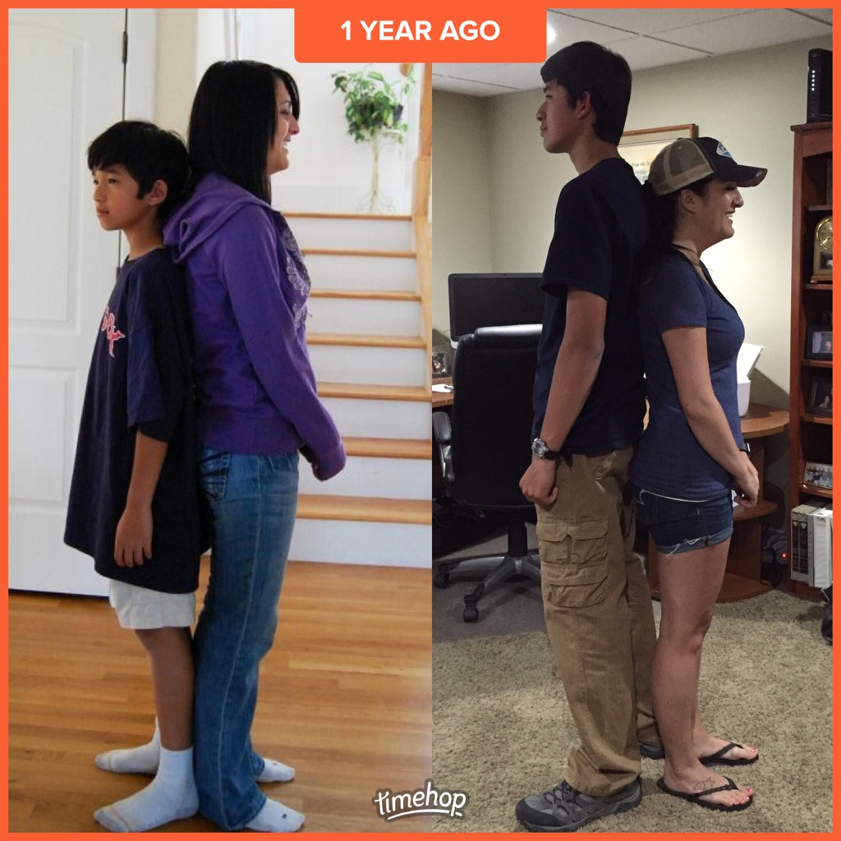

Slide 4
PARENT CHILD RELATIONSHIP 父母和孩子的关系
Vs. 1 "Children, obey your parents in the Lord, for this is right. 你们作儿女的，要在主里听从父母，这是理所当然的。"
Natural for parents to lead and children to follow. Good parents are good leaders好的父母就是好的领导，好的榜样

Slide 5
PARENT CHILD RELATIONSHIP 父母和孩子的关系
Vs. 2-3 "Honor your father and mother (this is the first commandment with a promise.) that it may go well with you and that you may live long in the land. 要孝敬父母，使你得福，在世长寿。这是第一条带应许的诫命。（第五戒）

Slide 6
中国的
一位老
妇女的
故事
*要让老人
有事做
*他们也有
需要！

Slide 7
PARENT CHILD RELATIONSHIP 父母和孩子的关系
Vs. 4 "Fathers, do not provoke your children to anger, but bring them up in the discipline and instruction of the Lord. 你们作父亲的，不要惹儿女的气，只要照着主的教训和警戒，养育他们。”

Slide 8
WAYS TO PROVOKE YOUR CHILDREN 惹儿女气的意思
1. Anger Itself Needs to be Controlled: Don't Discipline your children with Anger不要用怒气教导儿女
2. Overprotection (Guidance and not Spoil Rotten)不能溺爱，不能太保护（只有神能）
3. Favoritism 不可偏爱(Jacob and Esau)

Slide 9
WAYS TO PROVOKE YOUR CHILDREN 惹儿女气的意思
4. Pushing Achievement Beyond Resonable Bounds 不要推动到极端，不可收回的地步 (Not every child is a genius or prodigy)
Illustration of a teen age girl who said "I don't care what it is I do, it never satisfies my mother."

Slide 10
WAYS TO PROVOKE YOUR CHILDREN 惹儿女气的意思
5. Unwanted Feeling by Children 孩子的感受很重要，不要让他们觉得父母不要他们，要给他们安全感(parents failing to sacrifice for their children, and make them feel unwanted)
6. Discouragement and not Encouragement (killing the spirit)不可打碎他们的灵魂

Slide 11
WAYS TO PROVOKE YOUR CHILDREN 惹儿女气的意思
7. Failing to let children grow up at a normal pace不可和别的孩子比
8. Using Love as a tool of reward or punishment不可乖就爱，不乖就不爱
9. Physical and/or verbal abuse 身体的虐待，话语的虐待，都不可

Slide 12
WAYS TO PROVOKE YOUR CHILDREN 惹儿女气的意思
10. Do It Right: 要做的对，讨神喜欢！ A. Love 爱 (God, Spouse, Children order)
B. Laugh and Enjoy Events Together一起开心
C. Listen More要听孩子和你的沟通（双方面）
D. Pray More Together 一起祷告的重要
E. Worship Together一起敬拜的重要

Slide 13
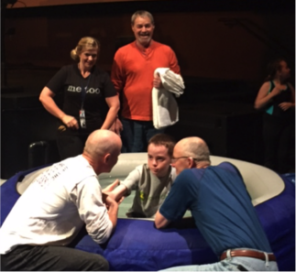
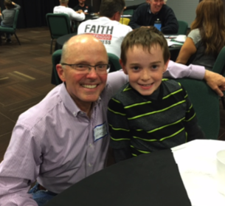

Slide 14
PARENT CHILD RELATIONSHIP 照着主的教训和警戒
1. You shall have no other gods before Me. 不可有别的神
2. You shall not make idols. 不可造偶像，也不可拜偶像
3. You shall not take the name of the LORD your God in vain.不可妄称神的名
4. Remember the Sabbath day, to keep it holy. 当纪念安息日，安息日守为圣日
5. Honor your father and your mother. 孝敬父母（应许是长寿）
6. You shall not murder. 不可杀人
7. You shall not commit adultery.不可奸淫
8. You shall not steal.不可偷盗
9. You shall not bear false witness against your neighbor.不可作假见证陷害人
10. You shall not covet.不可贪恋（人和他所有的）
Notes:
Teach your children the basic laws of the Lord. Then, they will not go wayward!

Slide 15
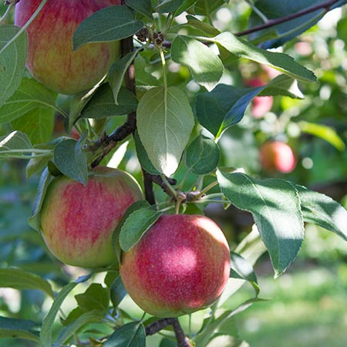
Notes:
Story of An Apple Tree and the Family Son

Slide 16
COMMUNION摆饼
HEBREWS 希伯来书6:4-8
1. OBEY GOD'S TEACHING顺服神
2. DEVELOPE GOOD RELATIONSHIPS
学习好的关系
3. DON'T CRUICIFY CHRIST AGAIN
不要在十架上重订耶稣

