Slide 1
CHURCH (8) RELATIONSHIPS: PEOPLE 教会 （8） 关系：与人
EPHESIANS 5: 10-21
以弗所书五章十-二十一节

Slide 2
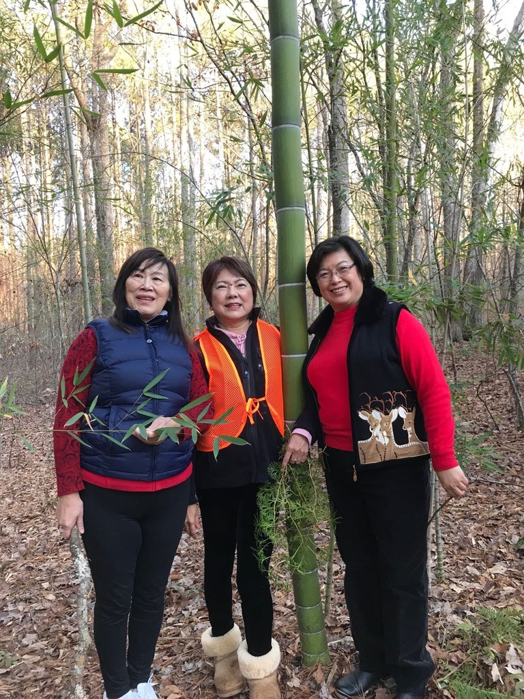
MY LIFE All
LIGHT SOURCE
光的影响:
1. GOD
2. FAMILY
3. FRIENDS
4. HOME
5. SERVING
6. GIVING
7. GARDENING
8. MISSIONS
9. VISION
10. TRAVEL

Slide 4
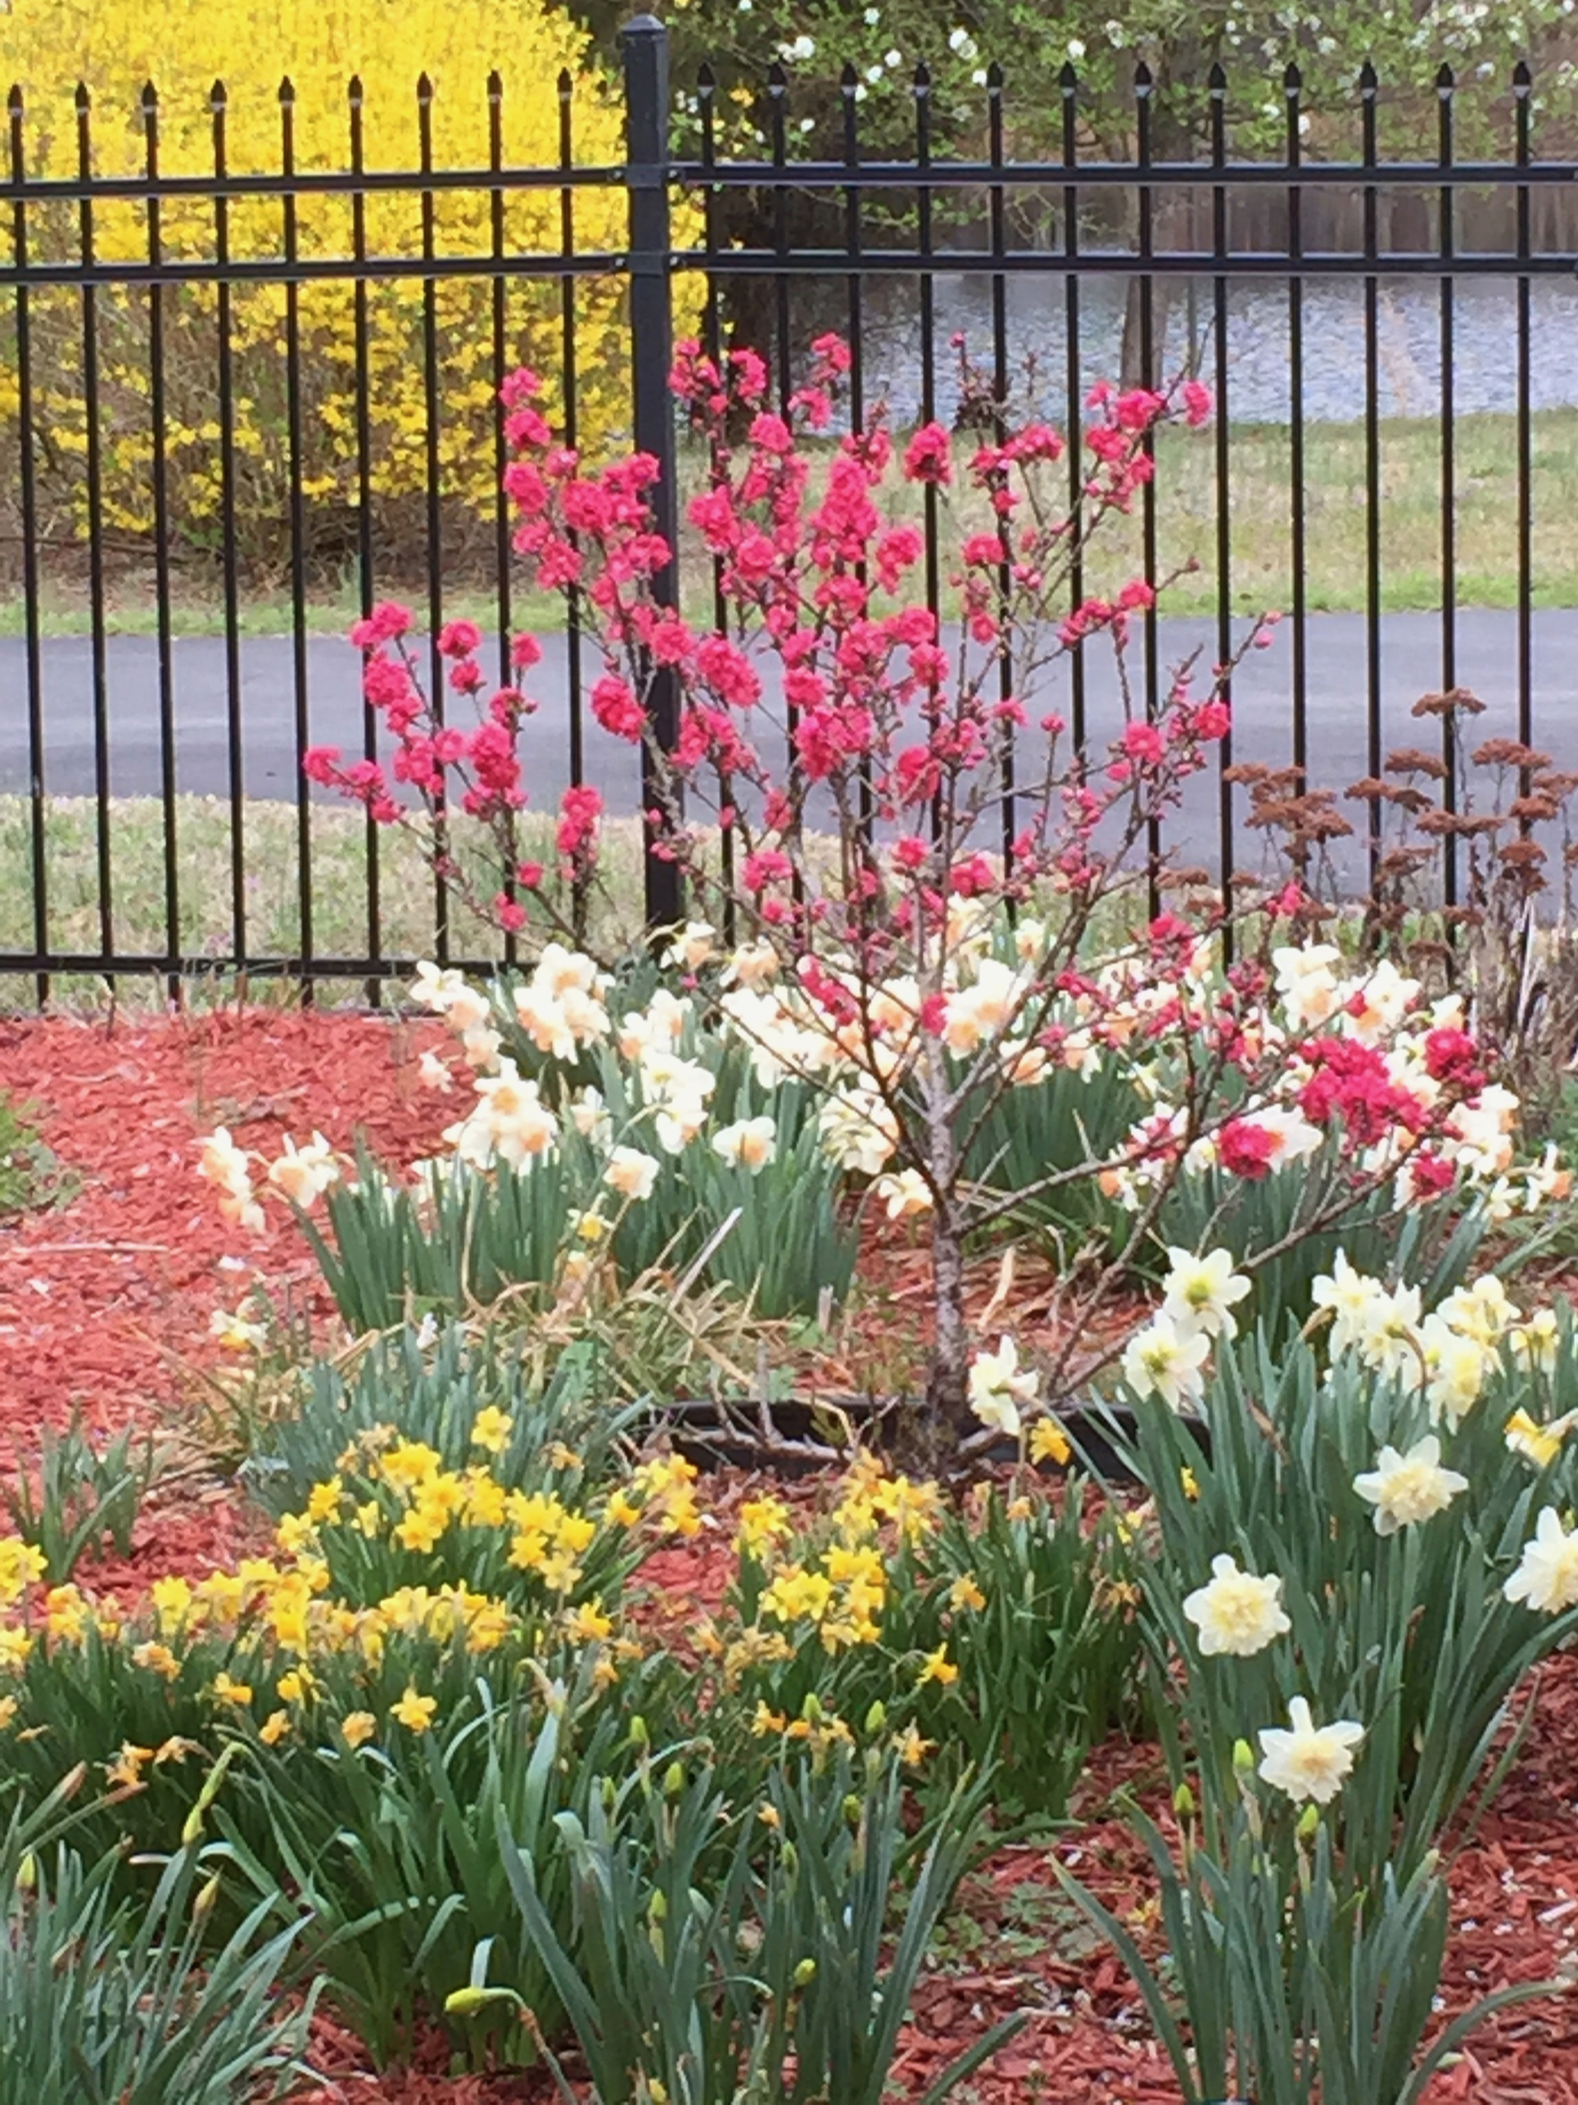
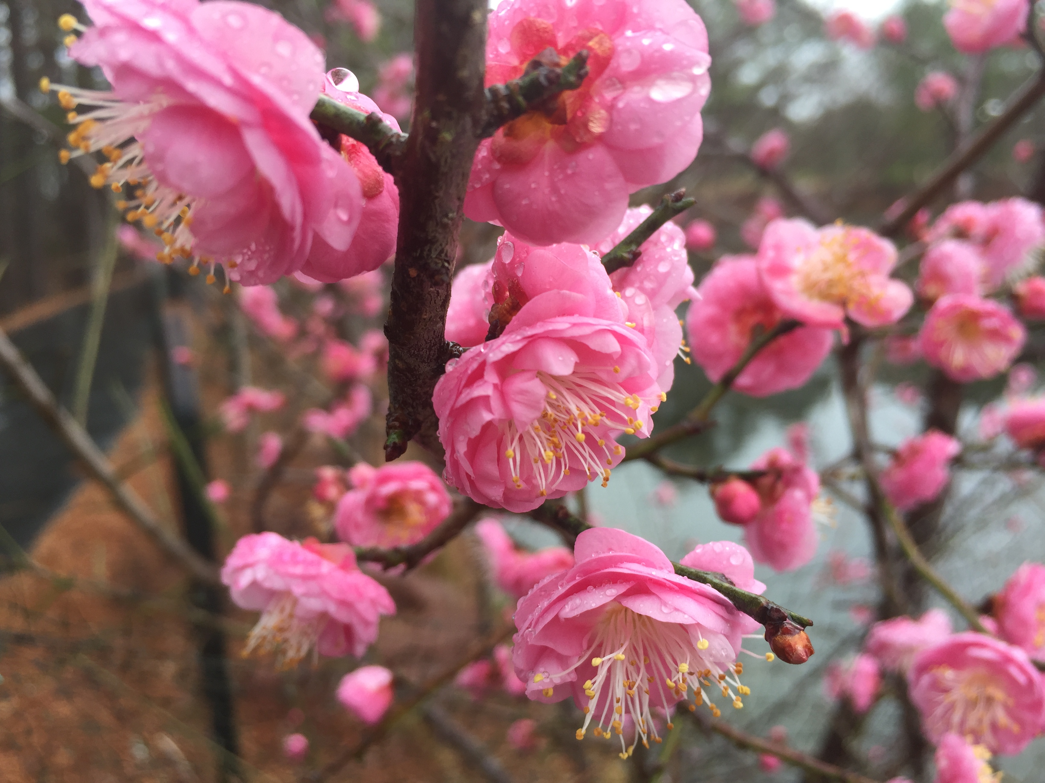
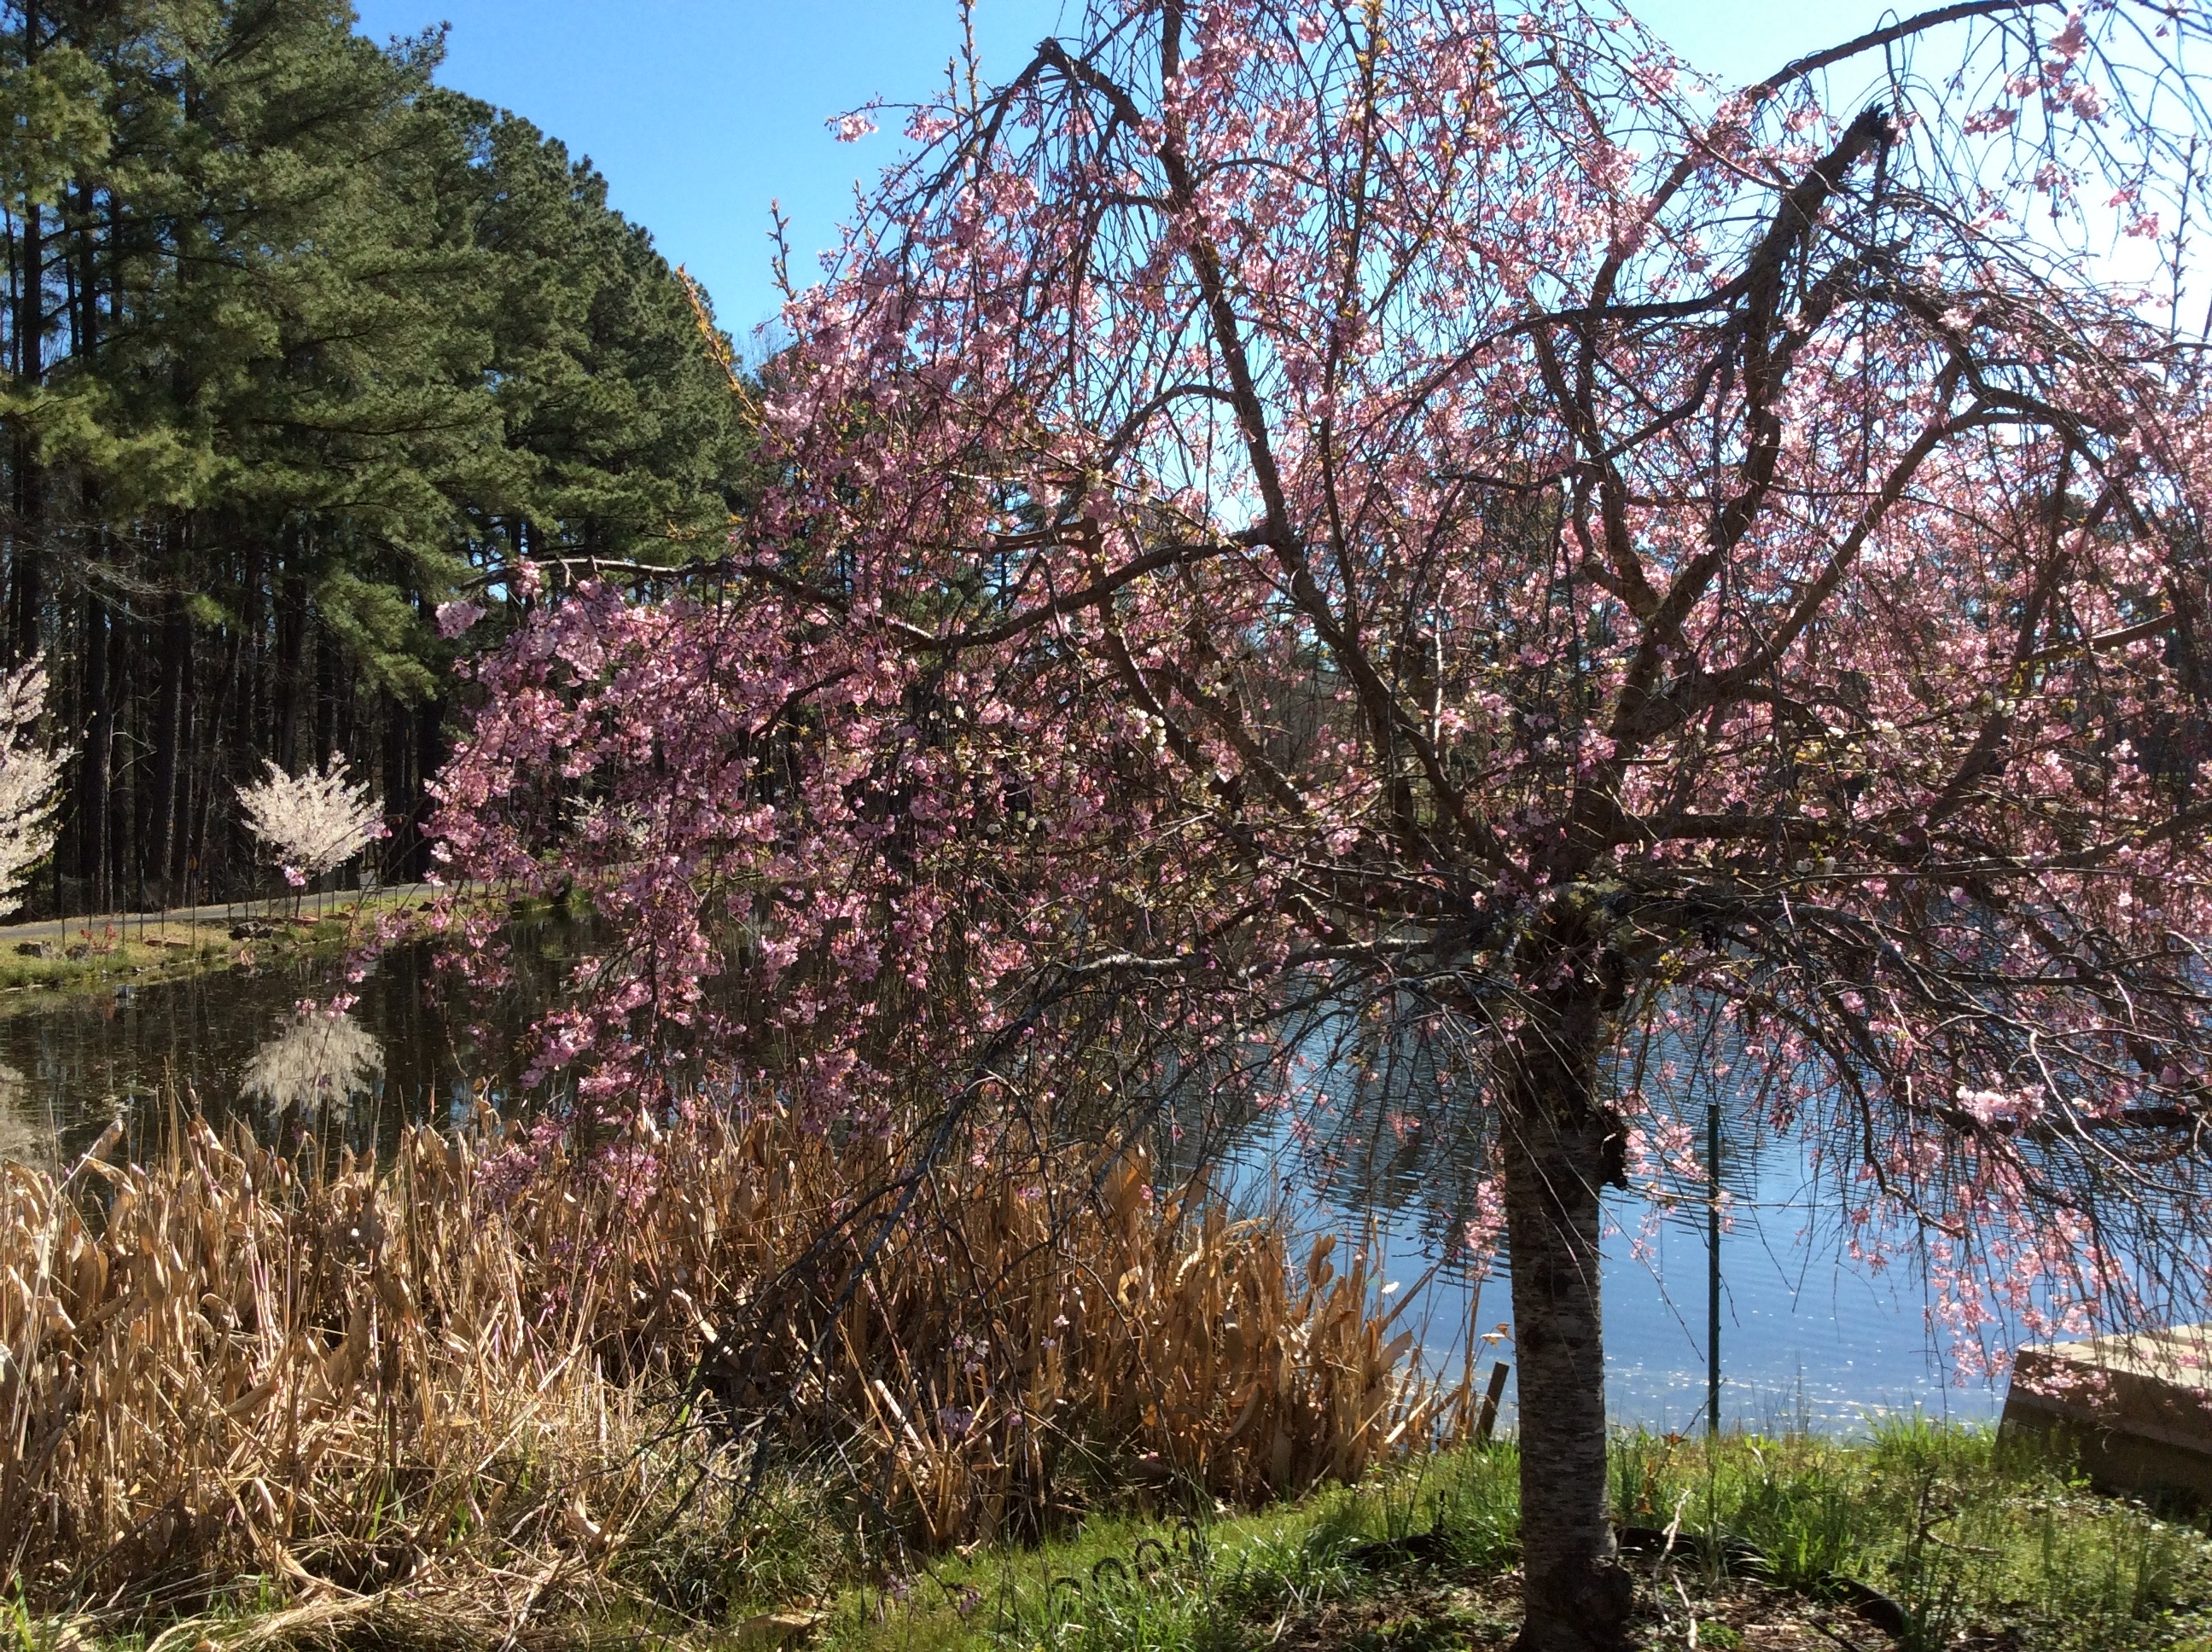
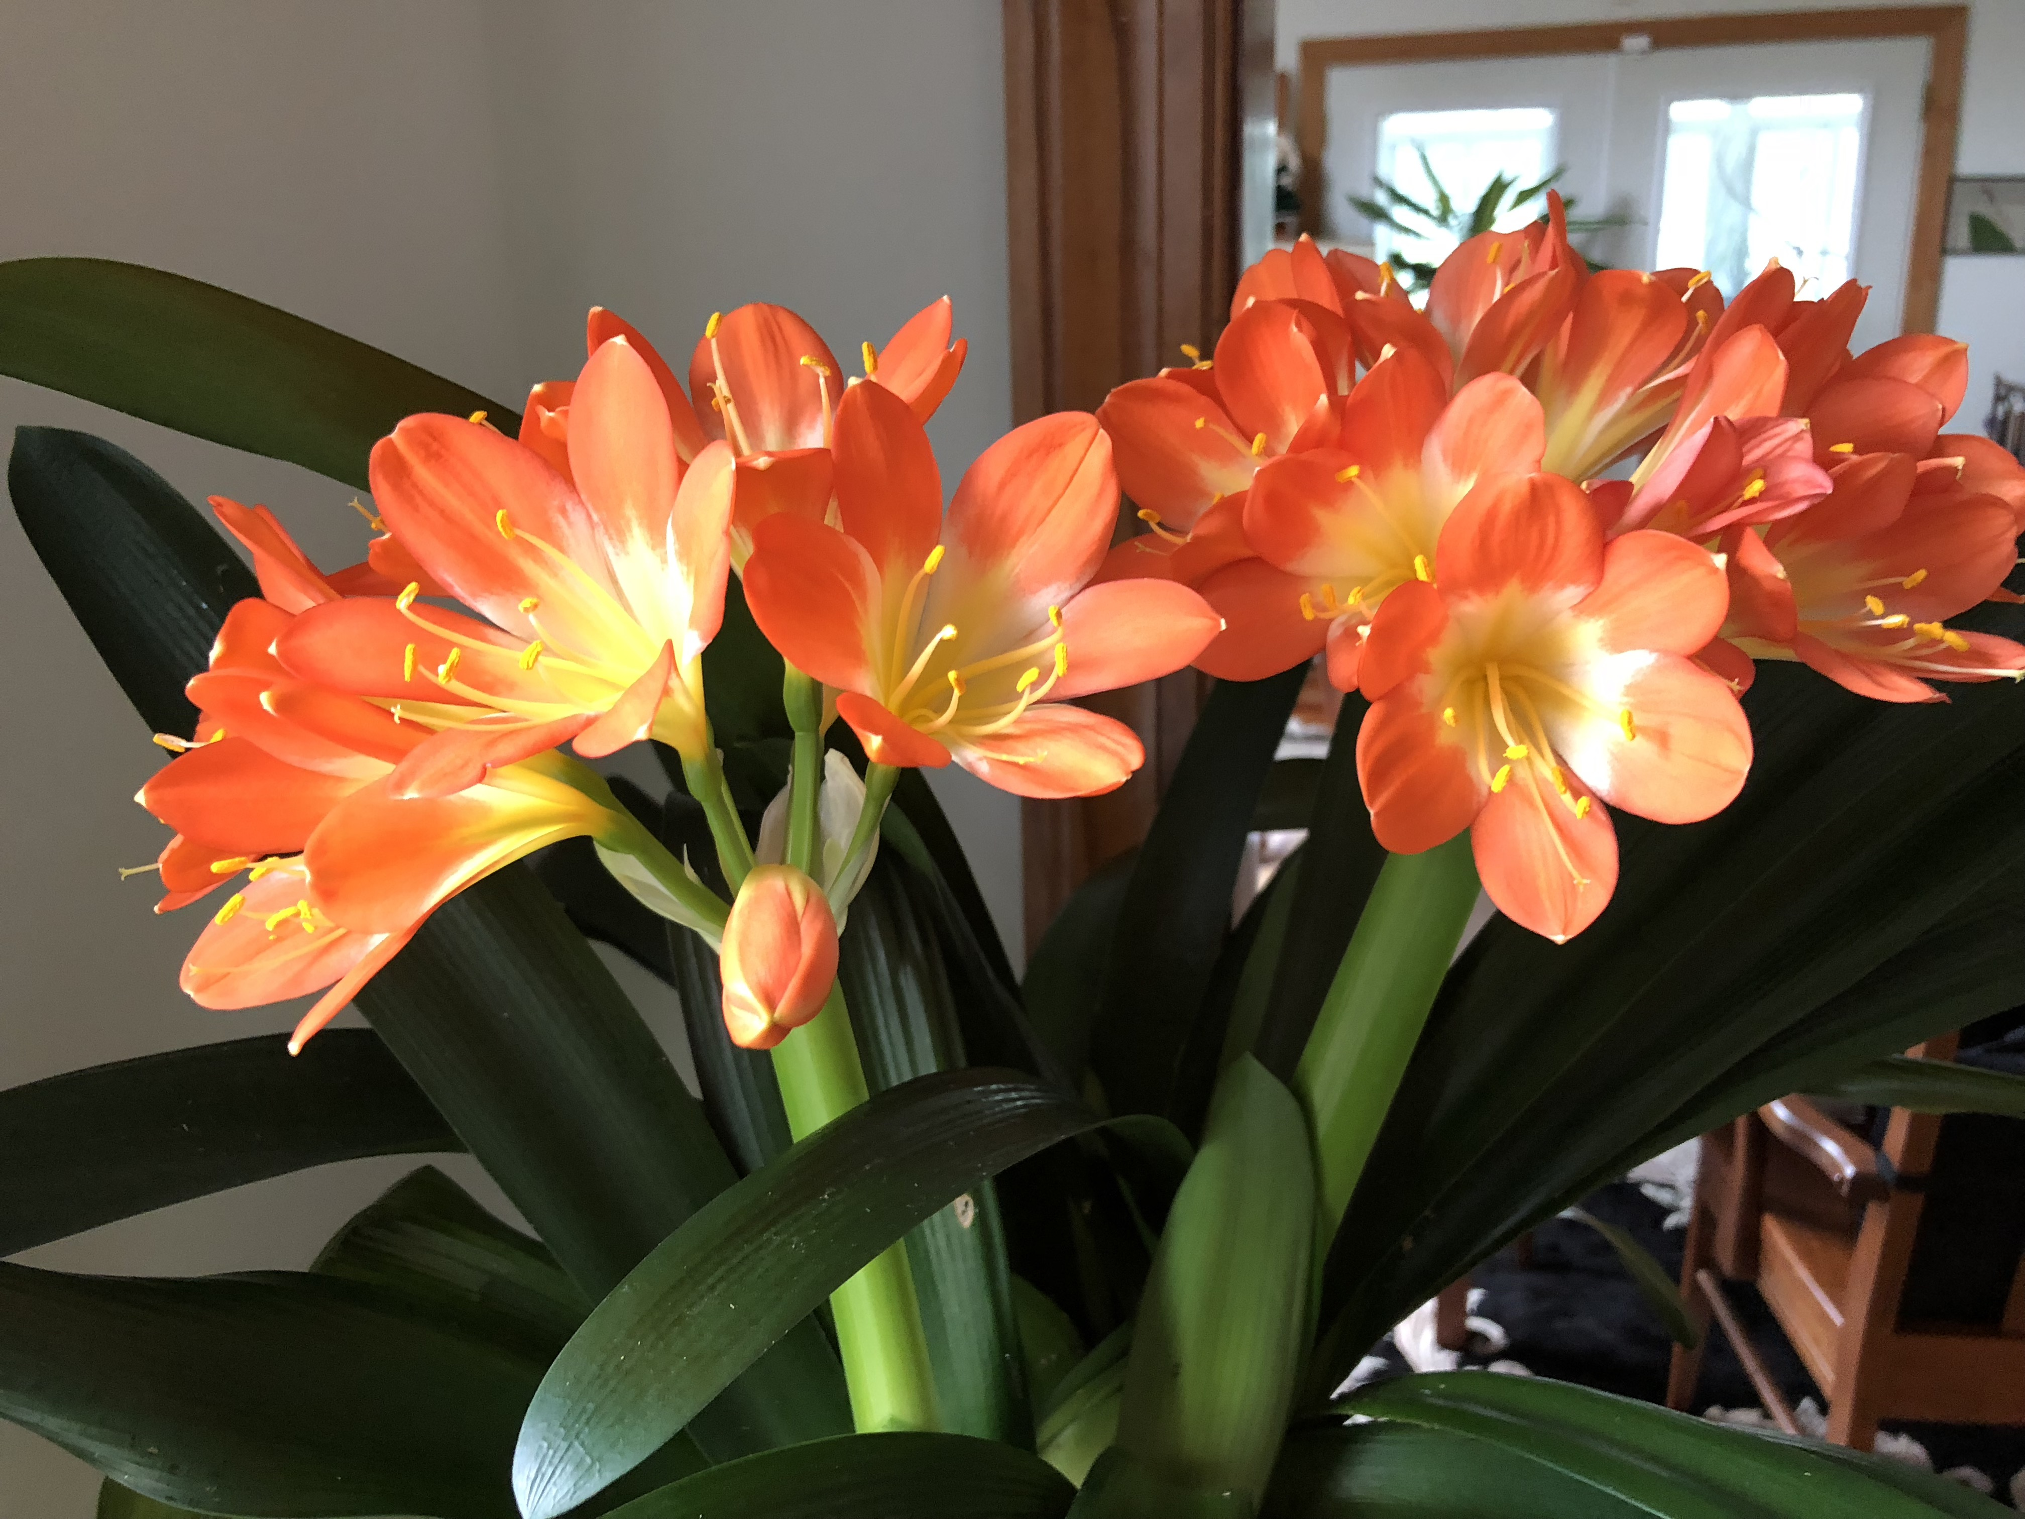
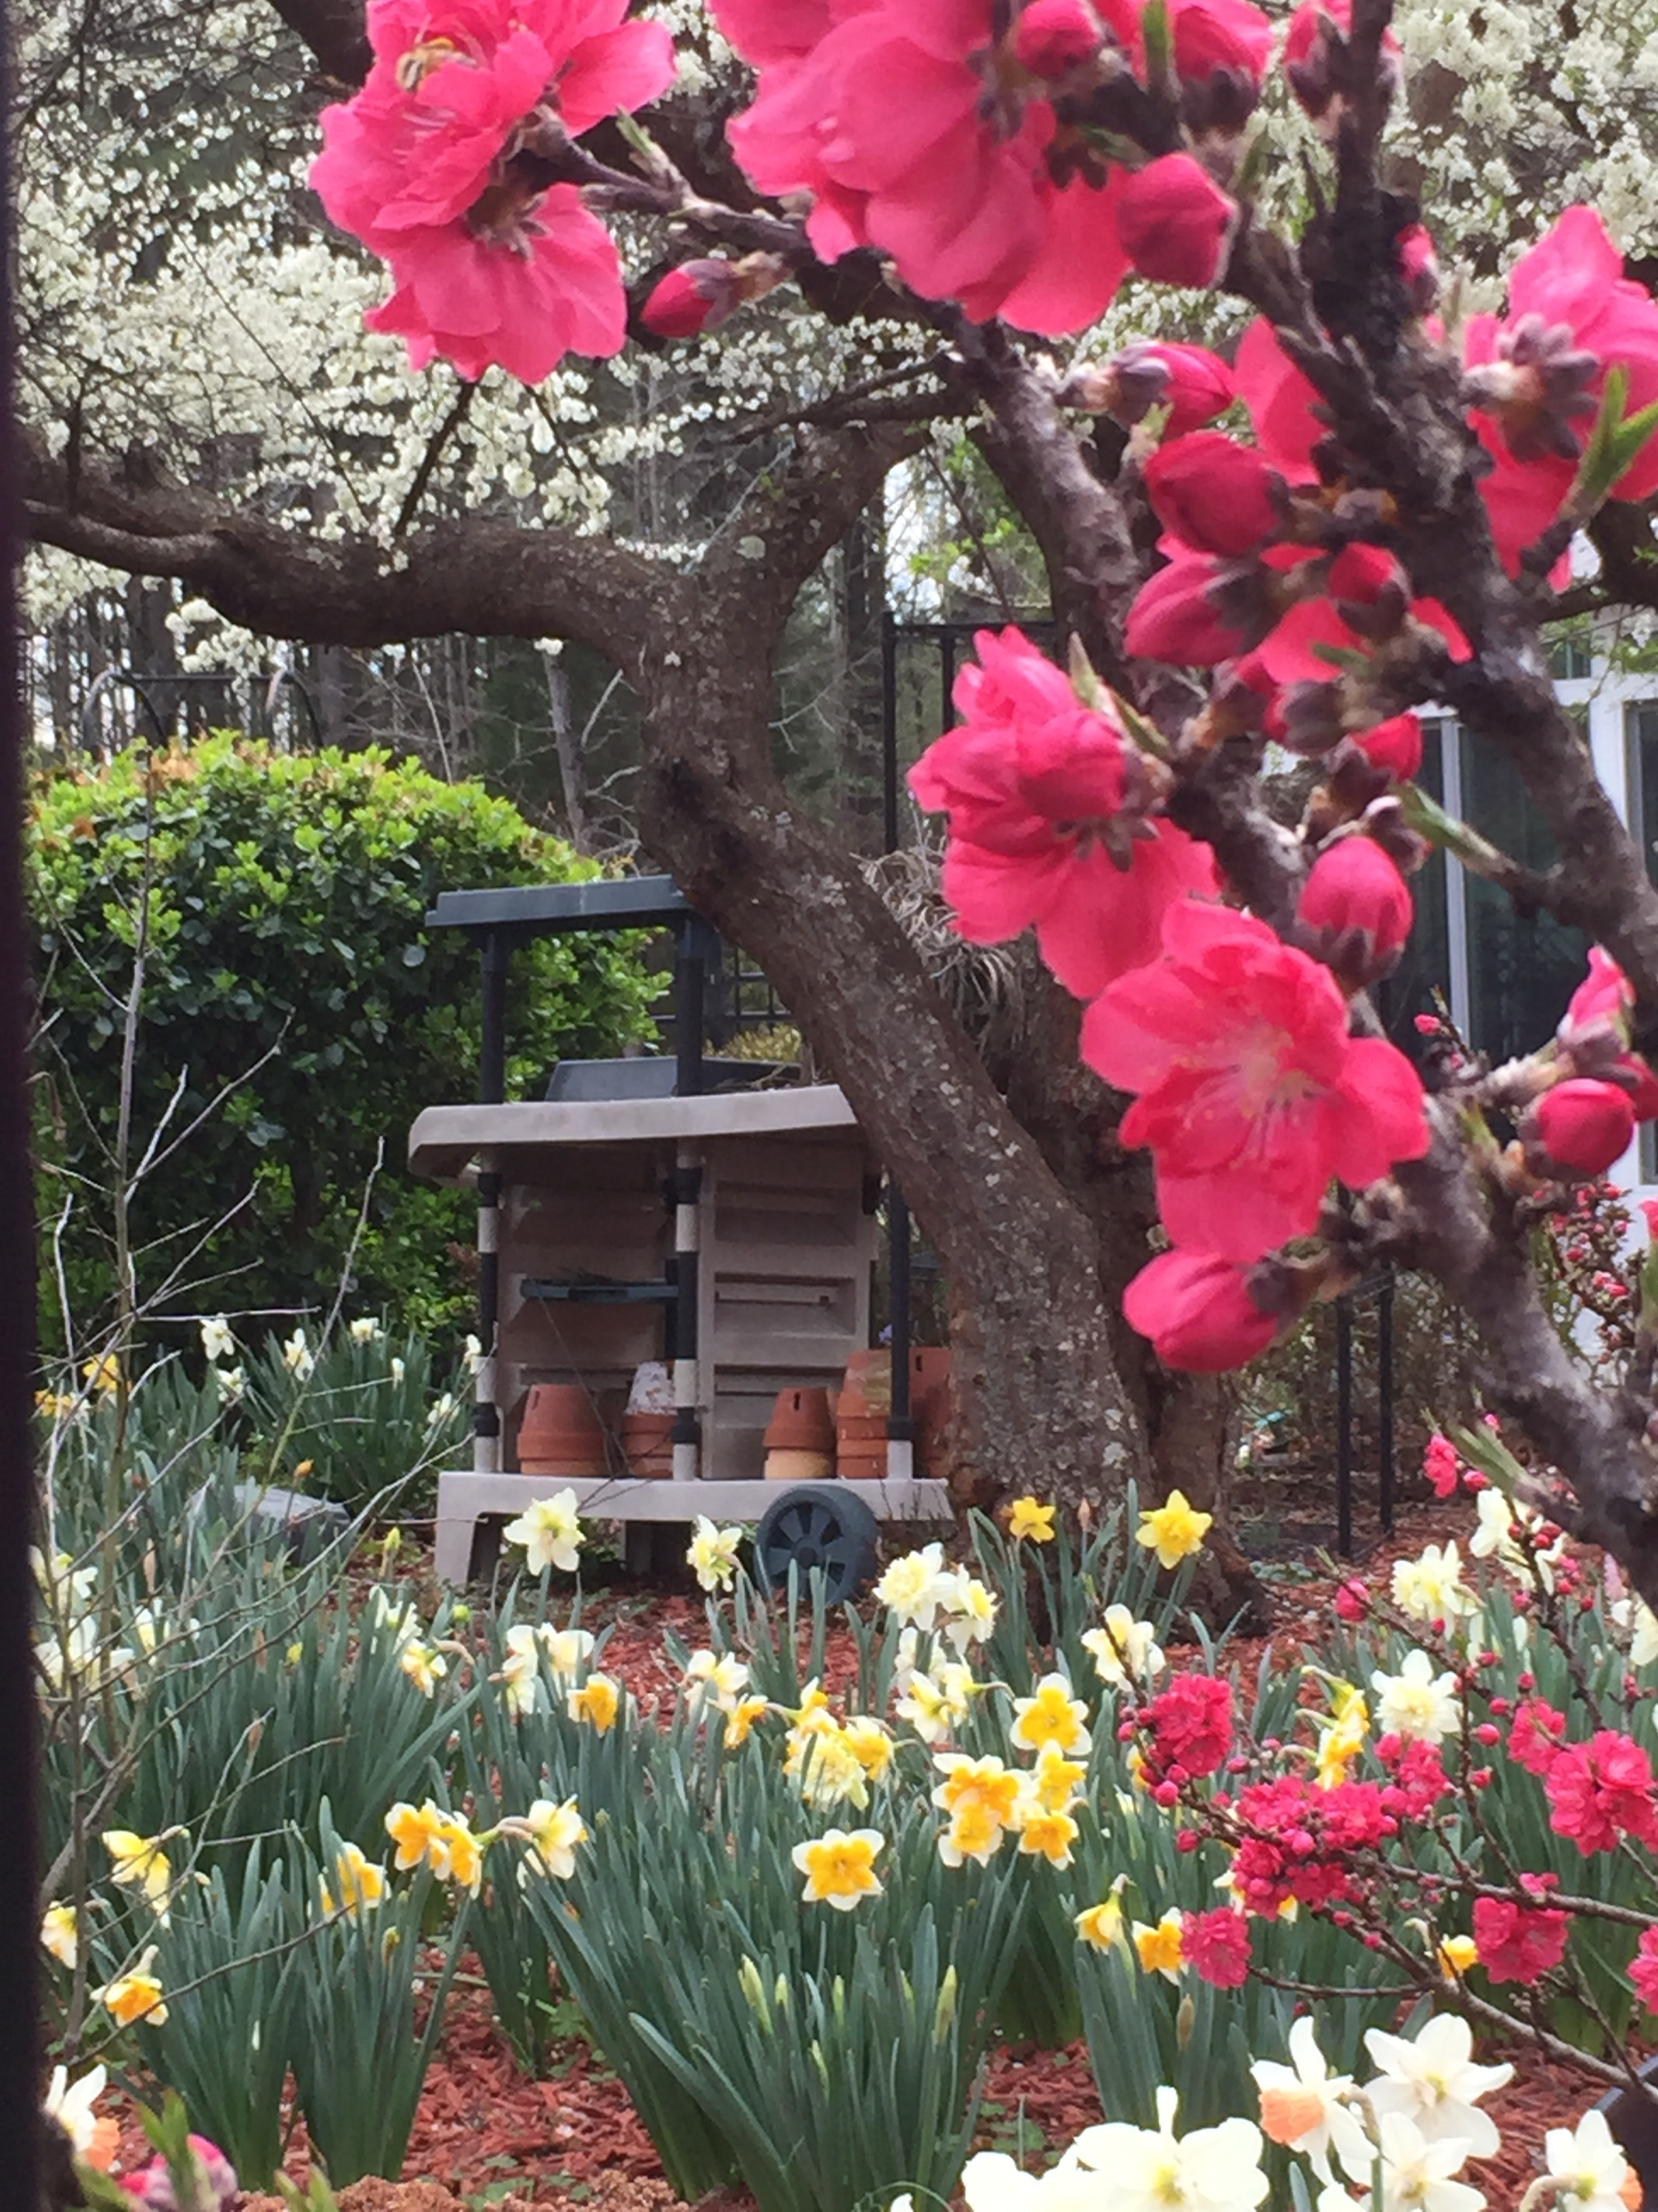

Slide 5
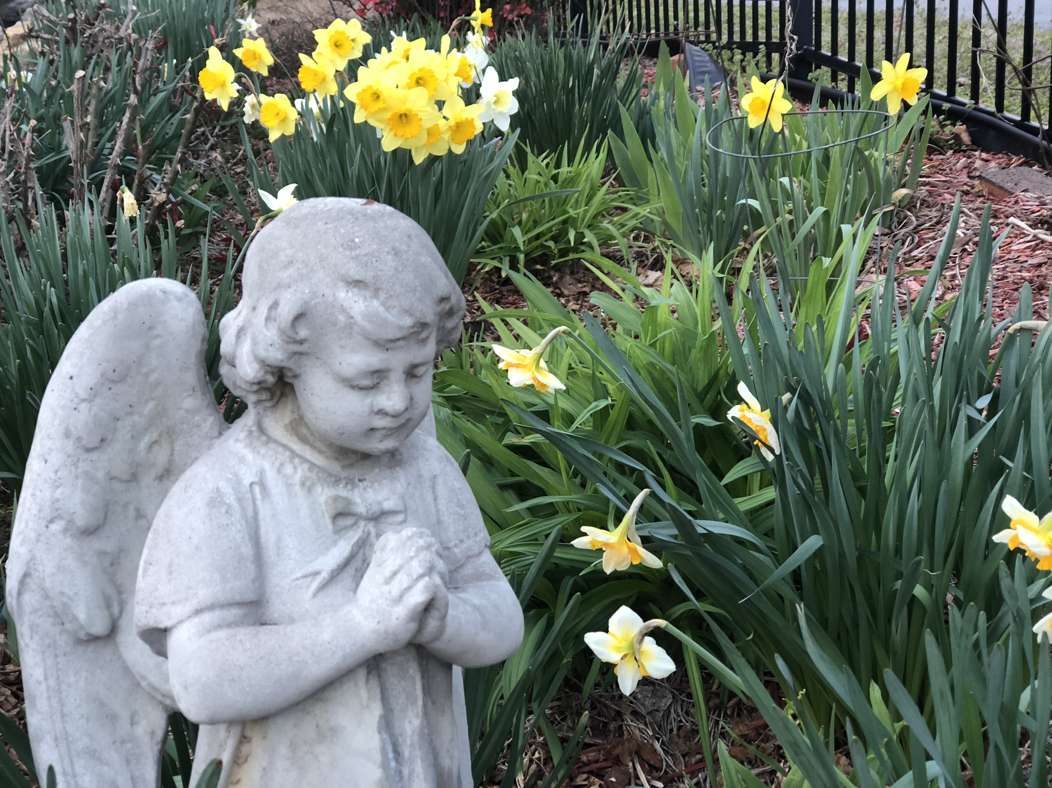
DAFFODIL
PRINCIPLE
水仙花的
原理

Slide 6
SHINE FOR OUR LORD 为主发光
Vs 10-11 "Find out what pleases the Lord. Have nothing to do with the fruitless deeds of darkness, but rather expose them."
“你们要查验什么是主喜悦的。不要参与暗味无益的事，倒要把它揭露出来。”

Slide 7
SHINE FOR OUR LORD 为主发光
Vs 13-14 "But everything exposed by the light becomes visible, for it is light that makes everything visible. This is why it is said: 'Wake up, O sleeper, rise from the dead, and Christ will shine on you.’" 因为一切显露出来的就是光。所以有话说：“睡了的人哪，醒过来，从死人中起来吧！基督必要照亮你。”

Slide 8
SHINE FOR OUR LORD 为主发光
A CARPENTER AND HIS STORY
木匠的故事
1. Worked hard 辛苦工作
2. Good Carpenter 好的木匠
3. Retire 退休
4. Boss Gave Him a Last Job最后的
5. He did a mediocre job马马虎虎
6. Was for his own house他的礼物

Slide 9
SHINE FOR OUR LORD 为主发光
VS. 15 "Be very careful then, how you live—not as unwise but as wise. 所以，你们行事为人要谨慎，不要像愚昧人，却要像聪明人。”
Don't take things for granted. Live everyday for the Lord

Slide 10
SHINE FOR OUR LORD 为主发光
VS. 16 “Making the most of every opportunity, because the days are evil. 要爱惜光阴，因为现今的世代邪恶。”
We Shine for the Lord, We are copies of Him and Mirror Him. If we shine for Him, the glory of our God will be in all nations.

Slide 11
SHINE FOR OUR LORD 为主发光
VS. 17-18 “Do not be foolish, but understand what the Lord's will is. Do not get drunk on wine, which leads to debauchery. Instead, be filled with the Spirit. 不要作糊涂人，要明白主的旨意如何。不要醉酒，酒能使人放荡，乃要被圣灵充满。”

Slide 12
SHINE FOR OUR LORD 为主发光
VS. 19-20 "Speak to one another with psalms, hymns and spiritual songs. Sing and make music in your heart to the Lord. Always giving thankds to God the Father for everything, in the name of our Lord Jesus Christ."
“当用诗章，颂词，灵歌，彼此对说，口唱心和的赞美主。凡事要奉我们主耶稣基督的名，常常感谢 父神。”

Slide 13
SHINE FOR OUR LORD 为主发光
VS. 21“Submit to one another out of reverence for Christ. 又当存敬畏基督的心，彼此顺服。”
Be Humble in Your Relationship with Others, as Jesus gave all sinners opportunity to know Him (Samaritans)

Slide 14
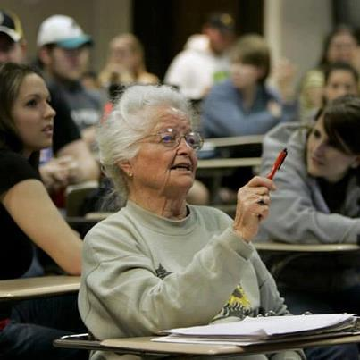
Are you Shining?
Story of ROSE
Do You Depend on the
Light Source?
Are You an Example
Of the Light?
Do You Always Mirror
Or Copy God?
No Excuses Please!

