Slide 1
CHURCH (7) RELATIONSHIPS: WITH GOD 关系：与神
EPHESIANS 5: 1-10
以弗所书五章一到十节

Slide 2
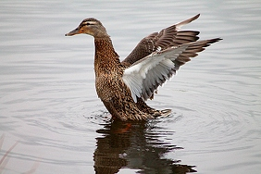
RELATIONSHIPS SAYINGS 关系的语言
"A bird with a broken wing
will never fly“翅膀断了的鸟
永远不能飞
"Don't judge a book by its Covers"
不要用封面来论断这本书好坏
Illustration: T J Ware

Slide 3
RELATIONSHIPS WITH GOD 与神的关系
Vs 1"be imitators of God, as beloved children. 你们该效法神，好象蒙慈爱的儿女一样。
1. God is Love 神就是爱
2. Like Father, like Son有其父就有其子
3. We have a Perfect Mentor for Life我们永远有一位完美，完全的导师

Slide 4
RELATIONSHIPS WITH GOD 与神的关系
Vs 2 Walk in Love as Christ loved us
"也要凭爱心行事，正如基督爱我们，为我们舍了自己，当作馨香的供物和祭物，献与神。”
Our Relationship should be based on love and nothing else. No judgmental, no criticism, no unkindness, but everything through LOVE！

Slide 5
RELATIONSHIPS WITH GOD 与神的关系
Illustration of "The Little Firefighter"
1. Mother loved him
2. Firefighter loved him
3. God LOVES him
4. Died Surrendered by Love!
5. Began the "Make a Wish" Found

Slide 6
RELATIONSHIPS WITH GOD 与神的关系
Vs. 3 As proper as saints, nothing immoral or impure or covet，be named
“至于淫乱并一切污秽，或是贪婪，在你们中间连提都是不可，方合圣徒的体统。”
Vs. 4 No filthy talk or crude jokes, instead let there be thanksgiving "淫词，妄语和戏笑的话，都不相宜，总要说感谢的话。”

Slide 7
RELATIONSHIPS WITH GOD 与神的关系
Vs 5 Sexually immoral or impre, or covet (idolater) has no inheritance in the kingdom of Christ and God
“无论是淫乱的，是污秽的，是有贪心的，在基督和神的国里，都是无份的；有贪心的，就与拜偶像的一样。”

Slide 8
RELATIONSHIPS WITH GOD 与神的关系
Vs 6 Let no one deceives you with empty words, for because of these things the wrath of God comes upon the sons of disobedience.
“不要被人虚浮的话欺哄，因这些事，神的忿怒必临到那悖逆之子。”
Vs 7 Do not become partners with them "不要与他们同伙”

Slide 9
RELATIONSHIPS WITH GOD 与神的关系
Vs 8 Once you were in darkness, now Walk as Children of Light “从前你们是暗昧的，但如今在主里面是光明的，行事为人就当象光明的子女”
Vs 9 Fruit of light is found in all that is good and right and true "光明所结的果子就是一切良善，公义，诚实。”

Slide 10
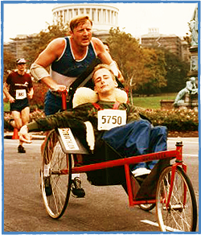
Strongest Dad in the World
Dick Hoyt (Father)
Rick Hoyt (Son)
-85x26.2miles marathons
-212 triathlons (swim)
-Dick 65 and Rick 43 finished
24 Boston Marathons 5,083
Out of 20,000.
-best time 2hrs and 40minutes
In 1992, 35min short world record

Slide 11
GOD COMES FIRST IN OUR LIVES 在我们的生命中神是最重要的
Vs 10 "Try to discern what is pleasing to the Lord. 总要查验何为主喜悦的事。”
We have an Abba Father in Heaven天上的父
We have an Advocate, Lord Jesus站在我们这边的救主
We have a Wonderful Teacher, the Holy Spirit圣灵是我们永远奇妙的老师

