Slide 1
Church (4) forgiveness by grace 教会(4) 饶恕是靠着恩典
MATTHEW 18:21-27
马太福音十八章二十七节

Slide 2
WHAT IS FORGIVENESS? 什么是饶恕？
Stop feeling angry怒气 or resentful愤怒 toward (someone) for an offense, flaw, or mistake.
"I don't think I'll ever forgive David for the way he treated her"
"they are not going to pat my head and say all is forgiven"
cancel (a debt不用还债).
"he proposed that their debts should be forgiven" Google Dictionary
Synonyms 同义词: | Pardon饶恕, excuse 原谅 exonerate 无罪 absolve 免除

Slide 3
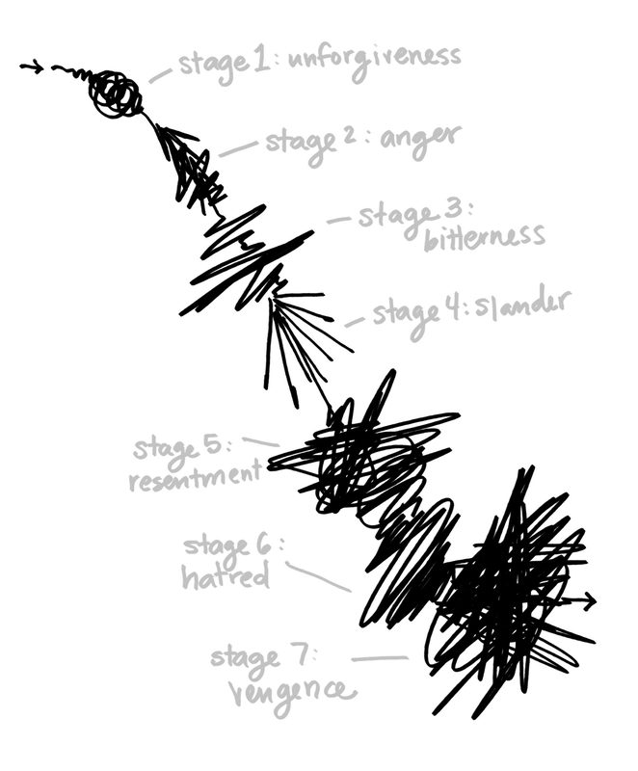
UNFORGIVENSS STAGES
不肯饶恕伤害自己的步骤：
STAGE 1: UNFORGIVENESS
不肯饶恕
STAGE 2: ANGER 发怒
STAGE 3: BITTERNESS 苦毒
STAGE 4: SLANDER 诽谤
STAGE 5: RESENTMENT 愤恨
STAGE 6: HATRED 仇恨/敌意
STAGE 7: VENGENCE 报复
"Freedom Factor: Finding Peace by Forgiving
Others" by Bruce Wilkinson with Mark E. Strong

Slide 4
TRULY FREE CHRISTIANS 真正自由的基督徒
HEALTHY APPETITE 健康的胃口
DEEP AND SOUND SLEEP 好的睡眠
FACIAL EXPRESSIONS AND SMILES A LOT 脸上笑容满面
WORDS OF ENCOURAGEMENT INSTEAD OF COMPLAINTS 说话造就人，不说埋冤的话
LOVE ENJOY LIVING 喜欢生活，生活乐趣

Slide 5
GOD FORGIVES THROUGH GRACE 靠着恩典饶恕
Vs 21 Peter asked "how many times should I forgive 我当饶恕他几次呢?"
Seven times is a perfect number. It is hard enough to forgive one time, let alone seven times 七次应该够了？这个是个完全的数字
Vs. 22 Jesus answered "not seven times, but seventy-seven times 不够，要饶恕七十个七次 （490次）

Slide 6
GOD FORGIVES THROUGH GRACE 靠着恩典饶恕
Vs. 23 King Wants to Settle Accounts with His Servants王要和他的仆人算帐 (One day, our God will settle our Accounts)
Vs 24 A Man Owed the King 10,000 talents of silver (About 375 tons of silver) hundreds of million dollars today 他欠一千万银子，大约今天的几百万 （不是个小的数目）

Slide 7
GOD FORGIVES THROUGH GRACE 靠着恩典饶恕
V25 He wasn‘t able to pay, therefore in those days, all his possessions are to be sold 在古时候，不能还债，就要全家作奴隶被主人卖掉
Vs. 26 The Servant humbled himself and begged for mercy and said he will pay back everything (When dire need will promise anything and may not be the truth)当一个人发现到自己有危机，什么都可以答应，不见得是做得到的！

Slide 8
GOD FORGIVES THROUGH GRACE 靠着恩典饶恕
Vs 27 The Master King took pity on the servant, and not only let him go and did not sell him and his family, but also cancelled the debt! 那仆人的主人动了慈心，把他释放了，还免了他的债 （几百万美金不是个小数目）
That is how God forgave us. He set us free from sins! 神就是这样的宽恕我们，饶恕我们

Slide 9
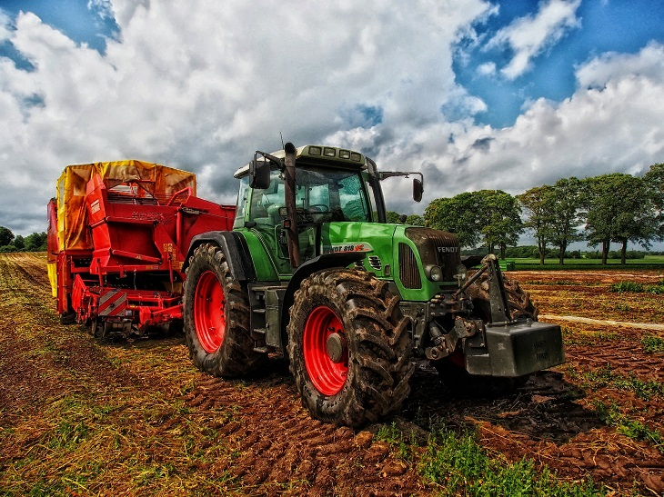
TWO BROTHERS
AND THE
FARM:
SHARED UNTIL
ONE DAY,
BECAME THE
WORST OF
ENEMIES
ARGUING OVER
THE WATER AND
BOUNDARIES

Slide 10
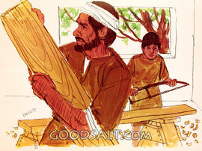

Slide 11
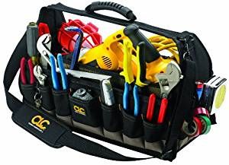

Slide 12
GOD FORGIVES THROUGH GRACE 靠着恩典饶恕
“To err is human, to forgive is divine 人总是会做错的，只有饶恕才是神圣的 ." Alexander Pope
“The Weak can never Forgive, Forgiveness is the Attribute of the Strong 软弱的人是不会饶恕的，饶恕是强者的属性和特性." M. Gandhi

Slide 13
GOD FORGIVES THROUGH GRACE 靠着恩典饶恕
"Forgiveness does not change the past, but it does enlarge the future 饶恕的过程，不能改变你的过去，可是可以扩大你的将来和你的前途！" Paul Boese (business executive)
JESUS IS THE CARPENTER, AND HE BUILT US A BRIDGE, THAT BRIDGE IS THE CROSS. SO WE ARE FORGIVEN AND CAN NOW GO TO THE FATHER耶稣是个天上来的木匠。他做的桥就是十字架。所以我们可以到父那里去！

