Slide 1
Church (5) forgiveness by LETTING GO 教会(5) 饶恕是放弃自我
MATTHEW 18:28-35
马太福音十八章二十八-三十五节

Slide 2
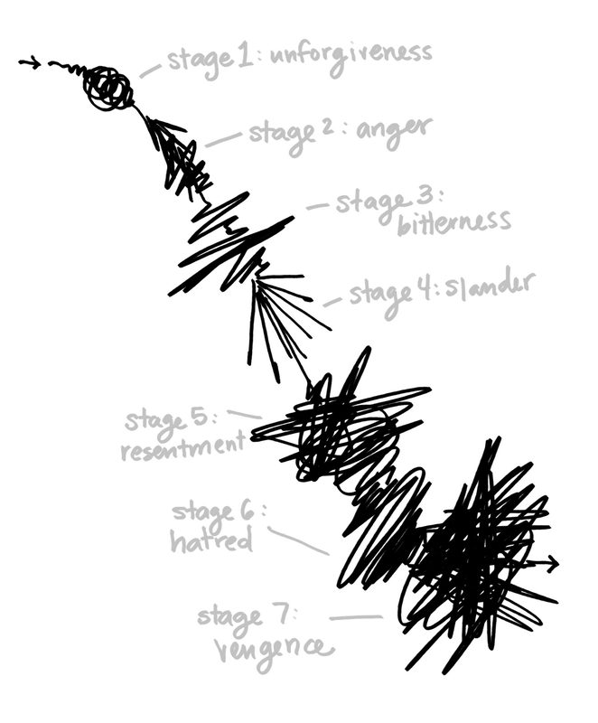
UNFORGIVENSS STAGES
不肯饶恕伤害自己的过程：
STAGE 1: UNFORGIVENESS
不肯饶恕
STAGE 2: ANGER 发怒
STAGE 3: BITTERNESS 苦毒
STAGE 4: SLANDER 排榜
STAGE 5: RESENTMENT 忿恨
STAGE 6: HATRED 仇恨/敌意
STAGE 7: VENGENCE 报复
"Freedom Factor: Finding Peace by Forgiving
Others" by Bruce Wilkinson with Mark E. Strong

Slide 3
WE HAD TO LEARN LETTING GO 一定要学习放弃自我
Part I（手的正面）: We are Forgiven by God's Grace: "In Him we have redemption through His blood, the forgiveness of sins, in accordance with the riches of God's grace" Ephesians 1:7
"我们借这爱子的血，得蒙救赎，过犯得以赦免，乃是照他丰富的恩典。" 以弗所书1:7

Slide 4
TRULY FREE 真正的自由
NettleGibson from Monreville, Penssylvania
Single Mom with a 13 year old son
August 19, 2011 was hit by a drunk driver
10 hours of emergency surgery: spleen, two-thirds of colon, upper intestine removed. Plus almost lost her right foot, broke her right arm, shattered her heel, graft her skin.
63 year old woman drunk at 8:15am

Slide 5
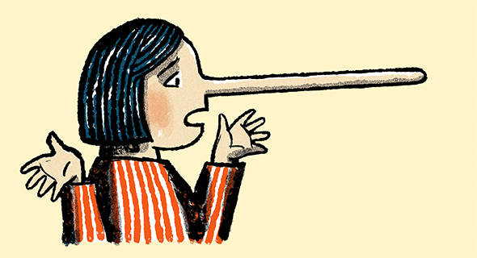
WE HAD TO LEARN LETTING GO 一定要学习放弃自我
Part II（手的反面）: To Let Go of “Self” is Very Hard. 人生最难的功课： 人性原本是自私的，亚当夏娃开始就是自私的！小孩子开始保护自己就是撒谎（不需要任何人来教他）
The Day American Told the Truth said:
91%lie routinely
36% only lie on important matters
86% lie to parents
75% lie to friends
73% to siblings
69% to spouses

Slide 6
Famous American Fibs 在美国有名的谎言
- The check is in the mail.你的支票在邮箱里
- I‘ll start my diet tomorrow. 我明天再减肥吧
- We service what we sell.我们为所卖的东西负责
- Give me your number and the doctor will call you right back. 告诉我你的电话号码，医生会马上打电话给你
- Money cheerfully refunded. 高兴的还你钱
- One size fits all.任何人都能穿的尺码 （free size in Japan selling to seniors)
- This offer limited to the first 100 people who call in.这种价格只买给前100位打进电话的顾客
- Your luggage isn‘t lost, it’s only misplaced. 你的行李没有丢，只是运到了别的地方
- Leave your resume and we‘ll keep it on file. 我们会保存你的摘要在文件上
- This hurts me more than it hurts you.这个伤害我比伤害你还要多
- I just need five minutes of your time.我只要你的五分钟时间就够了
- Your table will be ready in a few minutes. 你的座位几分钟就有了
- Open wide, it won‘t hurt a bit.将嘴张大点，不会疼的 （牙医的话）
- Let‘s have lunch sometime.我们改天再吃午餐吧
- It‘s not the money, it’s the principle. 不是钱的问题而是原则

Slide 7
MATTHEW 18:28-35 TEACHINGS 耶稣在马太福音十八章的教导
Vs. 28: He immediately 马上，立刻not after forgiven, he found his fellow servants who owed him a 100 denarii （10两银子）
1 denarii is one day's wage
Today it is like $20,000-$30,000
This evil servant owed his master more than 10 million dollars, yet he tried to choke his fellow servant and put him in jail until he can return all the money

Slide 8
MATTHEW 18:28-35 TEACHINGS 耶稣在马太福音十八章的教导
Vs. 29: This fellow servant fell to his knees and begged (The same thing with the evil servant recorded in vs. 26)他的同伴就俯伏央求他
The evil servant refused, even he himself was giving grace.可是这个恶仆丝毫不肯饶恕

Slide 9
MATTHEW 18:28-35 TEACHINGS 耶稣在马太福音十八章的教导
Vs. 31-32 Other servants saw this and reported to the Master because they were distressed. 1. They may have owed this evil servant too
2. They were more righteous than the evil servant 3. They were fellow servants and friends of the one just put in jail可能是朋友
The Master got angry and said he did this out of mercy and grace主人真的生气了（不可惹神）

Slide 10
MATTHEW 18:28-35 TEACHINGS 耶稣在马太福音十八章的教导
Vs. 33 "Shouldn't you have had mercy on your fellow servant just as I had on you?"(mercy is for passing forward) 怜恤是要传给别人的
What is the problem? The evil servant did not truly repent. He was caught in the sin, begged for mercy, and it was all for a show问题是恶仆人没有认罪，只是在演戏
Illustration of an unrepentant adulteress被抓到了

Slide 11
MATTHEW 18:28-35 TEACHINGS 耶稣在马太福音十八章的教导
Vs. 34 “In anger the Master turned the evil servant to the jailers to be tortured, until he should pay back all he owed.” That could be a lifetime. In the meantime his family also suffered 主人的愤怒是轻慢不得的！我们对神也是，不可作假，神很清楚我们在想什么，否则神的惩罚是严厉，我们受不了的！

Slide 12
MATTHEW 18:28-35 TEACHINGS 耶稣在马太十八章的教导
Vs. 35 “This is how my Heavenly Father will treat each of you unless you forgive your brother FROM YOUR HEART.”一定要从心里悔改认罪，不是形式，不是外表
***We need to be the same inside and out. Never lie or make a show of our lives. 里外不一致的人是迟早要有交代的。神是看我们的心！我们是神的儿女，神是真理，我们也要依靠真理活着，真理才能使我们真正得自由！

Slide 13
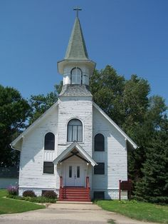
STORY OF A LITTLE WHITE CHURCH IN
KOREA:
1. The cruelty of Japanese soldiers during WWII
2. Many Christians were persecuted, missionaries
Ejected and closed church doors
3. As in Rome, and in many parts of the world,
The more persecution, the more revival
4. One pastor asked the chief of Japanese police
To just open the door on one Sunday so that the
Faithful can worship, just one Sunday. He kept
Begging, until given OK
5. The faithful crowed their church and many
Were not able to get inside because no rooms
6. Then, the police chief ordered his people to
Burn the church down
7. Before they were martyred, they sang two hymns
"At the Cross 在十架“ #67
8. In 1972, Japanese churches raised
$25,000 and build this white church
9. Many Koreans still not willing to forgive until
That song, At the Cross is sang

Slide 14
FORGIVENSS饶恕是：
1. BY GOD'S GRACE
靠着神的恩典
2. BY OUR OWN CHOICE
OF LETTING GO
我们可以选择要不要完全的
放弃自我

