Slide 1
Church (3) the temple of god 教会 （3） 神的圣殿
Ephesians 2:13-22 以弗所书二章十三到二十二节

Slide 2
THREE TREES 三棵树
First tree: want to be a treasure holder, jewels, gold, all treasures represented
Second Tree: MIGHTIEST SHIP CARRY KINGS
THIRD TREE: TALLEST TREE WHERE PEOpLE CAN LOOK AT AND THANK GOD
WHAT WE DESIRE, IS NOT WHAT HAS PLANS. WE AS A CHURCH IS A TEMPLE OF GOD, OUR DESIRES ARE TO PLEASE GOD, AND
NOT WE OURSELVES. WHAT DOES GOD HAS FOR US AS A CHURCH, A TEMPLE OF GOD?

Slide 3
We are the temple of god 我们是神的圣殿
VS 13: BROUGHT NEAR THROUGH THE BLOOD OF JESUS CHRIST从前我们远离神现在因为主的宝血，已经亲近了
VS 14: JESUS DESTROYED THE DIVIDING WALL OF HOSTILITY耶稣就是我们的平安，折毁了墙
今天Trump要盖一个墙，不让偷渡的犯人进到美国来。是好还是坏？墙就是在耶稣以前，我们都不能进神
的国。今天我们可以都是因为耶稣的关系。他来了已经把哪个神与人隔开的墙折坏了！

Slide 4
We are the temple of god 我们是神的圣殿
VS 15: PURPOSE WAS TO CREATE ONE NEW MAN。我们信主的人是新人，就和神和睦了！“IF ANYONE BE IN CHRSIT, HE IS A NEW CREATURE, OLD HAS PASSED, ALL IS NEW 若有人在基督里，旧事已过，都变成新的了。”歌林多后5:17
Vs. 16: Reconcile to god through the cross。 只有借着十字架才可以去掉冤仇

Slide 5
We are the temple of god 我们是神的圣殿
VS. 17: JESUS CAME TO PREACH PEACE耶稣来了就是要让福音能够传到地级，远和近的人
VS. 18: THROUGH JESUS WE HAVE ACCESS TO THE FATHER AND THE HOLY SPIRIT 我们借着耶稣可以到父的面前，被一个圣灵感动

Slide 6
We are the temple of god 我们是神的圣殿
VS. 19: FELLOW CITIZENS WITH GOD'S PEOPLE我们不在是外人，是神家的人
VS. 20: BUILT ON APOSTLES AND PROPHETS FOUNDATION WITH CHRIST AS THE CORNERSTONE 我们的教会是建造在使徒和先知的根基上，基督自己是我们的房角石。

Slide 7
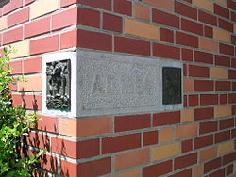
The cornerstone (or
foundation stone or setting stone) is the first stone set in the construction of a masonryfoundation
, important since all other stones will be set in reference to this stone, thus determining the position of the entire structure.
I am remodeling the old part of my home (33 years old) the contractor has to have a knowledge of the
Structure. He needs to know where my cornerstone is at, or else the house can collapse.

Slide 8
We are the temple of god 我们是神的圣殿
VS. 21: IN JESUS, WE ARE JOINED TOGETHER TO BECOME A HOLY TEMPLE我们都是靠着耶稣联络得合适，渐渐成为主的殿
VS. 22: CHURCH IS A DWELLING WHERE GOD LIVES有耶稣作为房角石就是教会。我们借着圣灵居住的所在

Slide 9
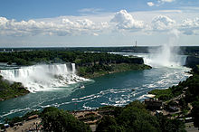
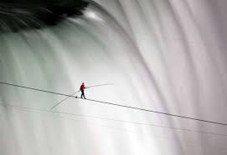
CHARLES BLONDIN AND THE WHEELBARROW
NIANIAGRA FALLS
1860 CHARLES BLONDIN WALKED ON A TIGHTROAP BACKWARD FROM US SIDE TO CANADA SIDE
HE TOOK A WHEELBARROW AND BEGIN TO GO FROM CANADA SIDE TO US SIDE AND
ASKED IF THE CROWD BELIEVE HE CAN DO IT. ABOUT A MILE LONG. THEY OOOOHD AND AAAHD
BUT WHEN HE ASKED FOR VOLUNTEER, NO ONE WANT TO GO ON!

