Slide 1
CHURCH BODY OF CHRIST (1) 教会是主的身体
EPHESIANS 1:17-23
以弗所书一章十七到二十三节

Slide 2
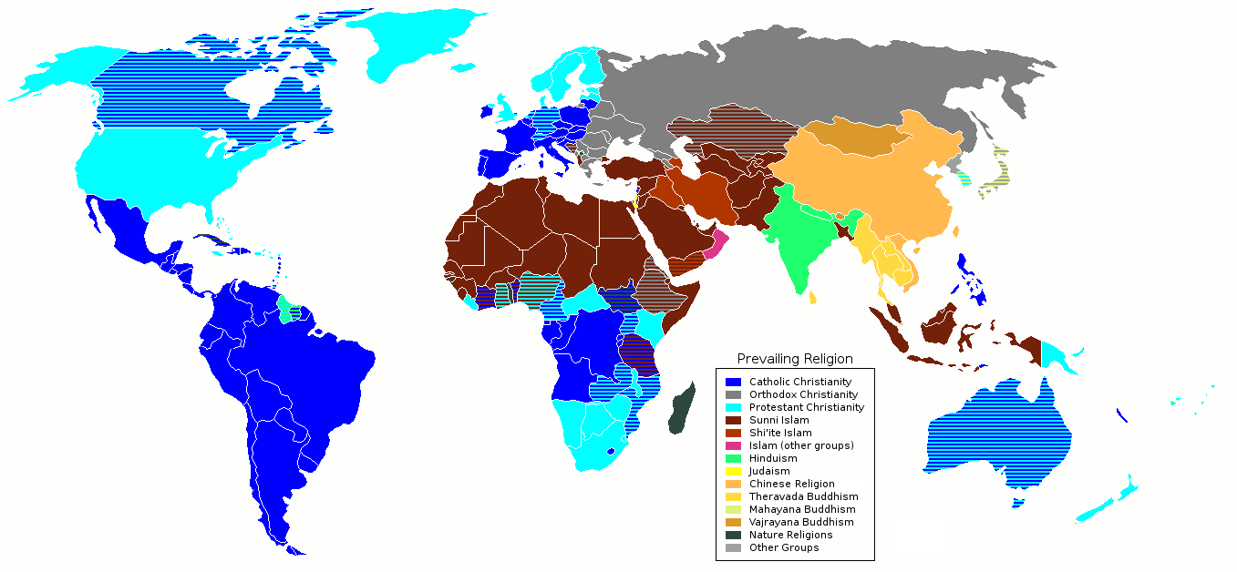
Notes:
World Religion Now. More Christians (Protestants and Catholics) than Islam now. Islam is rapidly growing. North and South America (Catholic and Protestants) Russia (Orthodox Christianity) South Africa (Catholics and Protestants) Philippines (Catholics) Australia (Protestants and Catholics)

Slide 3
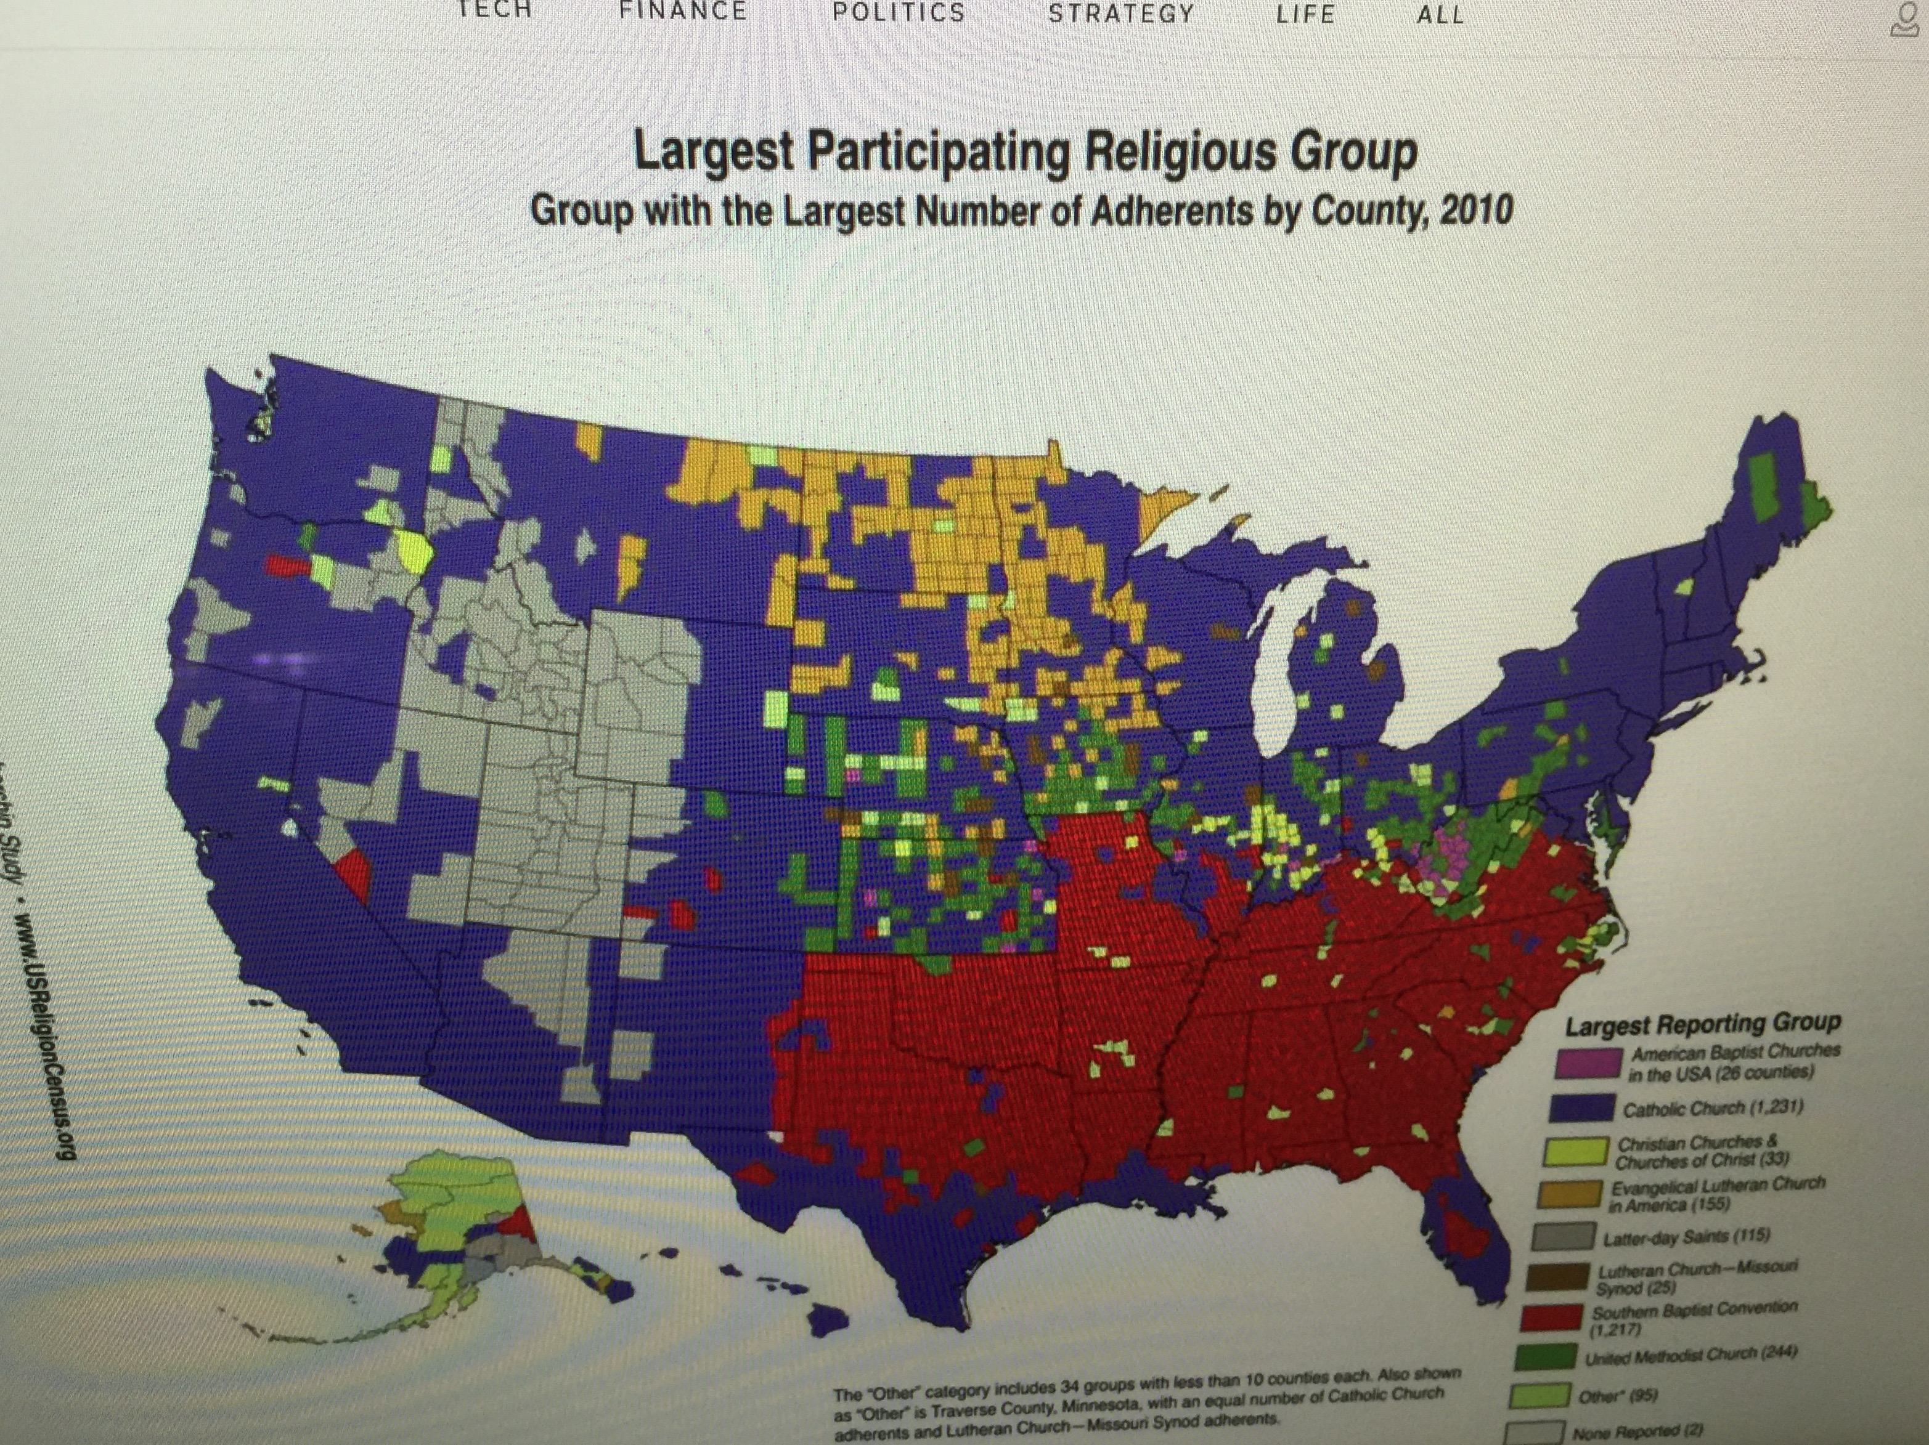

Slide 4
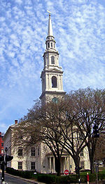
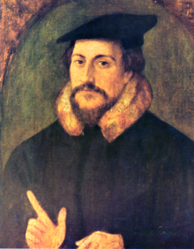
Martin Luther’s Reformation in the 16th Century
John Calvin约翰·加尔文 Teaching
Baptist History 浸信会历史

Slide 5
BAPTIST CHURCH HISTORY 浸信会历史
17th Century from England
Baptism through immersion:
Arminian belief that God’s saving grace is available to everyone
Calvinist Orthodoxy that Grace is available only to the predestined “elect”

Slide 6
Two groups of Baptist 两种浸信会组织
Southern Baptist Convention (SBC) 美南浸信會 a. Largest con-Catholic denomination in the U.S. b. 1970’s A Conservative Take Over (SEBTS)保守派 c. Do Not Ordain Women (Pastors, Chaplains, Deacons)
Cooperative Baptist Fellowship (CBF) 浸信會合作團契 a. Formed in 1991 by Moderates b. Ordains Women in Ministry

Slide 7
EPHESIANS 1:17-23 以弗所书一章十七节到二十三节
God the Father, God the Son, God the Holy Spirit 主耶稣基督，荣耀的父，智慧和启示的灵17
Hope of the call by our God for Riches and Inheritance in the Saints 圣徒们得丰盛的基业和荣耀18
Power for Believers 信的人所显的能力19
Same Power of the Resurrection of Christ 使耶稣复活的能力 20

Slide 8
EPHESIANS 1:17-23 以弗所书一章十七节到二十三节
Power Greater than 21: a. All Rule and Authority 执政的，掌权的 b. Dominion 主治的，所有的控制（魔鬼的控制） c. Every Title in the Present Age and Age to Come 今世和来世都在这个权力以下

Slide 9
EPHESIANS 1:17-23 以弗所书一章十七节到二十三节
God Placed All Things Under Christ’s Feet 22a 神将万有服在主的脚下
Appointed Him to be Head over Everything for the Church 22b 耶稣是为教会作万有之首！

Slide 10
EPHESIANS 1:17-23 以弗所书一章十七节到二十三节
Church is Christ’s Body 23 教会是主基督的身体
Fullness of Christ in the Church 在教会里有耶稣的充满
Christ Fills Everything in Every Way 耶稣充满万有万事

Slide 11
CHURCH ILLUSTRATIONS 教会的例子
ALMIGHTY GOD TABERNACLE 教会的名字“全能的神殿”
IN GOD WE TRUST? A Rich Man and A Penny 信靠神？IN GOLD WE TRUST?信靠金子？
Story of a Mother Bird 一只母鸟的故事 （教会就是有耶稣和他保护的地方）

Slide 12
PSALM 91:4 诗篇九十一篇四节
“HE WILL COVER YOU WITH HIS FEATHERS, AND UNDER HIS WINGS YOU WILL FIND REFUGE; HIS FAITHFULNESS WILL BE YOUR SHIELF AND RAMPART. 他必用自己的翎毛遮蔽你。你要投靠在他的翅膀底下。他的诚实，是大能的盾牌."

