Slide 1
CHURCH (2) BAND OF BROTHERS AND SISTERS 教会 （2） 与主结伙的弟兄姐妹们
GALATIANS 6:1-10
加拉太书六章一到十节

Slide 2
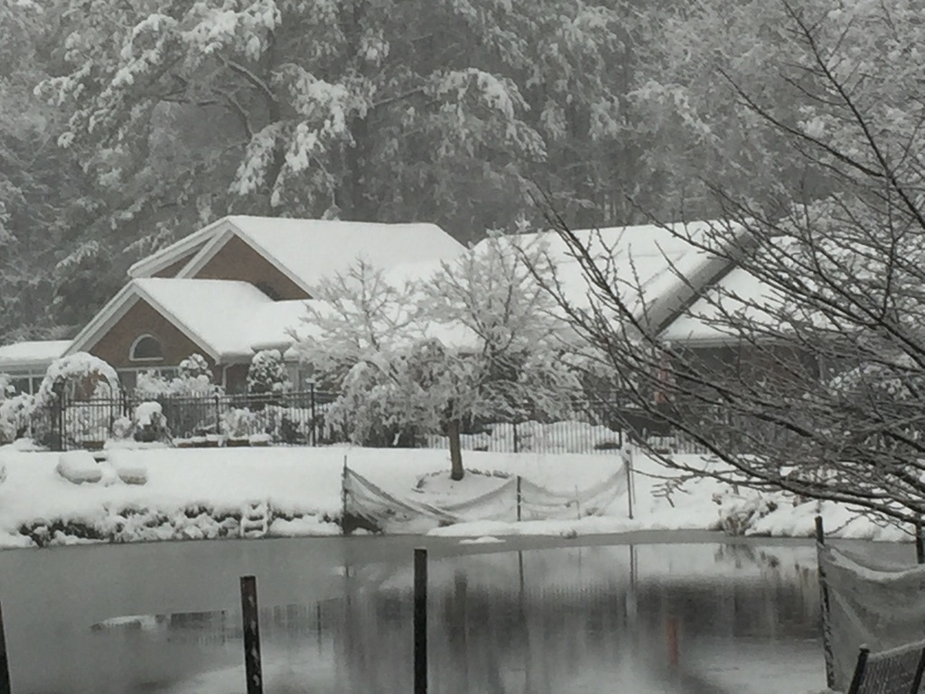
Notes:
My Power was out Wednesday night from 10:10pm until Thursday afternoon at 3pm. That was 17 hours of no power! My whole house is on electricity, therefore when power is out, everything shuts down, well, hot water, heat, etc. This is the power of the Almighty One. He is in control of the weather. We have to learn to totally depending on Him!

Slide 3
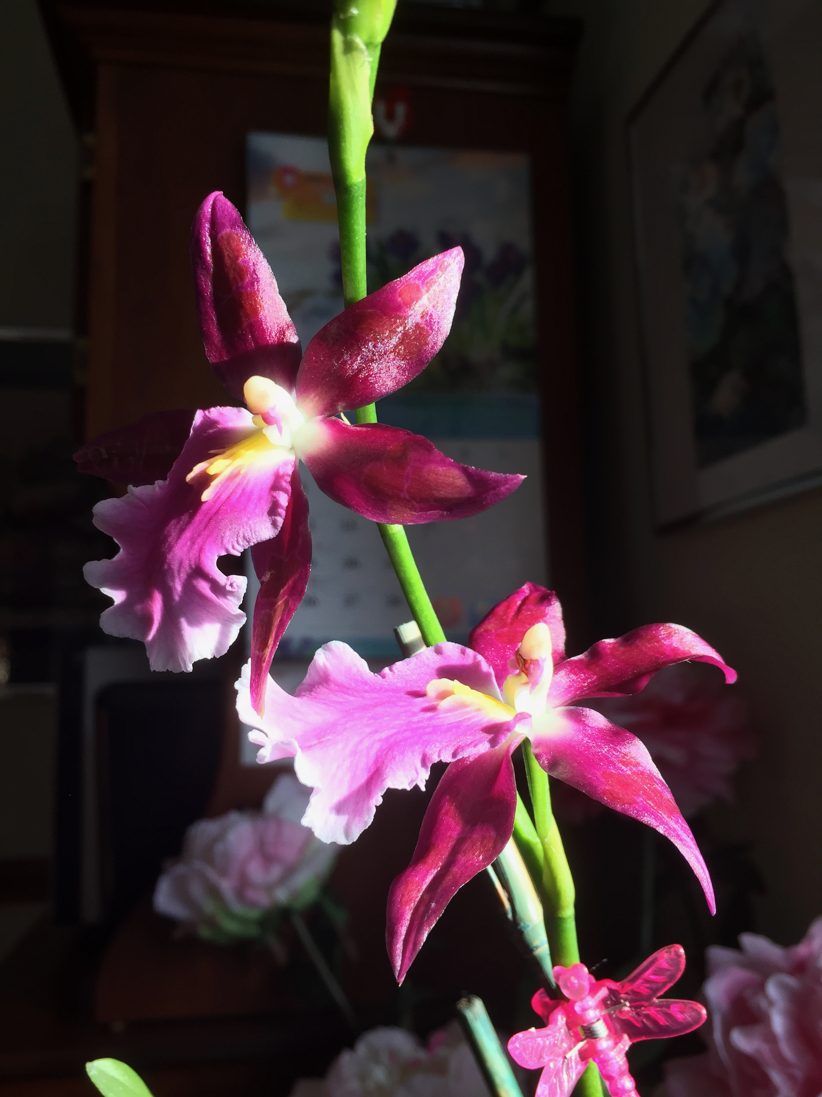
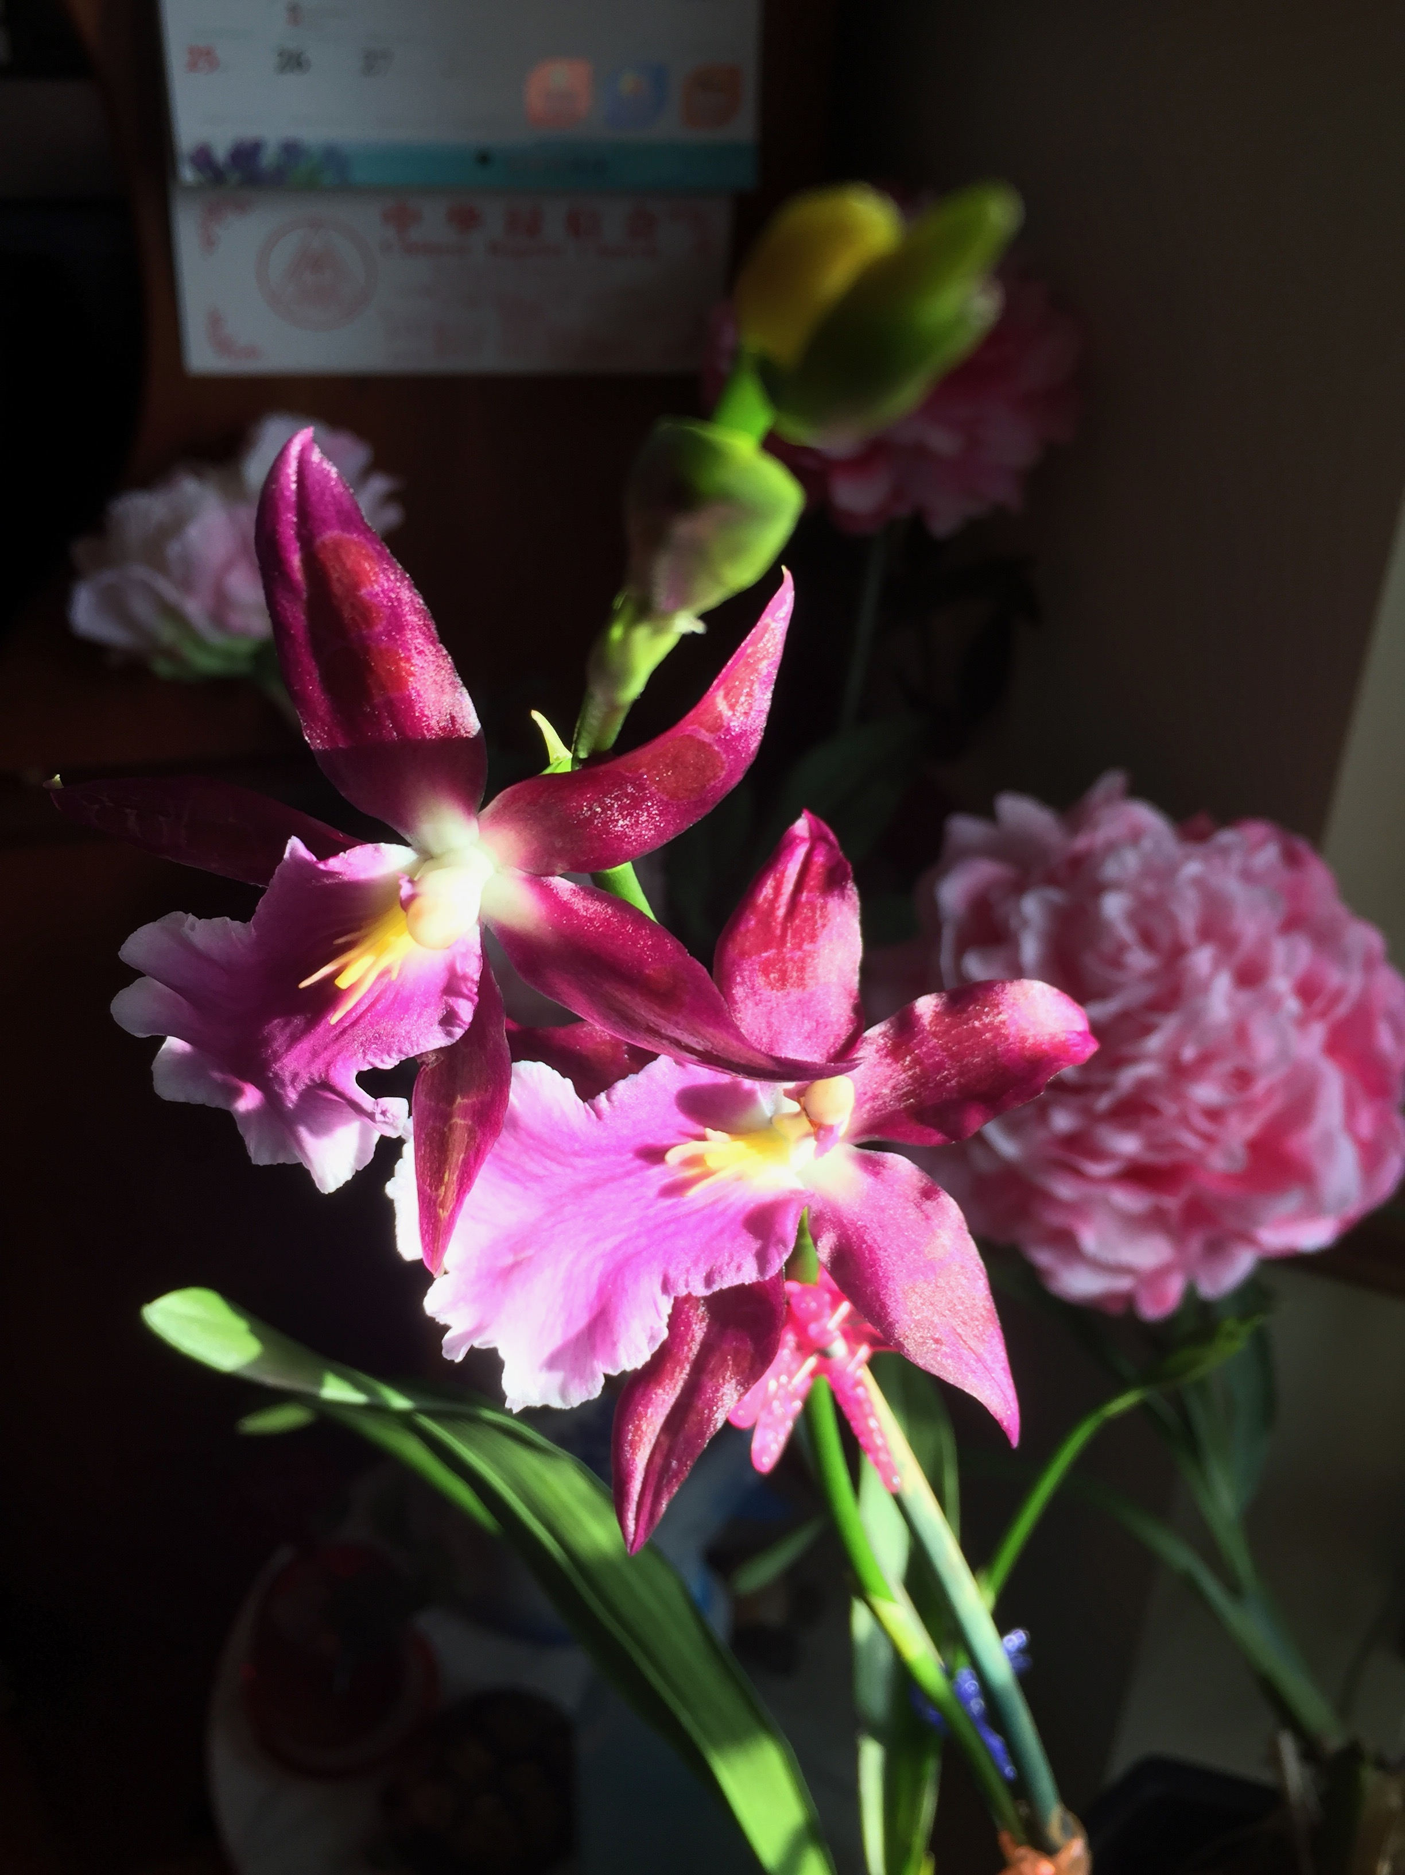
Notes:
Even when outside is snowing heavily, and I am without Power, the Lord's creation is so beautiful. This orchid is going to bloom for a month with vibrant color and fragrance. The world still goes on. However, we Christians shouldn't we also leave an imprint for the world? How do we do that? With the blood of Jesus, we can do all good things to help the world and especially to help and support one another!

Slide 4
NOTHING BUT THE BLOOD OF JESUS 只靠耶稣的宝血洗净罪
THE BIBLE IS FULL OF SINNERS: 1. Noah was a drunk 2. Jacob was a liar 3. Joseph was abused 4. Moses had a stuttering problem 5. Rahab, Tamar, were prostitutes 6. David an adulterer and murderer 7. Elijah was suicidal

Slide 5
NOTHING BUT THE BLOOD OF JESUS 只靠耶稣的宝血洗净罪
8. Jonah ran from God 9. Job went bankrupt 10. John the Baptist ate bugs (locusts) 11. Peter denied Christ 12. Disciples fell asleep while praying 13. Martha worried about everything 14. Samaritan woman divorced more than once 15. Lazarus, Tabitha, young man, the son were dead

Slide 6
NOTHING BUT THE BLOOD OF JESUS 只有耶稣的宝血洗净
CHURCH IS FULL OF SINNERS 今天的教会基督徒也是需要耶稣的宝血洗净！ Today, we are no different. Only God knows Us! 人是看外表，神是看我们的心！
ONLY THE BLOOD OF JESUS CAN MAKE US WHOLE AGAIN! Illustration "The Pastor's Son牧师的儿子". Why can't we forgive?

Slide 7
caring for one another with actions 彼此关心是需要行出来不是口头语
VERSE 1: RESTORE AND WATCH爱心挽回和自己小心
VERSE 2: CARRY EACH OTHER'S BURDEN重担互相担当
VERSE 3: DECEIVES HIMSELF不要自欺
VERSE 4: TEST OWN ACTIONS 察验自己的行为
VERSE 5: CARRY HIS OWN LOAD担当自己的担子

Slide 8
caring for one another with actions 彼此关心是需要行出来不是口头语
VERSE 6: SHARE ALL GOOD THINGS 一切需用的供给人
VERSE 7: REAPS WHAT HE SOWS 种的甚么收的是甚么
VERSE 8: SOWS TO PLEASE SELF OR THE SPIRIT 撒种顺着圣灵还是情欲，收的也是如此
VERSE 9: DOING GOOD 行善不可丧志，会收成的
VERSE 10: DO GOOD TO FAMILY OF BELIEVERS 像信徒一家的人行善

Slide 9
caring for one another with actions 彼此关心是需要行出来不是口头语
1. Stop to Smell the Flowers and thank God for them 不要急急忙忙，要停下来闻闻花感谢神。
2. Spend more quality time with family 花最好的时间给家人
3. Take a moment to look around you and appreciate them 观察你周围的人，感谢他们

Slide 10
caring for one another with actions 彼此关心是需要行出来不是口头语
4. Come to Prayer Meeting and Sunday School 参加教会的祷告和主日学
5. Be still and listen to what God wants to say to you 安静在神的面前聆听他的话
6. Talk to God everyday through prayers and songs 和神天天说话借着祷告和诗歌
7. Read the Bible daily 每天读圣经

Slide 11
caring for one another with actions 彼此关心是需要行出来不是口头语
8. Meditate on quotes and scriptures that encourage, equip, and inspire you 默想神的话来鼓励，装备，和感动我们
9. Serve a Person in Need 教会里有没有需要你帮助的人？ 祷告后，去花时间帮住他

Slide 12
caring for one another with actions 彼此关心是需要行出来不是口头语
10. Make a Special effort to capture and preserve memories (Especially in the church where you serve) 我们要时常想念和纪念我们属灵的长辈。可以当作服事方面的鼓励。有没有一些照片让你回忆到你在神面前的服事长进，曾经有谁帮助过你？不止要感谢他们，也要时常的纪念他们！

Slide 13
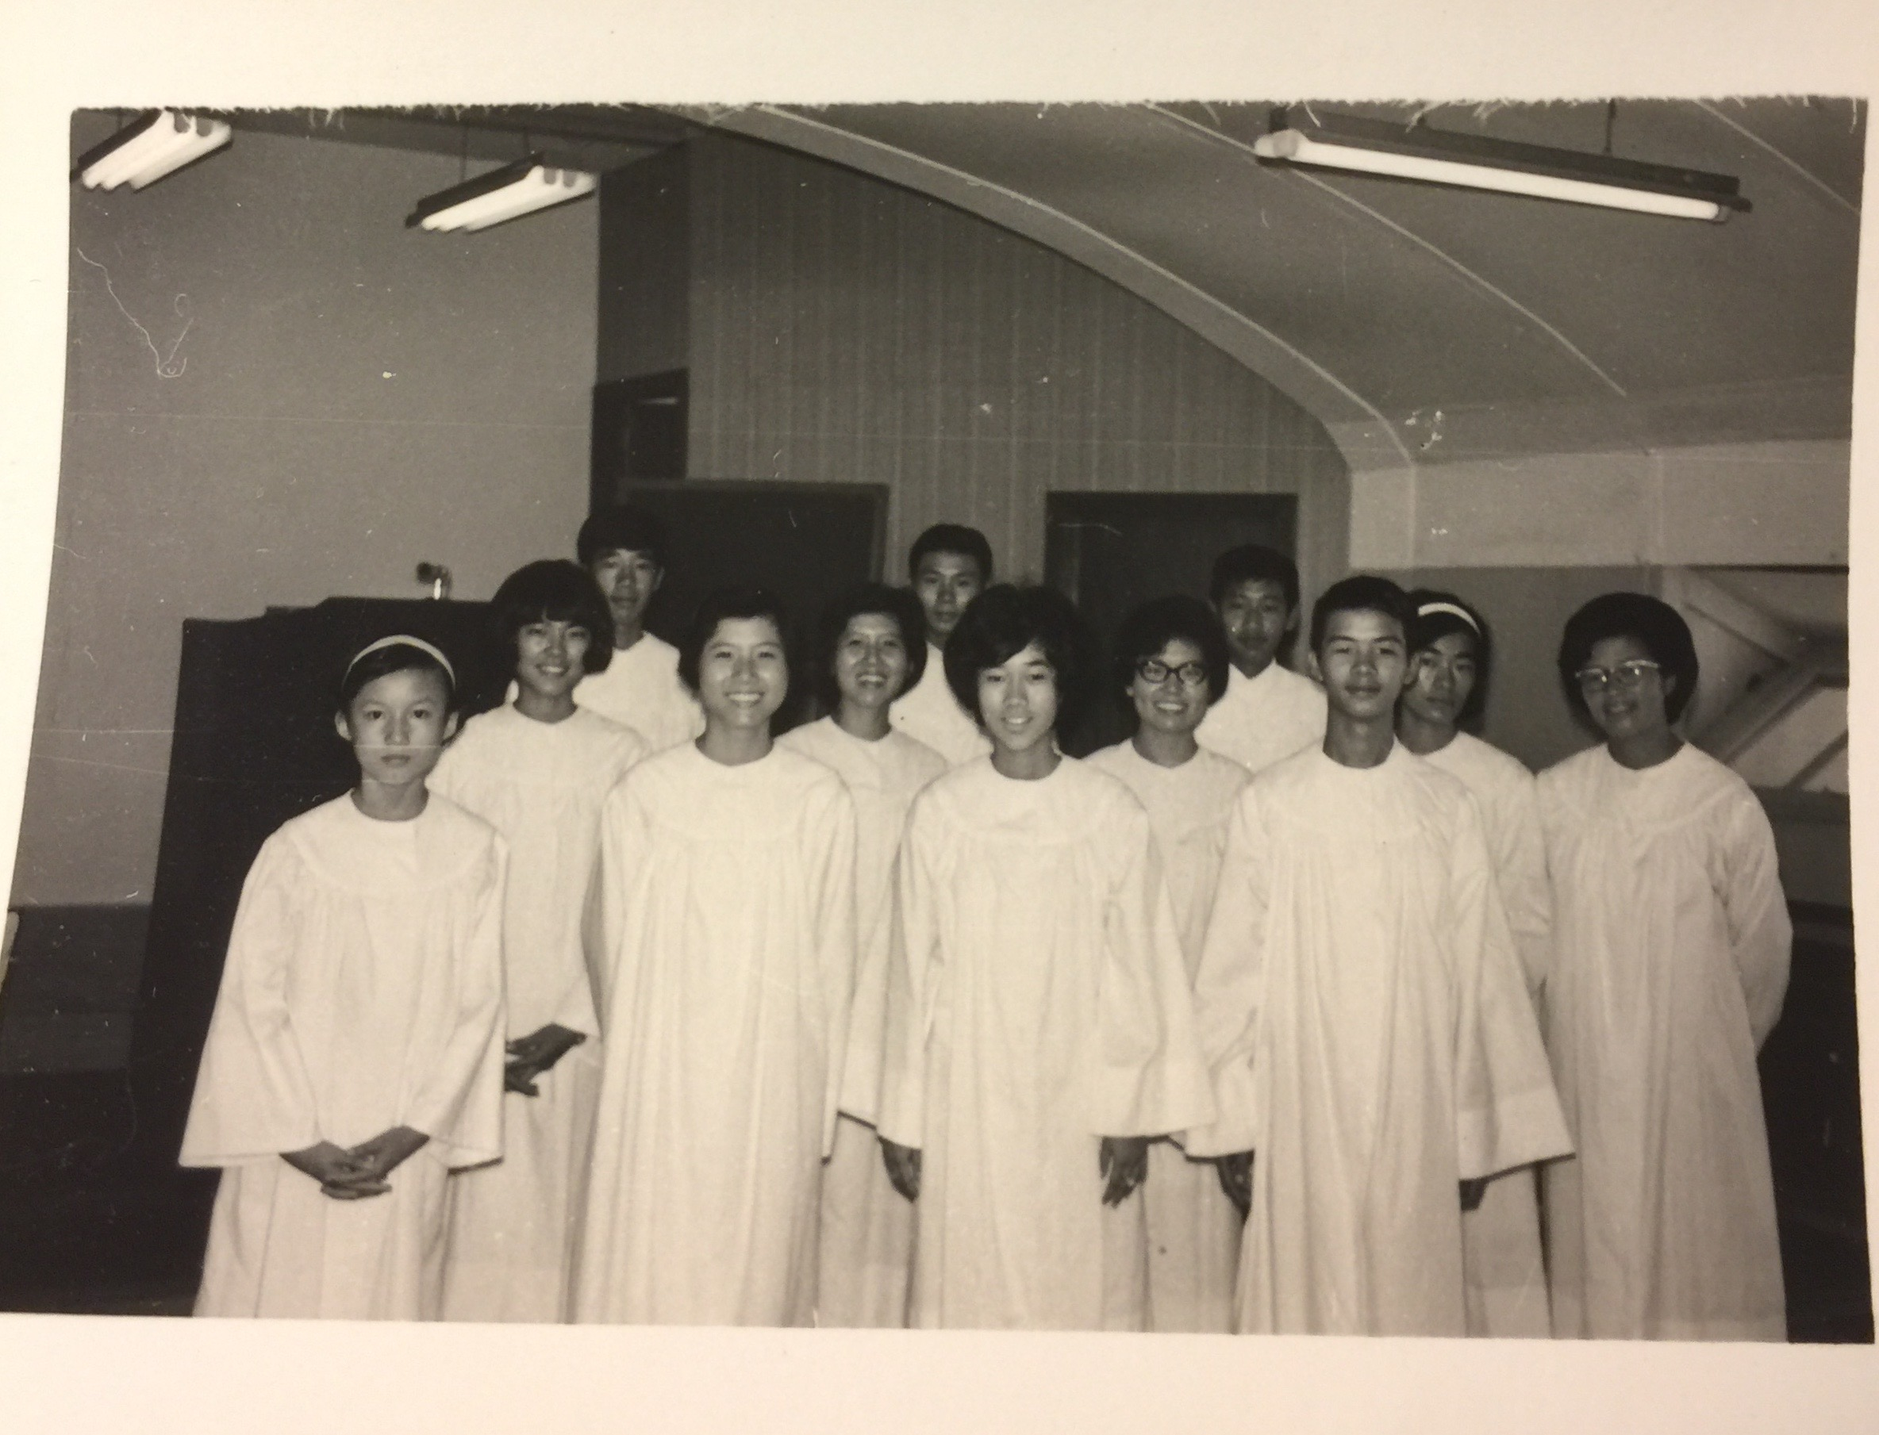
Notes:
I have so many fond memories of my serving the Lord, starting from my youths on Okinawa. We will be having a reunion of this group on 5/4-5/6. Do you have good memories when you started serving the Lord? These are important to show to yourself that you love God and the people around you, especially in a church!

